Slide 1
Attention
Langston, PSY 4040
Cognitive Psychology
Notes 3

Slide 2
Some examples
http://baddesigns.com/shampoo.html
http://baddesigns.com/insulin.html
http://baddesigns.com/tlight1.html
http://baddesigns.com/manylts.html
http://baddesigns.com/mopsnk.html

Slide 3
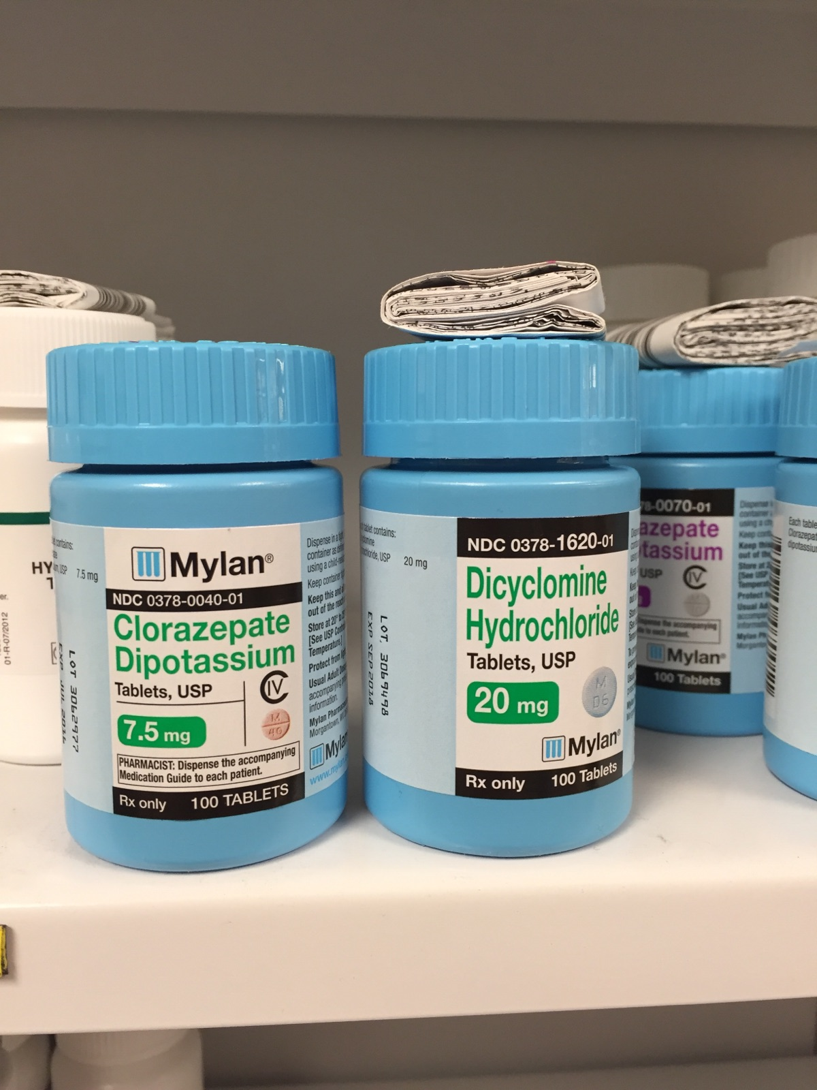

Slide 4
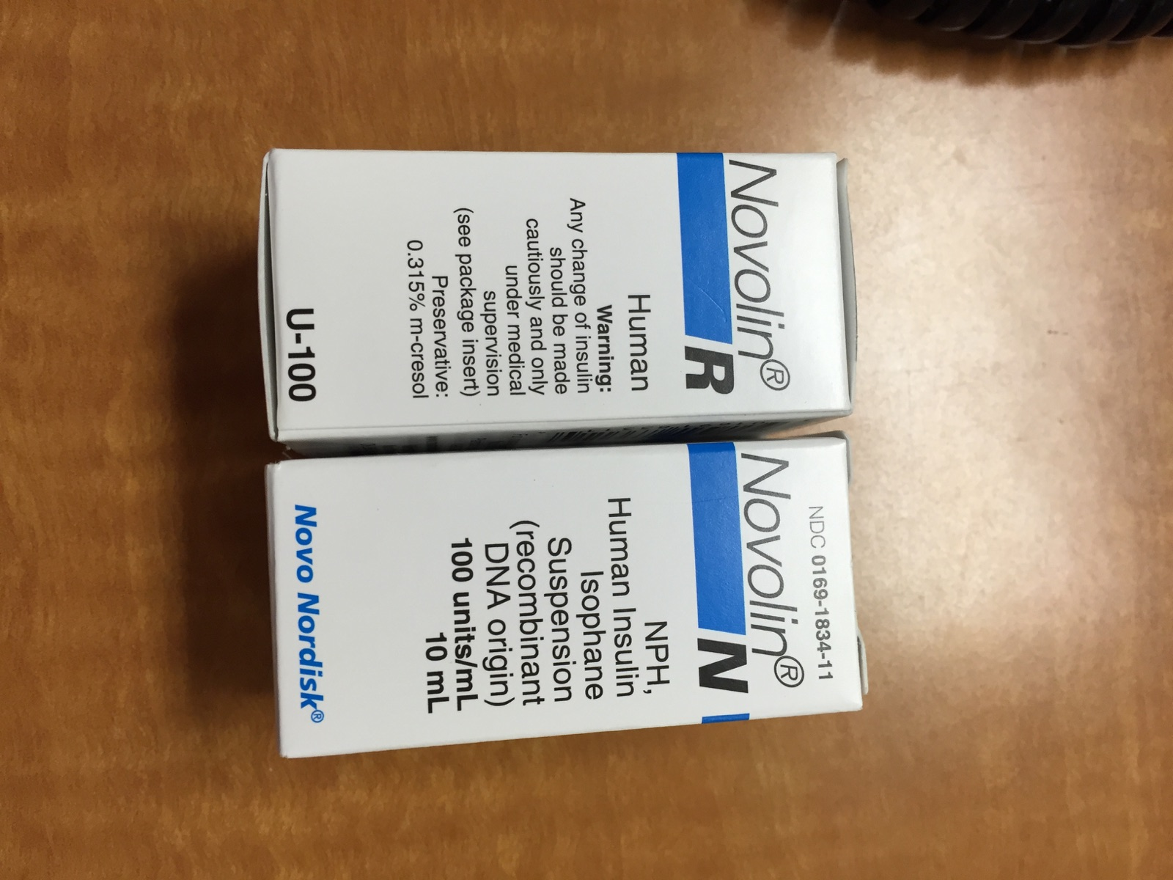

Slide 5
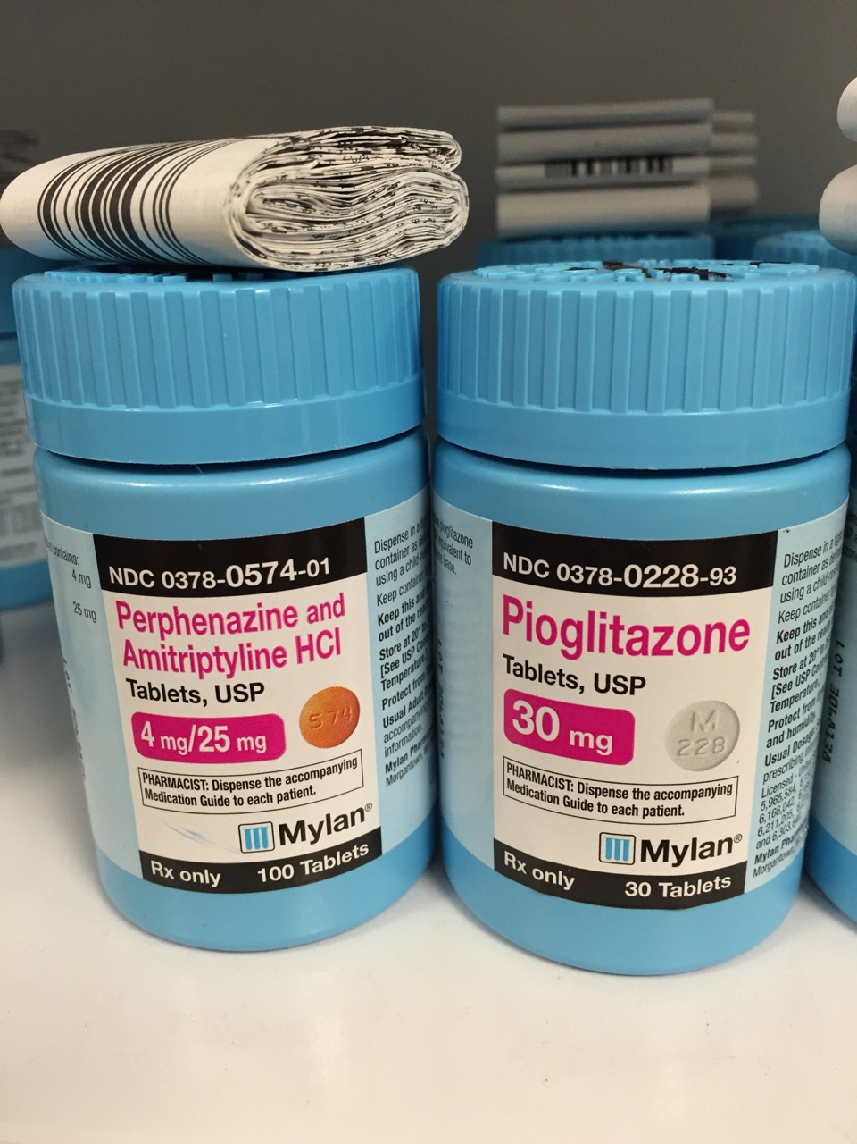

Slide 6
What do these have in common?
You’re driving in a strange neighborhood looking for "Long" street. You accidentally turn on "Lone.”
You’re thinking about a quiz that’s coming up in your next class as you walk there. Someone calls your name, but you don’t hear them.
You arrive late at a party and try to find your friends.
You’re driving home and want to stop at the store. Suddenly you find yourself at home and you didn’t stop.
You’re trying to think about the research paper you’re working on, but you keep thinking of the great first date you had last night.

Slide 7
What do these have in common?
Detection.
http://baddesigns.com/streetsn.html
Filtering and selection.
Search.
http://baddesigns.com/pushto.html
Automatic processing.
Concentration.
The common element is attention.

Slide 8
Architecture
Recall our box model:
Sensory
Store
Filter
Pattern
Recognition
Selection
STM
LTM
Input
(Environment)
Response

Slide 9
Attention
In this model, attention is:
The filter and selection boxes (note that there’s a bit of a cheat built in when you separate them).
The arrows.
In this model attention does:
Putting together information from various sources.
Processing in STM (sort of).

Slide 10
Themes
Early or late? The answer to this question influences a lot of other cognitive stuff.
What is it?
Some sort of bottleneck or filter?
A capacity or resource (or several kinds)?

Slide 11
Attention
Highlights parts of the environment and blocks other parts.
Primes a person for speedy reaction.
Helps you retain information.

Slide 12
Attention
As you can see from my attempts to define it, attention is usually defined as what it does. As a result, we’re going to study it as five kinds of thing.

Slide 13
Attention
1. Detection
2. Filtering
3. Search
4. Automatic Processing
5. Concentration

Slide 14
Detection
Two kinds of thresholds:
Absolute: Minimum amount of stimulation required for detection.
Difference: Amount of change necessary for two stimuli to be perceived as different.
Basically, we can find the absolute threshold and then a series of difference thresholds to work out the scale for a given physical dimension.

Slide 15
Detection
Thresholds:
Vision: One candle, on a mountain, perfectly dark, 30 miles.
Hearing: A watch ticking 20 feet away.
Smell: A single drop of perfume in a three room apartment.
Touch: The wing of a bee on your cheek.
Taste: One teaspoon of sugar in two gallons of water.

Slide 16
Determining Thresholds
How to determine thresholds:
Method of limits:
Ascending: Start with a value below the threshold, increase, ask for detection, increase… At the point a person says “detect,” average that stimulus value with the value from the previous trial. Repeat to estimate threshold.
Descending: Same, but start above threshold and work down.
Combining results from both directions will give you an estimate of the threshold.

Slide 17
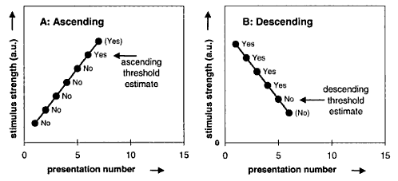
Determining Thresholds
How to determine thresholds:
Encyclopedia of Optical Engineering (2003, p. 2183)

Slide 18
Determining Thresholds
How to determine thresholds:
Method of constant stimuli:
Present a series of randomly selected stimulus values, ask for yes/no response for each. The value that’s detected 50% of the time is the threshold.
CogLab for Muller-Lyer Illusion: Which method was it?
These methods can be adapted to determine difference thresholds.
Problem: Observer biases can contaminate the results.

Slide 19
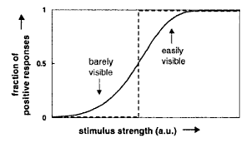
Determining Thresholds
We want thresholds to work like a step function, but they don’t:
Encyclopedia of Optical Engineering (2003, p. 2177)

Slide 20
Signal Detection
Can estimate detection (sensitivity) independent of bias.
Two kinds of trials:
Noise alone: Background noise only.
Signal + noise: Background noise with signal.
Two responses from observer:
Detect.
Don’t detect.

Slide 21
Signal Detection: Four Situations
 | State of the world
Response | Signal | Noise
Yes (Present) | Hit | False Alarm
No (Absent) | Miss | Correct Rejection

Slide 22
Signal Detection: Four Situations
From http://www.cns.nyu.edu/~david/handouts/sdt/sdt.html (Heeger, 2007)

Slide 23
Signal Detection: Four Situations
Criterion
Noise
Signal + Noise
« No
Yes »
Modified from http://www.cns.nyu.edu/~david/handouts/sdt/sdt.html (Heeger, 2007)

Slide 24
Signal Detection: Four Situations
Criterion
Noise
Signal + Noise
Hit
Modified from http://www.cns.nyu.edu/~david/handouts/sdt/sdt.html (Heeger, 2007)

Slide 25
Signal Detection: Four Situations
Criterion
Noise
Signal + Noise
Miss
Modified from http://www.cns.nyu.edu/~david/handouts/sdt/sdt.html (Heeger, 2007)

Slide 26
Signal Detection: Four Situations
Criterion
Noise
Signal + Noise
False Alarm
Modified from http://www.cns.nyu.edu/~david/handouts/sdt/sdt.html (Heeger, 2007)

Slide 27
Signal Detection: Four Situations
Criterion
Noise
Signal + Noise
Correct Rejection
Modified from http://www.cns.nyu.edu/~david/handouts/sdt/sdt.html (Heeger, 2007)

Slide 28
Signal Detection: Sensitivity and Bias
We can estimate two parameters from performance in this task:
Sensitivity: Ability to detect.
Good sensitivity = High hit rate + low false alarm rate.
Poor sensitivity = About the same hit and false alarm rates.

Slide 29
Signal Detection: Sensitivity and Bias
Sensitivity
Noise
Signal + Noise
Modified from http://www.cns.nyu.edu/~david/handouts/sdt/sdt.html (Heeger, 2007)

Slide 30
Signal Detection: Sensitivity and Bias
From http://www.cns.nyu.edu/~david/handouts/sdt/sdt.html (Heeger, 2007)

Slide 31
Signal Detection: Sensitivity and Bias
We can estimate two parameters from performance in this task:
Response bias: Willingness to say you detect.
Can be liberal (too willing) or conservative (not willing enough).

Slide 32
Signal Detection: Sensitivity and Bias
Liberal Criterion
Noise
Signal + Noise
False Alarm
Hit
Modified from http://www.cns.nyu.edu/~david/handouts/sdt/sdt.html (Heeger, 2007)

Slide 33
Signal Detection: Sensitivity and Bias
Conservative Criterion
Noise
Signal + Noise
Hit
False Alarm
Modified from http://www.cns.nyu.edu/~david/handouts/sdt/sdt.html (Heeger, 2007)

Slide 34
Signal Detection: Sensitivity and Bias
Computing bias:
The criterion is the point above which a person says “detect.” It can be unbiased (the point where the distributions cross; 1.0), liberally biased (< 1.0), or conservatively biased (> 1.0).

Slide 35
Signal Detection: Sensitivity and Bias
Since sensitivity and bias are independent, you can measure the effect of different biases on responding to a particular value for detectability.
Influences on bias:
Instructions (only say “yes” if you’re absolutely sure).
Payoffs (big reward for hits, no penalty for false alarms).
Probability of signal (higher probability leads to more liberal bias).

Slide 36
Signal Detection
We did a CogLab for signal detection, let’s check that now…
(Note my challenge choosing “signal detection” when there’s also one called “simple detection.”)

Slide 37
Applications
Radiology examples: The following examples are all from Mullan (2003). More information is available at http://www.ceessentials.net/article17.html
Find the appendicitis…

Slide 43
Applications
Spam detection:
Hey, what’s up? I’ve been just taking it easy the last few weeks. Work, etc. I am trying to plan a trip over the holidays. Juggling the dates can be tricky I am finding. I’m sure I’ll figure out something.
I had to laugh a few weeks ago. My buddy Jeff sent me a website of some stuff he picked up. Told me to try it out. Thought it was a joke. I ordered some for the hell of it. I know it’s sort of funny but I figured with the kind of person you are you might find it interesting. I actually tried it and holy crap, the stuff seemed to work awesome. Like twice a day I have energy to-do-it and the "outcome" is pretty huge. I still can’t stop laughing at what I am seeing. Anyways, check it out for fun, seems to be working for me.
By the way, let me know if you are going anywhere over the holidays as well. O ya, may get a new SUV as well. Maybe Navigator or Commander. Take care.

Slide 44
Applications
Spam detection:
Forwarding Message Service by FMS
From: Mark
Subject: Dieting
This is not meant to be an insult or anything but people are talking at work about your weight. I thought you should know. I know it would upset you if you knew but I know some friends here and outside work that have used a program that worked within weeks. I am not pushing anything on you but thought it wouldn’t hurt if you looked at it. I also think I am doing you a favor as it’s always nice when people talk about how much better you look than how much you’ve been putting on. I hope I am not intruding, just trying to help out. My cousin & friend Mike used this and it helped a lot. Here is the site I know they got it from direct.

Slide 45
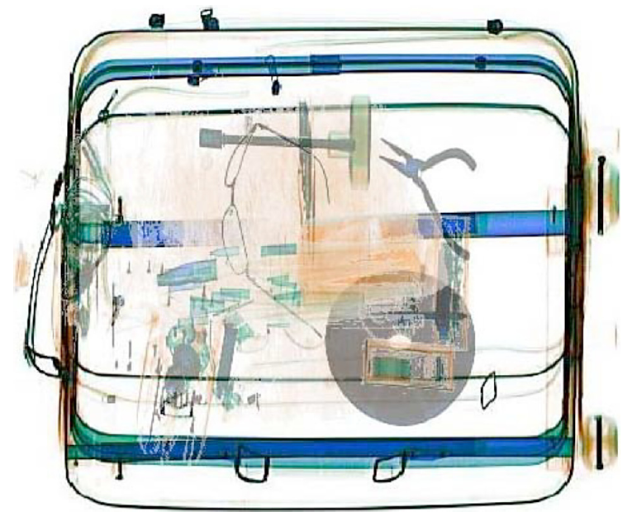
Applications
Signal detection is a problem in a variety of contexts:
Mammography.
Baggage screeners.
Van Wert, Horowitz, & Wolfe (2009, p. 543)

Slide 46
Applications
When targets are rare, what effect does that have on performance?
Mammography 0.3% target prevalence (Wolfe, Horowitz, & Kenner, 2005).
Baggage screening: Low (not typically published).

Slide 47
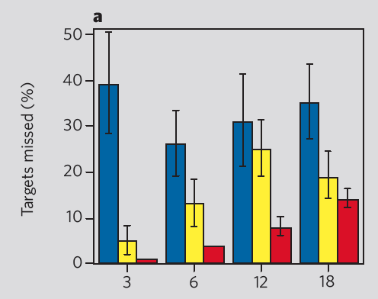
Applications
Wolfe, Horowitz, & Kenner (2005): Rare targets frequently missed in search tasks.
Blue bars rare (1% 20/2000),
Yellow bars low (10%),
Red bars common (50%), x-axis = size of search set
Wolfe, Horowitz, & Kenner (2005, p. 439)

Slide 48
Applications
The problem is criterion shift:
When targets are rare, users become increasingly conservative, increasing the number of miss errors.

Slide 49
Applications
Conservative Criterion
Noise
Signal + Noise
Miss
Hit
Modified from http://www.cns.nyu.edu/~david/handouts/sdt/sdt.html (Heeger, 2007)

Slide 50
Applications
Corrections to improve performance (Wolfe, Horowitz, Van Wert, Kenner, Place, & Kibbi, 2007):
Rest: No. Not strictly a vigilance issue.
Changing the payoff matrix: Not likely. Given the magnitude of the effect, it probably can’t get big enough.
Being able to change your answer doesn’t help (Van Wert, Horowitz, & Wolfe, 2009).

Slide 51
Applications
Wolfe et al. (2007): Efforts to reduce the effect.
Two observers doesn’t help.
Working independently, their misses are highly correlated. This suggests that it isn’t carelessness (sensitivity stays high), and lapses of attention or motor errors can’t account for them being correlated.
Working together they do a little better (still a large prevalence effect and response time more than doubled).

Slide 52
Applications
Wolfe et al. (2007): Efforts to reduce the effect.
Making them respond more slowly doesn’t help. After forcing slower responses, no change in sensitivity (still high) or criterion.

Slide 53
Applications
Wolfe et al. (2007): Efforts to reduce the effect.
More yes responses helps some, but is fraught with difficulty.
Adding in a high prevalence target to search for along with a low prevalence target improves performance, but “satisfaction of search” problem. If there are two, one might be missed. Also methodological issues.

Slide 54
Applications
Wolfe et al. (2007): Efforts to reduce the effect.
More yes responses helps some, but is fraught with difficulty.
Having multiple targets with multiple frequencies from different categories returns them to previous performance even though they say “yes” 50% of the time. Closer to reality.

Slide 55
Applications
Wolfe et al. (2007):
Bursts of higher prevalence with feedback does seem to help. Suggests a regular “refreshment” procedure to move the criterion back.

Slide 56
Connection
Why do you turn on “Long” when you’re looking for “Lone?”

Slide 57
Attention
1. Detection
2. Filtering
3. Search
4. Automatic Processing
5. Concentration

Slide 58
Filtering
How do we choose what to attend to? Is the choice made early or late?
We’ll look at several versions of filter models and some of the evidence.

Slide 59
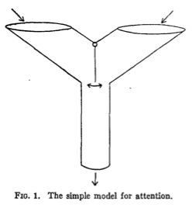
Filtering
Early: Broadbent (1957). Place the filter between sensory store and pattern recognition. The selection is made on the basis of a crude physical analysis.
Sensory
Store
Filter
Pattern
Recognition
Input
Broadbent (1957, p. 206)

Slide 60
Filtering
The filter is a flap. It normally sits in a neutral position. If you drop a ball in, it moves the filter and drops out as a response. If something comes in each side, it will either be a competition or jam.
The two arms of the ‘Y’ could be two ears, an ear and an eye, … (Broadbent, 1957, p. 206).

Slide 61
Filtering
Why is this reasonable? (Broadbent, 1957):
Two things put in simultaneously can jam it, as happens in people. Instructions can bias the flap to one side and allow something in, as in people.
When two things compete, the first or the stronger can get an advantage, as in people.
There is a switching cost for going to different arms of the ‘Y.’

Slide 62
Filtering
Evidence for early filtering:
Filter flapping: Two sets of numbers come in, one set in each ear.
Report by ear: Easy.
Report in order: Hard.
The argument is that the filter lets in all of one channel, then the other, no problem. To switch back and forth takes a lot of effort.

Slide 63
Filtering
Evidence for early filtering:
Dichotic listening. Two messages, one to each ear, played simultaneously.
Shadowing: Repeat out loud everything in one ear. What do people (or what don’t people) notice in the unattended ear?
Miss change of speaker.
Miss change of language.
Miss change of direction.

Slide 64
Filtering
Problem for early models:
People detect their name on the unattended channel (cocktail party phenomenon).
Treisman (1960): If a shadowed story switches ears, people follow it and then correct. They have to be attending to meaning to follow the story.

Slide 65
Filtering
Problem for early models:
Example 1:
…I SAW THE GIRL/song was WISHING…
…me that bird/JUMPING in the street…
Example 2:
…AT A MAHOGANY/three POSSIBILITIES…
…look at these/TABLE with her head…

Slide 66
Filtering
Attenuation model:
Everything in memory is active at some resting level. Some stuff that’s important has a high resting level, making it easier to respond to (e.g., your name).
Other stuff has a lower resting level, making it harder to respond to (e.g., artichoke).
As you think about something, you raise its resting level.

Slide 67
Filtering
Attenuation model:
Memory

Slide 68
Filtering
Attenuation model:
High resting threshold

Slide 69
Filtering
Attenuation model:
High resting threshold
Your name

Slide 70
Filtering
Attenuation model:
Memory
Low resting threshold

Slide 71
Filtering
Attenuation model:
Memory
Low resting threshold
Artichoke

Slide 72
Filtering
Attenuation model:
High resting threshold
Your name
Memory
Low resting threshold
Artichoke

Slide 73
Filtering
Attenuation model:
Relatively small amount of information to reach it
High resting threshold
Your name
Memory
Low resting threshold
Artichoke

Slide 74
Filtering
Attenuation model:
High resting threshold
Your name
Relatively large amount of information to reach it
Memory
Low resting threshold
Artichoke

Slide 75
Filtering
Attenuation model:
Relatively small amount of information to reach it
High resting threshold
Your name
Relatively large amount of information to reach it
Memory
Low resting threshold
Artichoke

Slide 76
Filtering
Attenuation model:
The unshadowed ear is attenuated (the volume is low). This little bit of attention can reach something with a high resting level (your name, a story you’re shadowing), but not some random bit of information.
So, no filter, just attenuation.

Slide 77
Filtering
Capacity model:
You have a certain amount of attention, you can spread it around as needed. If you spend a lot on one task, then you have less for others.
Primary task: Do well on this no matter what (main focus of resources).
Secondary task: Also do this.
By manipulating the difficulty of the primary task and measuring the secondary task, we can see how attention allocation affects performance.

Slide 78
Filtering
Capacity model:
For example, Johnston and Heinz (1978) had two tasks:
Primary: Shadow one ear. This can be based on gender or category.
Secondary: Detect a light.

Slide 79
Filtering
Capacity model: Johnston and Heinz (1978)
 | Primary | Secondary
Shadow one list (control) | 1.4% error | 310 ms
Easy (gender) | 5.3% error | 370 ms
Hard (category) | 20.5% error | 482 ms

Slide 80
Filtering
Capacity model:
What this implies is that the filter can be early (gender) or late (category), the amount of your resources that you allocate to it determines where the filter is.

Slide 81
Filtering
Note that this section has mostly been about selective attention: choosing between two things.
You can do it, and the thing you’re not attending to suffers as a consequence.
What about dividing attention?

Slide 82
Filtering
Neisser and Becklen (1975) superimposed two games and had people monitor one, the other, or both.
For one game, people weren’t so bad (selective attention).
For monitoring both, errors went up a bunch (divided attention).
I have some videos on the main cognitive page to illustrate this.

Slide 83
Filtering
Simons and Chablis (1999):
Watch one of two teams passing a ball
Easy: Count passes
Hard: Count air passes and bounce passes separately
An unexpected event happens, do they notice?

Slide 84
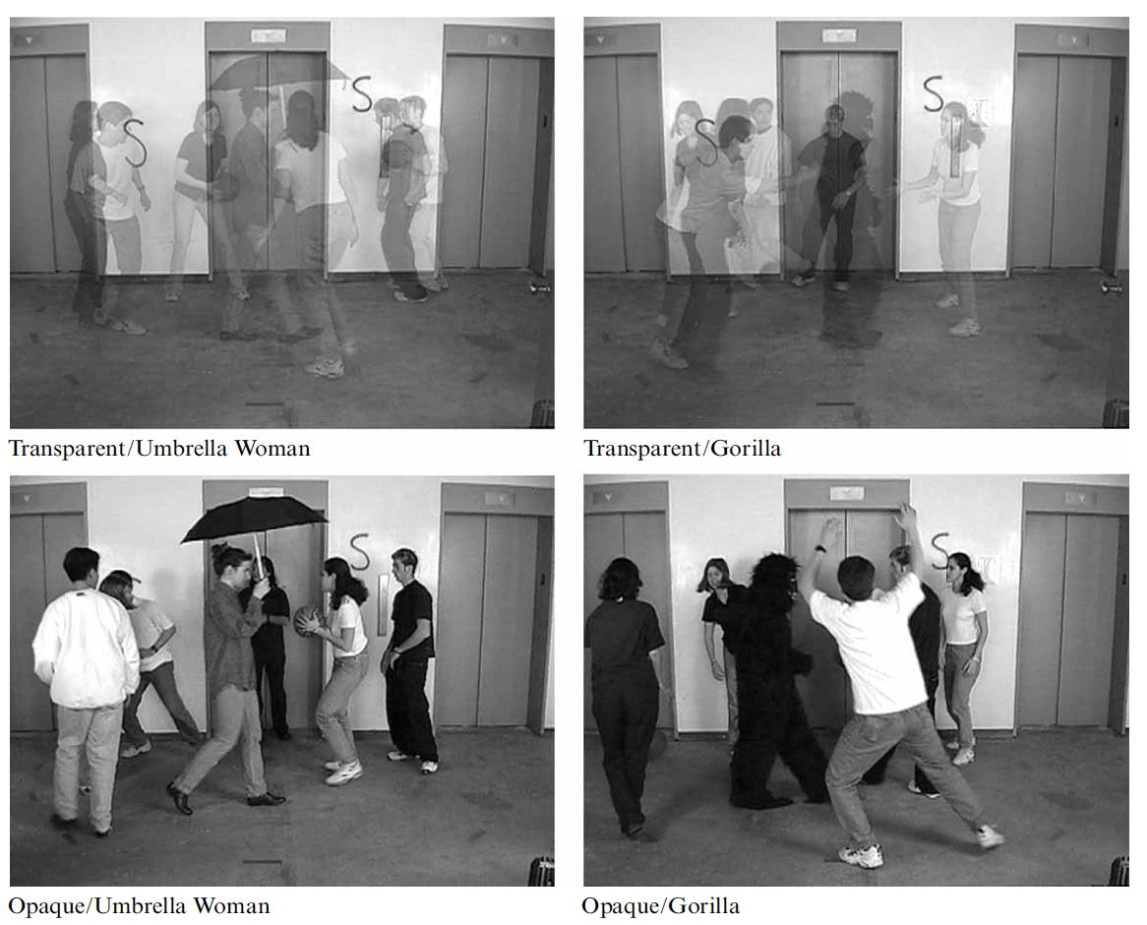
Filtering
Simons and Chablis (1999):
Simons & Chablis (1999, p. 1067)

Slide 85
Filtering
Simons and Chablis (1999):
Simons & Chablis (1999, p. 1068)

Slide 86
Filtering
Simons and Chablis (1999):
Hard was harder
The umbrella woman was easier (looked more like the players they were already looking for?)
The gorilla was easier when monitoring the black team (matched the features they were looking for?)

Slide 87
Application
Why is it bad to talk on the phone and drive? (It’s about the same as driving drunk, Strayer, Drews, & Crouch, 2006; hands-free or not.)
Kunar, Carter, Cohen, & Horowitz (2008; doi: 10.3758/PBR.15.6.1135): Central attention bottleneck.
Experiment 1: Talking vs. narrative.
Sustained attention task while talking or while listening.
Talking hurts performance more.

Slide 88
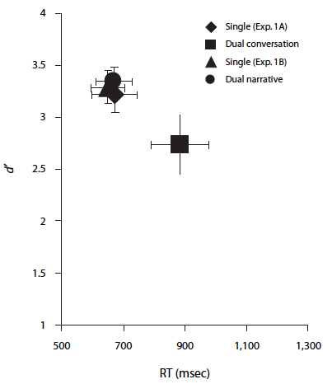
Application
Experiment 1: Talking vs. narrative.
Kunar, Carter, Cohen, & Horowitz (2008, p. 1137)

Slide 89
Application
Experiment 2: Talking vs. shadowing vs. generating.
Sustained attention task while talking, or while repeating, or while generating words (from the last letter).
Talking and generating hurt performance more.

Slide 90
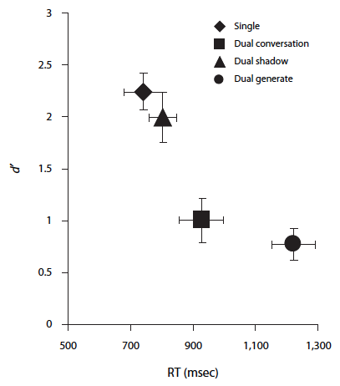
Application
Experiment 2: Talking vs. shadowing vs. generating.
Kunar, Carter, Cohen, & Horowitz (2008, p. 1138)

Slide 91
Application
Questions:
Why doesn’t hands-free work?
What about listening to the radio?
Why can I talk to someone who is in the car with me?

Slide 92
Application
Dunning-Kruger effect (Kruger & Dunning, 1999):
Sanbonmatsu, Strayer, Biondi, Behrends, & Moore (2015)
Control drivers: Correlation between serious driving errors and rated driving performance r(49) = -.37 (more errors, lower ratings)
Cell phone drivers: r(49) = .25 (more errors, higher ratings!)

Slide 93
Application
Multitasking?
The evidence is that it’s not a thing (it’s task-switching instead; Srna, Schrift, & Zauberman, 2018)
But, what if you think you’re multitasking vs. not, even if you’re doing the same two tasks?

Slide 94
Application
Multitasking?
Srna, Schrift, & Zauberman, 2018:
Do two tasks (e.g., learn and transcribe)
Describe it as multitasking or one task
People do better when they think it’s multitasking

Slide 95
Application
Multitasking?
Srna, Schrift, & Zauberman (2018, p. 1950)

Slide 96
Connection
You’re walking to class and thinking about a quiz that’s coming up. Someone calls your name, but you don’t hear them.

Slide 97
Attention
1. Detection
2. Filtering
3. Search
4. Automatic Processing
5. Concentration

Slide 98
Search
How do you use attention to locate items in a complicated array? Two kinds of search:
Feature search: A single feature allows you to find the item you are searching for.
Find the blue S.

Slide 99
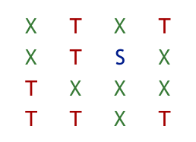
Search

Slide 100
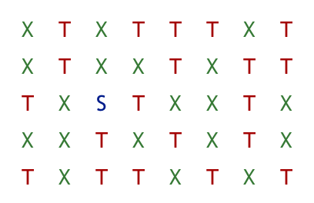
Search

Slide 101
Search
How do you use attention to locate items in a complicated array? Two kinds of search:
Conjunction search: You have to combine features to find the item you are searching for. This should take attention and be more difficult (Treisman, 1988).
Find the green T.

Slide 102
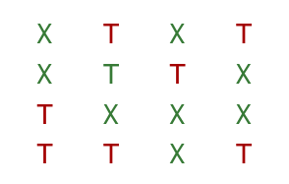
Search

Slide 103
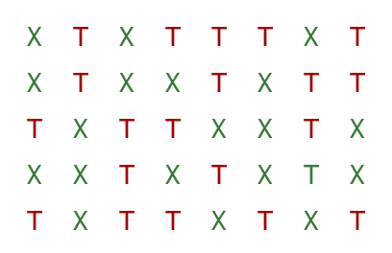
Search

Slide 104
Properties of searches:
Feature searches:
Don’t require attention (pop-out).
No help from location cueing (don’t need it).
Conjunction searches:
Require attention.
Affected by the number of distracters.
Helped by cueing the location.

Slide 105
Search
CogLab for change detection: It’s a more advanced version of search. What affects detection?
Could something like the flicker effect occur when you’re driving?

Slide 106
Connection
How about this: http://www.psych.ubc.ca/~heine/MMMSwitch.wmv
Or this: http://www.youtube.com/watch?v=vBPG_OBgTWg

Slide 107
Connection
How does this affect finding your friends at a party?

Slide 108
Attention
1. Detection
2. Filtering
3. Search
4. Automatic Processing
5. Concentration

Slide 109
Automatic Processing
After practice, some tasks no longer require attention. Three criteria for automatic tasks:
Occur without intention.
No conscious awareness/Can’t be introspected.
Don’t interfere with other activities.
Fast.
You can tell how the process of automatization is going by doing dual task studies (primary and secondary).

Slide 110
Automatic Processing
Try this: Count the ’F’s in this passage…
FINISHED FILES ARE THE RESULT OF YEARS OF SCIENTIFIC STUDY COMBINED WITH THE EXPERIENCE OF MANY YEARS.

Slide 111
Automatic Processing
Shiffrin and Schneider (1977): After 2100 trials with consistent practice (always look for a t, r, or l in a background of d, s, or p), switch (reverse target and distracter sets). It takes 900 trials to get back to original performance, and 1,500 trials to get as good as before.

Slide 112
Shiffrin & Schneider (1977, p. 132)

Slide 113
Automatic Processing
Automaticity can be a great benefit because it reduces resource demands and allows an operator to do multiple things at the same time.
However, since it’s unconscious, it can be a burden to overcome when the task changes or you need to add a step.
The Stroop task illustrates both of these.

Slide 114
Automatic Processing
CogLab results for Stroop Effect.
The interpretation is that you automatically read the word. If that’s the task, the color doesn’t interfere because you don’t automatically register that. If you’re supposed to name the color, automatic reading messes you up.
Try the digit Stroop as another example…

Slide 115
Connection
How does this relate to the problem of driving home and not stopping at the store?

Slide 116
Attention
1. Detection
2. Filtering
3. Search
4. Automatic Processing
5. Concentration

Slide 117
Concentration
Our last topic has to do with the task of “paying attention.”
Sometimes you have to concentrate on something in which you have no interest.
Sometimes you have to not think about something in which you have an interest.

Slide 118
Concentration
Wegner, Schneider, Carter, and White (1987).
Try not to think of a white bear.
Five minutes, measure the number of times people do it.
Or, try to think of it.
Both are hard, with less activity later on.

Slide 119
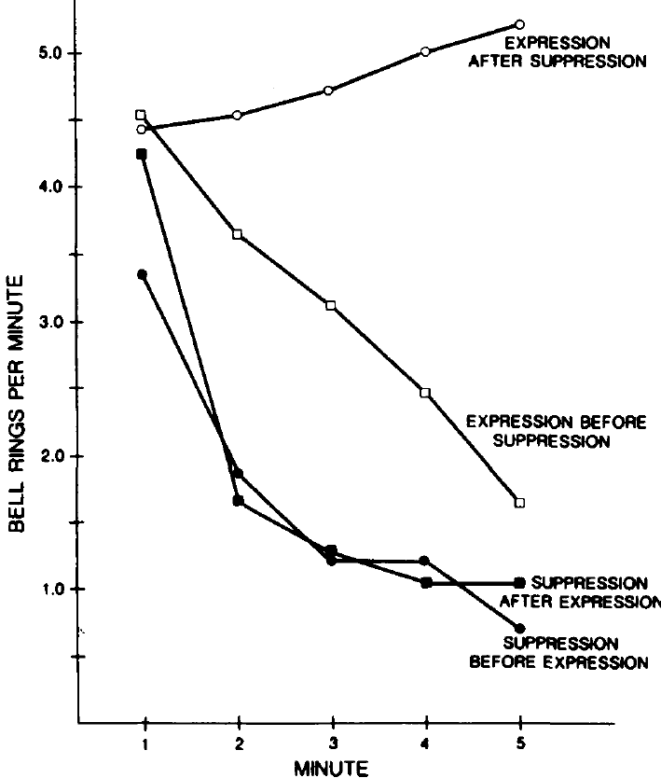
Wegner, Schneider, Carter, & White (1987, p. 8)

Slide 120
Concentration
Wegner, Schneider, Carter, and White (1987).
After suppression, it’s easier to keep thinking about a white bear.
After expression, it’s still hard not to think of a white bear at first, but people adapt.

Slide 121
Connection
How could this relate to your thinking about your big date?

Slide 122
End of Attention Show

