Slide 1
Episodic Long Term Memory
Langston, PSY 4040
Cognitive Psychology
Notes 6

Slide 2
Questions
Why do you have such a hard time learning some things, but others seem really easy?
Did Billie Eilish win an album of the year Grammy?
Who came up with the attenuation model?
I know I used to know a lot of stuff (like I got a B in calculus). Where has it all gone?

Slide 3
Questions
These are long-term memory questions:
A permanent memory store with unlimited capacity that holds everything you know.
Issues:
One long-term memory, or many?
If many, is it different kinds of memory or different kinds of processing?

Slide 4
Architecture
Recall our box model:
Sensory
Store
Filter
Pattern
Recognition
Selection
STM
LTM
Input
(Environment)
Response

Slide 5
Architecture
Recall our box model:
Sensory
Store
Filter
Pattern
Recognition
Selection
STM
LTM
Input
(Environment)
Response

Slide 6
Processes
There are two basic processes, encoding and retrieval. They’re not really independent (if you don’t encode something, you can’t retrieve it). But, we’ll do each in turn.
As a demonstration of encoding and retrieval, we did a more formal serial position study in CogLab, let’s check the data and see what happened…

Slide 7
Processes—Encoding
A number of factors influence encoding. (Control processes that you can use to get stuff from STM to LTM.)
Rehearsal (repetition): Repeat items over and over as you hear them. Some predictions:
More repetitions should lead to better transfer. Glanzer and Cunitz (1966) showed that by manipulating spacing (more time per item increased the primacy portion of a serial position curve).
Time flies like an arrow; fruit flies like a banana.

Slide 8
Processes—Encoding
Rehearsal (repetition): Some predictions:
More repetitions will lead to better transfer was also shown by Rundus (1971). As people did a free recall task, he had them rehearse out loud. Number of rehearsals was related to primacy.

Slide 9
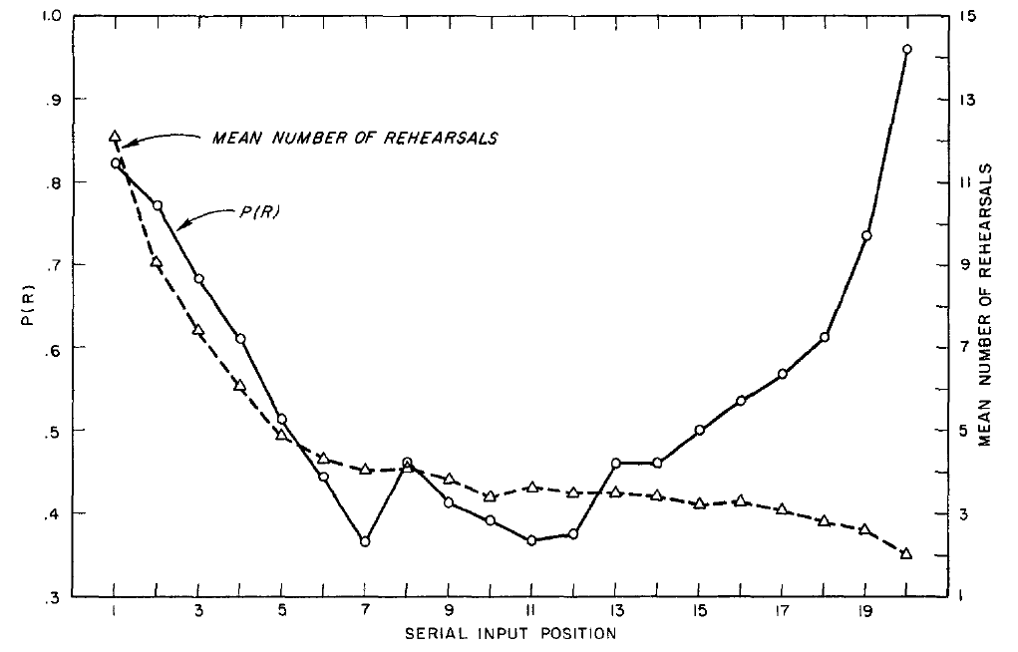
Processes—Encoding
Rundus (1971, p. 66)

Slide 10
Processes—Encoding
Rehearsal (repetition): Some predictions:
Fischler, Rundus, and Atkinson (1970) made people rehearse only the current item. Primacy flattened out (no differential rehearsal).

Slide 11
Processes—Encoding
Mnemonic devices: Special memory strategies that can improve transfer.
HOMES
My Very Eager Mother Just Served Us Nine (Pizzas)
Dixie drive your cows in; toothpicks are so dirty
We did some of this in the imagery unit with peg words, and we’ll see more as we go.

Slide 12
Processes—Encoding
Visual images: Most people can benefit from using imagery to improve transfer. Generally speaking, more bizarre images will lead to better recall (imagine the to-be-remembered material interacting in a bizarre way). The imagery unit has a lot of information related to this.
Dual coding.

Slide 13
Processes—Encoding
Spacing: How much time you take between study episodes influences what you will get (Cepeda, Vul, Rohrer, Wixted, & Pashler, 2008).
Cepeda et al. (2008, p. 1096)

Slide 14
Processes—Encoding
Cepeda et al. (2008): Vary the study gap between study sessions and the retention interval to find the optimal combination for various retention intervals.

Slide 15
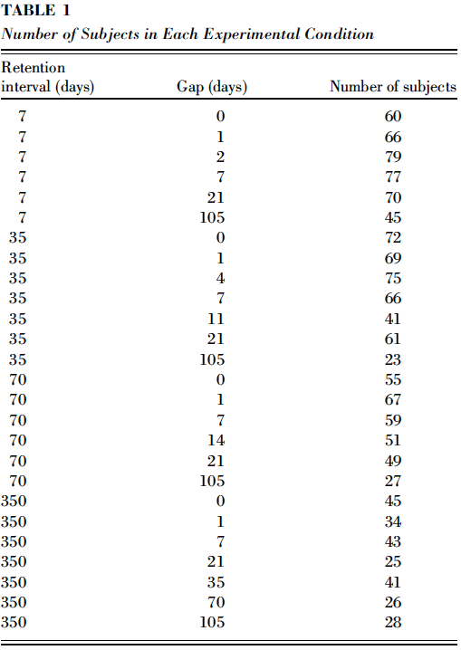
Processes—Encoding
Cepeda et al. (2008, p. 1097)

Slide 16
Processes—Encoding
Cepeda et al. (2008): The result is that there is an optimal gap where spacing out study sessions leads to improvements in memory.
It’s different for different retention intervals.
Waiting too long between study sessions can also hurt you, but not as much as too short.

Slide 17
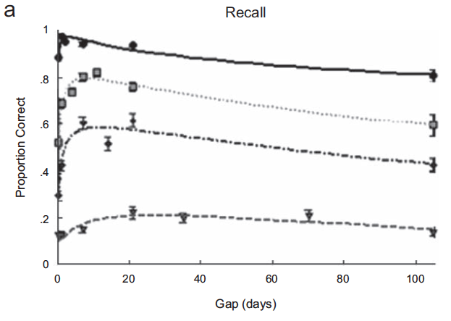
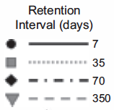
Processes—Encoding
Cepeda et al. (2008, p. 1098)

Slide 18
Processes—Encoding
Cepeda et al. (2008): The overall function is also pretty cool…

Slide 19
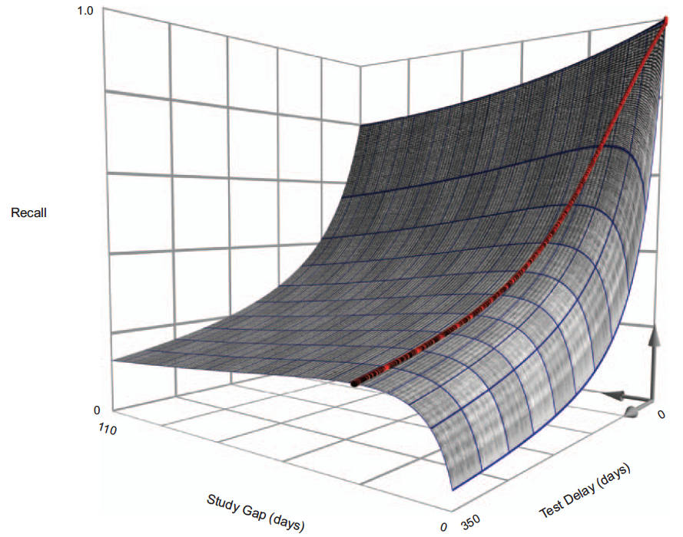
Processes—Encoding
Cepeda et al. (2008, p. 1100)

Slide 20
Processes—Encoding
Kornell & Bjork (2008): What about induction tasks? Will spacing out examples make it harder to learn a rule?
Art history lesson: Learn to identify which paintings are by which artist.

Slide 21
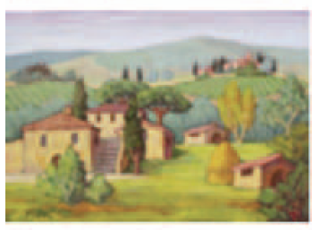
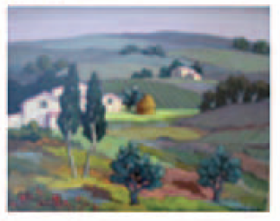
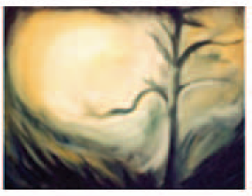
Processes—Encoding
Kornell & Bjork (2008, p. 587)

Slide 22
Processes—Encoding
Kornell & Bjork (2008):
Look at a set of paintings by one artist (massed), then a set with the artists mixed up (spaced).
15 s counting backwards task.
Look at new paintings and identify the artist.

Slide 23
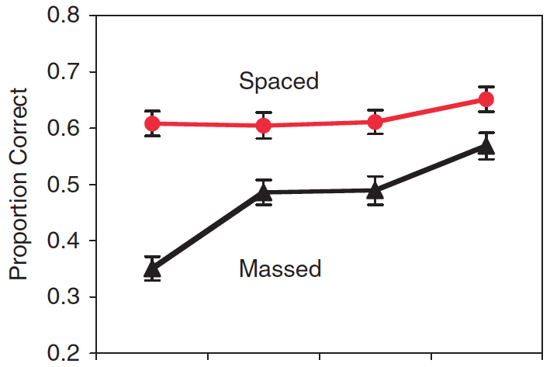
Processes—Encoding
Kornell & Bjork (2008, p. 588)

Slide 24
Processes—Encoding
Kornell & Bjork (2008):
Even for this kind of task, spacing is better.
The problem of introspection: What did participants think?

Slide 25
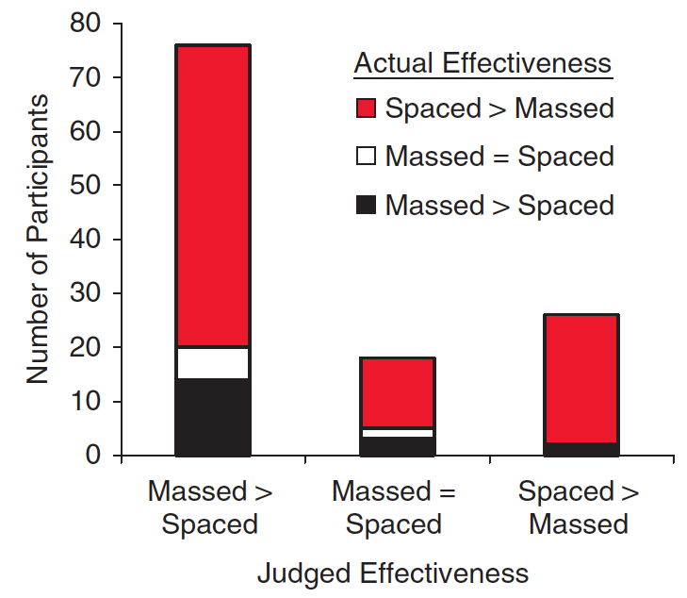
Processes—Encoding
Kornell & Bjork (2008, p. 588)

Slide 26
Processes—Encoding
Structure of control processes: Assuming you have a technique, it also matters how you choose what to learn. Some related stuff:
Atkinson (1972) had people learn German words. He had three study conditions:
Random: Each word to study was picked at random.
User controlled: People chose what to study.
Optimal: The only material chosen to be studied was the material most likely to transition from an unlearned state to a learned state (really two versions of this).

Slide 27
Processes—Encoding
Structure of control processes:
Atkinson (1972) found that during learning the random group got the most correct, the participant driven group was next best, and the optimal group was the worst (they only studied what they didn’t know).
At the test, the order switched. The optimal group did the best, the participant driven group was next, the random group was the worst.

Slide 28
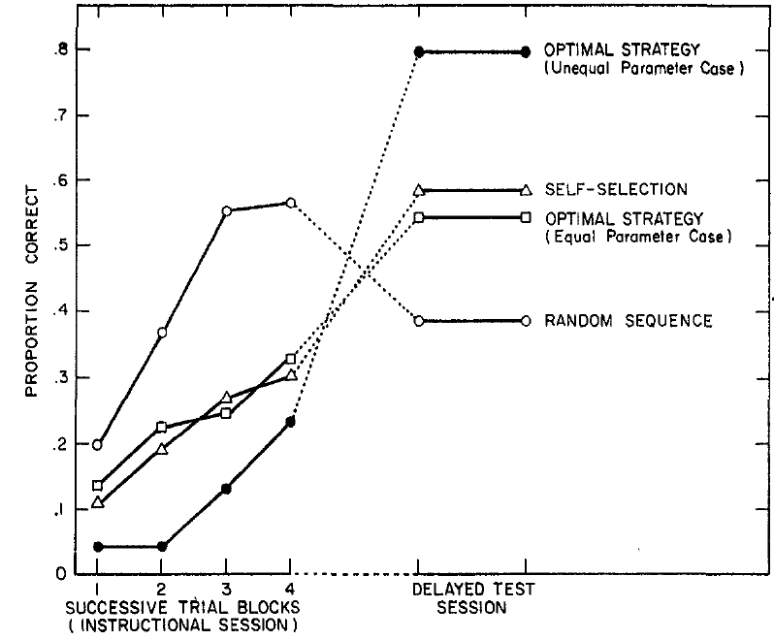
Processes—Encoding
Atkinson (1972, p. 126)

Slide 29
Processes—Encoding
Structure of control processes:
The conclusion from Atkinson (1972) is that people aren’t as bad as random, but they are not optimal at choosing what to study. Something to keep in mind.
These results point to the concept of “desirable difficulty.” Sometimes it’s good if it’s hard work when you’re learning something because it will produce better results later.

Slide 30
Processes—Encoding
Structure of control processes:
The conclusion from Atkinson (1972) is that people aren’t as bad as random, but they are not optimal at choosing what to study. Something to keep in mind.
These results point to the concept of “desirable difficulty.” Sometimes it’s good if it’s hard work when you’re learning something because it will produce better results later.
“Incoherent teaching method.”

Slide 31
Processes—Encoding
Structure of control processes:
There are lots of kinds of desirable difficulty. For example:
What is the effect of NOT being able to answer a question on memory?
In other words, if you try to answer a question on a test and you can’t, then you get feedback, what does that do to memory?

Slide 32
Processes—Encoding
“What is the last name of the person who panicked America with his book Plague of Fear?” (Kornell, Hays, & Bjork, 2009, p. 990).

Slide 33
Processes—Encoding
You couldn’t answer the question because it was fictional.
People were asked fictional questions and given feedback OR they read the answers. Memory for the answers was compared.
Overall, people did better when tested first over them before hearing the answer.

Slide 34
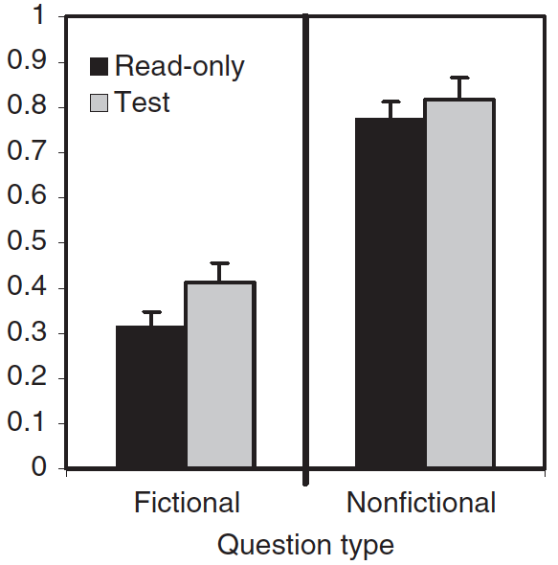
Kornell, Hays, & Bjork (2009, p. 992)

Slide 35
Processes—Encoding
What goes in the blank?
Hot - _____
Pond - _____

Slide 36
Processes—Encoding
Pond – frog is a low probability one, so you’re less likely to generate it.
When you get feedback after trying to answer, memory is better than if you just read it.

Slide 37
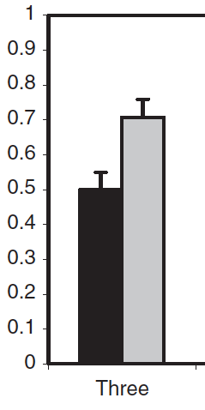
Kornell, Hays, & Bjork (2009, p. 994)

Slide 38
Processes—Encoding
The effort to retrieve improved memory, even when you didn’t have the answer to retrieve. Why? Kornell et al. (2009)
Retrieval helps with deeper processing (it connects to more things in memory because you’re rooting around in there looking for the answer).
Helps weed out bad paths to retrieval (“I know it isn’t over here”).
Generates more cues.

Slide 39
Processes—Encoding
“A practical implication of the current research is that educators and learners should introduce challenges into learning situations, including using tests as learning events, even if doing so increases initial error rates” (Kornell et al., 2009, p. 997).

Slide 40
Processes—Encoding
Encoding. (Control processes)
Structure of control processes:
When should you stop studying? This is related to a phenomenon called calibration of comprehension: How well do people know whether or not they know something?

Slide 41
Processes—Encoding
Structure of control processes:
Calibration of comprehension: Glenberg, Sanocki, Epstein, and Morris (1987) had people read some material. The participants then rated how they would do on a test of verbatim information or an inference test and they rated that for either an immediate test or a delay. Regardless of the kind of test, people’s confidence in how they would do on a test was unrelated to how they actually did.
This is true of a lot more circumstances and can be corrected, but only with very specific feedback.

Slide 42
Processes—Encoding
Structure of control processes:
Calibration of comprehension: The take-home message is that people are not very good at knowing if they know something. Your feeling of confidence is a bad way to gauge whether or not you’re done. (A better way is to study and try a sample test to get an objective measure of how prepared you are.)

Slide 43
Take a break…
When it comes to encoding, there are some things that are under your control, and some that are under the environment’s (instructor’s) control.
What can you do for encoding to improve performance?
What is under the environment’s control?
Can you leverage some of this to do better even if it’s not under your control?

Slide 44
Processes—Retrieval
Retrieval: Once it’s in, you need to get it out. What influences retrieval?
Model: We need to go on a digression and consider a model of retrieval before we look at influences.
We will propose a two-stage model of retrieval:
Automatic familiarity
Effortful search
We’ll do each in turn.

Slide 45
Processes—Retrieval
Retrieval: Model:
A lot of memory processes seem to be automatically encoded and retrieved:
Position (as in where on a page material was presented).
Frequency.
Familiarity is also automatic. Probably it’s a result of prior processing. If you’ve seen something recently or often, a trace of that processing will make it easier to resolve that thing again.

Slide 46
Processes—Retrieval
Retrieval: Model:
Automatic familiarity: An example: Which is more familiar?
The old man boats made of wood.
Time flies like an arrow; fruit flies like a banana.
A practical implication of the current research is that educators and learners should introduce challenges into learning situations.
There is a lot of effort at first; it’s easier the second time you process it. That ease = familiarity.
When you try to remember something, you compute familiarity to get started.

Slide 47
Processes—Retrieval
Retrieval: Model:
A process:
START
Not at all
Familiar?
Very
A little
No; Stop
Yes; Stop
Effortful search

Slide 48
Processes—Retrieval
Retrieval: Model:
Effortful search: If it seems like something might be there and it’s worth looking, search.
Construct a recall cue: Take everything you know about the item you’re searching for (what you were wearing, what it’s related to, etc.) and pull it together.
Pass the cue through memory. To the extent that it’s related to something you have in there, it will pull that out. (This won’t necessarily work if you have a bad cue, which we’ll discuss later.)
Mixing up the cues can help, and the type of test can influence the process.

Slide 49
Processes—Retrieval
Retrieval: Model:
Effortful search: You might see the search process in one of these demonstrations:
Write down all 50 states. At the point where you stop slapping them down and start thinking, draw a line. If we look at what’s below the line, we might see a retrieval strategy.
We can also use the tip of the tongue technique. If I give you the definition to relatively rare words, you might encounter one where you think you know it but can’t retrieve it. Then we can play with effortful retrieval.

Slide 50
Processes—Retrieval
Retrieval: Now that we have a model, we can look at influences on retrieval:
Retention interval: The longer you wait the less you’ll have. For example, Ebbinghaus memorized nonsense syllables and looked at the forgetting curve (next slide).

Slide 51
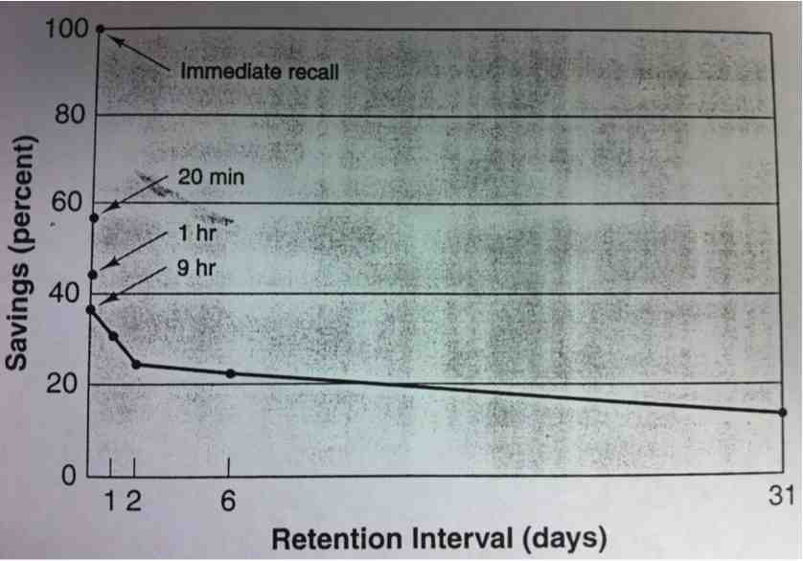
Processes—Retrieval
Retention interval: Why might our model predict this?

Slide 52
Processes—Retrieval
List length: The longer the list the harder it is to learn. Could be:
Proactive interference (hurting familiarity and search).
Cue overload (hurting search).

Slide 53
Processes—Retrieval
Cue overload: I have a rather lengthy discussion of long term recency to demonstrate cue overload.
Demonstrate long term recency (similar to Bjork & Whitten, 1974)…
Works for real world things like movies seen, games played, etc.

Slide 54
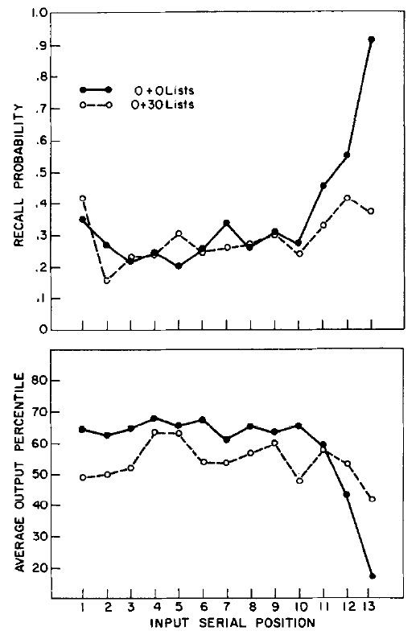
Processes— Retrieval
This is a replication of Glanzer and Cunitz (1966) that we saw earlier.
Counting backwards kills recency without hurting primacy.
Bjork & Whitten (1974, p. 180)

Slide 55
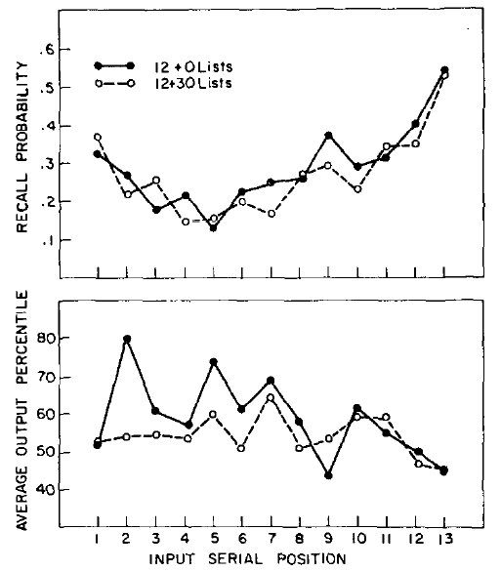
Processes— Retrieval
But, if you count for 12 seconds between items, then count backwards for 30 seconds, recency comes back.
Bjork & Whitten (1974, p. 181)

Slide 56
Processes—Retrieval
Cue overload: Long term recency.
Even after a counting backwards delay, you still get recency if something happens between items. Why?
One guess is changing context. Context is continually changing. It can come from:
The experiment itself (PowerPoint slides, etc.)
Cognitive and affective state (I’m bored, etc.)
The environment
Different aspects are changing at different rates.

Slide 57
Processes—Retrieval
Cue overload: Long term recency.
The more activity that goes by between items, the more context can change and the more unique cues you have to work with at retrieval.
The faster the list comes (or the more in a similar context), the less unique the cues will be, and the stuff you get from any particular cue will overwhelm its ability to pick anything in particular out of memory.

Slide 58
Processes—Retrieval
Cue overload: Long term recency.
What is the relationship between testing conditions and recency? We need two terms:
IPI: Interpresentation interval: How long you have between to-be-remembered items.
RI: Retention interval: How long after you learn the material before you take the test.

Slide 59
Processes—Retrieval
The relationship between IPI, RI, and recency:
Task | IPI | RI | Ratio (IPI/RI) | Recency?
Standard free recall | Short (3 s) | Short (3 s) | Large | Yes
G&C (1966) more spacing | Longer (6-9 s) | Short | Larger | Yes
G&C (1966) 30 s counting | Short (3 s) | Long (30 s) | Small | No
B&W (1974) 12+0 | Long (12 s) | Short (0 s) | Larger | Yes
B&W (1974) 12+30 | Long (12 s) | Long (30 s) | Moderate | Yes

Slide 60
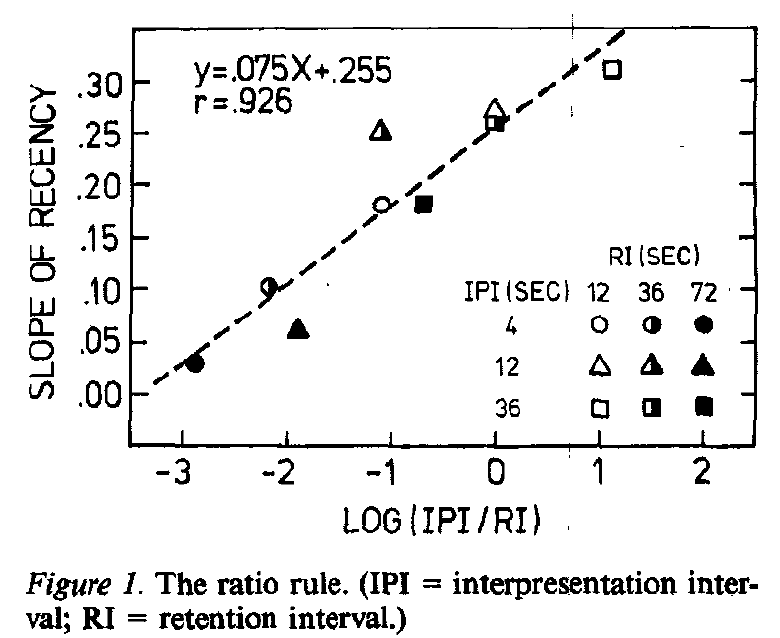
Processes—Retrieval
Glenberg, Bradley, Kraus, & Renzaglia (1983, p. 233)

Slide 61
Processes—Retrieval
Cue overload: Long term recency.
Why? The different conditions influence the overlap between the testing conditions and the learning conditions and the amount of cue overload.
I have a chart to demonstrate this (next slide).

Slide 62
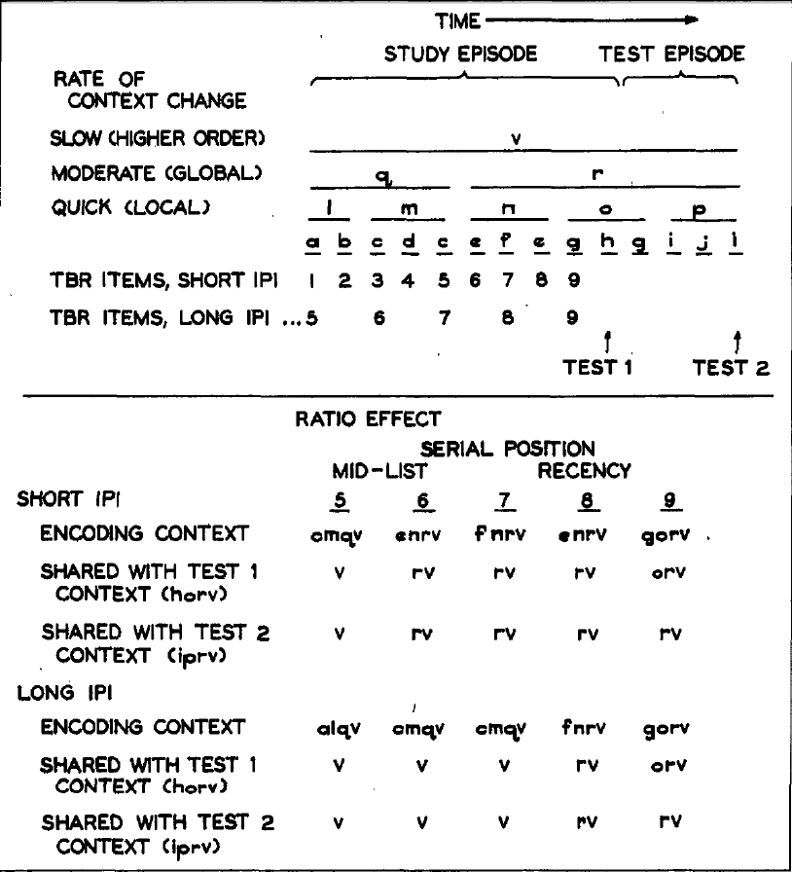
Glenberg, Bradley, Kraus, & Renzaglia (1983, p. 237)

Slide 63
Processes—Retrieval
Cue overload: One thing we can get from this is that you can’t overload retrieval cues and expect them to be effective.
Will longer lists at one sitting do that?
How does spacing out material affect things?
How does retention interval affect things?

Slide 64
Processes—Retrieval
Serial position: Primacy and recency produce the highest recall. We could probably think about our model and figure that out.

Slide 65
Processes—Retrieval
Type of test: There are two big kinds:
Recall: You answer it out of your own head. Like an essay test or the memory list tasks we’ve been doing.
Recognition: The answer is there, you just recognize it.
From our model, we’d expect recognition to be easier. The perfect cue is there before you (the thing itself). All you have to do is find it.

Slide 66
Processes—Retrieval
Type of test:
Some of the advice above is qualified by type of test considerations.
Mixing up cues helps the effortful part, which is more important in recall.
Cue overload is probably important for both, with maybe an edge to recall.
Retention interval probably hits recognition more if you think about its effects on familiarity. However, that also assumes that you were studying for a recognition test.

Slide 67
Processes—Retrieval
Type of test:
Recognition can also be really hard if a person pays attention to the model:
Question 1 | Question 2
Peterson and Peterson found that the duration of short term memory is: | Peterson and Peterson found that the duration of short term memory is:
a. 16 seconds | a. 1 minute
b. 17 seconds | b. 1 hour
c. 18 seconds | c. 18 seconds
d. 19 seconds | d. 1 day

Slide 68
Processes—Retrieval
Control processes: Glenberg, Schroeder, and Robertson (1998) showed that looking away can help retrieval. The idea was that memory is driven by the current environment (it’s providing all the cues). To get to something not associated with those cues you have to disengage the environment. Something to think about.

Slide 69
Processes
We can think about our two questions again:
Why is some stuff so hard to learn? Think about the model and the influences. What about the easy stuff? Do it again.
Where is my calculus? It’s probably there but I need the right retrieval cue.

Slide 70
Structure of LTM
We have been speaking in general terms so far, and treating LTM as if it’s one kind of thing. There might actually be multiple components in the LTM box.
The data come from two sources:
Data from psychology experiments.
Neuropsychology and brain injury research.
What follows is not in historical order, but it seems like a logical arrangement.

Slide 71
Structure of LTM
Divisions of LTM:
Non-Declarative/Declarative: The first big division. Some kinds of memory seem to be spared when people have anterograde amnesia (trouble acquiring new information). Evidence from research with this population suggests a split:
Non-declarative (implicit memory): You can’t declare these verbally, there’s not usually a feeling of remembering, and you might not know you’re remembering when you retrieve them.
Declarative (explicit memory): Memories you can verbalize that come with a feeling of knowing. These are damaged in anterograde amnesia.

Slide 72
Structure of LTM
Divisions of LTM:
Evidence: A lot of tasks that have a profound effect on explicit memory do not seem to have the same effect on implicit memory:
Type of processing: If you do more at learning (e.g., generate the word vs. read it), explicit memory improves. Jacoby and Dallas (1981) manipulated the encoding task and showed an effect on recognition (explicit memory), but not on priming (implicit memory).
Retention interval: Waiting to remember produces a pretty standard forgetting curve. Some forms of implicit memory can last relatively unaffected for very long delays as explicit memory for the same material goes down.

Slide 73
Structure of LTM
LTM
Non-Declarative
Declarative

Slide 74
Structure of LTM
Divisions of LTM:
Episodic/Semantic (Tulving, 1972): The second big division, splitting declarative memory. Researchers seemed to be studying two kinds of memory when you looked at the experiments closely:
Episodic: Autobiographical memory. There’s a sense of your presence associated with the memories. Organized around time cues and experience cues. So far, most of what we’ve done has been episodic (e.g., free recall).
Semantic: Fact knowledge. This is like compiled episodic memories. Memories are organized around meaning cues and are divorced from your experience of the episode in which they were learned. We’ll have a unit on this later.

Slide 75
Structure of LTM
LTM
Non-Declarative
Declarative
Episodic Memory
Semantic Memory

Slide 76
Structure of LTM
Divisions of LTM:
Non-declarative varieties: There are also divisions within non-declarative:
Implicit memory: Associated with the effects of processing. Last a long time, no feeling of remembering. Similar to our familiarity component in the model.

Slide 77
Structure of LTM
Divisions of LTM:
Implicit memory: Evidence…
Warrington and Weiskrantz (1968): Amnesiacs have a profound problem with recall and recognition tests, but can do fine if the test is on word fragment completion (e.g., you see a list with “grape” on it and later complete the fragment “gra_ _”). A lot of their participants didn’t remember seeing a list of words at all, and were doing the task as a guessing game.
Graf, Squire, and Mandler (1984): With the exact same fragments and task, if you tell amnesiacs it’s a memory test they do horrible, tell them to complete stems with the first word that comes to mind, they’re fine.

Slide 78
Structure of LTM
Divisions of LTM:
Non-declarative varieties: There are also divisions within non-declarative:
Procedural memory: Skill learning can also be preserved in amnesiacs. They show improvement with practice performing tasks without any explicit memory of ever having performed the tasks before.

Slide 79
Structure of LTM
LTM
Non-Declarative
Declarative
Implicit Memory
Episodic Memory
Procedural Memory
Semantic Memory

Slide 80
Structure of Memory
We’ve been proliferating boxes, here’s the original model:
Sensory
Store
STM
LTM
Input
(Environment)
Response

Slide 81
Structure of Memory
Here’s a new version with all the boxes:
LTM
Working Memory (STM)
Non-Declarative
Declarative
Sensory
Store
Executive
Implicit
Episodic
AL
VSS
Procedural
Semantic
Input
(Environment)
Response

Slide 82
Structure of Memory
Let’s turn this on its head. What if there aren’t different kinds of memory, just different kinds of processing?
If you do low-level tasks, you will get what looks like implicit memory, sensory register, etc.
As you do more with the material, you get more memory of it, and you move up in boxes.
But, it’s not moving to new boxes, it’s just better traces in the same basic medium.

Slide 83
Structure of Memory
Let’s see if we can develop a processing approach. A couple of points:
There are a lot of data suggesting double dissociations between all of the boxes. We’ve looked at:
Experimental data.
Neuropsychological data.
We’ve seen data for most of the divisions.
One problem is that for each piece of positive data that we’ve considered, there are other data that suggest that the split is less than perfect.

Slide 84
Structure of Memory
Developing a processing approach. Points:
I’m not going to be able to resolve the issue of boxes vs. processing here.
If we really sat and thought about it, we could probably work out how the data from the double dissociations is possible from a processing perspective.
We might also conclude that you have to have at least some basic divisions.
What I’m proposing is that if we change our focus to processing, we can learn a lot of useful stuff about memory. We can do that without making any theoretical commitments.

Slide 85
A Processing Account
In the remainder of this unit, I’m going to introduce processing. Then, we’ll look at how a processing account changes the way we look at memory. After that, we’ll return to the basic division and look at semantic memory. After a look at interesting stuff that wouldn’t fit anywhere else, we’ll go on to higher cognition.

Slide 86
A Processing Account
Jacoby and Dallas (1981) suggest a processing approach:
Conceptually driven processes: More top-down, knowledge involved processes.
Accounts for declarative memory (recall and recognition) processes. Accessed with recall strategies (the second stage of our model).
Data driven processes: More bottom-up, low level processes.
Accounts for non-declarative memory (implicit tasks, skills) processes. Accessed more by familiarity.

Slide 87
A Processing Account
Jacoby and Dallas (1981) suggest a processing approach:
Evidence:
Manipulate presentation modality (read it vs. hear it). This should affect familiarity, but not explicit memory. In fact, you see modality effects in implicit tasks, but not explicit tasks.
Manipulate the task. As people learn the list they’re solving anagrams (EMTLA) or reading ( ). Working harder at encoding affects explicit memory, but not implicit memory.

Slide 88
A Processing Account
Jacoby and Dallas (1981) suggest a processing approach:
Evidence:
Manipulate presentation modality (read it vs. hear it). This should affect familiarity, but not explicit memory. In fact, you see modality effects in implicit tasks, but not explicit tasks.
Manipulate the task. As people learn the list they’re solving anagrams (EMTLA) or reading (METAL). Working harder at encoding affects explicit memory, but not implicit memory.

Slide 89
A Processing Account
Conclusion: Different kinds of processing lead to what looks like different kinds of memory. At a minimum, processing makes a difference. Let’s develop that idea.

Slide 90
A Processing Account
Processing influences:
Let’s return to rehearsal. So far, we’ve been saying more rehearsal leads to better long term memory. But, not all rehearsal is the same:
Type I (maintenance) rehearsal: Repeating items over and over. It’s better than nothing, but not that great.
Type II (elaborative) rehearsal: Elaborate the material to increase the number of cues that can access it later. This can be a mnemonic device, imagery, or a bunch of other stuff (e.g., solving anagrams). This is better.
I have a demonstration of the effectiveness of maintenance rehearsal that we can try…

Slide 91
A Processing Account
Processing influences:
Conclusion: Anything helps compared to nothing. But, increasing maintenance rehearsal isn’t going to pay big dividends.
This is a replication of Craik and Watkins (1973).

Slide 92
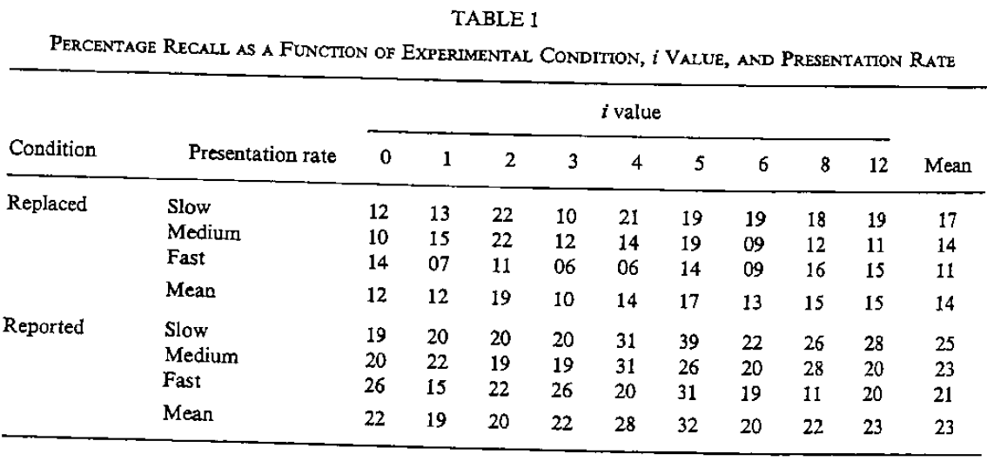
A Processing Account
Craik & Watkins (1973, p. 602)

Slide 93
A Processing Account
We can turn to the first question again. If you’re not getting much out of studying, maybe you need to stop doing purely maintenance rehearsal.

Slide 94
A Processing Account
Processing influences:
What should you do? Elaborative rehearsal.
Let’s do a demonstration of that…

Slide 95
A Processing Account
Processing influences:
What should you do? Elaborative rehearsal.
Let’s do a demonstration of that…
This replicates Hyde and Jenkins (1969). They found:
For meaning judgments people got 16.3 / 24.
For counting e people got 9.4 / 24.
Also, meaning affected clustering:
For meaning judgments, 68% clustering.
For counting e’s, 26% clustering.
Deeper vs. shallower processing makes a huge difference.
We also did a CogLab for this, so we’ll look at that as well…

Slide 96
A Processing Account
In the next unit, we develop the processing account by looking at LTM from a processing perspective.

Slide 97
End of Episodic Long Term Memory Show

