Slide 1

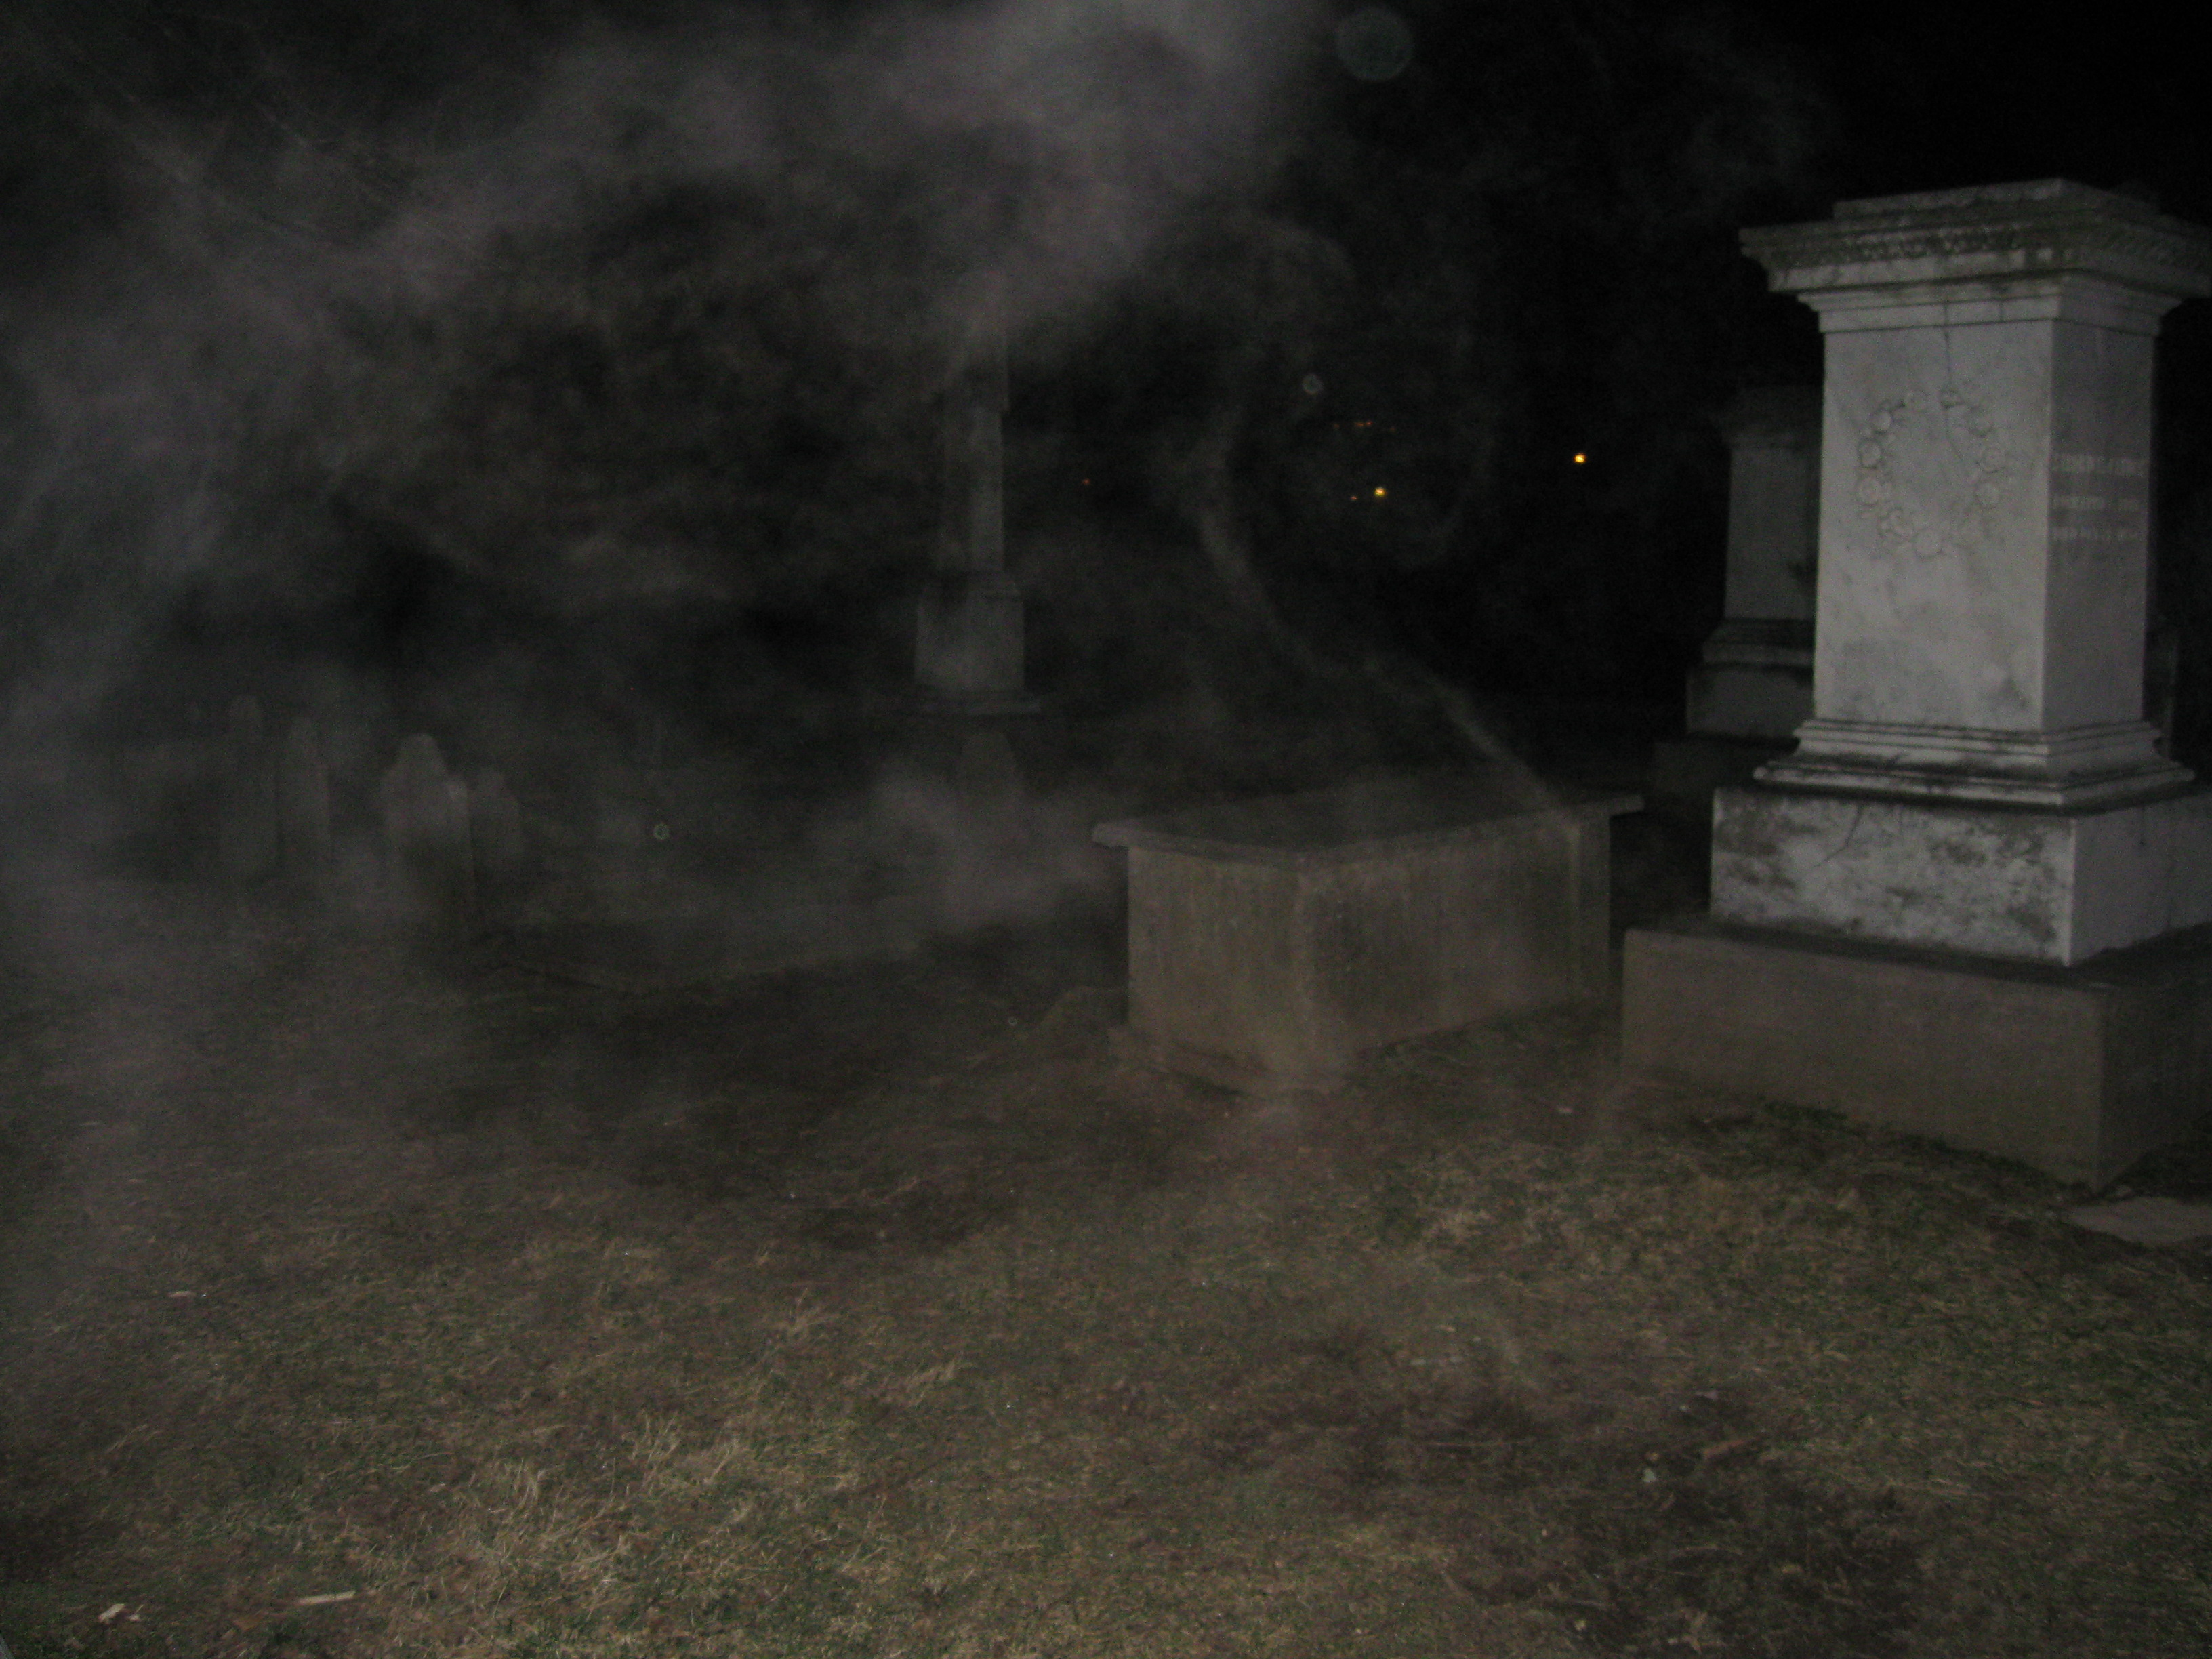
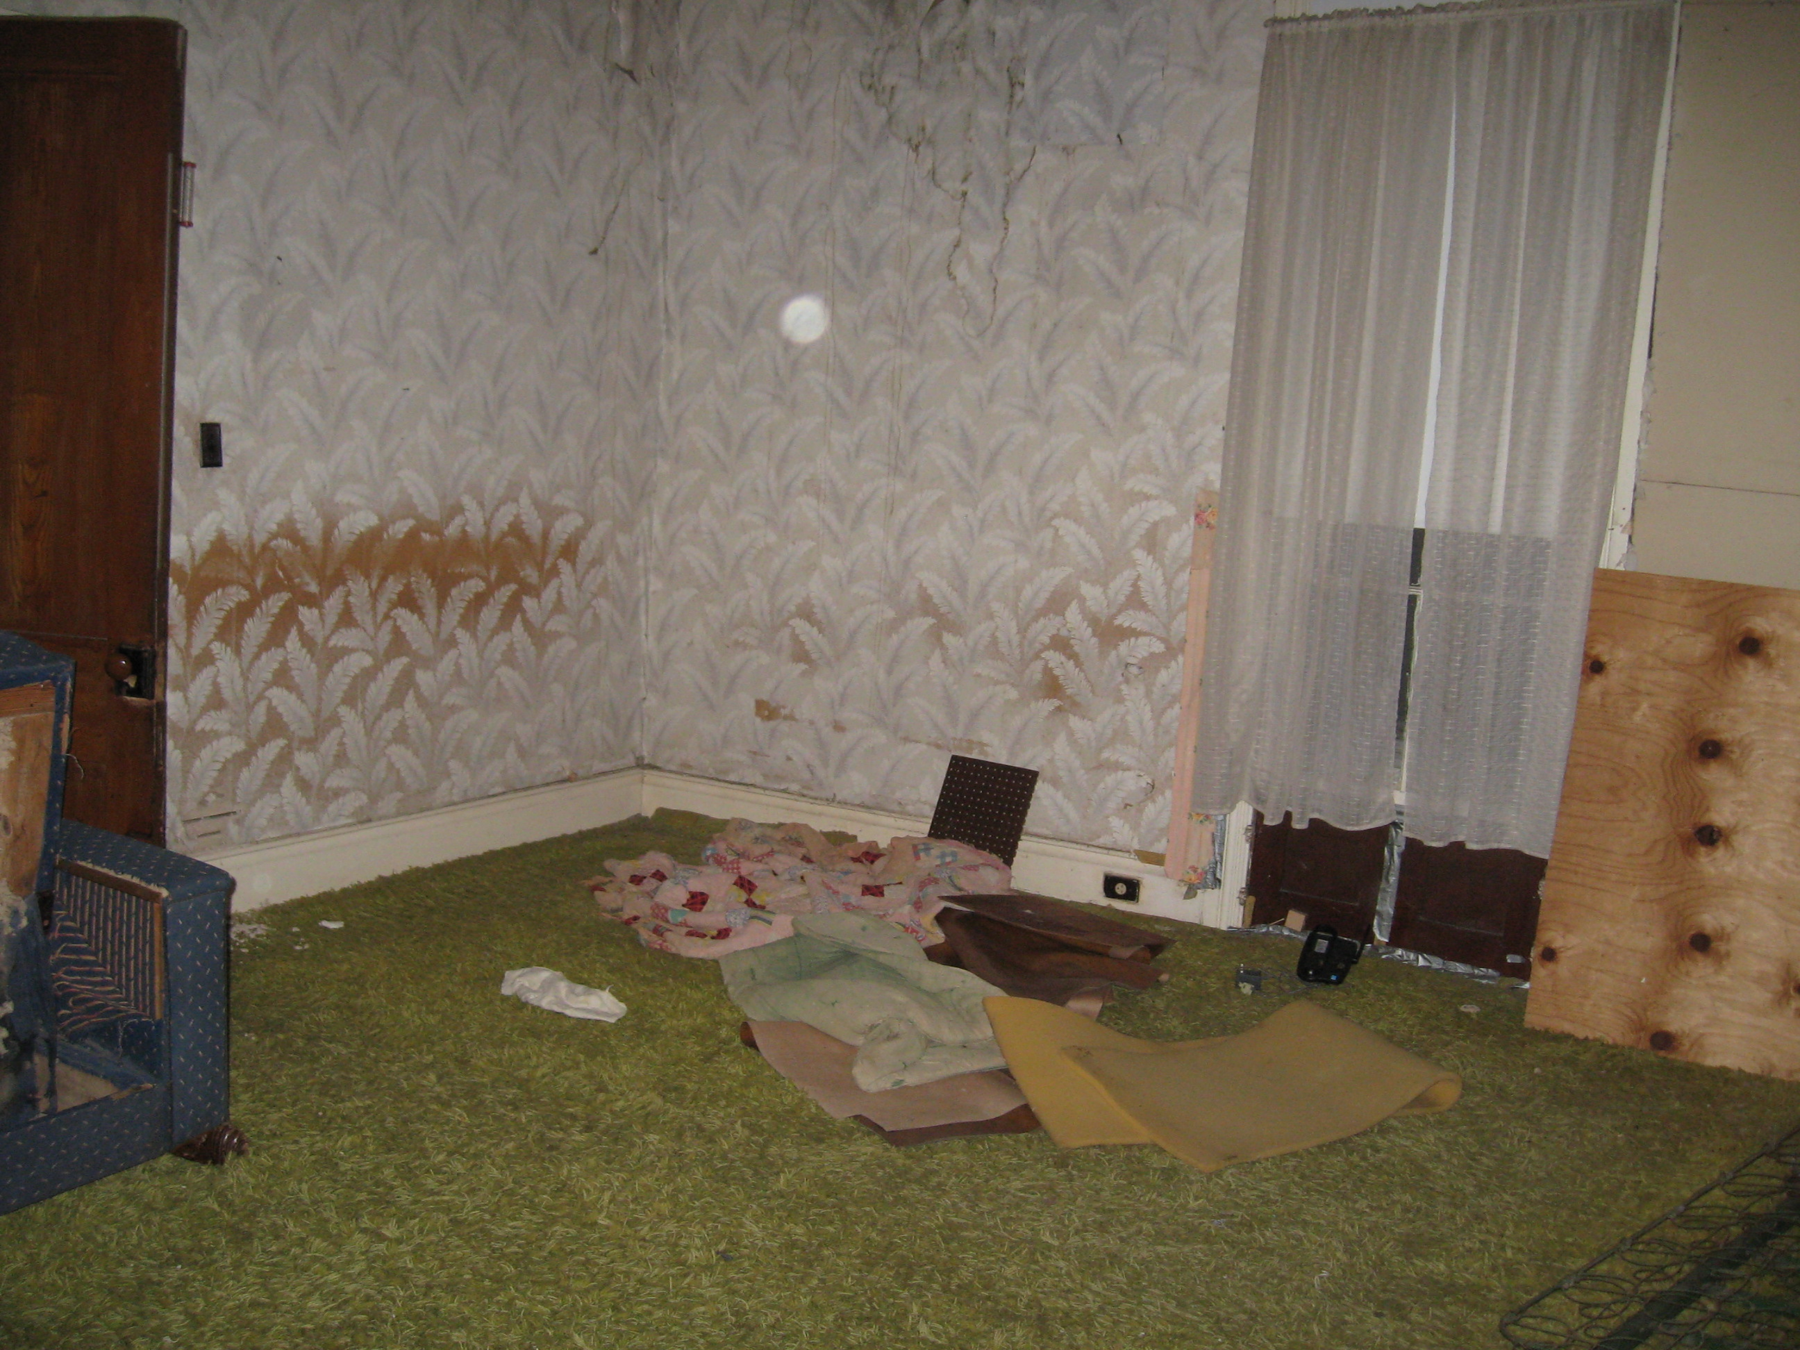
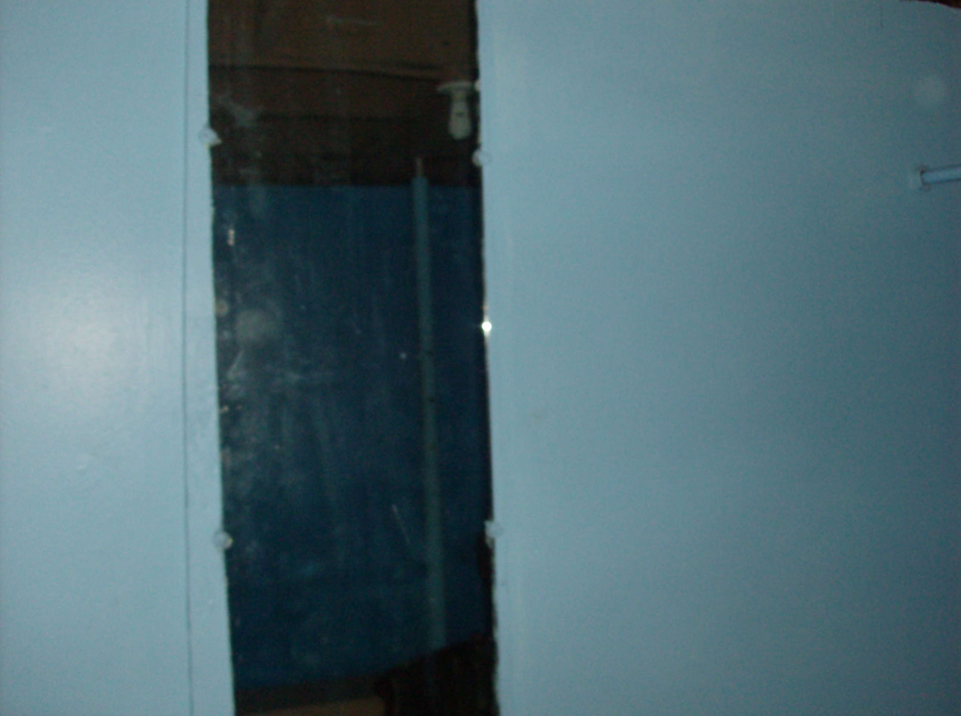
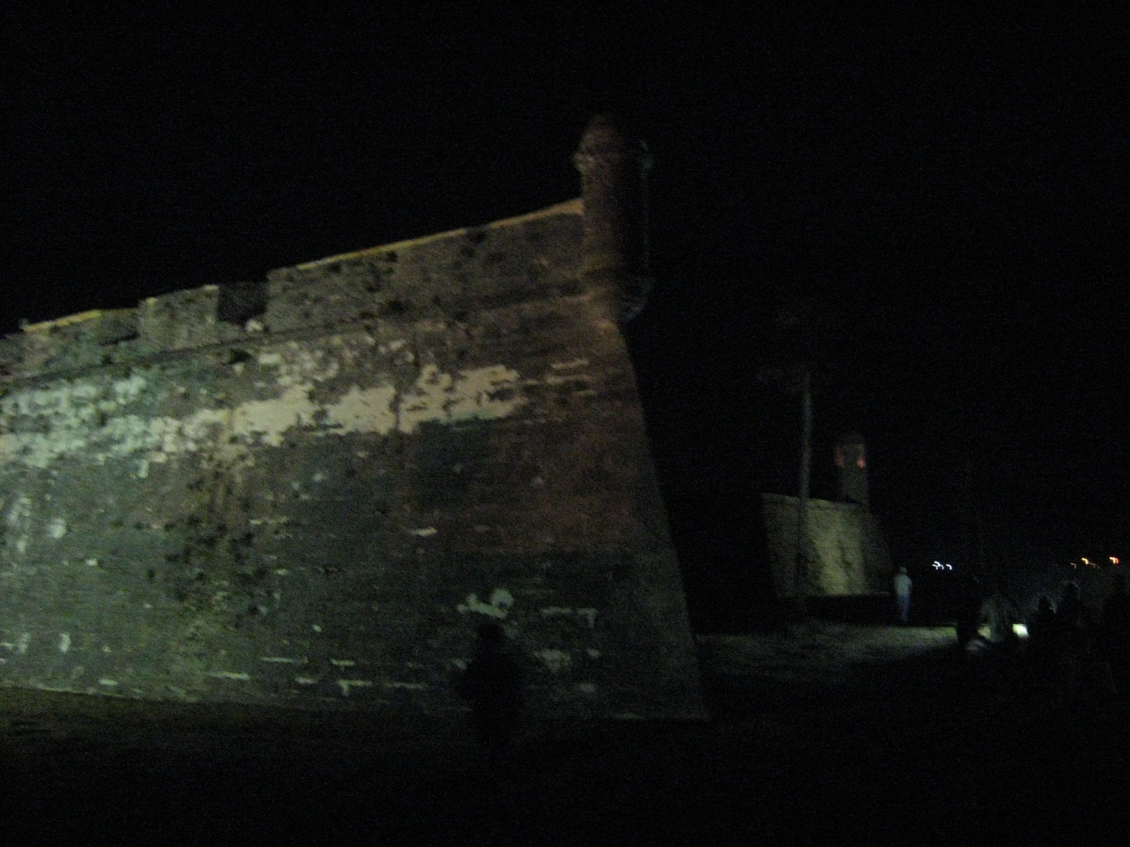
The Effects of Prior Belief, Expectations, and Experience on Belief in Ghosts
William Langston, Tyler Hubbard
Psychology Department, Middle Tennessee State University, Murfreesboro, TN
INTRODUCTION
RESULTS
The relationship between experience and belief is of interest for a variety of reasons. For example, myside bias (Stanovich, West, & Toplak, 2013) refers to the influence of prior beliefs on the evaluation of evidence. This bias is not related to intelligence, but can be overcome if people are warned in advance not to attend to their prior beliefs.
The current project was designed to evaluate how prior belief will interact with information provided during a task to influence participants’ responses and beliefs about the task. Participants were told that a pendulum could be used as a sensitive research tool to overcome possible experimenter biases (as in Chevreul, 1833) and then rated their confidence in a pendulum’s ability to achieve that goal. They then used the pendulum to evaluate pictures that did or did not contain “ghosts.”
The primary research questions were:
  Will information about the pictures influence the pendulum’s movement (a classic ideomotor effect)?
  Will experience with the pendulum change belief in the pendulum’s effectiveness?
  How will prior belief affect the pendulum’s movement?
Will Expectancy Influence Ideomotor Responses?
There was an interaction between picture type and presentation type, F(3, 117) = 9.30, MSE = 0.67, p < .01. There were more movements for ghost pictures when they were visible.
There was not an interaction between picture type and presentation type, F(3, 126) = 2.38, MSE = 0.47, p =.07. The type of picture did not influence the pendulum movement.
Does Experience Affect Belief?
METHOD
Increase in confidence after experience with the pendulum, F(2, 76) = 5.53, MSE = 0.14, p = .01; no effect of what they see first, no interaction, Fs < 1.0, ps > .67.
No change in confidence after experience with the pendulum, no effect of what they see first, no interaction, Fs < 1.0, ps > .59.
Participants
83 students were recruited from the psychology department research pool; 40 were in the informed group, 40 saw the visible pictures first. Participants in the informed and uninformed groups did not differ on prior beliefs (ts < .91, ps > .36).
Stimuli
12 pictures were provided by the Shadow Chasers ghost investigating team. There were 3 each of control pictures, debunked pictures, possible ghost pictures, and confirmed ghost pictures‡. Crystals were attached to thread to create pendulums. Participants completed the Anomalous Experiences Inventory (AEI) to measure prior belief (Gallagher, Kumar, & Pekala, 1994).
Procedure
Participants were told that people sometimes miss seeing things (and were shown videos used to measure visual attention that demonstrated this). Pendulums were presented as a more sensitive tool to overcome possible biases against seeing ghosts. Participants watched a brief video of a ghost investigator using a pendulum to have a conversation with a ghost. Participants were then told that they would use a pendulum to evaluate four kinds of pictures:
  Control: Made as comparisons to control for investigator contamination.
  Debunked: They appear to contain a ghost, but have been conclusively proven not to.
  Possible ghost: The picture cannot be determined to have a ghost, but cannot be conclusively proven not to.
  Confirmed: Based on converging evidence, the ghost in the picture is confirmed.
Informed participants were also told which pictures were which.
Half of the participants saw the pictures first, half saw opaque envelopes containing the pictures first. After participants evaluated whether or not the pendulum moved for the pictures, the conditions were switched and participants evaluated the pictures again.
Participants reported whether they expected the pendulum to work and rated their confidence before the first trial and after the first and second trials.
Participants completed the AEI after the picture evaluation task.
How Does Prior Belief Relate to Ideomotor Responses?
Informed Participants
Uninformed Participants
 | Visible Total | Envelope Total
AEI-B | .14 | .17
AEI-E | .25 | .30
AEI-A | .15 | .13
AEI-F | .04 | .02
 | Visible Total | Envelope Total
AEI-B | .45** | .52**
AEI-E | .43** | .32*
AEI-A | .23 | .20
AEI-F | .44** | .37*
Note. AEI = Anomalous Experiences Inventory; B = Belief; E = Experience; A = Ability; F = Fear; Total = Total number of pendulum movements in the condition.
*p < .05; **p < .01
Note. AEI = Anomalous Experiences Inventory; B = Belief; E = Experience; A = Ability; F = Fear; Total = Total number of pendulum movements in the condition..
With information about the pictures, prior belief has no relationship to the pendulum movement.
Without information about the pictures, prior belief is related to the pendulum movement.
Summary & Conclusion
The results provide another instance of what Hyman (1999) dubbed “the mischief-making of ideomotor action.” For informed participants, the pendulum’s movement matched the expectation provided by the instructions.
This kind of experience could easily provide support for belief in ghosts, as well as belief in the procedure itself. The nature of the experience could also make that belief especially persistent and difficult to correct.
The correlations between prior belief in the paranormal and ideomotor responses for the uninformed group suggest that participants rely on their belief when no information is available. The absence of correlations between prior belief in the paranormal and ideomotor responses for the informed groups suggests that participants can incorporate available information into their existing framework when making new evaluations.
In this case participants were able to suspend their prior beliefs and respond based on the information provided. This extends research on the myside bias (Stanovich et al., 2013) in that prior beliefs were discounted without an explicit warning.
‡It should be understood that all instances of terms like “confirmed ghost pictures” reflect the consensus opinion of the ghost hunting team providing the images and are not intended to endorse the concept that the images depict actual ghosts.
Control
Debunked
Possible
Confirmed

