Slide 1

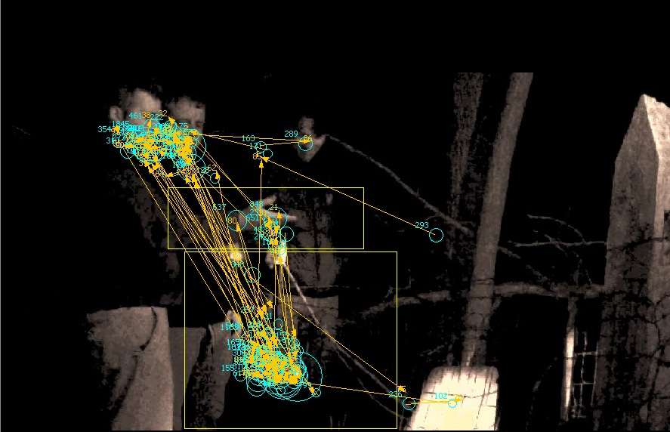
An Eye-Tracking Study to Identify Variables That Affect
the Interpretation of a Purportedly Paranormal Event
Andrew Hunt, Tyler Hubbard, Kevin Anderson, Christof Fehrman, & William Langston
Psychology Department, Middle Tennessee State University, Murfreesboro, TN
INTRODUCTION
RESULTS
Question: How does belief affect the way in which people collect information from the environment?
Background:
  Previous research has shown that belief influences people’s interpretation of paranormal events (e.g., Hergovich, 2004).
  Wiseman and Morris (1995) found that believers remembered fewer details that could reveal a paranormal event as a trick, which they interpreted as believers possibly attending to different information.
  We used an eye-tracking procedure to evaluate which aspects of an event would be attended to by believers and nonbelievers.
Question: Do the variables associated with prior belief predict participants’ updating of belief (belief change, information attended)?
Background:
  Freeman, Garety, Kuipers, Fowler, and Bebbington (2002) proposed that the variables leading to the formation of a persecutory delusion were different from variables related to delusion maintenance and updating.
  We evaluated the variables affecting different stages of the experiment to examine the applicability of this model.
Is There a Relationship Between Prior Belief and Viewing Target?
If belief influences viewing target, then we should see an interaction between belief and interest area (higher believers should spend more time on the pendulum than lower believers and higher believers should spend less time on the hand/arm than lower believers); we present data for two belief measures, prior belief, and belief that the video was genuine.
Figure 2. There was no interaction between prior belief in ghosts and viewing target, F(1, 183) = 0.002, p = .96, η²_{p} = .000 (note that the pendulum interest area was larger, making the effect of area meaningless; the effect of interest is within an area).
Figure 3. There was an interaction between belief that the video was genuine and viewing target, F(1, 183) = 23.08, p < .01, η²_{p} = .11; pendulum t(183) = -3.98, p < .01, d = .61, and arm t(183) = 4.29, p < .01, d = .71.
Are Different Variables Associated with Prior Belief and Belief Updating?
METHOD
To evaluate whether different variables are associated with prior belief and belief updating (e.g., belief change), we entered the variables prior belief, experience, personality (SPQ-B factors, CRT), suspicion, and demographics (gender, age) into stepwise regressions with the dependent variables prior belief, change in belief, and what participants watched (hand/arm and pendulum).
Participants
203 participants were recruited from the department research pool (for those reporting demographics, 126 F, 63 M; average age = 19.34, SD = 2.33, 18-35). Eye-tracking data from six participants were not recorded; 11 were removed for not attending to the video.
Measures
Schizotypal Personality Questionnaire-Brief (SPQ-B, Raine & Benishay, 1995): 22-item scale; three subscales, cognitive-perceptual factor (CPF; magical thinking/unusual perception), interpersonal factor (IF; social anxiety), and disorganized factor (DF; odd behavior). (Pre-test)
Belief scale derived from the Paranormal Belief Scale (PBS; Tobacyk & Milford, 1983): Ghost belief was assessed with the question “I believe in the existence of ghosts” (Wiseman, Watt, Greening, Stevens, & O’Keeffe, 2002), 2 PBS items, “The soul continues to exist though the body may die,” and “It is possible to communicate with the dead,” and “It is possible for places to be haunted” (Laythe & Owen, 2012; Chronbach’s alpha = .72). The Extraordinary Life Forms and Precognition subscales of the PBS were also included (alphas .88 and .69). All items were anchored with Strongly Disagree and Strongly Agree. (Measured in both the pre- and post-test using different random orders)
Cognitive Reflection Test (CRT, Frederick, 2005): Three problems (alpha = .49) with intuitive incorrect solutions to measure thinking style. We provided four options for each question, correct, obvious-but-incorrect, and two lures, randomly ordered for each item. (Post-test)
Ghost experience: Participants reported if they had encountered a ghost, how many, and which components they experienced (“unusual emotional feeling,” “sense of presence,” “unusual sound,” “unusual temperature (e.g., cold),” “unusual dizzy feeling,” “unusual smell,” “unusual sight,” “unusual taste,” and “sense of being touched”; Wiseman et al., 2002; Haraldsson, 2009). (Post-test)
Video questions: (Post-test)
  Comprehension scale: 10 true-false questions to ensure that participants paid attention.
  “The video showed a genuine paranormal event” (Strongly Disagree to Strongly Agree).
  Suspicion measure: “I watched” anchored with Only the pendulum and Only the investigator’s hand, “The investigator’s hand” anchored with Did not move and Moved a lot, and “The investigator was responsible for all of the pendulum movement” anchored with Strongly Disagree and Strongly Agree; alpha = .67). Also 2 open-ended questions about the experiment’s purpose.
Video
The video presented a cover story that a ghost investigation team would be using a pendulum (“a new method”) to try to communicate with a ghost. The lead investigator described how the pendulum would move in response to questions, and the investigators then asked questions and noted the pendulum’s responses. The entire video lasted approximately one minute.
Eye-Tracking
Data about eye movements, including number of fixations and the duration of those fixations, were recorded using an Eyelink CR 2000 eye tracker manufactured by SR-Research (http://www.sr-research.com/).
 | Model 1 |  |  | Model 2 |  |  | Model 3
 | B |  | 95% CI | B |  | 95% CI | B |  | 95% CI
Prior belief (N = 164) Constant Experience SPQ-B CPF R² F ∆R² ∆F | 3.34** 0.72** | .14 26.46** |  | 2.98** 0.56** 0.10** | .20 20.24** .06 12.20** | [2.75, 3.22] [0.28, 0.85] [0.04, 0.16]
Belief change (N = 163) Constant Suspicion R² F | 0.64** -0.20** | .12 21.27** | [0.38, 0.89] [-0.28, -0.11]
Hand/arm % (N = 161) Constant Suspicion Prior belief Gender R² F ∆R² ∆F | -0.18** 0.11** | .34 82.88** |  | -0.29** 0.11** 0.03** | .37 46.96** .03 7.61** |  | -0.22** 0.11** 0.03** -0.04* | .39 33.56** .02 4.63* | [-0.34, -0.10] [0.08, 0.13] [0.01, 0.06] [-0.08, -0.00]
Pendulum % (N = 161) Constant Suspicion R² F | 0.92** -0.12** | .33 79.16** | [0.84, 1.00] [-0.15, -0.10]
Note. Experience was coded no-ghost-encounter = 0, ghost-encounter = 1; SPQ-B CPF = cognitive-perceptual factor of schizotypy; Suspicion = average of the three suspicion items on the questionnaire; Gender was coded male = 1, female = 2; Belief change = post-test belief minus pre-test belief; Hand/arm % = percent of time participants watched the investigator’s hand/arm; Pendulum % = percent of time participants watched the pendulum. These analyses exclude participants who did not appear to attend to the video.
*p < .05, **p < .01
Summary & Conclusion
There was no effect of prior belief on participants’ viewing target. On the other hand, people who believed that the video contained a genuine paranormal event attended to different information than people who did not.
  Prior belief and belief that the video was genuine were significantly correlated, r(189) = .22, p = .003.
  The expectation was that prior belief would affect what participants viewed, but the actual effect was based on participants’ belief in the video.
  As the first study evaluating the information attended to by believers and nonbelievers, we feel these data make an important contribution to understanding the role of belief in attention to evidence.
The variables affecting prior belief were different from the variables affecting belief updating (belief change or information attended).
  Variables like schizotypy are important for predicting the formation of belief because they can affect the interpretation of an ambiguous input and turn it into a pattern that has meaning for the participant. Experience is also an important predictor of prior belief.
  Once a belief is established, variables that bias the interpretation of ambiguous events are less relevant. Rather, variables like suspicion and prior belief influence whether or not there is belief change.
Figure 1. Sample eye-track with the hand/arm and pendulum interest areas highlighted.
References
Frederick, S. (2005). Cognitive reflection and decision making. Journal of Economic Perspectives, 19, 25-42. http://dx.doi.org/10.1257/089533005775196732
Freeman, D., Garety, P. A., Kuipers, E., Fowler, D., & Bebbington, P. E. (2002). A cognitive model of persecutory delusions. British Journal of Clinical Psychology, 41, 331-347. http://dx.doi.org/10.1348/014466502760387461
Haraldsson, E. (2009). Alleged encounters with the dead: The importance of violent death in 337 new cases. The Journal of Parapsychology, 73, 91-118.
Hergovich, A. (2004). The effect of pseudo-psychic demonstrations as dependent on belief in paranormal phenomena and suggestibility. Personality and Individual Differences, 36, 365-380. http://dx.doi.org/10.1016/S0191-8869(03)00102-8
Laythe, B., & Owen, K. (2012). Paranormal belief and the strange case of haunt experiences: Evidence of a neglected population. Journal of Parapsychology, 76, 79-108.
Raine, A., & Benishay, D. (1995). The SPQ-B: A brief screening instrument for schizotypal personality disorder. Journal of Personality Disorders, 9, 346-355. http://dx.doi.org/10.1521/pedi.1995.9.4.346
Tobacyk, J., & Milford, G. (1983). Belief in paranormal phenomena: Assessment instrument development and implications for personality functioning. Journal of Personality and Social Psychology, 44, 1029-1037. http://dx.doi.org/10.1037/0022-3514.44.5.1029
Wiseman, R., & Morris, R. L. (1995). Recalling pseudo-psychic demonstrations. British Journal of Psychology, 86, 113-125. http://dx.doi.org/ 10.1111/j.2044-8295.1995.tb02549.x
Wiseman, R., Watt, C., Greening, E., Stevens, P., & O’Keeffe, C. (2002). An investigation into the alleged haunting of Hampton Court Palace: Psychological variables and magnetic fields. The Journal of Parapsychology, 66, 387-408.

