Slide 1
Syntax
Langston
Psycholinguistics
Lecture 7

Slide 2
Beyond Words
Multiple levels of analysis:
Syntax (word order; roles).
Semantics (meaning combination).
Discourse (more global).
Pragmatics (extra-language stuff).

Slide 3
Grammars
Grammar:
A set of elements.
Rules for combining those elements.
Where have we seen grammars?
Speech perception.
Reading.
Word formation.
Now for sentences…
Similar to math: 6^2 ÷ 2(3) + 4 = ?
https://m.curiosity.com/topics/can-you-solve-this-math-problem-with-the-order-of-operations-curiosity/

Slide 4
Grammars
Ambiguity: How to deal with it?
Lexical access: Entertain all possibilities (automatic access).
The boy saw the statue in the park with the telescope.

Slide 5
Grammars
Ambiguity: How to deal with it?
Lexical access: Entertain all possibilities (automatic access).
The boy saw the statue in the park with the telescope.
Two approaches:
Brute force: Represent them all.
Immediacy assumption: Make a choice and go on, reevaluate as needed.

Slide 6
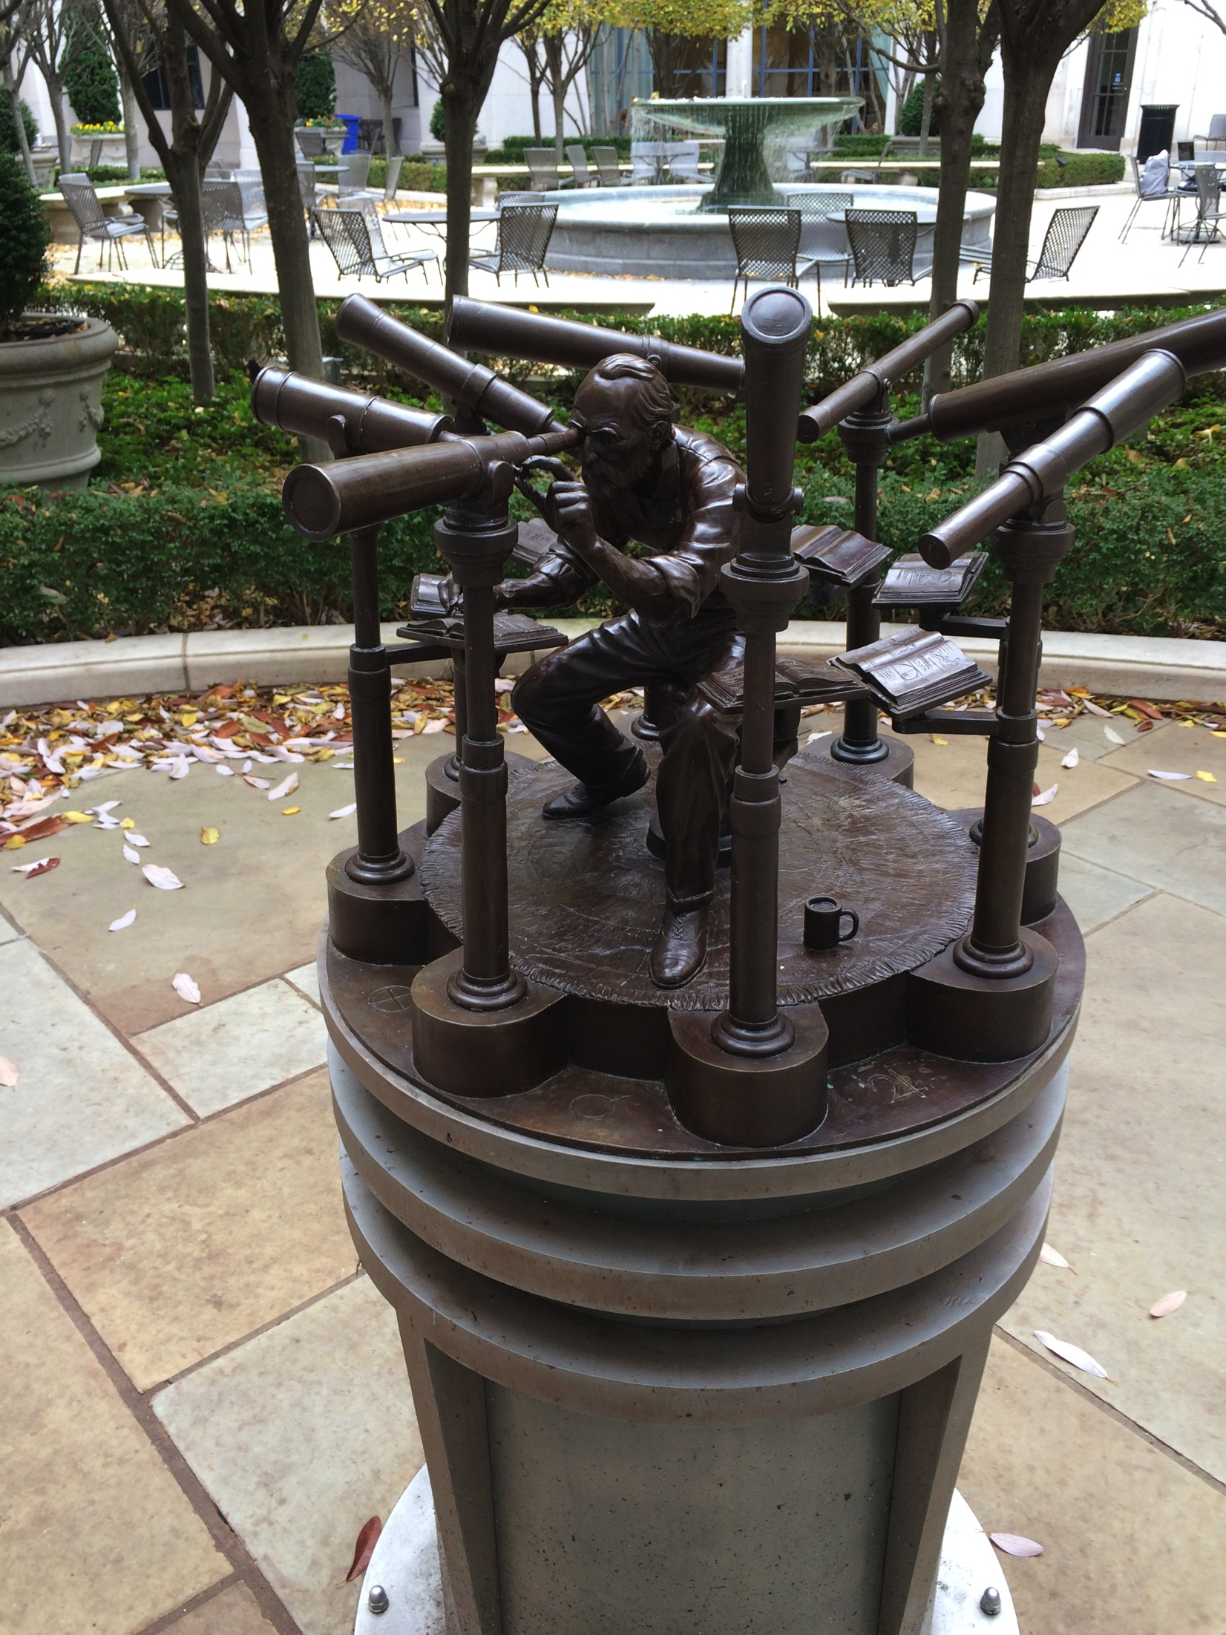

Slide 7
Word Order
One way to model syntax would be to calculate the probabilities of various words occurring together.
For example, Miller and Selfridge (1950; doi 10.2307/1418920) created word lists that were various approximations to English.

Slide 8
Word Order
Here are some words you would think would never occur together…
http://www.candyboots.com/wwcards/spectacular.html

Slide 9
Word Order
Miller and Selfridge (1950):
For a second-order approximation, present a word to a person and have them use it in a sentence. See what word they give after the target word, give that to someone, see what word they use, etc. When you string these together, you have a sequence that is a second-order approximation.
Scale up for 3-7.

Slide 10
Word Order
Miller and Selfridge (1950):
First order:
Third order:

Slide 11
Word Order
Miller and Selfridge (1950):
Fifth order:
Seventh order:

Slide 12
Word Order
Miller and Selfridge (1950):
Look at recall of the lists.
Does approximation to English affect recall?
MTSU voice to text:
Hello so I can talk to you before you left them signing the check on the class now you know when you get this message could you please give me a call and he had not in the office if you just let me know when you'll be around I just wanna ask you a favor okay talk to you soon take care bye.

Slide 13
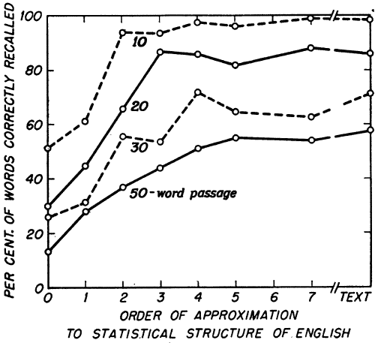
Word Order

Slide 14
Word Order
Miller and Selfridge (1950):
Order of approximation does affect memory.
Could something like this be scaled up to account for syntax?
Or, does understanding syntax require something more?

Slide 15
Formal Grammars
Finite state grammars: A sentence is a string of associations, essentially a bunch of S-R pairs run together. Each word is the response to the previous word and a stimulus for the next word.
Model as a set of lists with directors to go from list to list (Pinker, p. 82).

Slide 16
Formal Grammars (FS)
Make a sentence by selecting one word, going to the next list, etc.
Can be successful in limited domains (see Pinker, p. 81).

Slide 17
Formal Grammars (FS)
Can produce infinite strings with relatively simple models (Pinker, p. 83).

Slide 18
Formal Grammars (FS)
Understand by working the chain the other way.
Some evidence if you create nonsense word sentences and look at memory for them.
Vrom frug trag wolx pret.

Slide 19
Formal Grammars (FS)
Vrom frug trag wolx pret.
Cue | Report
Vrom | Frug
Frug | Trag
Trag | Wolx

Slide 20
Formal Grammars (FS)
Vrom frug trag wolx pret.
It looks like memory for sentences is a string of S-R pairs.
Lots of problems (one of which is nonsense material, but we’ll get there).

Slide 21
Formal Grammars (FS)
Colorless green ideas sleep furiously.
Most people feel that that is a sentence, but it has no association between the words. Chomsky argued that this means a sentence is more than a string of paired associates.

Slide 22
Formal Grammars (FS)
But, the real problem is long distance dependencies (a later decision depends upon an earlier decision).
Either-or, if-then (Pinker, p. 86-89): If the boy eats ice cream then the dog eats hot dogs.

Slide 23
Formal Grammars (FS)
If either the girl eats hot dogs or the boy eats ice cream then the dog eats candy.

Slide 24
Formal Grammars (FS)
“Daddy, what did you bring that book that I don’t want to be read to out of up for?”
“How Ann Salisbury can claim that Pam Dawber’s anger at not receiving her fair share of acclaim for Mork and Mindy’s success derives from a fragile ego escapes me.” (Pinker, p.89)

Slide 25
Formal Grammars (FS)
Finally, sentences have an underlying structure.
Pale children eat cold bread.
Pale and children are a unit.
Eat cold bread is a unit.
Cold bread is a unit.

Slide 26
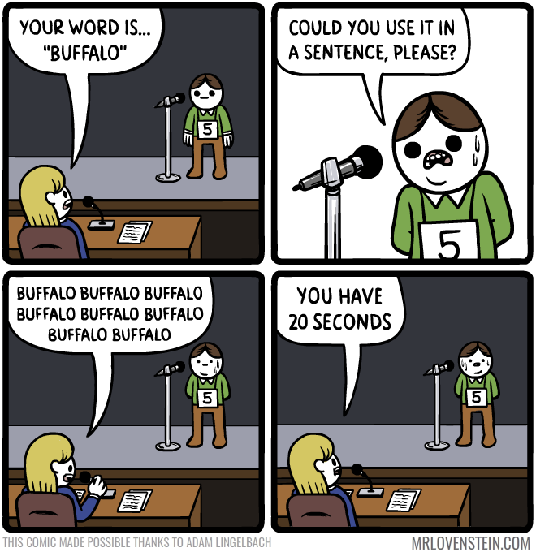
http://i.imgur.com/oTb8ER2.png

Slide 27
Formal Grammars (PSG)
Phrase structure grammars: Model the sentence with a phrase marker during parsing (syntactic analysis).
Follow the word-by-word order of the sentence to group words into successively larger units. Uncover hierarchical structure.

Slide 28
Formal Grammars (PSG)
The grammar is a set of rewrite rules that tell you how to rewrite elements into their component parts.

Slide 29
Formal Grammars (PSG)
A sample grammar:
P1: S -> NP VP
P2: NP -> (Det) (Adj*) N
P3: VP -> V (NP)
() optional
* can repeat

Slide 30
Formal Grammars (PSG)
A sample grammar:
L1: Det -> {a, an, the}
L2: N -> {television, program}
L3: V -> {shows}
L4: Adj -> {big, boring}
{} choose from this list

Slide 31
Formal Grammars (PSG)
The big television shows the boring program.
To parse:
det adj N V det adj N
NP V NP
NP VP
S

Slide 32
Formal Grammars (PSG)
You can also do this as a phrase marker tree:
det adj N V det adj N
NP V NP
NP VP
S

Slide 33
Formal Grammars (PSG)
You can generalize these rules to increase the power of the grammar.
The boy saw the statue in the park.
How do we incorporate prepositional phrases?

Slide 34
Formal Grammars (PSG)
P1: S -> NP VP
P2: NP -> (Det) (Adj*) N
P3: VP -> V (NP)

Slide 35
Formal Grammars (PSG)
P1: S -> NP VP
P2: NP -> (Det) (Adj*) N (PP*)
P3: VP -> V (NP)
P4: PP -> Prep NP

Slide 36
Formal Grammars (PSG)
P1: S -> NP VP
P2: NP -> (Det) (Adj*) N (PP*)
P3: VP -> V (NP) (PP*)
P4: PP -> Prep NP

Slide 37
Formal Grammars (PSG)
Note the power that you can get when you embed a phrase inside a rule recursively.
The boy saw the statue in the park with the telescope. (*)
The boy saw the statue in the park by the river with the island. (recursion)

Slide 38
Formal Grammars (PSG)
Phrase structure grammars also have problems.
Particle movement:
John phoned up the woman.
John phoned the woman up.
Same surface, two meanings:
Flying planes can be dangerous.

Slide 39
Formal Grammars (PSG)
Phrase structure grammars also have problems.
Two surfaces, same meaning:
Arlene is playing the tuba.
The tuba is being played by Arlene.

Slide 40
Formal Grammars (Transformational)
Chomsky’s transformational grammar addresses these problems.
Deep structure: The tree after the PSG and lexical insertion. Sentences start this way, but they don’t end here.
Transformation rules: Rearrange the elements of the deep structure tree. This solves the PSG problems (flip back and consider them).

Slide 41
Formal Grammars (Transformational)
The steps in transformational grammar:
(Construct trees)
Phrase structure rules
(Add words)
Lexical insertion rules
Deep structure
Transformation rules
(Pronounce)
Morpho-phonological rules
Surface structure

Slide 43
Formal Grammars (Transformational)
Transformational grammar rules:
P1: S -> NP + VP
P2: NP -> Det + N
P3: VP -> Aux + V (+ NP)
P4: Aux -> C (+ M) (+ have + en) (+ be + ing)
L1: Det -> {a, an, the}
L2: M -> {could, would, should, can, …}
L3: C -> {ø (empty), -s (singular subject), -past (past tense), -ing (progressive), -en (past participle)}
L4: N -> {cookie, boy}
L5: V -> {steal}
This part is pretty similar to what we’ve seen.

Slide 44
Formal Grammars (Transformational)
Transformational grammar rules:
T1: C + V -> V + C (affix hopping rule; obligatory)
T2: NP1 + Aux + V + NP2 -> NP2 + Aux + be + en + V + by + NP1 (active to passive transformation; optional)
These rules are the heart of the grammar. This is just a sample of possible rules.
Morpho-phonological rules: These rules tell you how to pronounce the final product.
M1: steal -> /s/ /t/ /i/ /l/…

Slide 45
Formal Grammars (Transformational)
Try:
The boy steals the cookie.
The boy might have stolen the cookie.
The cookie could have been stolen by the boy.

Slide 46
Formal Grammars (Transformational)
Evidence: The basic idea is to take a sentence and run a bunch of transformations on it, then measure how long it takes to understand it. For The man was enjoying the sunshine:
The man was not enjoying the sunshine. (N)
The sunshine was being enjoyed by the man. (P)
Was the man enjoying the sunshine? (Q)
The sunshine was not being enjoyed by the man. (NP)
Was the man not enjoying the sunshine? (NQ)
Was the sunshine being enjoyed by the man? (PQ)
Was the sunshine not being enjoyed by the man? (NPQ)
You should see slower comprehension for more transformations.

Slide 47
Formal Grammars (Transformational)
Aside: A defense of the passive voice (Good, 1996).
Seven uses:
Generalizing without using “one” all the time.
“Passive: Here are seven situations where the passive voice is preferred.
“Active: Here are seven situations where one prefers the passive voice.”

Slide 48
Formal Grammars (Transformational)
Seven uses:
To emphasize the actor by moving that person to the end.
“Passive: The tapes were hidden by the President of the United States.
“The President of the United States hid the tapes.”

Slide 49
Formal Grammars (Transformational)
Seven uses:
When the identity of the actor is irrelevant or obvious.
“Passive: The statute was enacted in 1968.
“Active: Congress enacted the statute in 1968.”

Slide 50
Formal Grammars (Transformational)
Seven uses:
When you don’t know who did it.
“Passive: The files were mysteriously destroyed.
“Active: Somebody mysteriously destroyed the files.”

Slide 51
Formal Grammars (Transformational)
Seven uses:
When you want to hide who did it.
“Passive: I regret to inform you that your file has been misplaced.
“Active: I regret to inform you that I misplaced your file.”

Slide 52
Formal Grammars (Transformational)
Seven uses:
To avoid sexist language.
“Passive: An application must be filed with the personnel office. A complete educational background should be included.
“Active: An applicant must file her/his application with the personnel office. He/she should include her/his complete educational background.”

Slide 53
Formal Grammars (Transformational)
Seven uses:
To maintain focus.
“Passive: Smith, because he knows the workings of the department, has lasted for more than a year. Nevertheless, he will probably be asked to resign.
“Active: Smith, because he knows the workings of the department, has lasted for more than a year. The President, nevertheless, probably will ask him to resign.”

Slide 54
Formal Grammars (Transformational)
Problems with transformational grammars:
Not very elegant. The grammars get very complicated.
Overly powerful. E.g., why these transformations? Why not The girl tied the shoe -> Shoe by tied is the girl?
They ignore meaning.

Slide 55
Formal Grammars (Semantic Approaches)
Focusing on empty syntactic categories (e.g., NP) causes trouble.
Chomsky: They are cooking apples is ambiguous.
Semantic approach: Only if someone walks up and says it to you out of the blue. In context the meaning is more transparent.

Slide 56
Formal Grammars (Semantic Approaches)
Someone read this…

Slide 57
Formal Grammars (Semantic Approaches)
Cinderella was sad because she couldn’t go to the dance that night. There were big tears in her brown dress.

Slide 58
Formal Grammars (Semantic Approaches)
Now this…

Slide 59
Formal Grammars (Semantic Approaches)
The young man turned his back on the rock concert stage and looked across the resort lake. Tomorrow was the annual fishing contest and fishermen would invade the place. Some of the best bass guitarists in the world would come to the spot. The usual routine of the fishing resort would be disrupted by the festivities.

Slide 60
Formal Grammars (Semantic Approaches)
Semantic grammar (Fillmore, 1968): Instead of ignoring meaning, base grammar on meaning. The goal of parsing is to figure out how all of the elements in the sentence relate to one another.
Case: Things like time, location, instrument.
Role: Actors in the sentence, agent, patient…

Slide 61
Formal Grammars (Semantic Approaches)
Start with the verb, load in its set of obligatory cases and roles, plus any optional ones, and then fit that to the sentence. Fill in all of the parts of the verb frame with the parts of the sentence, and that is your parse.

Slide 62
Formal Grammars (Semantic Approaches)
Father carved the turkey at the Thanksgiving dinner table with his new carving knife.
location
table
agent
father
time
Carve
Thanksgiving
knife
turkey
instrument
patient

Slide 63
Formal Grammars (Semantic Approaches)
Build these mini-semantic networks as you read. The structure contains the syntax and semantic information in one.

Slide 64
Formal Grammars
To sum up:
Competence/performance.
This is more of a “what is involved” than “here is what people do” account.
We’ve completed our survey of the problem area, now on to psychology…

Slide 65
Parsing Strategies
Working memory: Capacity is very limited. For reading, you have to hold and process features, orthographic information, word meanings, sentence meanings, syntax, discourse goals, global meanings…
If a sentence has three points where there could be two choices, there are 8 parses. The numbers grow from there. You can’t hold all of that, so you have to decide about ambiguous sentences right away.

Slide 66
Parsing Strategies
Consider:
John bought the flower for Susan.
What does it mean? Based on the immediacy assumption (our version, not the eye-tracking one), you probably didn’t notice it was ambiguous.

Slide 67
Parsing Strategies
How does working memory influence processing? Try:
The plumber the doctor the nurse met called ate the cheese.
Who called whom?
Who was met?

Slide 68
Parsing Strategies
How does working memory influence processing? Try:
The plumber that the doctor that the nurse met called ate the cheese.
Who called whom?
Who was met?

Slide 69
Parsing Strategies
How does working memory influence processing? Try:
The nurse met the doctor that called the plumber that ate the cheese.
Who called whom?
Who was met?

Slide 70
Parsing Strategies
Center embedding is possible:
The plumber ate the cheese.
The plumber the doctor called ate the cheese.
The plumber the doctor the nurse met called ate the cheese.
However, you should find a point where it gets past working memory capacity.

Slide 71
Parsing Strategies
Parsing strategies reduce working memory demands.
First, recovering clauses (NP, VP, etc.):
Constituent. Function words start a new constituent.
Det: NP
Prep: PP
Aux: VP

Slide 72
Parsing Strategies
Recovering clauses (NP, VP, etc.):
Content word. Once a constituent is going, look for content words to put in it.
Det: Adj or N
V: Det, Adj, Prep, N…

Slide 73
Parsing Strategies
Recovering clauses (NP, VP, etc.):
Noun-verb-noun. As an overall plan for the sentence, expect agent, action, patient. Apply this parse to every sentence as a first try.
Evidence:
The editor authors the newspaper hired liked laughed.
Garden path sentences support parsing strategies: If people “boggle” where the theory predicts, that means they tried the parse that way.

Slide 74
Parsing Strategies
Recovering clauses (NP, VP, etc.):
Clausal. When you finish with a clause, put the product of the parse in LTM, and discard the clause from WM.
Evidence:
Now that artists are working in oil prints are rare. (863 ms)
Now that artists are working longer hours oil prints are rare. (794 ms)
When the word is in the final clause, response time is faster.

Slide 75
Parsing Strategies
Connecting clauses:
Late closure. Keep the current node open as long as possible.
Minimizes working memory demands.
Consider:
Tom said Bill ate the cake yesterday.
Evidence: Garden path sentences:
Since J always jogs a mile seems like a very short distance to him.

Slide 76
Parsing Strategies
Connecting clauses:
Minimal attachment. Make the smallest tree possible.
Reduces WM demands.
Consider:
Ernie kissed Marcie and Joan…
Evidence:
The city council argued the mayor’s position forcefully.
The city council argued the mayor’s position was incorrect.

Slide 77
Language and Math
"Friday reading" Scheepers, C., Sturt, P., Martin, C. J., Myachykov, A., Teevan, K., & Viskupova, I. (2011). Structural priming across cognitive domains: From simple arithmetic to relative-clause attachment. Psychological Science, 22, 1319-1326. doi:10.1177/0956797611416997

Slide 78
The End

