Slide 1
Semantics and discourse
Langston
Psycholinguistics
Lecture 8b (Discourse)

Slide 2
Discourse
Weighing less than three pounds, the human brain in its natural state resembles nothing so much as a soft, wrinkled walnut. Yet despite this inauspicious appearance, the human brain can store more information than all the libraries in the world. It is also responsible for our most primitive urges, our loftiest ideals, the way we think, even the reason why, on occasion, we don't think, but act instead. The workings of an organ capable of creating Hamlet, the Bill of Rights, and Hiroshima remain deeply mysterious.

Slide 3
Discourse
On the other hand, there may be portions of this task which can be formulated without reference to numerical relationships, i.e. in purely logical terms. Thus certain qualitative principles involving physiological response or nonresponse can be stated without recourse to numbers by merely stating qualitatively under what combinations of circumstances certain events are to take place and under what combinations they are not desired.

Slide 4
Discourse
Questions:
  When you say you “understand” one of these passages, what do you have? What have you done?
  Why does one seem easier to “understand” than the other?

Slide 5
Discourse
A text is more than words or sentences. The overall representation of the discourse requires integration across all levels.
What might the process look like?

Slide 6
Discourse
Kintsch & Van Dijk (1978): Basic discourse model.
  Turn the text into propositions.
  Arrange the propositions into a text base (local representation).
  Form global concepts using world knowledge.
  Form a macrostructure.

Slide 7
Discourse
Propositions:
(P1 (WANTS JOAN APPLE))
  P1: Proposition number. Can embed (e.g., (P2 (TIME:IN P1 YESTERDAY))).
  WANTS: Relation.
  JOAN APPLE: Arguments.
  Not in language, rather concepts.

Slide 8
Discourse
Text base: Arrange the propositions into a local representation.
Sequence:
  Read in a chunk (set of propositions that are roughly about the same thing; a sentence)
  Try to connect to what's in working memory.
  If no connection search long term memory.
  If no connection, form an inference.

Slide 9
Discourse
Text base: Sequence:
  Once you have a start, link all of the propositions in a chunk into a structure.
  Choose what to retain in working memory. Choose the top 2-3 based on capacity, using a strategy.
    “Leading edge” strategy (modified Miller & Kintsch, 1980):
      Start at the top.
      If you have an embedded proposition, take that too.
      Take most recent from each level.

Slide 10
Discourse
Text base: Sequence:
  Read in the next chunk and try to connect to what you have.
  Repeat until finished.

Slide 11
Discourse
Text Sample:
  In the request to canonize the "Frontier Priest," John Newman, Bishop of Philadelphia in the 19th century, two miracles were attributed to him in this century. In 1923, Eva Benassi, dying from peritonitis, dramatically recovered after her nurse prayed to the bishop.
  (Miller & Kintsch, 1980; what follows is derived from their analysis)

Slide 12
Discourse
Propositional Analysis:
  “The propositions are ordered by the appearance in the text of the words corresponding to their predicates and are labeled for convenience. Propositions embedded as arguments in other propositions are referred to by their label (e.g., P1)” (p. 337)

Slide 13
Discourse
Propositional Analysis:
  “(P1 (REQUEST P2 P8))
  (P2 (CANONIZE P3))
  (P3 (ISA JOHN-NEWMAN FRONTIER-PRIEST))
  (P4 (ISA JOHN-NEWMAN BISHOP))
  (P5 (LOC:IN P4 PHILADELPHIA))
  (P6 (TIME:IN P4 19TH-CENTURY))
  (P7 (TWO MIRACLES))
  (P8 (ATTRIBUTED P7 JOHN-NEWMAN))
  (P9 (TIME:IN P8 THIS-CENTURY))
  *SENTENCE*” (p. 353)

Slide 14
Discourse
Steps:
  First sentence, connection not needed.
  The tree is based on this (p. 339):
    You have to choose a good starting (superordinate) proposition or it won’t work; ”this selection has to be done on an intuitive basis” (p. 339). They note that macro processes might help automate the selection.
    Add based on overlap at subsequent layers, connecting to the most recent one if there’s a conflict.

Slide 15
Discourse
Steps:
  “In Cycle 1, PI is specified as the superordinate proposition, and Propositions P2, P8, and P9 are connected to it at Level 2 (P2 and P8 are embedded in P1, and P1 and P9 both reference P8). Level 3 consists of P3, P4, and P7, connected to P8, and Level 4 contains P5 and P6, connected to P4” (p. 341).

Slide 16
Discourse
Steps:
  The tree:
  “Build a graph with Proposition PI at Level 1
  Put P2 at Level 2, pointed to by P1
  Put P8 at Level 2, pointed to by P1
  Put P9 at Level 2, pointed to by P1
  Put P3 at Level 3, pointed to by P8
  Put P4 at Level 3, pointed to by P8
  Put P7 at Level 3, pointed to by P8
  Put P5 at Level 4, pointed to by P4
  Put P6 at Level 4, pointed to by P4 (p. 353)

Slide 17
Discourse
Steps:
  First sentence, working memory connection not needed.
  We can draw out the tree above on the board.
  Retain using the modified leading edge (see board).
    Note that for the first sentence, use s + 1 to retain, (s = 3; s is the number of propositions you can retain in working memory).
  Read the next chunk…

Slide 18
Discourse
Propositional Analysis:
  “(P10 (TIME:IN P11 1923))
  (P11 (DYING EVA-BENASSI PERITONITIS))
  (P12 (DRAMATICALLY P13))
  (P13 (RECOVERED EVA-BENASSI))
  (P14 (AFTER P15 P13))
  (P15 (PRAYED NURSE BISHOP))
  *SENTENCE*” (p. 353)

Slide 19
Discourse
Steps:
  Connect:
    No propositions in common.
    Memory search finds P4 (note that P4 gets a memory boost for showing up twice).

Slide 20
Discourse
Steps:
  Build tree:
  “Build a graph with Proposition P13 at Level 1.
  Put P11 at Level 2, pointed to by P13.
  Put P12 at Level 2, pointed to by P13.
  Put P14 at Level 2, pointed to by P13.
  Put P15 at Level 3, pointed to by P14.
  Put P10 at Level 3, pointed to by P11.
  Put P4 at Level 4, pointed to by P15.” (p. 353)

Slide 21
Discourse
Steps:
  Choose what to retain…

Slide 22
Discourse
Four texts each were read by 600 people who then recalled them. The model was used to predict reading time and what would be recalled.
The fit of the model to the data was reasonable.

Slide 23
Discourse
Form global concepts: The proposition used to build a chunk's structure is usually the global concept. Use that to take the next step.
Build a macrostructure: Make a tree connecting the chunks to unify your representation of the entire text.

Slide 24
Discourse
One obvious prediction is that some “violations” should be more harmful/easily detected than others.
  Locally and globally consistent (each step is built in, plus a coherent theme).
  Globally consistent (inferences required).
  Locally consistent (problems at the macro level).

Slide 25
Discourse
Locally and globally consistent:
  George wanted to run in a marathon.
  Running requires a lot of energy, and this energy can come from carbohydrates.
  Spaghetti has a lot of carbohydrates, so George learned how to make spaghetti.
  Eating spaghetti helped George have the energy he needed to finish the marathon.

Slide 26
Discourse
Local inconsistencies:
  Diane wanted to lose some weight.
  She went to the garage to find her bike.
  Diane's bike was broken and she couldn't afford a new one.
  She went to the grocery store to buy grapefruit and yogurt.

Slide 27
Discourse
Globally inconsistent:
  Tammy was standing inside the health spa waiting for her friend.
  She had just completed an exhausting workout.
  Tammy's workout usually included a half hour of aerobics and an hour of weight training.
  Today, Tammy had doubled her aerobics time.
  Tammy saw her friend and went into the health spa to greet her.

Slide 28
Discourse
Model notes:
  The more times you keep a proposition in working memory, the more likely you are to remember it later.
  Readability is a function of the text and the reader.

Slide 29
Discourse
Model notes:
  We get all of the parts:
    Levels of representation.
    Working memory capacity.
    Strategies.
    Reader's knowledge.

Slide 30
Discourse
Model wrinkles: The model suggests a variety of important factors in discourse comprehension. We'll consider:
  Working memory.
  Strategies.
  Reader knowledge.
  Mental models (situation models).

Slide 31
Discourse
Model wrinkles: The model suggests a variety of important factors in discourse comprehension. We'll consider:
  Working memory.
  Strategies.
  Reader knowledge.
  Mental models (situation models).

Slide 32
Discourse
Working memory management: The trick in discourse comprehension is managing working memory load.
  Measurement: Reading span. Read each sentence and decide if it is a legitimate English sentence, remember the last word of each sentence (in caps).

Slide 33
When in trouble, children hope for an intervention by a super HUMAN.

Slide 34
It was your significance in the suffering of the war that honored the TOAST.

Slide 35
Recall WORDS…

Slide 36
Recall WORDS…
  HUMAN
  TOAST

Slide 37
The girl hesitated for a moment to eat the onions because her husband hated an OCEAN.

Slide 38
The man tripped and fell down the stairs, causing his knee to bleed BADLY.

Slide 39
Due to his gross inadequacies, his position as director was terminated ABRUPTLY.

Slide 40
Recall WORDS…

Slide 41
Recall WORDS…
  OCEAN
  BADLY
  ABRUPTLY

Slide 42
The child thought more about the war than his father who had been a HAT.

Slide 43
The man began to grow grain for last year's crop with dry WATER.

Slide 44
It is possible, of course, that life did not arise on the Earth at ALL.

Slide 45
Murphy's law states that if anything can possibly go wrong, it WILL.

Slide 46
Recall WORDS…

Slide 47
Recall WORDS…
  HAT
  WATER
  ALL
  WILL

Slide 48
They saw Cary in the field and concluded that she was eating slip TOWELS.

Slide 49
After all he had not gone far, and some of his walking had been CIRCULAR.

Slide 50
The poor lady was thoroughly undoing that she was not too right to JUMP.

Slide 51
There had been no feelings for Laura because she went to California beside a CREEK.

Slide 52
In our predominantly right handed society, to lose one's right arm signifies a great LOSS.

Slide 53
Recall WORDS…

Slide 54
Recall WORDS…
  TOWELS
  CIRCULAR
  JUMP
  CREEK
  LOSS

Slide 55
Discourse
Working memory management: The trick in discourse comprehension is managing working memory load.
  Measurement: Reading span.
  Typically much smaller than 7 ± 2 (Daneman & Carpenter, 1980).
  Storage + processing more taxing.

Slide 56
Discourse
Working memory management:
  Given the memory limitation, how you use it is important.
  Putting something in requires two sorts of activity.
    Stealing mental energy to represent it (as long as you have some to work with).
    Deleting something (what?) to make room.

Slide 57
Discourse
Working memory management:
  Imagine this text:
    The plate is on the table.
    The spoon is left of the plate.
    The fork is behind the spoon.
    The cup is right of the fork.

Slide 58
Discourse
Working memory management:
  Imagine this text (four propositions):
    (P1 (ON TABLE PLATE))
    (P2 (LEFTOF PLATE SPOON))
    (P3 (BEHIND SPOON FORK))
    (P4 (RIGHTOF FORK CUP))

Slide 59
Discourse
Working memory management:
  You have four propositions to hold in working memory, how does it work?

Slide 60
Discourse
Working memory (bars indicate proportion of capacity devoted to storage of a proposition):
(P1 (ON TABLE
PLATE))

Slide 61
Discourse
Working memory (bars indicate proportion of capacity devoted to storage of a proposition):
(P1 (ON TABLE (P2 (LEFTOF
PLATE)) PLATE SPOON))

Slide 62
Discourse
Working memory (bars indicate proportion of capacity devoted to storage of a proposition):
(P1 (ON TABLE (P2 (LEFTOF (P3 (BEHIND
PLATE)) PLATE SPOON)) SPOON FORK))

Slide 63
Discourse
Working memory (bars indicate proportion of capacity devoted to storage of a proposition):
(P1 (ON TABLE (P2 (LEFTOF (P3 (BEHIND (P4 RIGHTOF
PLATE)) PLATE SPOON)) SPOON FORK)) FORK CUP))

Slide 64
Discourse
Working memory management:
  As new propositions come in, you can steal activation until you reach the limit, at which time you have to delete one.
  I deleted the oldest. Are there other approaches?

Slide 65
Discourse
Model wrinkles: The model suggests a variety of important factors in discourse comprehension. We'll consider:
  Working memory.
  Strategies.
  Reader knowledge.
  Mental models (situation models).

Slide 66
Discourse
Strategies: How you choose what to keep and what to delete (Fletcher, 1986).
  Think-aloud paradigm: As you read it, say out loud everything that you're thinking.
  We'll get a volunteer to do it for one of his texts…

Slide 67
Discourse
Sample text:
  Once there was a tortoise and a crow who were best friends. The tortoise was having a birthday party and the crow had no present to give him. While all the other animals played games, the crow just sat under a tree and watched. Then everyone had ice cream and cake, but the crow barely touched his.

Slide 68
Discourse
Example propositions: “Once there was a tortoise and a crow who were best friends.”
  (P1 (TIME P2 ONCE))
  (P2 (EXIST P3))
  (P3 (SET-MEMBERS TORT CROW))
  (P4 (BEST-FRIENDS P3))
  *SENTENCE*

Slide 69
Discourse
Think-alouds from:
  "Then everyone had ice cream and cake, but the crow barely touched his."
S1: Really depressed, he just didn't eat
S2: I wonder what's happening?

Slide 70
Discourse
What you choose to do to process the text is affected by:
  Your knowledge
  Your goals
  Decoding ability
  Memory capacity…
What might you do?

Slide 71
Discourse
Fletcher identified a variety of local and global strategies, focusing on local:
  Recency: Keep most recent propositions.
  Frequency: Hold most frequent propositions.

Slide 72
Discourse
Local strategies:
  Sentence topic: Hold the topic and related propositions. Topic is:
    First person or object mentioned
    Referred to using a pronoun, definite article, or proper name
    What the sentence is about
  Leading edge (from before)

Slide 73
Discourse
Get the propositions from the think-alouds, see what people are doing. The ranking:
  Sentence topic = frequency > leading edge > recency
  People are sensitive to higher level information when choosing what to represent.

Slide 74
Discourse
Put some research on working memory management and poor readers here.

Slide 75
Discourse
Model wrinkles: The model suggests a variety of important factors in discourse comprehension. We'll consider:
  Working memory.
  Strategies.
  Reader knowledge.
  Mental models (situation models).

Slide 76
Discourse
How does reader knowledge affect the outcome?
  With hocked gems financing him, our hero bravely defied all scornful laughter that tried to prevent his scheme. “Your eyes deceive,” he had said, “An egg, not a table, correctly typifies this unexplored planet.” Now, three sturdy sisters sought proof. Forging along, sometimes through calm vastness, yet more often over turbulent peaks and valleys, days became weeks as many doubters spread fearful rumors about the edge. At last, from nowhere, welcome winged creatures appeared, signifying momentous success (Dooling & Lachman, 1971).

Slide 77
Discourse
Columbus discovering America.

Slide 78
Discourse
Reader knowledge:
  The procedure is actually quite simple. First, you arrange things into different groups. Of course, one pile may be sufficient, depending on how much there is to do. If you have to go somewhere else due to lack of facilities, that is the next step; otherwise, you are pretty well set. It is important not to overdo things. That is, it is better to do too few things at once than too many. In the short run, this may not seem important, but complications can easily arise. A mistake can be expensive as well. At first, the whole procedure will seem complicated. Once the procedure is completed, one arranges the materials into different groups again. Then they can be put into their appropriate places. Eventually, they will be used once more and the whole cycle will have to be repeated (Bransford & Johnson, 1973).

Slide 79
Discourse
Washing clothes.

Slide 80
Discourse
One is an example of schema knowledge, one is an example of script knowledge.
Obviously, knowledge affects comprehension.

Slide 81
Discourse
Problem: How do you tell individual events apart if comprehension is based on knowledge?
  You probably don't, most of the time.
  You need to represent script + tags to unique information in memory. The tags are susceptible to loss.

Slide 82
Discourse
Model wrinkles: The model suggests a variety of important factors in discourse comprehension. We'll consider:
  Working memory.
  Strategies.
  Reader knowledge.
  Mental models (situation models).

Slide 83
Discourse
So far, we've been using one component of working memory, the articulatory loop. However, some comprehension tasks take advantage of the visuo-spatial sketchpad. If you use that, you double your resources and open up other kinds of understanding.

Slide 84
Discourse
Working memory:
Visuo-spatial
sketchpad
Articulatory loop
Central executive

Slide 85
Discourse
If the balloons popped, the sound wouldn't be able to carry, since everything would be too far away from the correct floor. A closed window would also prevent the sound from carrying. Since the whole operation depends on a steady flow of electricity, a break in the middle of the wire would also cause problems. Of course, the fellow could shout, but the human voice is not loud enough to carry that far. An additional problem is that a string could break on the instrument. Then there could be no accompaniment to the message. It is clear that the best situation would involve less distance. There would be fewer potential problems.

Slide 86
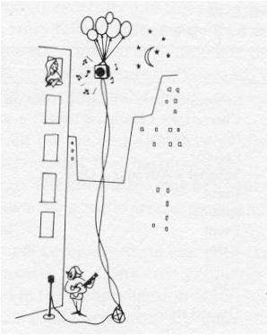
Discourse

Slide 87
Discourse
Having an appropriate mental model helps with comprehension.
  A representation of what the text is about rather than the text itself. Analogical rather than propositions.

Slide 88
Discourse
Consider these sentence pairs:
  Three turtles rested on a floating log and a fish swam beneath them.
  Three turtles rested on a floating log and a fish swam beneath it.
  Three turtles rested beside a floating log and a fish swam beneath them.
  Three turtles rested beside a floating log and a fish swam beneath it.

Slide 89

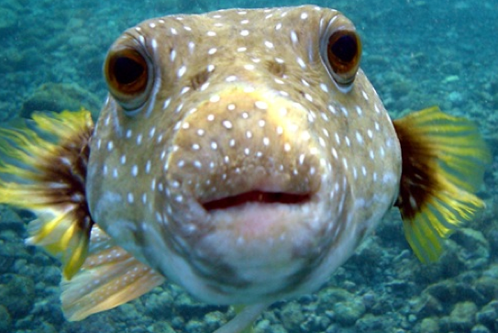
Discourse
First pair:

Slide 90

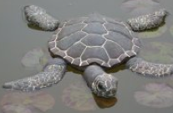
Discourse
Second pair, first one:

Slide 91
Discourse
Second pair, second one:

Slide 92
Discourse
Propositionally, the change between the two sentences within a pair is identical:
  Three turtles rested on a floating log and a fish swam beneath them.
  Three turtles rested on a floating log and a fish swam beneath it.
  Three turtles rested beside a floating log and a fish swam beneath them.
  Three turtles rested beside a floating log and a fish swam beneath it.

Slide 93
Discourse
But, they describe very different underlying situations.
From a propositional account, they should be equally confusable.
From a mental models account, the first pair should be way more confusable. That's what happens.

Slide 94
Discourse
Mental models account for effects that propositional accounts might have a harder time with.
  Glenberg, Meyer, and Lindem (1987): Mental models contribute to foregrounding.

Slide 95
Discourse
Sample text:
  Setting: John was preparing for a marathon in August.
  Critical (assoc.): After doing a few warm-up exercises, he put on his sweatshirt and went jogging.
  Critical (dissoc.): After doing a few warm-up exercises he took off his sweatshirt and went jogging.
  Filler: He jogged halfway around the lake without too much difficulty.
  Filler: Further along his route, however, John's muscles began to ache.
  Question: Was the marathon scheduled to be held in the summer?

Slide 96
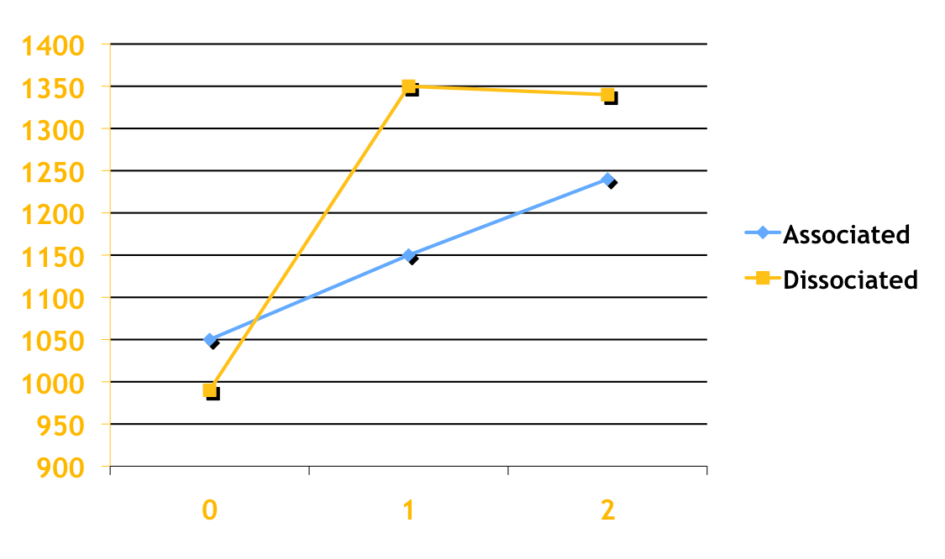
Discourse

Slide 97
Discourse
  Glenberg, et al. (1987) found that items that were associated with the protagonist were kept active in working memory longer than items that were dissociated.

Slide 98
Discourse
  To what extent is language comprehension embodied? (I relied on Meteyard & Vigliocco, 2009 here.)
    Embodiment has a chance to overcome the symbol grounding problem.
  Pulvermüller (2001) “such words as kick and lick recruit motor systems involved in kicking and licking” (M & V, p. 565).

Slide 99
Discourse
  Embodiment:
  “such words as rise and fall recruit sensory systems involved in motion processing (Meteyard, Bahrami, & Vigliocco, 2007; Meteyard, Zokaei, Bahrami, & Vigliocco, 2008)” (M & V, 2009, p. 565).

Slide 100
Discourse
  To the extent that language is embodied, “understanding” is grounded in embodied relations that arise from direct experience.

Slide 101
Discourse
  For example, metaphor.
    Lakoff and Johnson (1980): Orientational metaphors. Sad, unconscious, dead are all down because they are literally down.
    This can ground other domains not directly experienced: sad, unconscious, and dead have negative connotations, that turns into BAD IS DOWN.

Slide 102
Discourse
  Other kinds of embodied language effcects (M & V, 2009 for the list):
    Glenberg and Kaschak (2002): Towards and away sentences responded to more slowly if the movement needed to respond mismatches the movement described (even for abstract).
  Zwaan, Madden, Yaxley, & Aveyard (2004): When motion matched a sentence, responding was faster.

Slide 103
Discourse
  How might embodiment effects work into our thinking about discourse?

Slide 104
Embodiment
Zwaan & Yaxley (2003)
  Spatial iconicity effects also suggest that location is part of the representation of words and that location simulation is part of comprehension.
  Present a pair of words, are they related?
    Attic
    Basement
  Or
    Basement
    Attic

Slide 105
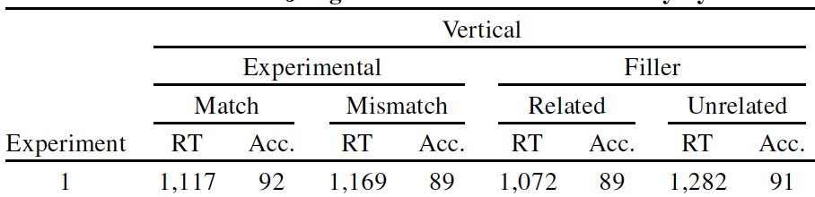
Embodiment
Zwaan & Yaxley (2003)
Zwaan & Yaxley (2003, p. 956)

Slide 106
Embodiment
Zwaan & Yaxley (2003)
  When vertical arrangements were correct, participants were faster than when they were incorrect.
  Again, location seems to be part of the understanding of a word.

Slide 107
Embodiment
We will get to brains later, but let’s take a peek at some brain stuff.
Reaction times may be too crude to detect whether or not “typical arrangement” is part of your semantic representation.
What follows is partially derived from Kutas and Federmeier (2000; doi:10.1016/S1364-6613(00)01560-6)

Slide 108
Embodiment
With event-related potentials (ERPs) you can measure changes in EEG as a result of presenting an event.
The figure on the next slide has lots of examples of N400: “a negative component peaking around 400 ms after stimulus-onset [that] has been shown to vary systematically with the processing of semantic information” (p. 463).

Slide 109
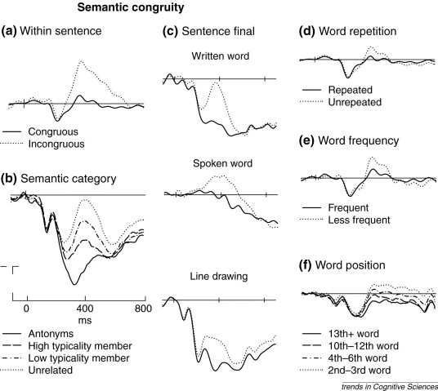
Kutas & Federmeier (2000, p. 465)

Slide 110
Embodiment
Will you get an N400 when you present stimuli from Zwaan & Yaxley (2003)?
This is from Hubbard, Magne, & Langston (in press, NeuroReport)
Three kinds of comparisons:
  Iconic vs. Unrelated
  Attic Witch
  Basement Median

Slide 111
Hubbard (2012, p. 17)

Slide 112
Embodiment
Will you get an N400 when you present stimuli from Zwaan & Yaxley (2003)?
Three kinds of comparisons:
  Reverse Iconic vs. Unrelated
  Basement Witch
  Attic Median

Slide 113
Hubbard (2012, p. 18)

Slide 114
Embodiment
Will you get an N400 when you present stimuli from Zwaan & Yaxley (2003)?
Three kinds of comparisons:
  Iconic vs. Reverse Iconic
  Attic Basement
  Basement Attic

Slide 115
Hubbard (2012, p. 19)

Slide 116
Embodiment
In other words, there is some evidence for a more embodied representation (at least, embodied-type perceptual representations affect conceptualization). What are the implications of this for discourse?
What are the implications of this for language comprehension in general?

Slide 117
Body Language (Deception)
One of the properties of language was prevarication (Hockett, 1968; a speaker can say falsehoods, lies, and meaningless statements).
How do you know someone is telling a lie?
(A lot of what follows is copied from Research Methods Laboratory Manual for Psychology, chapter 9.)

Slide 118
Body Language (Deception)
Why accurate lie detection techniques would be useful:
  Police work (Iacono, 2008; evaluating post-conviction sex offenders, Grubin, 2008).
  Employment screening (Walczyk, Mahoney, Doverspike, & Griffith-Ross, 2009).
  A “proactive” lie detection technique to help voters understand politicians' true motivations, etc. (Oates, 1996).
  Getting along in a society (Tang, 2012).

Slide 119
Body Language (Deception)
Lots of things have been tried, they all have problems:
  Polygraph. The basic premise is that items of importance to a person will create physiological arousal.
  Comparison question test. The examiner and the examinee work out a list of control questions (personally relevant, expect anxiety about answering them, Iacono, 2008).

Slide 120
Body Language (Deception)
Lots of things have been tried, they all have problems:
  Concealed information test (Vandenbosch, Verschuere, Crombez, &De Clercq, 2009). Stimuli are presented to participants, some relevant to secret knowledge.
  Cognitive load (Vrij et al., 2008). It takes more effort to simultaneously conceal the truth and come up with a new story than to simply report the facts.

Slide 121
Body Language (Deception)
Reverse speech (Oates, 1996; www.reversespeech.com). Forward speech is accompanied by a secondary speech channel. The secondary channel is spoken in reverse and can be uncovered by taping a person speaking and then playing the tape backwards.
  Get a person to lie, reverse it, figure out the truth.

Slide 122
Body Language (Deception)
Reverse speech (Oates, 1996; www.reversespeech.com).
  http://www.reversespeech.com/rev/cantbeatles.Mp3
  http://www.reversespeech.com/rev/susmith.Mp3
  http://www.reversespeech.com/rev/ojhigh.Mp3

Slide 123
Body Language (Deception)
Reverse speech (Oates, 1996; www.reversespeech.com).
  http://www.reversespeech.com/rev/cantbeatles.Mp3
  Can’t be Beatles now.
  http://www.reversespeech.com/rev/susmith.Mp3
  I kidnapped boy.
  http://www.reversespeech.com/rev/ojhigh.Mp3
  I skinned them all.
  I killed them high.

Slide 124
Body Language (Deception)
Reverse speech (Oates, 1996; www.reversespeech.com).
  http://www.reversespeech.com/rev/cantbeatles.Mp3
  Can’t be Beatles now.
  http://www.reversespeech.com/rev/susmith.Mp3
  Made the big gamble up.
  http://www.reversespeech.com/rev/ojhigh.Mp3
  I skinned them all.
  It’s them, slaughtered them.

Slide 125
Body Language (Deception)
Language
  "Friday reading" Van Swol, L. M., Braun, M. T., & Malhotra, D. (2012). Evidence for the Pinocchio Effect: Linguistic differences between lies, deception by omissions, and truths. Discourse Processes, 49, 79-106. doi:10.1080/0163853X.2011.633331

Slide 126
Body Language (Deception)
Language: Van Swol et al. (2012).
  Liars use more third person pronouns, numbers and profanity. Liars generally use more words.
  Deception by omission used fewer words and a lower percentage of causation words.

Slide 127
Body Language (Deception)
Body language/nonverbal cues (see Porter & ten Brinke, 2008, for a recent study of nonverbal cues).
  Vrij (2008) reviewed research on nonverbal cues. Some cues people pay attention to:
    Perceived enthusiasm.
    Blushing.
    Inappropriate emotional response (e.g., not showing enough emotion when given bad news).

Slide 128
Body Language (Deception)
Body language/nonverbal cues.
  Some cues:
    Tone of voice.
    Narrowing of the lips.
    Speech rate.
    Failing to make eye contact.
    Fidgeting

Slide 129
Body Language (Deception)
Body language/nonverbal cues. From The Global Deception Research Team (2006).
    Zuckerman, Koestner, and Driver (1981), Americans: “liars avert gaze, touch themselves, move their feet and legs, shift their posture, shrug, and speak quickly” (p. 60).
    Akehurst, Köehnken, Vrij, and Bull (1996), British: “liars reduce eye contact, turn away, blink, and pause” (p. 60).

Slide 130
Body Language (Deception)
From The Global Deception Research Team (2006).
  Is there a stereotype across all cultures of what a liar is, or is the stereotype culture-specific? If lying is a deviation from a social norm, then the norms will set cues to lying.
  75 countries over 2 studies. Question for study 1: How can you tell when someone is lying? 20 male and female respondents from each country, local dominant language.

Slide 131
Body Language (Deception)
From The Global Deception Research Team (2006).
  Study 1: 2,320 people, 58 countries, 11,157 responses, 103 distinct beliefs.
  Generally high level of agreement across cultures.
  Beliefs endorsed by at least 15% of respondents:

Slide 132
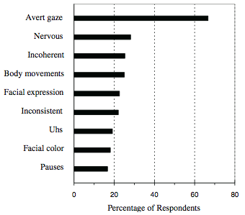
Body Language (Deception)
From The Global Deception Research Team (2006).
The Global Deception Research Team (2006, p. 65)

Slide 133
Body Language (Deception)
From The Global Deception Research Team (2006).
  Study 2 looks at beliefs in a closed questionnaire.
  Results:

Slide 134
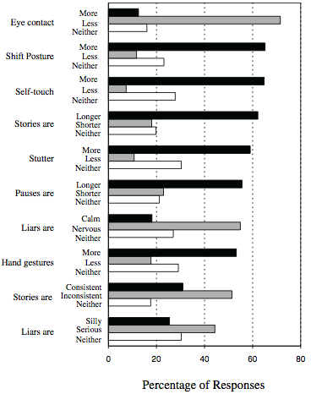
Body Language (Deception)
The Global Deception Research Team (2006, p. 68)

Slide 135
Body Language (Deception)
Body language/nonverbal cues (Vrij, Granhag, & Porter, 2010; http://www.psychologicalscience.org/journals/pspi/pspi_10_6.pdf)
  Are these cues effective: Not so much…

Slide 136
Body Language (Deception)
Vrij et al., 2010: Examining the wrong cues (p. 96):
  Gaze aversion and grooming gestures not reliable, even though they come highly recommended and police use them.
  Let's dig deeper into one of their sources:

Slide 137
Body Language (Deception)
Sporer & Schwandt (2007; doi:10.1037/1076-8971.13.1.1):
  Find effect sizes for 11 variables.
  Evaluate theories about those variables.
  Evaluate the effect of moderator variables.
    Motivation, preparation, content of deceptive message, interaction between examiner and liar, sanctioned vs. unsanctioned lying (p. 8).
  Compare effect sizes of reality to effect sizes of beliefs.

Slide 138
Body Language (Deception)
Sporer & Schwandt (2007; doi:10.1037/1076-8971.13.1.1):
  Find effect sizes for 11 variables…

Slide 139
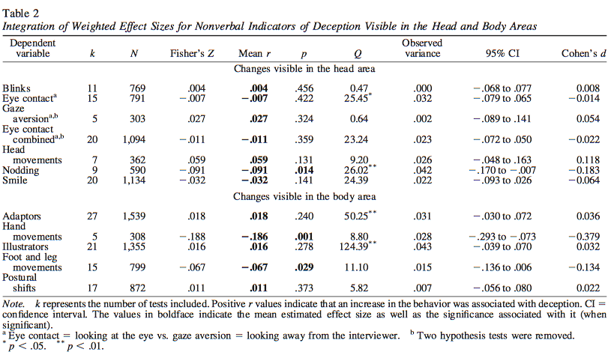
Body Language (Deception)
Sporer & Schwandt (2007, p. 14)

Slide 140
Body Language (Deception)
Sporer & Schwandt (2007; doi:10.1037/1076-8971.13.1.1):
  Compare effect sizes of reality to effect sizes of beliefs…

Slide 141
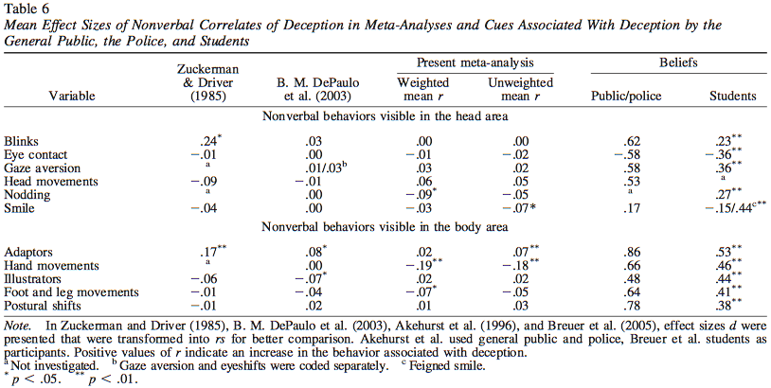
Body Language (Deception)
Sporer & Schwandt (2007, p. 20)

Slide 142
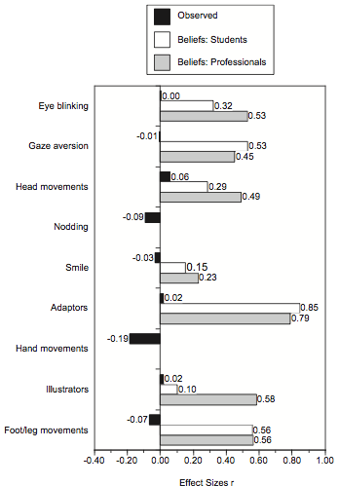
Body Language
(Deception)
Sporer & Schwandt (2007, p. 21)

Slide 143
Body Language (Deception)
Sporer & Schwandt (2007; doi:10.1037/1076-8971.13.1.1):
  “These same universally held beliefs were also endorsed by police officers and the general public…various professionals including lawyers…and students thinking about a crime situation…, but the objective data speak quite a different language” (p. 26).

Slide 144
Body Language (Deception)
Sporer & Schwandt (2007; doi:10.1037/1076-8971.13.1.1):
  “Not only do lay people believe that certain nonverbal behaviors are strongly associated with deception but also, for some of the behaviors, these beliefs are actually diametrically opposed to those observed to be indicators of deception in experimental studies” (p. 26).

Slide 145
Body Language (Deception)
Vrij et al., 2010: Overemphasis on nonverbal cues (p. 97): Why?
  Nothing else to go on.
  It can reveal some information outside of the context of lie detection.
  Guilt has already been decided upon before starting the interview.
  Cognitive demands of interviewing overload all but nonverbal channel.
  Training.

Slide 146
The End

