Slide 1
Release from PI Demonstration
Langston,
Cognitive Psychology

Slide 2
Instructions
You are going to see a list of words.
Pay attention to the words and try to remember as many as you can.
When the instruction to count appears, count backwards from the first number by the second number (e.g., if you saw count 247, 4, you would say 247, 243, 239…).
When the instruction to recall appears, write down the words.
There will be four trials.

Slide 3
Instructions
Label the first set “Recall 1.”
Prepare to see words:

Slide 4
BANANA

Slide 5
PEACH

Slide 6
APPLE

Slide 7
COUNT BACKWARDS
278
5

Slide 8
***RECALL THE LIST***

Slide 9
Instructions
Label the second set “Recall 2.”
Prepare to see words:

Slide 10
PLUM

Slide 11
APRICOT

Slide 12
LIME

Slide 13
COUNT BACKWARDS
436
3

Slide 14
***RECALL THE LIST***

Slide 15
Instructions
Label the third set “Recall 3.”
Prepare to see words:

Slide 16
MELON

Slide 17
LEMON

Slide 18
GRAPE

Slide 19
COUNT BACKWARDS
322
7

Slide 20
***RECALL THE LIST***

Slide 21
Instructions
Label the fourth set “Recall 4.”
Prepare to see words:

Slide 22
DOCTOR

Slide 23
TEACHER

Slide 24
LAWYER

Slide 25
COUNT BACKWARDS
184
4

Slide 26
***RECALL THE LIST***

Slide 27
Data Analysis
First we’ll count recalls for each list:
Banana, peach, apple:
Plum, apricot, lime:
Melon, lemon, grape:
Doctor, teacher, lawyer:

Slide 28
Discussion
Why would it be cheating to:
Let you count longer for the third list?

Slide 29
Discussion
Why would it be cheating to:
Make the counting task harder for the third list?

Slide 30
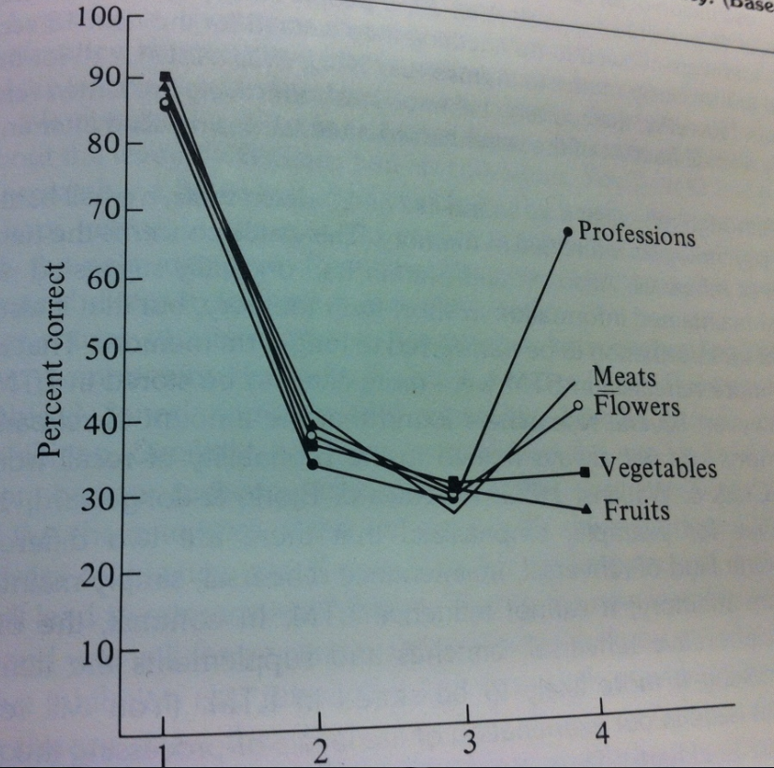
Discussion
Look at the data from Wickens, Dalezman, and Eggemeier (1976)…

Slide 31
Discussion
How did I cheat in my selection of the third list?

Slide 32
End Release from PI Demonstration

