Slide 1
Seminar on Careers in Psychology
Graduate School

Slide 2
Graduate School
This is organized around Chapter 7 in your text. The content from Chapter 8 is merged in as appropriate.
What are the odds of getting in?
Am I an attractive candidate?
Do I really want to go?
What types of school are there?
(Extras.)

Slide 3
Graduate School
Steps (from the book p. 94):
Decide if you want to go.
Define your interests (area and specialization).
Research schools and programs.
Apply.
Interview.
What follows is related to these steps, we’ll have “nuts and bolts” from Chapter 8 at the end.

Slide 4
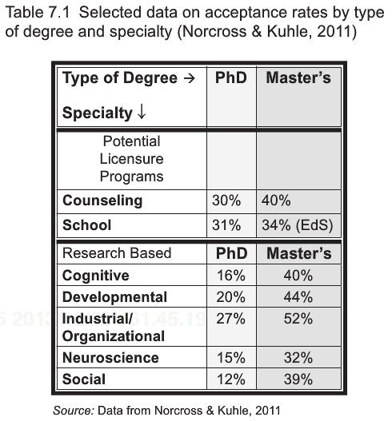
Graduate School
What are the odds?

Slide 5
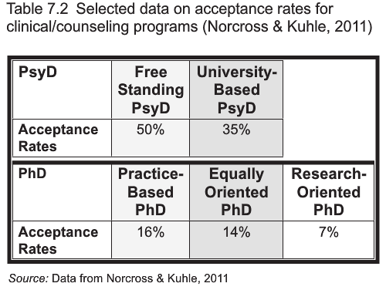
Graduate School
What are the odds?

Slide 6
Graduate School
Note:
Free-standing and for-profit schools might have higher acceptance rates, but they charge more and leave you with a higher debt load.

Slide 7
Graduate School
Am I attractive?
Getting into graduate school is just like getting a job. You have to make the case that you’re the most qualified applicant.
Why am I going to spend my time and resources on you? What are you going to do for me?

Slide 8
Graduate School
Am I attractive?
Grades
GRE
If I have 300 applicants and 10 spots, I need a quick and dirty way to narrow it down. This is it…
Remember, as the graduate program, pretty much no matter who I end up with, I get a winner. If I accidentally toss out a great candidate like you, it doesn’t matter that much to me.
You have to get through the first filter.

Slide 9
Graduate School
Am I attractive?
Letters of recommendation
You made the cut!
What do your professors think of you? Three or four letters from people that say you did well in their class and seem like a nice person are worthless. Everyone can get that. What substantive things can be said about you? What experiences have we shared that let me evaluate your potential? What skills do you bring to the table?
You need to develop a relationship with people who can write real things about you.

Slide 10
Graduate School
Am I attractive?
Letters of recommendation
Who?
Professor (academic competence)
Internship supervisor/employer in related area (skills and abilities/are you mentally and emotionally stable?/are you responsible?)
Research supervisor (are you clever?/are you responsible?/what skills do you bring to the table?)

Slide 11
Graduate School
Am I attractive?
http://capone.mtsu.edu/wlangsto/Recs.html

Slide 12
Graduate School
Am I attractive?
Professional experience.
You’re trying to stand out against a very competitive group. What have you DONE that makes me take interest?
Internships
Relevant work experience
Knowledge base
“Just having experience is not always enough. The key is to have developed skills and perspective from these experiences” (p. 104).

Slide 13
Graduate School
Am I attractive?
Research experience.
Even if you’re not going into a career in research, you develop skills that make you attractive, including being responsible and working with people. You also get a letter.

Slide 14
Graduate School
Am I attractive?
Personal statement
Address these sorts of things:
Who are you?
What do you want to do?
What are your special skills and abilities?
Why are you applying here? (This needs to be real, not just a “find and replace school name”)
Why are you a good fit?
Why can’t I live without you?
This takes a lot of research and editing.

Slide 15
Graduate School
Am I attractive?
Personal statement
Note: I’m looking for an excuse to toss you on the reject pile. Don’t give me one.
“While your journey was probably important to you, it is less so to them” (p. 105).

Slide 16
Graduate School
Am I attractive?
Kisses of death: Appleby, D. C., & Appleby, K. M. (2006). Kisses of death in the graduate school application process. Teaching of Psychology, 33, 19-24. doi:10.1207/s15328023top3301_5
“We identified the following five major KOD categories:
“(a) damaging personal statements,
“(b) harmful letters of recommendation,
“(c) lack of program information,
“(d) poor writing skills,
“(e) misfired attempts to impress” (Appleby & Appleby, 2006, p. 19)

Slide 17
Graduate School
Am I attractive?
Kisses of death: Damaging personal statements (p. 20, sort of quoting/copying):
Personal mental health: “showing evidence of untreated mental illness,” applying to understand yourself or your family, inspired by personal trauma.
Excessive altruism: “I want to help people,” “everyone brings their problems to me.”
Excessive self-disclosure: A non-professional level of discussion of odds overcome, etc.
Professionally inappropriate: Details that don’t belong, too cutesy or funny, too religious.

Slide 18
Graduate School
Am I attractive?
Kisses of death: Harmful letters of recommendation (p. 20, sort of quoting/copying):
Undesirable applicant characteristics: Can’t say things like unmotivated, stubborn, doesn’t care for research. Needs to convey desired characteristics “above competency.”
Inappropriate sources: “‘therapists,’ ‘travel agents,’ ‘parents,’ ‘boyfriend[s] or girlfriend[s],’ ‘family friends,’ and ‘the applicant.’”

Slide 19
Graduate School
Am I attractive?
Kisses of death: Lack of program information (p. 21, sort of quoting/copying):
Program focus: Must know research concentration of program and faculty, read faculty publications, and have an interest in working with existing faculty based on knowledge of what they do.
Fit into the program: You need to analyze your fit with the program (e.g., your career goals match their training). Explicitly mentioned was how bad it is to have a generic essay with a “customized” paragraph tacked on.

Slide 20
Graduate School
Am I attractive?
Kisses of death: Poor writing skills (p. 21, sort of quoting/copying):
Spelling and grammatical errors: If it’s underlined in red or green, you need to attend to it; that’s a clue provided by the software… Careless = gone.
Poorly written: It needs structure. It needs to be concise and complete. Rambling essays light on content and organization will lead to rejection.

Slide 21
Graduate School
Am I attractive?
Kisses of death: Misfired attempts to impress (p. 21, sort of quoting/copying):
Being overly critical of your undergraduate institution/faculty or unwarrantedly praiseful of the program to which you’re applying.
Name dropping or getting letters from “names” that don’t really know you.

Slide 22
Graduate School
Am I attractive?
Interview.
Most programs want you to come for a visit for a final test of fit and aptitude. You need to prepare for the interview.

Slide 23
Graduate School
Am I attractive?
Interview: I’ve had students going out on interviews bring back detailed notes. Three parts:
Part 1—Process:
Group interview: You sit in a room with a bunch of other students and they ask questions. If they ask the same question in order around the room, you need to be sure your answer can stand out. “She took my answer” won’t work.
Small group interviews: You go from meeting to meeting with the same other person or small group, one faculty member.
One-on-one interviews with you and faculty, same or similar questions asked by all.

Slide 24
Graduate School
Am I attractive?
Interview:
Part 1—Process:
Note: All parts of the interview are the interview. Dinner, lunch, chats with current graduate students. Everything you say will be taken down and may be used against you. Everyone you interact with will be forming an opinion.
Learn all you can about the school, learn what fork to use, learn how to make appropriate small talk.
Interact in group interviews. Some programs are gauging how well you interact with others. Show listening, reflecting, responding skills.

Slide 25
Graduate School
Am I attractive?
Interview:
Part 2—Questions:
What do you do?
What do you want to do in graduate school?
What do you want to do after graduate school?
Why is our program right for you?/Why are you right for our program?
What other programs have you applied to?
Tell me about yourself.
What are your strengths and weaknesses?

Slide 26
Graduate School
Am I attractive?
Interview:
Part 2—Questions:
Tell me about a specific (professional) challenge you’ve faced and how you dealt with it (a difficult research problem, participant, situation, co-worker).
What makes you stand out as a researcher and why are you a top candidate for our program?

Slide 27
Graduate School
Am I attractive?
Interview:
Part 2—Questions:
***Do you have any questions for us?*** This one shows a level of interest and investment and will be judged heavily. Examples to ask:
When do I start teaching/doing research?
Is there a first year research project? Tell me about it.
Will I work with a particular faculty member?
Do students apply for grants? What sorts, etc.
Can I take courses in other departments? Is there a minor requirement?

Slide 28
Graduate School
Am I attractive?
Interview:
Part 2—Questions:
***Do you have any questions for us?*** This one shows a level of interest and investment and will be judged heavily. Examples to ask:
What can I do to be better prepared to hit the ground running when I get here? (Your major professor may have a reading list, etc.)
Course load.
May be more appropriate to ask graduate students: What is the best area to live, average rent, survivability issues, their take on funding opportunities.

Slide 29
Graduate School
Am I attractive?
Interview:
Part 3—Tips:
Ask questions.
Be fully prepared to talk about your goals and interests.
Sound interested and passionate. Keep your energy up over a long and stressful day.
Make friends with the graduate students, they can swing it and can give the best insider information.
Be prepared to meet with your potential major professor/Know the faculty’s research and be prepared to discuss it.

Slide 30
Graduate School
Am I attractive?
Interview:
Part 3—Tips:
***You are also interviewing them to make the best possible decision.***

Slide 31
Graduate School
Do you really want it?
It takes a long time (after you manage to get in).
It’s hard. (You feel dumb a lot of the time.)
It’s expensive.
Application fees, testing, travel, preparation…
Tuition.

Slide 32
Graduate School
Do you really want it?
Not sure?
Graduate and get a job (targeted to your field of interest).
Stay in school and get more experiences (research, internships, coursework). (Of course, the goal is to get that as part of your degree…)
Should you take time off?
You can complete projects that won’t be finished at application time during your senior year.
You can develop relevant work experience.
You can build up funds/employer may help fund it.

Slide 33
Graduate School
Do you really want it?
Not sure?
Should you take time off?
BUT:
Don’t get too comfortable having money.
Stay engaged.
Make arrangements with your letter writers.

Slide 34
Graduate School
What kinds of graduate school are there?
Masters.
PhD.
PsyD.

Slide 35
Graduate School
What kinds of graduate school are there?
Masters:
Usually two years.
Slightly lower admissions standards.
Applications usually due around March 1.
Work well if they’re focused training (e.g., I/O, school psychology).
Pay attention to career opportunities available at this level.

Slide 36
Graduate School
What kinds of graduate school are there?
PhD:
Median 5-7 years, not counting extras.
High admissions standards.
Applications due December 1-January 15.
Two outcomes:
Research/Academia.
Clinical/counseling practitioner.

Slide 37
Graduate School
What kinds of graduate school are there?
PsyD:
Similar in time to PhD.
Can have looser admissions standards if lower quality.
Less research focus/more practitioner oriented.

Slide 38
Graduate School
What kinds of graduate school are there?
Others:
There are a variety of options inside and outside of psychology that you could consider. Be sure to do your homework to match your interests to a degree program.

Slide 39
Graduate School
Extra notes and thoughts:
Should you email professors you might want to work with?
Maybe.
Craft the email carefully; seek the input of a local faculty member who will be honest with you and has some sense of how things work.
If faculty advise you not to, don’t.
Be professional, be clear, keep it short.
You should know who they are and what they do. Otherwise, why are you emailing? (TMT)

Slide 40
Graduate School
Extra notes and thoughts:
How do you ask for letters of recommendation?
Don’t be shy, we know it’s coming.
Provide the necessary information. Being honest, you’re more likely to remember me than I am to remember you, assume nothing.
Choose wisely.
Nag, nag, nag. At least, nag me. Make sure the person got the materials and make sure it’s in their calendar.

Slide 41
Graduate School
Extra notes and thoughts:
Building relationships with faculty:
The book says not to stop by faculty offices to chat. True. But, it’s OK a little.
You should seek multiple opinions about what to do. You’ll get lots of advice, collect various perspectives and triangulate. Seek people who know best to give you advice. Be suspicious of people who feel confident advising you about anything and everything.
When you’re in class with a person who has the expertise for your area, take advantage and pick that person’s brain.
We are asked if you’re stable, if you get along with others, if you have the personality to do x. How are we supposed to know that?

Slide 42
Graduate School
Extra notes and thoughts:
Research experience:
You’re building a list of skills. Identify what skill you’ll learn from each experience, diversify skills, acquire them well.
You need to be able to talk about your research. Have a two minute drill. Be prepared to provide detail if asked. Do not provide detail if not asked.
Actually, across the board in all areas, don’t provide more than is asked for.
We are asked if you’re responsible, hardworking, clever. How are we supposed to know that?

Slide 43
The End

