Slide 1
Interpreting Financial Statements
Chapter One

Slide 2
Key Points
Accounting is the scorecard of business.
Managers who understand accounting can diagnose ills and prescribe remedies.
Chapter 1 reviews accounting concepts that are essential for financial management.

Slide 3
The Cash Flow Cycle
Finance and operations are integrated.
Cash → Fixed Assets → Inventory → AR → Cash
Where is production (operations) in this cycle?
Where does the initial cash come from?
Where is the working capital cycle?
Where is investment in this cycle?

Slide 4
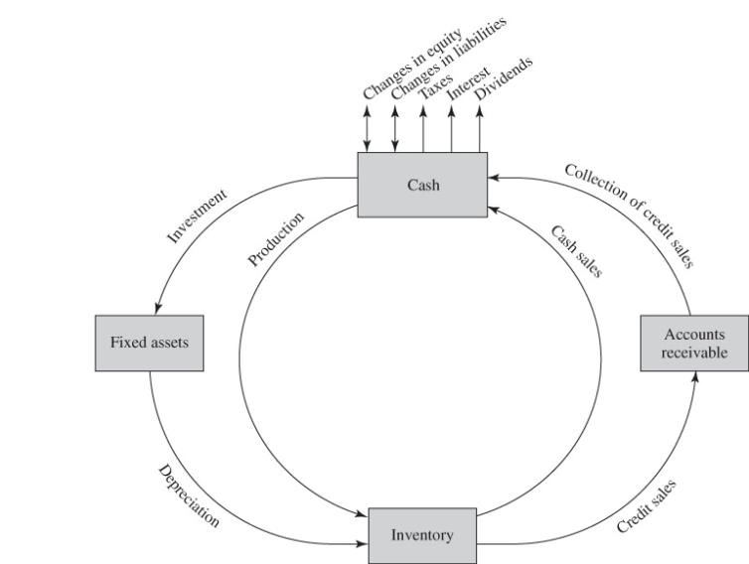
Figure 1.1 The Cash Flow–Production Cycle

Slide 5
More Questions
What is depreciation?
Did we miss AP? If so, where does it fit in?
  Cash → Fixed Assets → Inventory → AR → Cash
Are profits and cash flow the same?
Does depreciation have anything to do with this question?

Slide 6
The Balance Sheet
The balance sheet is a financial snapshot.
Assets = Liabilities + Shareholders’ Equity
What do these items measure?
What is double-entry bookkeeping?
What happens to the numbers in a balance sheet when a company borrows money from a bank?
What’s Worldwide Sports’ story in Table 1.1?

Slide 7
TABLE 1.1 Worldwide Sports Financial Transactions 2014 ($ thousands)

Slide 8
Questions
How much did WWS sell?
What was the value of WWS merchandise purchases?
How much did WWS borrow, and what rate of interest did they pay?
Are assets equal to the sum of liabilities and shareholders’ equity?
Move from snapshots to videos ➔ income statement and statement of cash flows

Slide 9
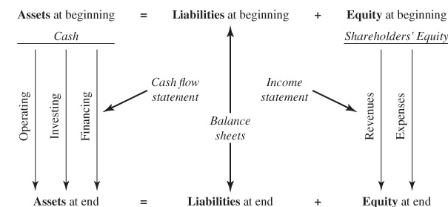
FIGURE 1.2 Ties among Financial Statements

Slide 10

Stryker Corporation
Photo credit: Stryker Corp.
Used as example throughout text

Slide 11

Medical technology industry
Specializes in orthopedic products
Headquartered in Kalamazoo, Michigan
Sales > $9 billion
Listed on NYSE
Member of S&P 500

Slide 12
TABLE 1.2 Stryker Corporation Balance Sheets ($ millions)

Slide 13
TABLE 1.3 Stryker Corporation Income Statements ($ millions)

Slide 14
Key Concepts
Current assets and liabilities
Shareholders’ equity
Income statement
  Revenues – expenses = Net income
  Operating and non-operating segments

Slide 15
Measuring Earnings
Accrual accounting and matching principle
Depreciation
  Straight-line vs. accelerated
Taxes
  2 sets of books: one to report financial condition of company to investors and the second to compute taxes

Slide 16
Tax Arithmetic
Provision for income taxes on income statement
+ increase in prepaid income taxes on asset side of balance sheet
− increase in income taxes payable and deferred income taxes on liabilities side of balance sheet
= Taxes paid

Slide 17
Example of Taxes Paid
From Stryker’s income statement, 2013
  Provision for Income Taxes = 206
From Stryker’s balance sheet, 2012 to 2013
  Increase in Taxes Payable = 61
  (No Deferred Taxes or Prepaid Taxes are listed)
Taxes Stryker paid
  206 − 61 = $145 million

Slide 18
You try it.
Calculate Home Depot’s taxes paid in year ended Feb. 2014.
Excerpt from Balance Sheet
Excerpt from Income Statement
Notes:
Taxes paid=Prov. for taxes (3,082) - increase in payable (-10) – increase in deferred (195) = $2,897 million (they had no prepaid inc. taxes)

Slide 19
R&D
Expense it all!
Why?
Difficult to estimate effective time horizon
Result? Earnings understate profitability.

Slide 20
Sources & Uses
Income statement only pertains to items sold
Income statement included noncash expenses
For cash flows, need something else
Where does a company get its cash, and where does it spend its cash?

Slide 21
Sources & Uses of Cash
Sources | Uses
Decreases in assets | Increases in assets
Increases in liabilities & equity | Decreases in liabilities & equity

Slide 22
Examples from Stryker’s Balance Sheet
Why is a decrease in cash a source?

Slide 23
TABLE 1.4 Stryker Corporation, Sources and Uses Statement, 2013 ($ millions)

Slide 24
You try it. Identify the sources and uses.
Notes:
Sources: Cash 20, Inv. 10, AP 10, LTD 25, Stock 5, PIC 25, RE 30, TOTAL=125
Uses: AR 20, NFA 90, STD 15, TOTAL=125

Slide 25
Statement of Cash Flows
Rearrangement of sources and uses?
In practice, there are additional issues.
Tax benefit from exercise of stock options
  When employees exercise stock options and incur a tax liability, the company gets to take this tax as a deduction.
  e.g., Cisco Systems’ tax benefit exceeded its net income in 2000

Slide 26
Cash Flow and Net Income
Which is the better measure of performance?
Net income includes estimates, allocations, and approximations.
Cash flow from operations is actual cash.
Low or negative cash flow does not necessarily imply poor performance.
Cash flow statements can record items such as AR and employee stock options differently from sources and uses.

Slide 27
TABLE 1.5 Stryker Corporation, Cash Flow Statement, 2013 ($ millions)

Slide 28
Market Value vs. Book Value
The financial statements are a mix of historical amounts and mark-to-market amounts.
Book values are historical.
Market values are forward-looking.
Intangible assets not appearing in the financial statements include patents, brand reputation, superior technology, human capital of workforce, etc.

Slide 29
Fair Value Accounting
Some quirks revealed by financial crisis of 2008
Drop in market value of debt
Fair value accounting required firms to record this change as a gain, because they were able to repurchase the debt at a lower price than they originally issued (sold it).
Effect reversed when market rebounded

Slide 30
Distortion and Discretion
Panic selling during financial crisis appears to have decreased market prices below fundamental values.
Distressed prices led creditors to take steps, such as demanding payment of debt and/or requiring collateral.
Prices fell further, leading to a vicious cycle, with yet more panic.

Slide 31
TABLE 1.6 The Book Value of Equity is a Poor Surrogate for the Market Value of Equity, December 31, 2013

Slide 32
Goodwill
Intangible on the balance sheet
Goodwill is the difference between acquisition price and the fair value of the asset acquired.
Fair value corresponds to either the book value or the replacement value of the target, whichever is more appropriate.
For Stryker, how important is goodwill?

Slide 33
Economic Income and Accounting Income
Realized vs. unrealized income
Marketable securities are marked to market, but not others.
Imputed costs: economic income recognizes the cost of equity as well as the cost of debt, while accounting income does not.

Slide 34
IFRS
International Financial Reporting Standards
2005, Europe adopts IFRS
Japan and U.S.?
Effect of Enron and WorldCom accounting scandals?

Slide 35
Philosophy of IFRS
Consolidated balance sheets vs. those of parent, expensing R&D, fair value accounting
Principles vs. rules

