Slide 1
Evaluating Financial Performance
Chapter Two

Slide 2
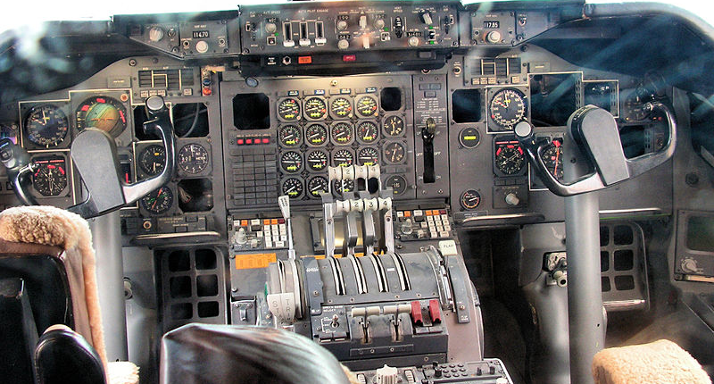
Photo: Public domain
How can financial levers be compared to controls in a 747?

Slide 3


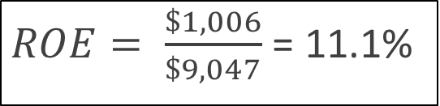
Levers of Financial Performance
Return on Equity: The most popular measure of financial performance
$ROE= \frac{Net income}{Shareholders^{′}equity}$
Why does this definition make sense?
$ROE= \frac{\$1,006}{\$9,047}$ = 11.1%

Slide 4

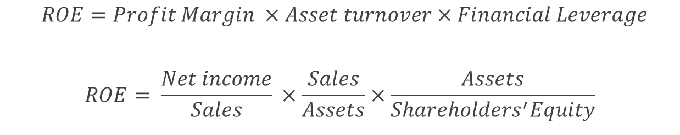
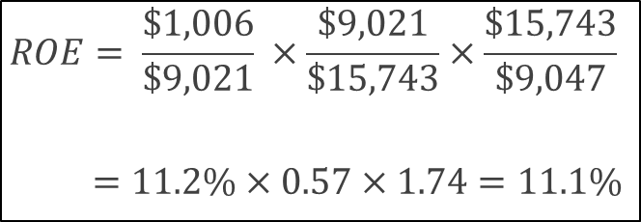
The 3 Determinants of ROE
$$ROE=Profit Margin ×Asset turnover×Financial Leverage$$
$$ROE= \frac{Net income}{Sales} ×\frac{Sales}{Assets}×\frac{Assets}{Shareholders^{′}Equity}$$
How is this a measure of leverage?
$$ROE= \frac{\$1,006}{\$9,021} ×\frac{\$9,021}{\$15,743}×\frac{\$15,743}{\$9,047}$$
$=11.2\%×0.57×1.74=11.1\%$

Slide 5
TABLE 2.1 ROE and Levers of Performance for 10 Diverse Companies, 2013

Slide 6
Questions about Table 2.1
Differences in ROE across firms is less than differences in components. Why?
What is the role of competition in ROE differences?
Is there any reason why profit margin and asset turnover are negatively related?

Slide 7
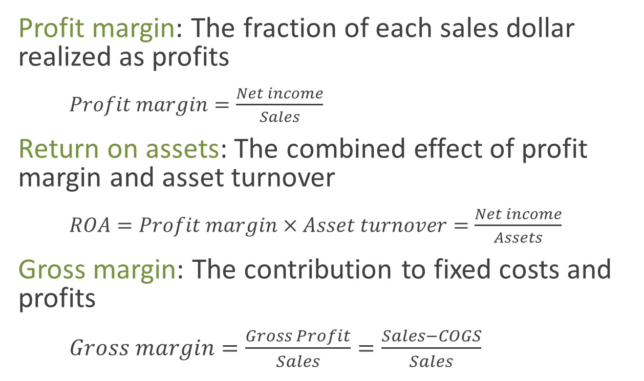
Profitability Ratios
Profit margin: The fraction of each sales dollar realized as profits
$Profit margin=\frac{Net income}{Sales}$
Return on assets: The combined effect of profit margin and asset turnover
$ROA=Profit margin×Asset turnover=\frac{Net income}{Assets}$
Gross margin: The contribution to fixed costs and profits
$Gross margin=\frac{Gross Profit}{Sales}=\frac{Sales−COGS}{Sales}$
Are COGS fixed or variable?

Slide 8
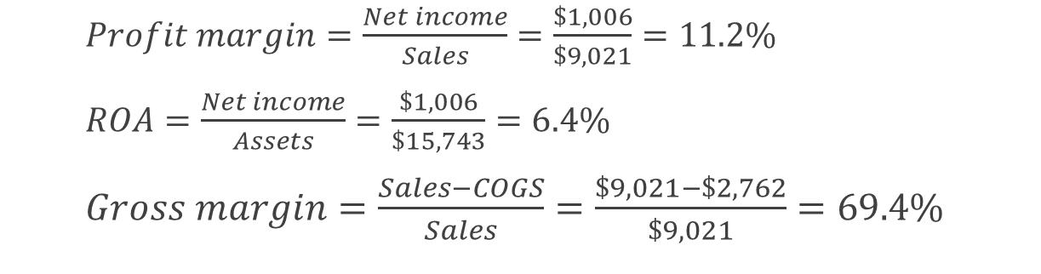
Profitability Ratios
$Profit margin=\frac{Net income}{Sales}=\frac{\$1,006}{\$9,021}=11.2\%$
$ROA=\frac{Net income}{Assets}=\frac{\$1,006}{\$15,743}=6.4\%$
$Gross margin=\frac{Sales−COGS}{Sales}=\frac{\$9,021−\$2,762}{\$9,021}=69.4\%$

Slide 9
Breakeven Sales
Use gross margin to calculate Stryker’s breakeven sales volume
Assume COGS are variable and operating expenses are fixed.
Stryker’s 2013 operating costs were $4,920 million.
Since 69% of sales goes to cover operating costs, breakeven sales volume = $4,920/0.69 = $7,130 million.

Slide 10
You try it. Calculate breakeven sales volume for Apple Inc. for 2014.
Notes:
Gross margin=70,537/182,795=38.6%. Breakeven=18,034/0.386=$46,720.

Slide 11
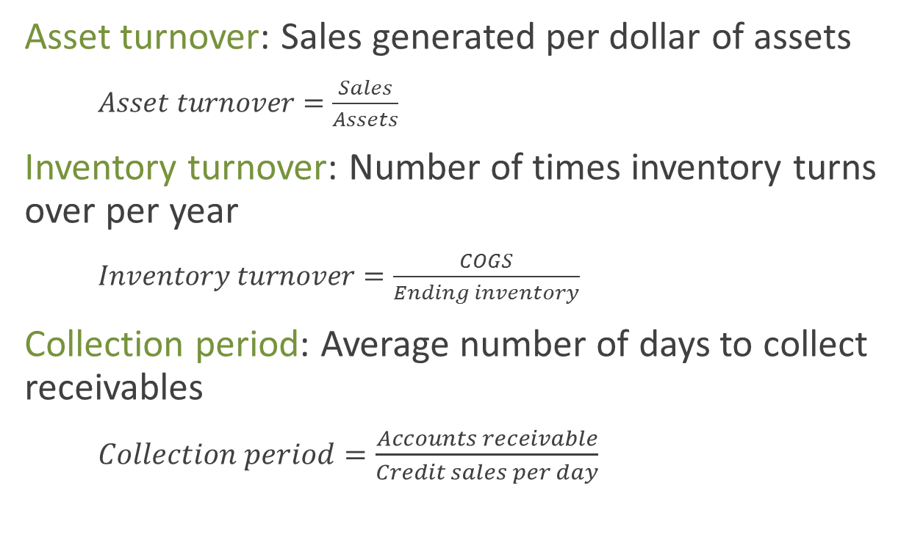
Turnover-Control Ratios
Asset turnover: Sales generated per dollar of assets
$Asset turnover=\frac{Sales}{Assets}$
Inventory turnover: Number of times inventory turns over per year
$Inventory turnover=\frac{COGS}{Ending inventory}$
Collection period: Average number of days to collect receivables
$Collection period=\frac{Accounts receivable}{Credit sales per day}$
What if you don’t know credit sales?

Slide 12
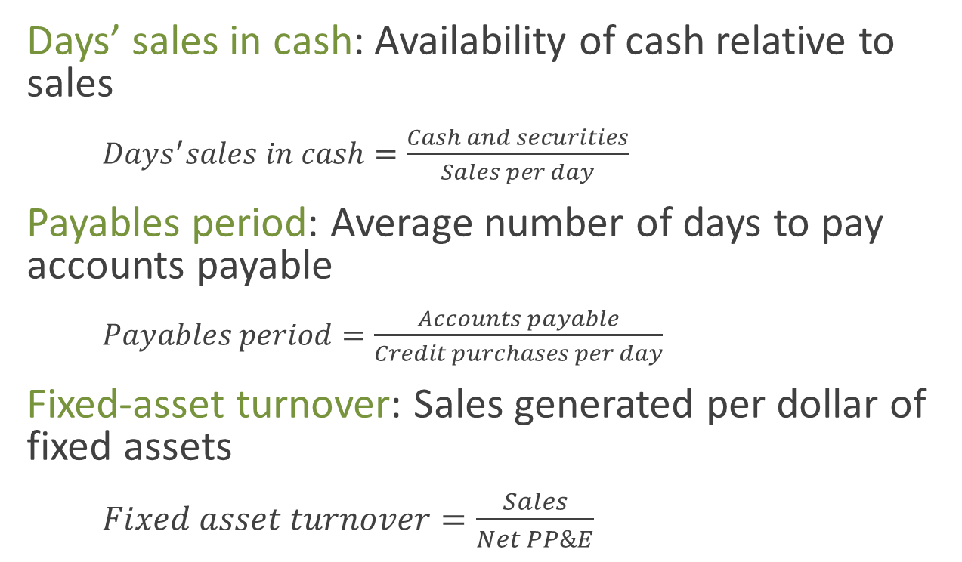
More Turnover-Control Ratios
Days’ sales in cash: Availability of cash relative to sales
$Days^{′}sales in cash=\frac{Cash and securities}{Sales per day}$
Payables period: Average number of days to pay accounts payable
$Payables period=\frac{Accounts payable}{Credit purchases per day}$
Fixed-asset turnover: Sales generated per dollar of fixed assets
$Fixed asset turnover=\frac{Sales}{Net PP\&E}$
What if you don’t know credit purchases?

Slide 13
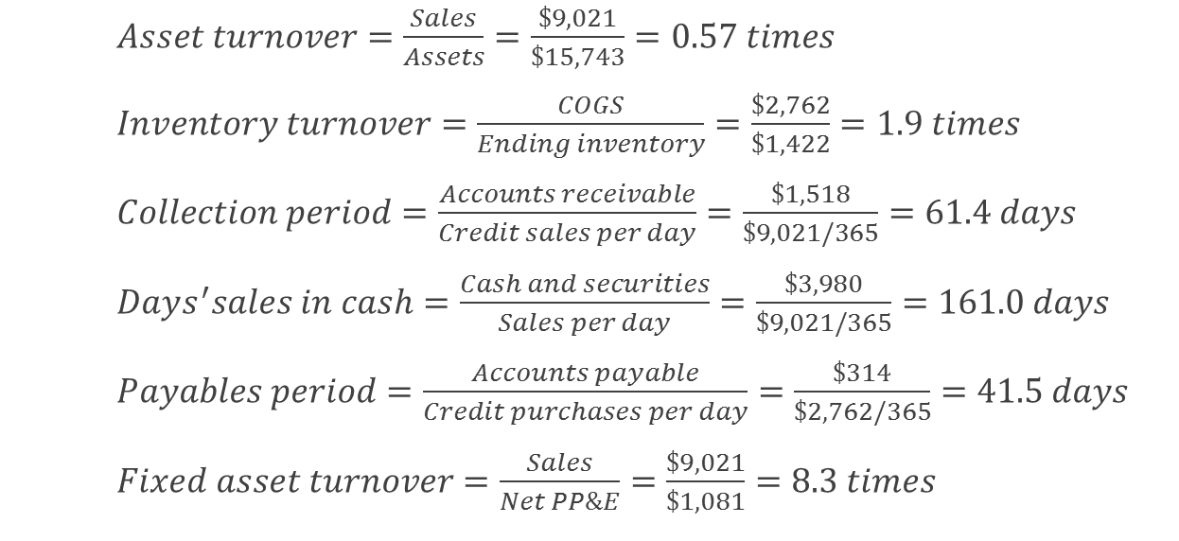
Turnover-Control Ratios
$Asset turnover=\frac{Sales}{Assets}=\frac{\$9,021}{\$15,743}=0.57 times$
$Inventory turnover=\frac{COGS}{Ending inventory}=\frac{\$2,762}{\$1,422}=1.9 times$
$Collection period=\frac{Accounts receivable}{Credit sales per day}=\frac{\$1,518}{\$9,021/365}=61.4 days$
$Days^{′}sales in cash=\frac{Cash and securities}{Sales per day}=\frac{\$3,980}{\$9,021/365}=161.0 days$
$Payables period=\frac{Accounts payable}{Credit purchases per day}=\frac{\$314}{\$2,762/365}=41.5 days$
$Fixed asset turnover=\frac{Sales}{Net PP\&E}=\frac{\$9,021}{\$1,081}=8.3 times$
Does a higher fixed-asset turnover indicate higher or lower capital intensity?

Slide 14
Fixed Assets vs. Current Assets
Which is likely to be more sensitive to external events, current assets or fixed assets?
What is a self-liquidating loan?
Loan to support current assets
What happens to AR and inventory when sales go up?
What happens to AR and inventory when sales go down?

Slide 15
Financial Leverage
What does increased financial leverage do to ROE?
Is increased leverage a good thing?
Electricite de France vs. Google in Table 2.1?
JPMorgan Chase?
Have a look, and describe what you see, along with an explanation.

Slide 16
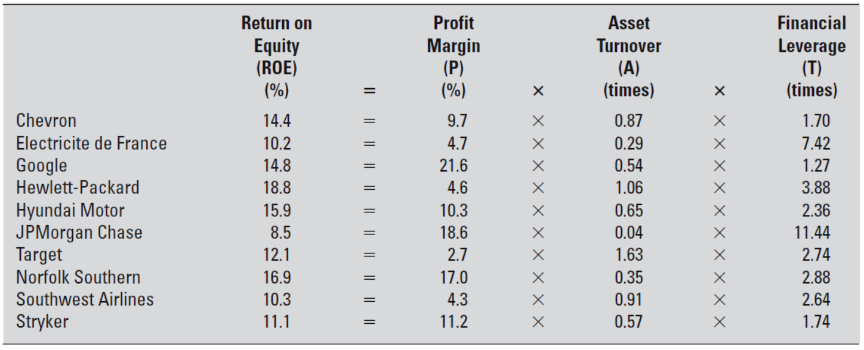
TABLE 2.1 ROE and Levers of Performance for 10 Diverse Companies, 2013

Slide 17
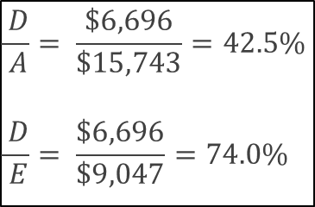
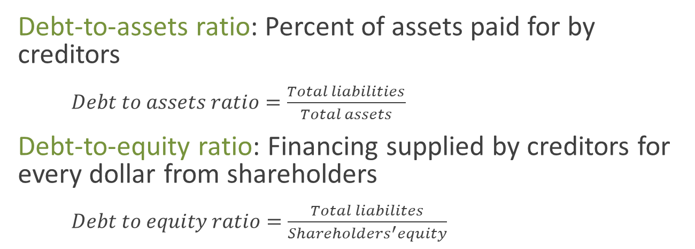
Leverage and Liquidity Ratios 1 Balance Sheet Ratios
Debt-to-assets ratio: Percent of assets paid for by creditors
$Debt to assets ratio=\frac{Total liabilities}{Total assets}$
Debt-to-equity ratio: Financing supplied by creditors for every dollar from shareholders
$Debt to equity ratio=\frac{Total liabilites}{Shareholders^{′}equity}$
$$\frac{ D}{ A}= \frac{\$6,696}{\$15,743}=42.5\%$$
$$\frac{ D}{ E}= \frac{\$6,696}{\$9,047}=74.0\%$$

Slide 18
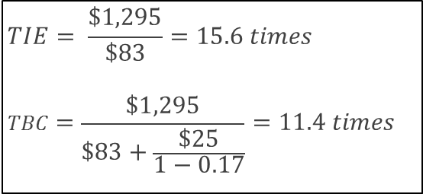
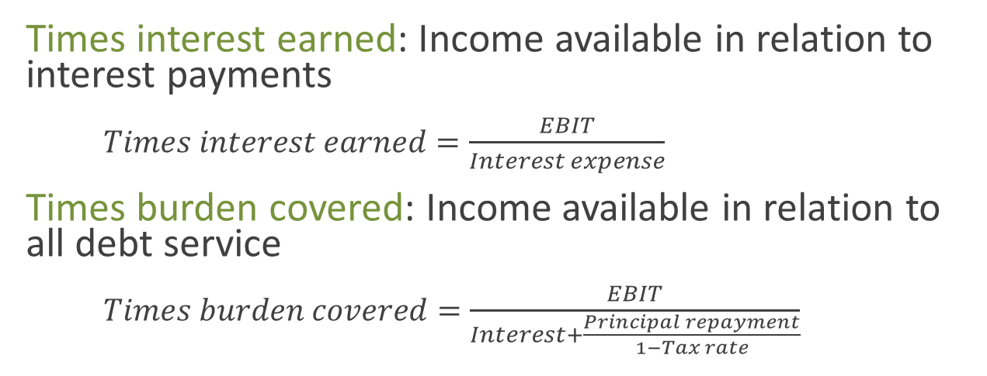
Leverage and Liquidity Ratios 2 Coverage Ratios
Times interest earned: Income available in relation to interest payments
$Times interest earned=\frac{EBIT}{Interest expense}$
Times burden covered: Income available in relation to all debt service
$Times burden covered=\frac{EBIT}{Interest+\frac{Principal repayment}{1−Tax rate}}$
Which coverage ratio is more important? Why?
$$TIE= \frac{\$1,295}{\$83}=15.6 times$$
$$TBC=\frac{\$1,295}{\$83+\frac{\$25}{1−0.17}}=11.4 times$$
Notes:
Stryker’s tax rate is $206/$1,212 = 17%

Slide 19
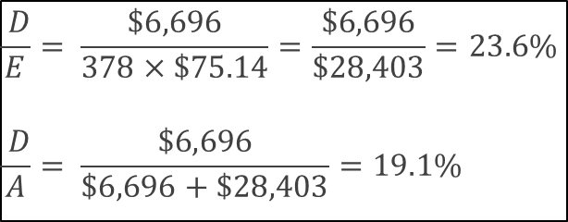
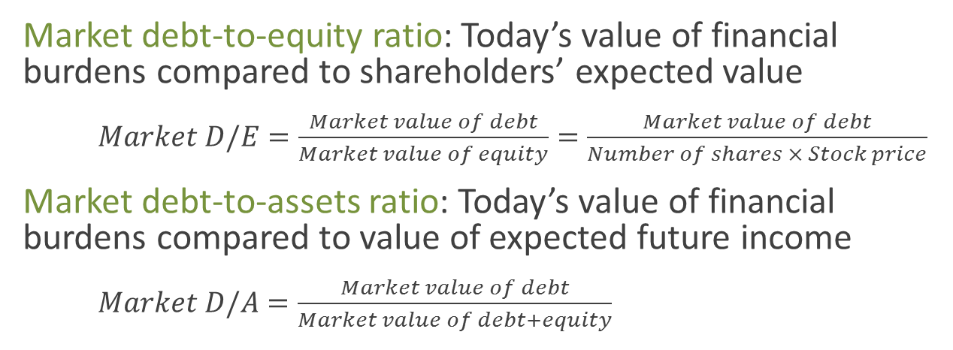
Leverage and Liquidity Ratios 3 Market Value Leverage Ratios
Market debt-to-equity ratio: Today’s value of financial burdens compared to shareholders’ expected value
$Market D/E=\frac{Market value of debt}{Market value of equity}=\frac{Market value of debt}{Number of shares × Stock price}$
Market debt-to-assets ratio: Today’s value of financial burdens compared to value of expected future income
$Market D/A=\frac{Market value of debt}{Market value of debt+equity}$
What if you don’t know the market value of debt?
$$\frac{ D}{E}= \frac{\$6,696}{378×\$75.14}=\frac{\$6,696}{\$28,403}=23.6\%$$
$$\frac{ D}{A}= \frac{\$6,696}{\$6,696+\$28,403}=19.1\%$$

Slide 20
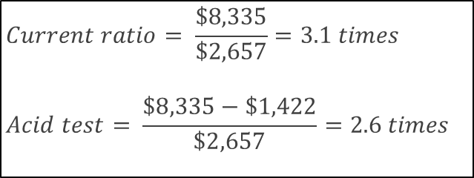
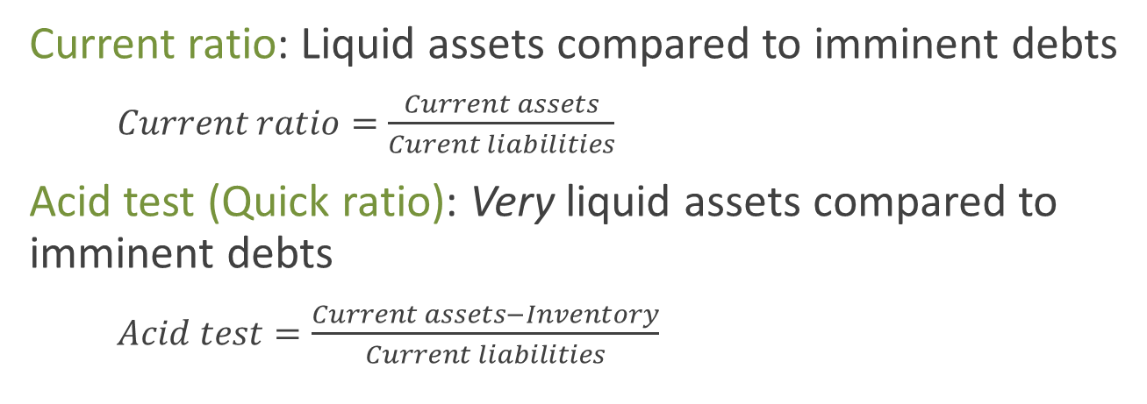
Leverage and Liquidity Ratios 4 Liquidity Ratios
Current ratio: Liquid assets compared to imminent debts
$Current ratio=\frac{Current assets}{Curent liabilities}$
Acid test (Quick ratio): Very liquid assets compared to imminent debts
$Acid test=\frac{Current assets−Inventory}{Current liabilities}$
$$Current ratio= \frac{\$8,335}{\$2,657}=3.1 times$$
$$Acid test= \frac{\$8,335−\$1,422}{\$2,657}=2.6 times$$

Slide 21
ROE: The Timing Problem
Is ROE forward-looking?
Does ROE have a long-term perspective?

Slide 22
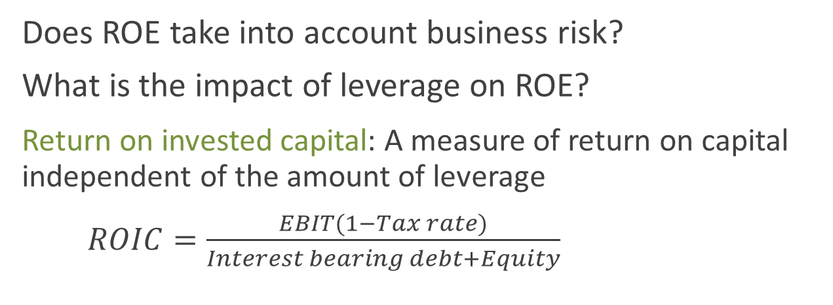
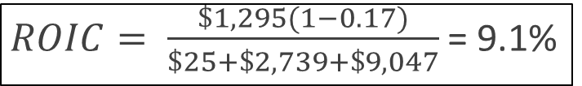
ROE: The Risk Problem
Does ROE take into account business risk?
What is the impact of leverage on ROE?
Return on invested capital: A measure of return on capital independent of the amount of leverage
$ROIC=\frac{EBIT(1−Tax rate)}{Interest bearing debt+Equity}$
$ROIC= \frac{\$1,295(1−0.17)}{\$25+\$2,739+\$9,047}$ = 9.1%

Slide 23
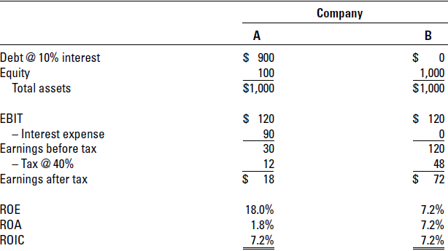
ROIC Is Not Distorted by Company Financing

Slide 24
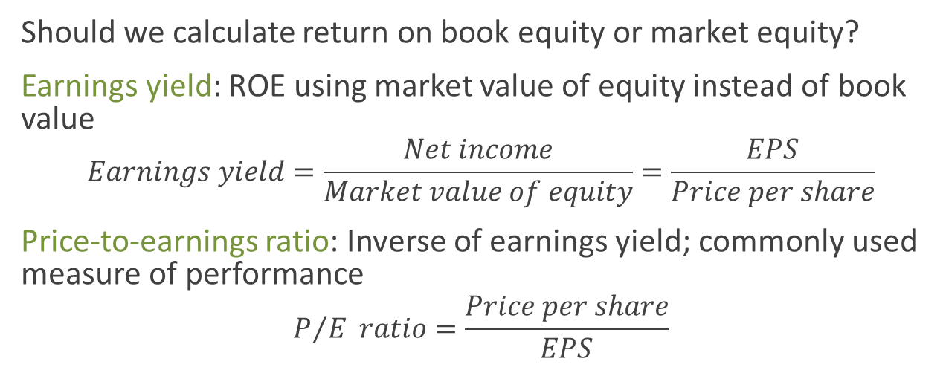
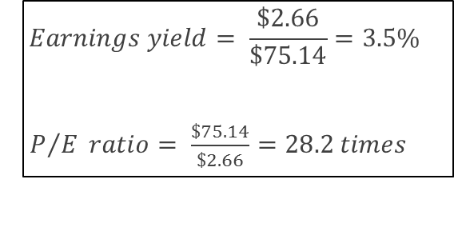
ROE: The Value Problem
Should we calculate return on book equity or market equity?
Earnings yield: ROE using market value of equity instead of book value
$$Earnings yield=\frac{Net income}{Market value of equity}=\frac{EPS}{Price per share}$$
Price-to-earnings ratio: Inverse of earnings yield; commonly used measure of performance
$$P/{E }ratio=\frac{Price per share}{EPS}$$
Is this a better measure of performance than ROE?
$$Earnings yield= \frac{\$2.66}{\$75.14}=3.5\%$$
$P/{E }ratio= \frac{\$75.14}{\$2.66}=28.2 times$

Slide 25
ROE or Market Price?
Which is the better way to measure financial performance?
Value creation for investors involves market values.
Line of sight (for managers)?
Asymmetric information, in that managers know more than investors?
External effects, economy, other stocks, etc.?

Slide 26
Scatter Plots
Price-to-book vs. ROE (weighted-average)
Figures 2.1 and 2.2 coming up
Slope and dispersion (R-squared)?
Where is Stryker’s relative to others in Figure 2.1?
Where are Apple and Amazon in Figure 2.2?

Slide 27
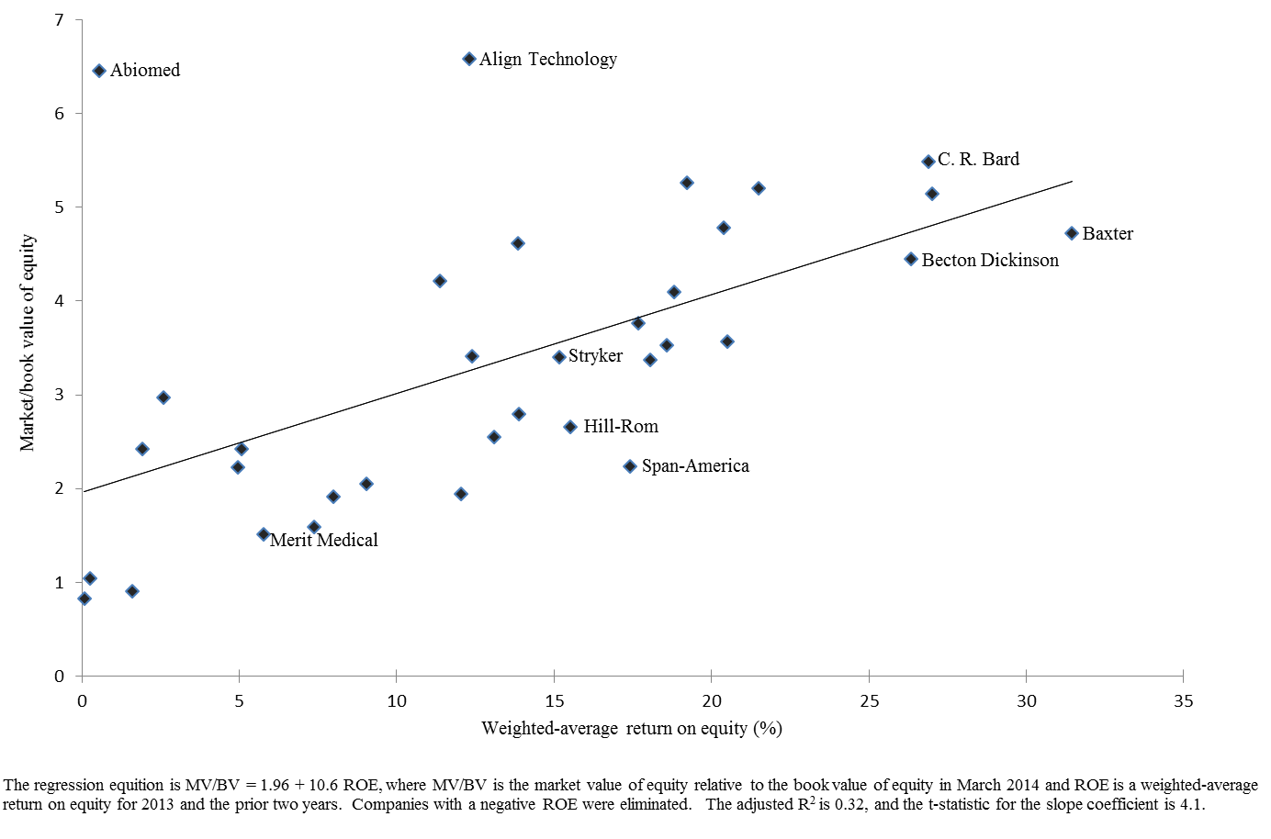
FIGURE 2.1 M/B vs. ROE for 34 Medical Technology Firms

Slide 28
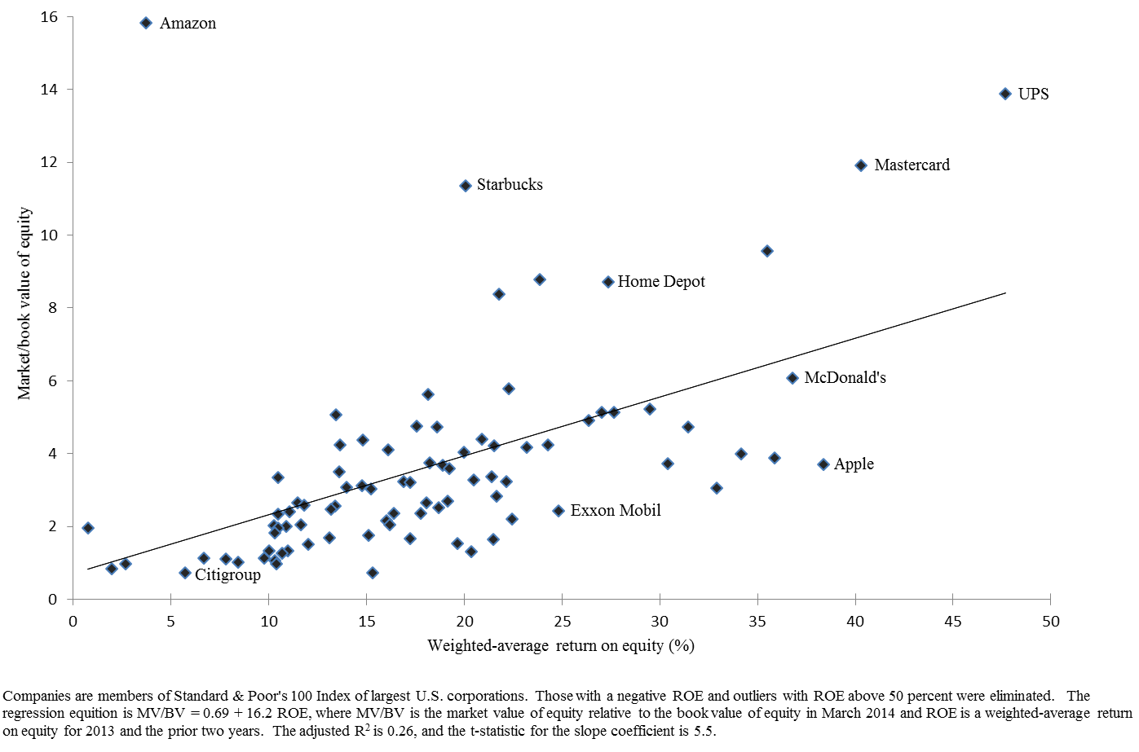
FIGURE 2.2 M/B vs. ROE for 87 Large Corporations

Slide 29
Using Ratios Effectively
Ratio values need to be understood in context.
Usually, no “correct” values for ratios
Important to compare ratios to something else
Comparable companies
Changes in a company’s ratios over time

Slide 30
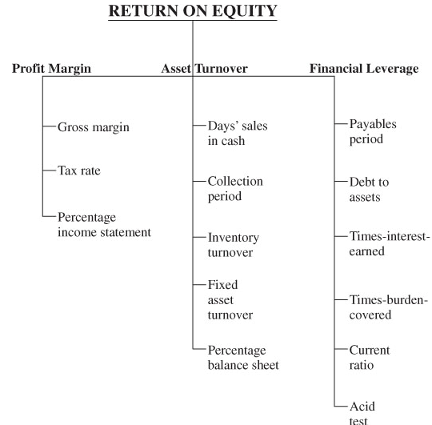
FIGURE 2.3 The Levers of Performance Suggest One Road Map for Ratio Analysis

Slide 31
Example of Ratio Analysis
Analyze the profitability measures
What do the various measures tell you?
What’s Stryker’s trend over time?
How does Stryker compare to the industry?
Analyze the levers of ROE
Which levers explain the changes in ROE over time?
Analyze the control ratios
Is Stryker managing assets efficiently?
How do they compare to prior performance and industry performance?
Analyze the leverage ratios
What’s the trend in their use of debt?
How do they compare to the industry?
Is their amount of leverage concerning?

Slide 32
TABLE 2.2 Ratio Analysis of Stryker Corporation

Slide 33
Common Size Financial Statements
Add insight in analyzing a company
Helps in recognizing trends over time
Can compare to other companies without scale effects
What do common-size figures tell you compared to typical ratios?
For example, collection period vs. AR/Assets
For example, inventory turnover vs. Inventory/Assets
What do you learn about working capital
Fraction of assets that are short-term
What do you learn about COGS?
Small changes in percentages can be large relative to net income

Slide 34
TABLE 2.3 Stryker Corporation, Common-Size Balance Sheets

Slide 35
TABLE 2.3 Stryker Corporation, Common-Size Income Statements

Slide 36
TABLE 2.4 Definitions of Principal Ratios Appearing in Chapter

Slide 37
TABLE 2.4 Definitions of Principal Ratios Appearing in Chapter (cont.)

