Slide 1
Financial Forecasting
Chapter Three

Slide 2
Introduction
From the past (Chapters 1 and 2) to the future. . .
  financial forecasting
  planning
  budgeting
This chapter describes techniques that are part of planning.

Slide 3
Why Financial Forecasting?
Estimate the company’s future need for external financing
Ensure the consistency of internal goals
Be prepared for various possible outcomes
Other?

Slide 4
Pro Forma Statements
Pro forma = as if
Much of the language of business forecasting is financial.
Many of the measures used to evaluate plans are financial.
A key issue is determining whether a plan is financially feasible.

Slide 5
Pro Forma Points of Emphasis
Bottom-up detailed plans vs. top-down bird’s eye view plans
Pro forma financial statements are a prediction of what financial statements will look like in the future
Can stem from broad outlines or detailed sub-plans
Future need for external funding, external financing required (EFR)

Slide 6
Percent of Sales
Forecast future sales, and tie other items in income statement and balance sheet to the sales forecast
Works well for variable costs, most current assets, and current liabilities
Not generally true for fixed assets

Slide 7
Steps to Creating Pro Formas
Examine historical data to observe patterns.
Forecast sales.
Forecast items that grow in proportion to sales.
Forecast other financial statement items
Estimate external funding required
Evaluate how to cover the shortfall (or use the surplus)

Slide 8
Example: R&E Supplies
R&E Supplies, Inc. is a wholesaler of plumbing and electrical supplies.
R&E has been a customer of Suburban National Bank for many years.
Average deposits have been $30K.
Short-term renewable loan has been $50K, with a 5-year maturity.

Slide 9
R&E’s Current Situation
In late 2014, R&E asks that the loan amount for 2015 be increased to $500K.
R&E explains that because of growth, AP has gone up and cash balances have gone down.
Suppliers are threatening to go to COD.
Why $500K?
Pro forma financial statements will give better quantitative justification for R&E’s request.

Slide 10
Step 1: Examine R&E’s Historical Data
Study R&E’s recent financial statements, Table 3.1.

Slide 11
TABLE 3.1 Income Statements for R&E Supplies
2011-2014
What’s happening with R&E’s profitability?

Slide 12
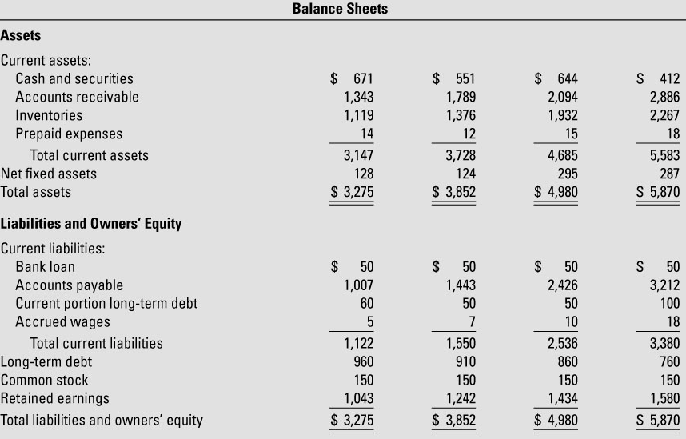
TABLE 3.1 Balance Sheets for R&E Supplies
December 31, 2011-2014
Why is cash declining?
Why are AP increasing?

Slide 13
Step 2: Forecast R&E’s Sales
R&E projects 25% sales growth
  This number should be carefully determined with input from many in the organization

Slide 14
Step 3: Forecast Items that Grow in Proportion to Sales
See historical and forecasted ratios, Table 3.2.

Slide 15
TABLE 3.2 Historical Financial Ratios for R&E Supplies
2011-2014 and 2015 Forecast
Are these forecasts reasonable?

Slide 16
Step 4: Forecast Other Items Not Closely Linked to Sales
Prepaid expenses = rough guess
Net fixed assets?
  capital budget of $43K already approved
  $50K depreciation
  $280K = $287K (prior year) + $43K – $50K
Bank loan initially set to $0, but only temporarily.

Slide 17
Additional Items
Current portion (100) of long-term debt is contractual (760 = 660 + 100)
Note assumption that new loans = 0
Retained earnings?
  Prior year RE + income statement earnings – dividends

Slide 18
TABLE 3.3 Pro Forma Income Statement for R&E Supplies,
2015

Slide 19
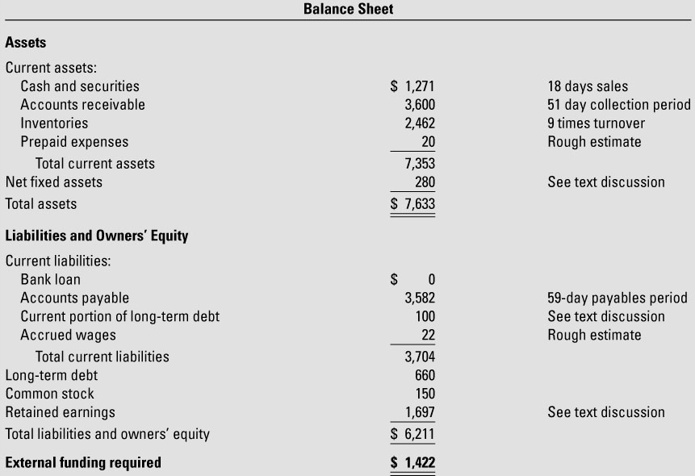
TABLE 3.3 Pro Forma Balance Sheet for R&E Supplies,
December 31, 2015

Slide 20
You try it.
Project pro forma balance sheet items
Given the pro forma income statement, what would be Trapezoid’s projected shareholders’ equity for Dec. 31, 2015? Assume a dividend payout ratio of 25% and no new issues of equity.
What would be Trapezoid’s projected Net fixed assets for Dec. 31, 2015. Assume capital expenditures of $200 for 2015, and no sale or disposal of assets.
Notes:
1. 300 + (1-0.25)(100) = $375 2. 1,000 + 200 – 100 = $1,100.

Slide 21
Step 5: Estimating the External Funding Required
Income statement measures profitability, and garners most investors’ attention.
The CFO focuses on the balance sheet to estimate funding needs.
External funding required = Assets – Liabilities and Equity
In R&E’s first-stage pro formas, EFR = $1,422,000

Slide 22
Banker’s Reaction?
EFR = $1.4 million >> $500K!
Not good news about the CFO
Still, AR = $3.6 million, which would provide security.

Slide 23
Step 6: Evaluate How to Cover the Shortfall
One solution would be a $1.4 million loan from Suburban National Bank
This might be more than Suburban (or R&E) is comfortable with
What if loan is limited to $1 million?
Where to shave $400K?
  Tighten up AR, so that DSO drops from 51 to 47?
  Increase payables period from 59 to 60?
  These might lower sales growth (25→20%) and increase costs (SG&A 12-12.5%) from foregone discounts .

Slide 24
TABLE 3.4 Revised Pro Forma Income Statement for R&E Supplies, 2015
How did the revised plan affect profits?

Slide 25
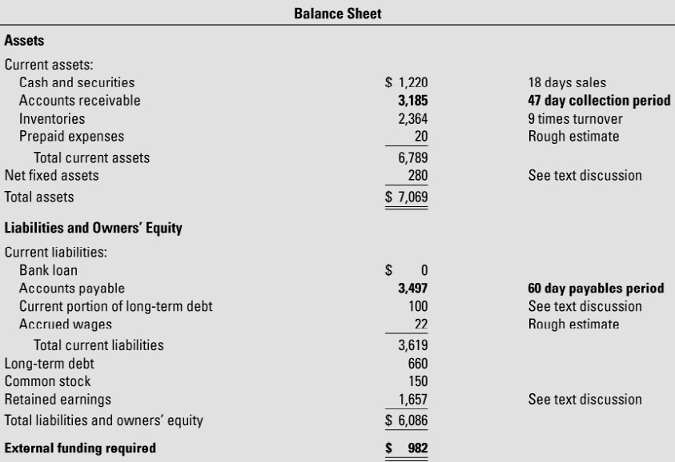
TABLE 3.4 Revised Pro Forma Balance Sheet for R&E Supplies, December 31, 2015
Is everybody happy now?

Slide 26
Other Issues: Interest Expense
Circular reasoning
  Interest this year is based on debt this year.
  But interest this year feeds into earnings this year, and therefore into balance sheet retained earnings.
  Debt this year, needs to be determined by the gap between assets and liabilities in the balance sheet.
Can try a decent plug, such as basing the interest on the prior year debt
Can iterate, because the two need to be determined simultaneously (Spreadsheets can handle this).

Slide 27
Other Issues: Seasonality
External financing needed is only computed on the date of the balance sheet.
What about in-between?
Do a series of these, quarterly, monthly, etc.

Slide 28
Pro Forma Statements &
Financial Planning
The initial financial plan, as embodied within the pro forma, provides the starting point for a discussion about operations.
If the external amount of financing is too large, what kinds of operating changes need to be made, relative to pro forma?
  Different level of investment?
  Sale of assets?
  Different working capital policy?
  Cutting costs, with associated impact on revenue?

Slide 29
Why Are Lenders So Conservative?
If expected loan returns are low, lenders cannot accept high risk.
Look at the lending margin (spread) between paying depositors and what the loan pays.
Example on p. 93 shows a low net profit margin.
So getting a high ROE requires high financial leverage (like 10-to-1).

Slide 30
Prophetic Comments:
A Few Bad Apples?
Complete default by just a few borrowers can erase a bank’s earnings.
Why are lenders so conservative?
Because the aggressive ones have long since gone bankrupt.

Slide 31
Computer-Based Forecasting
Table 3.5 lays out Excel spreadsheet with formulas.

Slide 32
TABLE 3.5 Forecasting with a Computer Spreadsheet: Pro Forma Financial Forecast for R&E Supplies, 2015

Slide 33
TABLE 3.5 Forecasting with a Computer Spreadsheet: Pro Forma Financial Forecast for R&E Supplies, 2015

Slide 34
Sensitivity Analysis
“What if” questions:
  What if sales growth is only 15%, instead of 25%?
  What if COGS is 84% instead of 85%?
Benefit #1: sensitivity analysis produces a range of outcomes.
Benefit #2: sensitivity analysis induces managers to prioritize their assumptions according to importance.

Slide 35
Scenario Analysis
In practice, forecast variables change together, not one at a time.
Develop a set of scenarios with different co-movements.
Each scenario is built around a story or narrative, such as losing a major customer or facing a new competitor.

Slide 36
Simulation Analysis
Assign probability distributions to each major variable.
Run many pro formas, with the variable values drawn from a Monte Carlo process.
Advantage: many scenarios
Disadvantage: many managers do not think in terms of probabilities, and the planning issues are opaque

Slide 37
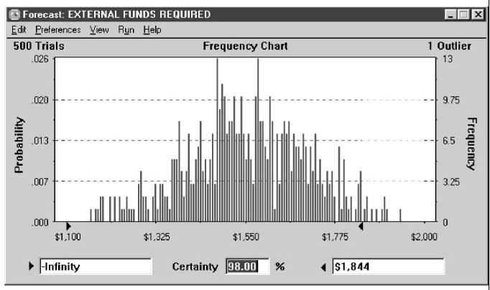
FIGURE 3.1 Simulating R&E Supplies’ Need for External Funding: Frequency Chart

Slide 38
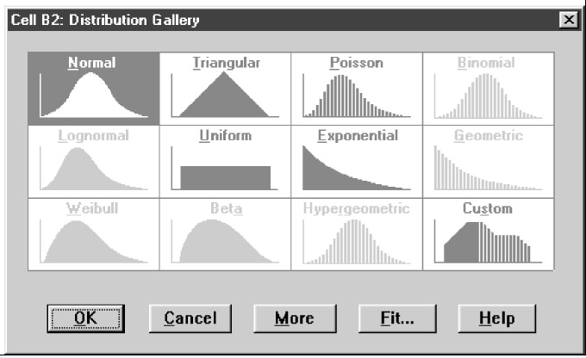
FIGURE 3.1 Distribution Gallery for Sales Growth
Source: Crystal Ball, Oracle Corp.

Slide 39
Cash Flow Forecasts
Sources and Uses of Cash
Based on same assumptions as the interim pro forma income statement and balance sheet
EFR = Total uses – Total sources

Slide 40
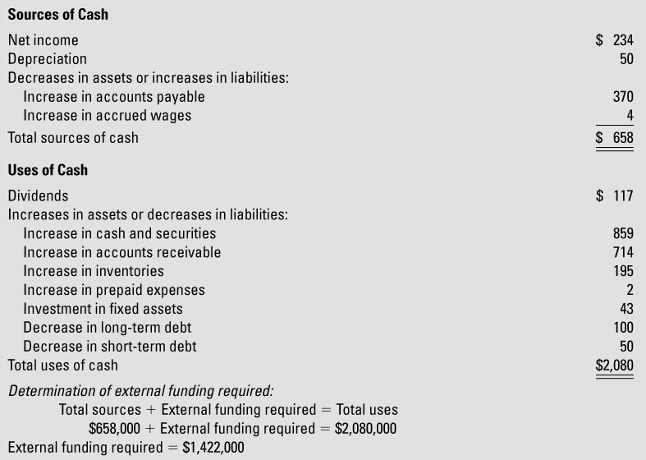
TABLE 3.6 Cash Flow Forecast for R&E Supplies, 2015

Slide 41
Cash Budgets
Pro forma statements rely on accrual accounting.
Cash budgets are strictly cash accounting.
Cash budgets require translation from accrual projections to cash projections.
  Adjust for timing of collections and payments.
Example: Jill Clair Fashions’ monthly cash budget
  2%/10 net 30 days – factoring it in

Slide 42
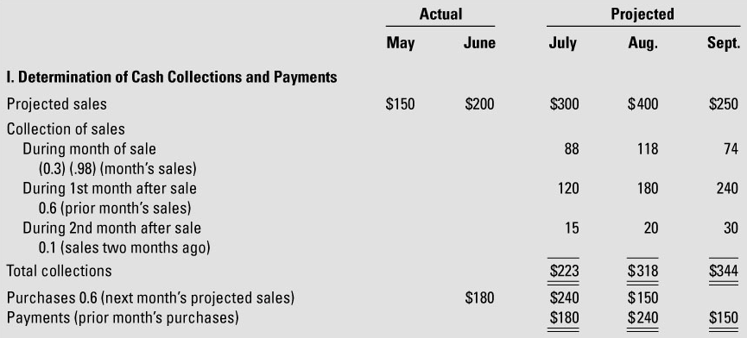
TABLE 3.7 Cash Budget for Jill Clair Fashions 3rd Quarter, 2015

Slide 43
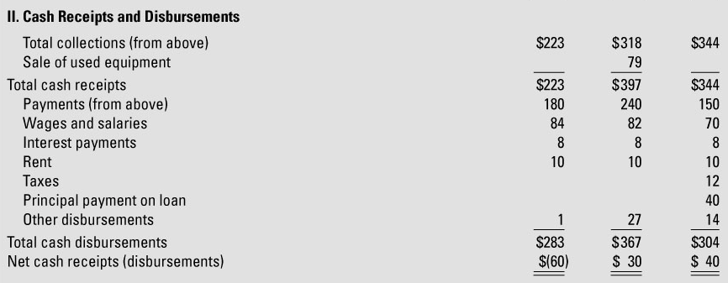
TABLE 3.7 Cash Budget for Jill Clair Fashions 3rd Quarter, 2015

Slide 44
Bottom Line
In the next slide, look at the bottom line cumulative EFR line, as well as the changes.

Slide 45
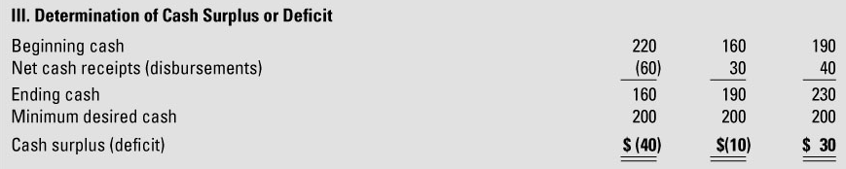
TABLE 3.7 Cash Budget for Jill Clair Fashions, 3rd Quarter, 2015

Slide 46
Planning in Large Companies
Three stages to planning:
  Hammer out corporate strategy, with broad brush financial planning.
  Translate qualitative goals into internal division activities, with rough financial forecasts.
  Quantitative plans and budgets, both operating budgets and capital budgets.
Integration of #3 leads to the corporation’s financial plan.

