Slide 1
Managing
Growth
Chapter Four

Slide 2
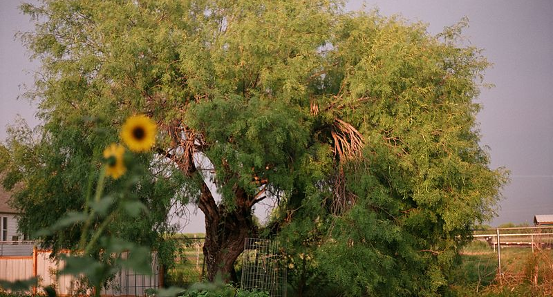
Photo: Public domain
Companies can grow too quickly or too slowly.
Growth needs to be managed.

Slide 3
The Company Life Cycle
Startup (usually with losses)
Rapid growth (with infusions of outside financing)
Maturity (generating cash)
Decline (marginally profitable, with cash to search for new products, investments)

Slide 4
Different Phases of the Life Cycle Pose Different Challenges
Consider a firm in its rapid growth phase.
  Sales growth requires investment in AR, inventory, and productive capacity.
Consider a firm in its declining phase.
  Often the cash produced isn’t required for further investment and must be used elsewhere.

Slide 5
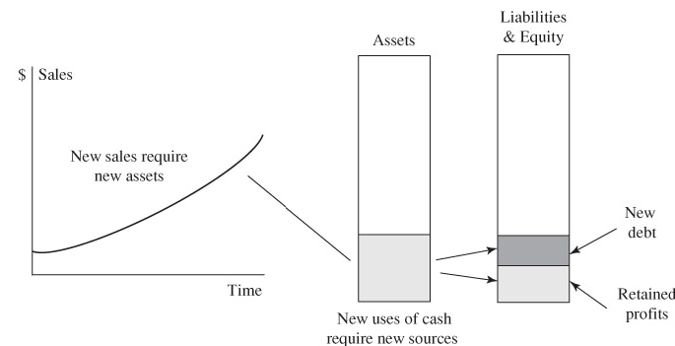
FIGURE 4.1 New Sales Require New Assets, Which Must Be Financed

Slide 6
The Sustainable Growth Rate
A company’s sustainable growth rate is the maximum rate at which it can grow without depleting financial resources.
The sustainable growth rate is based on the assumption that management will not sell new equity and will maintain a constant debt ratio.

Slide 7
Sustainable Growth Rate = g*
What limits the rate at which this company can increase sales or, more generally, its overall expansion?
From the Figure 4.1, the limit to growth is the rate at which equity expands.
Therefore, g* is the ratio of the change in equity to equity at the beginning of the period.

Slide 8
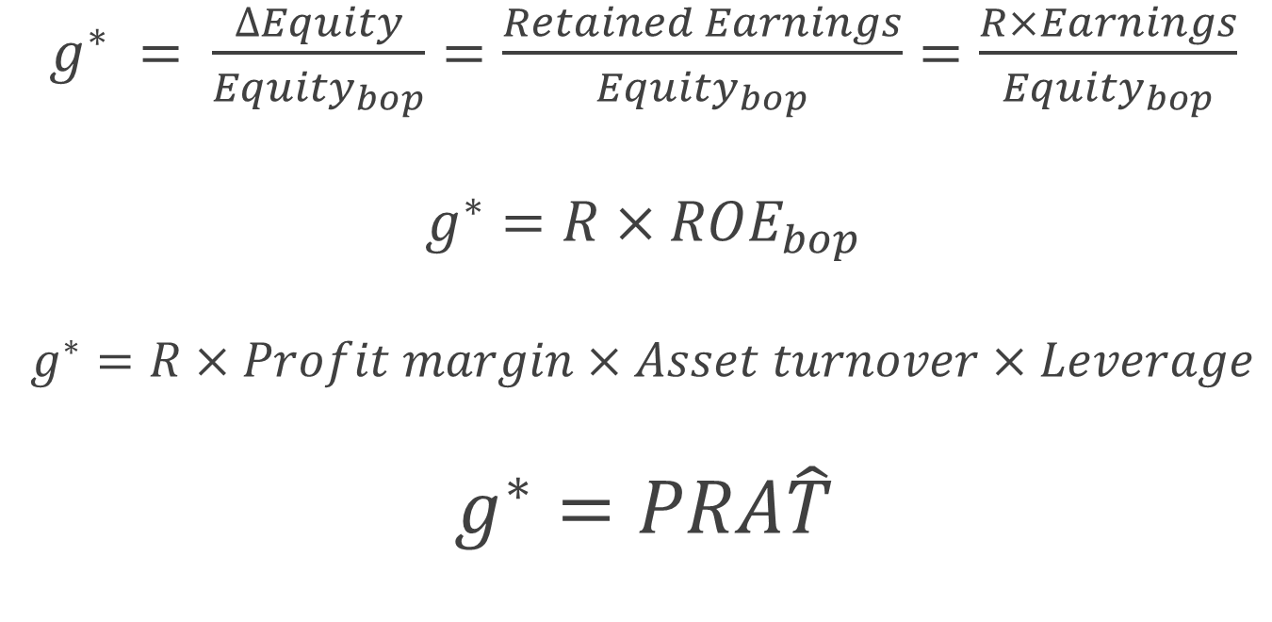
Equations for g*
What’s the meaning of R?
$g^{∗} = \frac{∆Equity}{{Equity}_{bop}}=\frac{Retained Earnings}{{Equity}_{bop}}=\frac{R×Earnings}{{Equity}_{bop}}$
$g^{∗}=R×{ROE}_{bop}$
$g^{∗}=R×Profit margin×Asset turnover×Leverage$
$g^{∗}=PRA\hat{T}$

Slide 9
You try it.
Calculate the sustainable growth rate for 2014.
Notes:
g* = Change in equity/equity_{bop} = (3126-2950)/2950 = 6.0%
g* = R × ROE_{bop} = 0.6 × 293/2950 = 6.0% [R = (3126-2950)/293 = 0.6; assuming no new equity issued]
g* = PRAT = (293/5500) × 0.6 × (5500/4950) × (4950/2950) = 6.0%

Slide 10
Levers of Growth
The levers of growth here are PRAT.
g* is the only growth rate consistent with these ratios.
If a company grows at a rate g > g*, then one of the four levers must increase.
If a fast-growing company can’t increase profit margin, retention ratio, or asset turnover, it will end up increasing leverage.

Slide 11
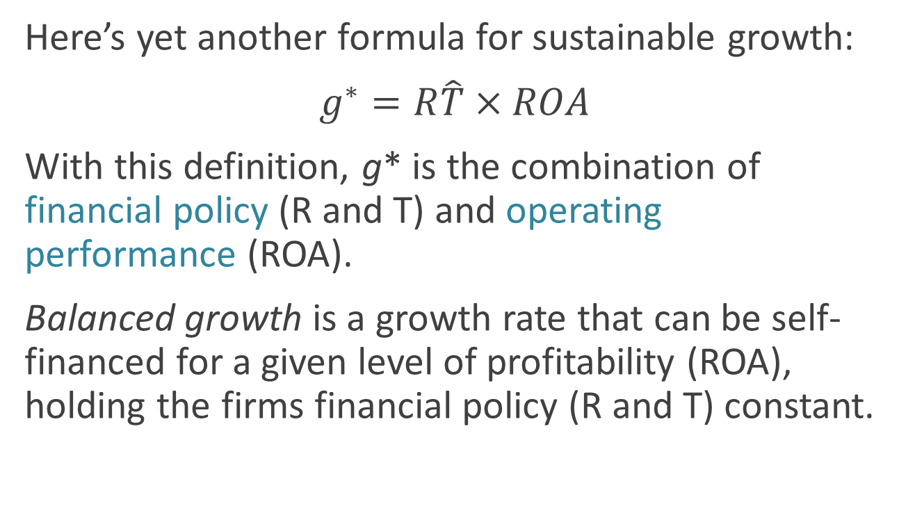
Balanced Growth
Here’s yet another formula for sustainable growth:
$g^{∗}=R\hat{T}×ROA$
With this definition, g* is the combination of financial policy (R and T) and operating performance (ROA).
Balanced growth is a growth rate that can be self-financed for a given level of profitability (ROA), holding the firms financial policy (R and T) constant.

Slide 12
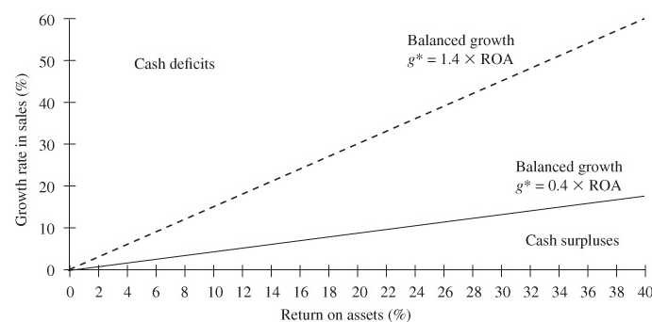
FIGURE 4.2 A Graphical Representation of Sustainable Growth

Slide 13
Unbalanced Growth
A company with unbalanced growth has 3 choices:
Change its growth rate (g).
Change its ROA (P or A).
Change its financial policy, meaning the slope of the line (R or T).

Slide 14
TABLE 4.1 Sustainable Growth Analysis of Under Armour 2009–2013
How does Under Armour’s g compare to its g*?
How is Under Armour dealing with the gap between g and g*?

Slide 15
Under Armour’s Response to the Gap
25% average growth in actual sales over period; well over sustainable growth rate
P: 27% increase
R: maxed out at 100%
A: decline in 2013
T: 17% increase

Slide 16
FIGURE 4.3 Under Armour’s Sustainable Growth Challenges, 2009–2013
Has Under Armour resolved its cash deficits?

Slide 17
What To Do When Actual Growth Exceeds Sustainable Growth
If growth is temporarily too fast, just borrow and wait for it to slow down.
If not, then there are a number of possible actions to take.

Slide 18
Option #1: Sell New Equity
Get cash
Increase borrowing capacity
Difficult to do in most countries

Slide 19
TABLE 4.2 Sources of Capital to U.S. Nonfinancial Corporations, 2004—2013
Do U.S. companies like to sell new equity?

Slide 20
Option #2: Increase Leverage
Raises cash
Also raises risk of bankruptcy

Slide 21
Option #3: Reduce the Payout Ratio
Saves cash that can be used to build up equity
Can anger shareholders who respond by selling their stock, thereby driving down stock price.

Slide 22
Option #4: Profitable Pruning
Raises ROE, and therefore earnings, and therefore retained earnings.
Retained earnings are part of equity.
Prune by un-diversifying unrelated product lines with no synergy.
  Who benefits from corporate diversification, shareholders or managers?
Un-diversifying generates cash from the sale of assets.

Slide 23
Option #5: Outsourcing
Can increase asset turnover and therefore, ROA.

Slide 24
Option #6: Raise Pricing
Increases ROE, if %-demand doesn’t fall by more than the %-price increase.

Slide 25
Option #7: Merger
Find a cash cow (white knight, if threatened) with deep pockets.

Slide 26

TABLE 4.3 Sustainable Growth Analysis of Stryker, 2009–2013
How does Stryker’s g compare to its g*?
How is Stryker dealing with the gap between g and g*?

Slide 27
What Did Stryker Do?
Sustainable growth rates higher than actual growth rates by a 2-to-1 ratio
P: Decreased
R: Decreased (repurchased shares also)
A: Decreased
T: Increased
Why would Stryker increase leverage?

Slide 28
FIGURE 4.4 Stryker’s Sustainable Growth Challenges, 2009–2013

Slide 29
What To Do When Sustainable Growth Exceeds Actual Growth
Ask if the situation is temporary.
If yes, build up cash.
If no, ask if the phenomenon is industry-wide, or within the firm.
If within the firm, then a few options are available.

Slide 30
Option #1: Ignore the Problem
Accumulated cash and slow growth attracts corporate raiders
Why?
What do raiders believe?
Is a corporate raid bad news for shareholders?

Slide 31
Option #2: Return The Money To The Shareholders
Increase dividends
Repurchase shares
Temptation is to invest in assets that reduce corporate value but increase management’s empire

Slide 32
Option #3: Buy Growth
Buy other businesses, especially ones that need cash because they are growing rapidly.
History suggests that returning the money is the better option.

Slide 33
New Equity Financing
The next slide illustrates the value of new equity issues over time.
What happened before and after 1983?
What happened in 2007?
What happened in 2008?
How does acquisition impact common stock ownership?

Slide 34
FIGURE 4.5 Net New Equity Issues 1975–2013

Slide 35
Acquisitions
In the last slide, what happened in 1998?
Companies reduce their shares by repurchasing them or by acquiring the stock of another firm for cash or debt.
Was the situation different in the U.K. and Japan?
The numbers suggest that companies sell new shares about once every 20 years.

Slide 36
FIGURE 4.6 Gross New Stock Issues by Corporations and IPOs, 1980–2013
What caused this peak?

Slide 37
Gross Proceeds
30 year average = $69 billion
High $295 billion in 2000
Gross proceeds from new stock for nonfinancial corporations equaled 5% of total sources of capital

Slide 38
IPOs
Check the graph of IPOs relative to gross public equity issues
Modest 25% of new equity raised over the period
In 2000, IPOs contributed 5% of total external capital

Slide 39
Why Don’t U.S. Companies Issue More Equity?
Other sources generated sufficient cash
Equity is expensive to issue (flotation)
Fear of diluting EPS in the short run
Concern that their stock is undervalued in the market
Windows close

