Slide 1
The Financing Decision
Chapter Six

Slide 2
Choices
If a firm requires $200 million in external financing, should it issue new debt or new equity?
If equity financing is not an alternative, how much debt should the firm issue?
How does the firm’s financing decision today impact its situation in the future?

Slide 3
Things to Keep in Mind
Do not assume there is a single right answer to any of these questions.
OPM is other people’s money.
How does OPM affect:
risk-return relationships in a corporate setting?
tax implications?
financial distress?
signaling effects?

Slide 4
Financial Leverage
Think about jacking up a car.
Most people cannot lift a heavy car with their bare hands.
A jack is a lever that uses increased distance to amplify effort.
But using a jack, the car will go up a small distance when a person pushes the handle down a greater distance.
Financial leverage is like that, using increased risk to amplify expected return.

Slide 5
Example
Examine Table 6.1.
$1,000 outlay
Two possible investment outcomes.
Probabilities are 50-50.
Panel A illustrates 100% equity financing.
Panel B illustrates debt financing.
How does debt financing impact the return to owners (shareholders) in the two outcomes, and on average?

Slide 6
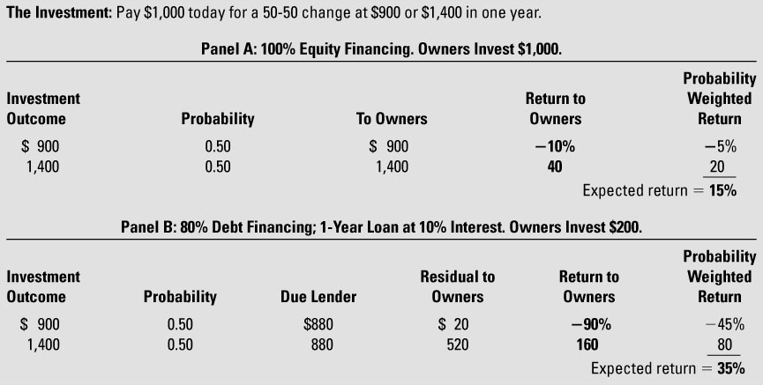
TABLE 6.1 Debt Financing Increases Expected Return and Risk to Owners

Slide 7
The Bottom Line
Increased debt lowers the initial investment required by shareholders.
Increased debt amplifies the expected return.
Increased debt amplifies the risk faced by shareholders.
That’s what financial leverage is all about.
Operating leverage, featuring high fixed costs, but low variable costs, works the same way.

Slide 8
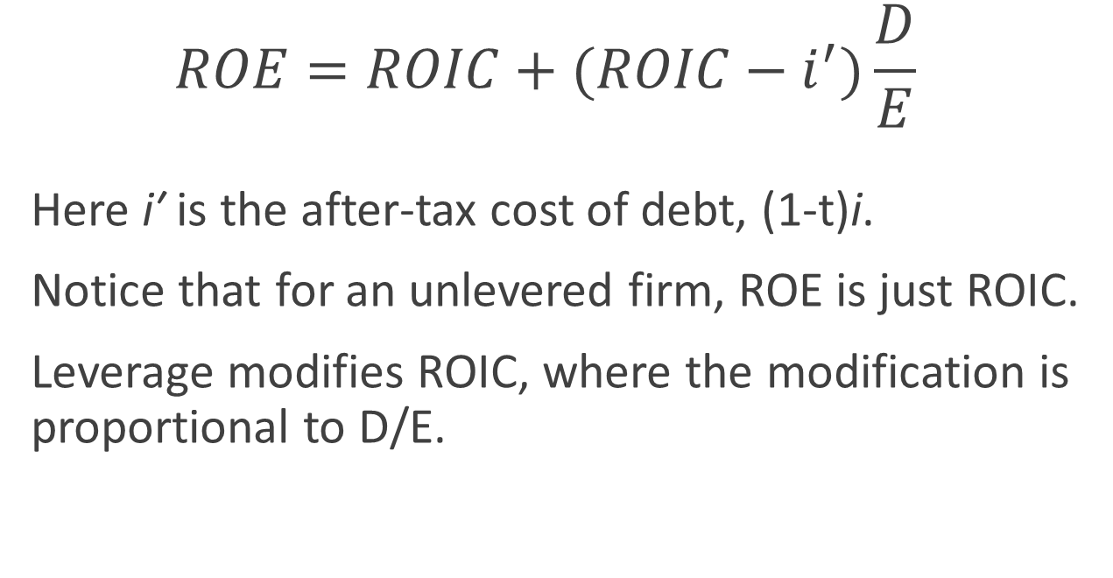
Key Equation
$$ROE=ROIC+(ROIC−i^{′})\frac{D}{E}$$
Here iʹ is the after-tax cost of debt, (1-t)i.
Notice that for an unlevered firm, ROE is just ROIC.
Leverage modifies ROIC, where the modification is proportional to D/E.

Slide 9
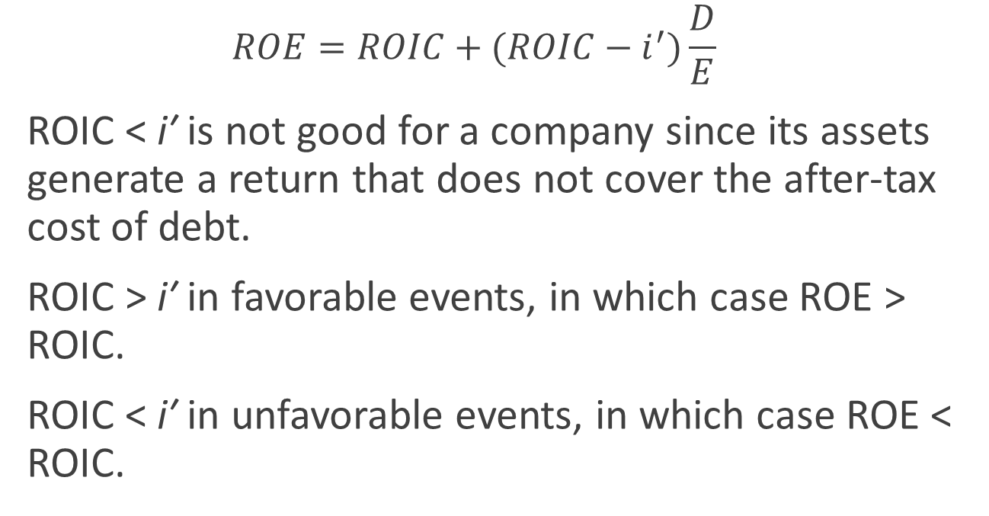
Favorable and Unfavorable Outcomes
$$ROE=ROIC+(ROIC−i^{′})\frac{D}{E}$$
ROIC < iʹ is not good for a company since its assets generate a return that does not cover the after-tax cost of debt.
ROIC > iʹ in favorable events, in which case ROE > ROIC.
ROIC < iʹ in unfavorable events, in which case ROE < ROIC.

Slide 10
It’s Not So Easy
In 2013, only 45% of large publicly traded firms tracked by S&P accomplished this feat.
For larger firms with sales above $200 million, 65% accomplished this feat.
Figure 6.1 illustrates the impact of leverage on both risk and expected return.

Slide 11
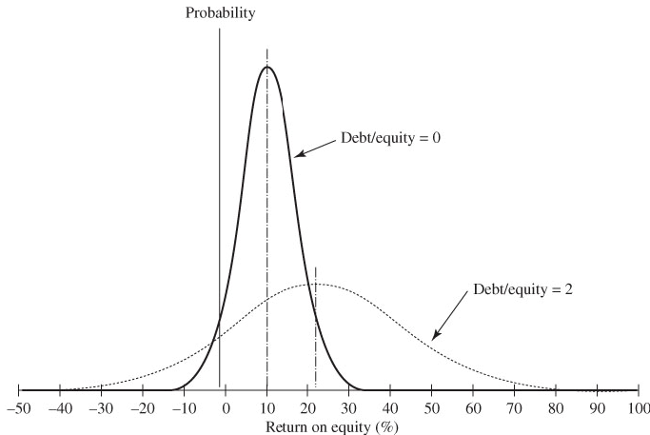
FIGURE 6.1 Leverage Increases Risk and Expected Return

Slide 12
Highlights
Leverage shifts expected return to the right.
Leverage flattens the distribution, shifting probability to the extremes.
Bankruptcy lies at the left extreme.
Leverage of 2-to-1 pushes the lower tail from -12 to -40 for the same operating income.

Slide 13

Stryker Corporation
Stable, profitable, conservatively financed, uses assets efficiently
Hypothetical opportunity ➔ new acquisition
How to finance acquisition:
Stock or bonds?

Slide 14

TABLE 6.2 Selected Information about Stryker’s Financing Options in 2014 ($ millions)

Slide 15
Leverage and Risk
Can use pro forma analysis
Can use ratios
Important to gross up after-tax amounts to before tax-amounts by dividing after-tax amounts by 1−t, where t is the corporate tax rate
Look at 3 coverage ratios, involving the payment of interest, principal, and dividends, where coverage is for 1, top 2, or all 3 payments.

Slide 16
% EBIT Can Fall
When a coverage ratio drops below 1.0, the company is in danger of not being able to make its payments from operating cash flows.
Ask by what % can EBIT fall before a ratio drops to 1.0
The larger the % EBIT can drop, the less risk the company faces.
Consider how debt financing impacts % that EBIT can fall.

Slide 17
TABLE 6.3 Stryker’s Projected Financial Obligations and Coverage Ratios in 2014 ($ millions)

Slide 18
Compare With Industry Figures
How do D/A and TIE vary across industries?
See Table 6.4.
Indebtedness rising overall in recent years.
How do the firm’s ratios stack up against the industry data?
Table 6.5 enables the firm to ballpark itself in respect to bond rating.

Slide 19
TABLE 6.4 Average Corporate Debt Ratios 2004-2013 and Industry Debt Ratios 2013

Slide 20
TABLE 6.5 Median Values of Key Ratios by Standard & Poor’s Rating Category

Slide 21
Leverage and Earnings
How are the two financing schemes likely to affect reported income and ROE?
To answer this question, look at pro forma statements for the two plans, under two different conditions, boom and bust.
See Table 6.6.
This table displays the bottom portion of a pro forma income statement.

Slide 22
TABLE 6.6 Stryker’s Partial Pro Forma Income Statements in 2014 ($ millions except EPS)
Does debt or equity lead to higher overall earnings?
Is debt or equity more favorable in a boom period?

Slide 23
Interest Tax Shields
Notice the difference in the tax bill in Table 6.6
If t = tax rate and I = interest payment, then the product t × I measures the tax savings or tax shield from debt.
Many believe this is the chief attraction of debt financing.

Slide 24
You try it. Calculate Aetna’s annual interest tax shield from this bond offering.
Note: Assume Aetna’s tax rate is 40%.
Notes:
Annual tax shield = tI = 0.4 × (750,000,000 × 0.035) = $10,500,000

Slide 25
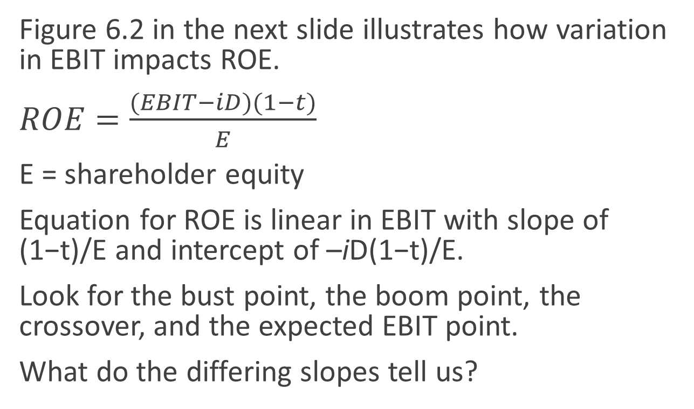
Crossover Analysis
Figure 6.2 in the next slide illustrates how variation in EBIT impacts ROE.
$ROE=\frac{(EBIT−iD)(1−t)}{E}$
E = shareholder equity
Equation for ROE is linear in EBIT with slope of (1−t)/E and intercept of –iD(1−t)/E.
Look for the bust point, the boom point, the crossover, and the expected EBIT point.
What do the differing slopes tell us?

Slide 26
FIGURE 6.2 Range of Earnings Chart for Stryker Corporation

Slide 27
How Much to Borrow?
What level of debt financing is best for a firm?
M&M’s irrelevance principle ➔ in the absence of taxes and transaction costs, firm’s debt levels do not impact value.
Total cash flows generated over time are the basis for the firm’s value.
The debt-equity split only determines how this value is apportioned between holders of debt and holders of equity.

Slide 28
Real World Issues
Taxes and transaction costs are part of the real world.
What are the various items to take into consideration when making decisions about financing with debt or equity?
Table 6.3 provides a capsule summary.

Slide 29
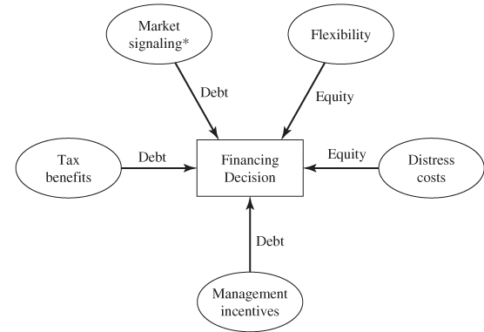
FIGURE 6.3 The Higgins 5-Factor Model for Financing Decisions

Slide 30
Tax Benefits
Interest is tax deductible.
Lowering the tax bill leaves more left over for all investors, meaning the pool of shareholders and debtholders.

Slide 31
Distress Costs
Increased debt leads to higher expected costs associated with financial distress.
Bankruptcy costs → debt can turn a mild inconvenience into a major problem involving:
major legal expenses, and/or
the sale of company assets at fire sale prices.

Slide 32
Assets
Can assets be sold off, thereby lowering the probability of bankruptcy and leaving a reasonable amount for shareholders of the bankrupt entity?
It depends on the assets.
Are they hard or soft?
Do they walk out the door at the end of the day?

Slide 33
Indirect Costs
Indirect costs come in many forms:
Lost profit opportunities from cutbacks to R&D
Lost sales as customers bail, fearing difficulties down the line, or suppliers bail out for fear that the firm won’t pay its bills

Slide 34
Conflicts of Interest
When times are rough and bankruptcy looks like it’s just around the corner, it might be reasonable for a firm to “go for broke.”
If “go for broke” fails, debtholders will pick up the tab.
If the “go for broke” works, equity holders benefit and bankruptcy is averted.
This behavior was part of the S&L crisis in the 1980s.

Slide 35
Anticipation
Debtholders are not stupid.
They anticipate what might happen if a firm winds up in financial distress, and demand compensation up front in the form of higher interest rates.
Firm’s managers should also anticipate what might happen down the line, if its debt weakened the firm, and new potential customers were frightened off.

Slide 36
Summary Checklist
When making financing choices, keep the following in mind:
The ability of the company to use additional interest tax shields over the life of the debt.
The increased probability of bankruptcy stemming from added leverage.
The cost to the firm if bankruptcy occurs.

Slide 37
Observed debt ratios, selected industries Source: Damodaran online, 2014
Do you see any patterns consistent with the trade-off between tax benefits and distress costs?

Slide 38
Flexibility
Credit squeezes happen.
A firm might not be able to borrow to stay competitive, when it needs it most to fund an important investment opportunity.
For this reason, firm managers must think about being financially flexible.
Cash is king, so finance while it’s possible, using equity if it’s available and not too expensive.

Slide 39
Issue Debt or Restrict Growth?
Remember that g* = PRAT, where T is based on prior shareholders’ equity.
The connection to financing is through R and T.
Increasing retention and increasing leverage both lead to increased g*.
Therefore, the firm faces a tradeoff, since issuing less debt and paying additional dividends to shareholders will lower growth.

Slide 40
What Is the Prudent Thing to Do?
Financial managers should recognize the true risks they confront, and balance the benefits of higher leverage against the costs of higher leverage.
Too high a T will heighten the risk that critical management decisions will fall into the hands of creditors, who have interests of their own.

Slide 41
Equity and Flexibility
Remember that financial flexibility might argue for equity financing.
Lenders are wary about lending to companies whose D/E ratio is already high, because the probability of default for these firms is higher.
Keeping D/E on the low side serves as a buffer to help the firm raise new debt more easily if necessary.

Slide 42
Market Signaling
When companies announce that they intend to raise new equity, their stock prices drop.
On average, the drop in value is about one third the size of the new issue.
Announcements about new debt have a much more neutral impact.
Announcements about stock repurchases result in a stock price increase.

Slide 43
Dilution?
Does issuing new equity lower EPS?
It can, if earnings stay the same but the number of shares goes up.
But why would earnings stay the same if the money raised from the new stock issue was put to good use?

Slide 44
Rosy Outlook
If the outlook is rosy, relative to what they would be otherwise, increased leverage:
raises g*
increases EPS
Look again at Figure 6.2.
If the outlook is not rosy, then increased equity produces these same two effects.
Therefore, what does a new equity issue suggest?

Slide 45
What Do the Tea Leaves Say?
Managers know more about a firm’s future prospects than investors.
If the market hears that a firm plans to issue new equity, should it conclude that managers have a rosy outlook?
Is it any surprise that stock prices fall when firms announce their intention to issue new equity?
Vice versa for share repurchases?

Slide 46
Opportunistic Issues
Managers might issue new equity when they view current equity as being overpriced.
Investors understand the situation, and ask for protection in the form of a lower stock price.
Therefore, managers who view the true outlook to be rosy are stuck.

Slide 47
Pecking Order
Managers might respond to these issues with a “pecking order” rule.
They fund new projects with cash, before turning to external sources.
If they fund externally, they fund first with debt.
They use equity only as a last resort.

Slide 48
Management Incentives
Being human, managers look out for #1 (themselves) before shareholders.
Their actions increase private value for themselves at the expense of shareholder value.
Aggressive debt financing can put the heat on managers, reducing the extent of this value transfer possible without risking financial distress for the firm.

Slide 49
Management Incentives
“Every company has got people sitting around who do nothing for what they get paid. If they take on a lot of debt, it forces them to cut fat.”
– Joseph Perella, financier
quoted in Lewis, Liar’s Poker

Slide 50
Financing Decision and Growth
The financing decision should weigh the relative importance of the five factors.
For rapidly growing businesses, remember to make financing subservient to operations as a source of value creation.
This means prudent debt policies.

Slide 51
What Prudence Means
Conservative leverage ratio with ample unused borrowing capacity
A modest dividend payout policy to preserve cash
If investment needs temporarily exceed funds generated by internal operations, draw down cash and use debt as a backstop.

Slide 52
More Prudent Steps
Do not issue debt if it jeopardizes financial flexibility.
Sell equity rather than jeopardize financial flexibility.
Constrain growth only as a last alternative.

Slide 53
Low Growth Firms
Slow growth companies have an easier time with financing decisions.
They have excess operating cash flows.
Financial flexibility is not an issue.
Market signaling is not an issue.
They can use the company’s healthy operating cash flow as a magnet to borrow, and then repurchase shares.

Slide 54
Benefits of Debt
Increased interest tax shields, if the company is profitable.
The share repurchase announcement will be warmly greeted by the market, and the firm’s stock price will go up.
The higher debt will inject additional discipline in respect to management incentives.

Slide 55
Stryker Corporation
Does increased debt make sense for them?
Financial flexibility?
Management incentives?
Distress costs?
What to do with the extra cash?

Slide 56
Selecting a Maturity Structure
What is the right maturity for debt?
The minimum risk maturity structure is to match the maturity of the liabilities against the maturity of the operating income from the firm’s assets.
This makes the liabilities self-liquidating.
If the debt matures too soon, there is refinancing risk.
If the debt matures too late, the company must manage the cash until maturity.

Slide 57
Why Mismatch?
Debt with the right maturity is unavailable
Mismatching will reduce total borrowing costs
Beware market timing in efficient markets

Slide 58
Inflation and Financing Strategy
During inflationary times, debts get repaid with cheaper dollars.
Investors who expect inflation ask for higher interest rates to compensate them for the inflation they expect.
Only if inflation is unexpected is it true that debtors gain at the expense of debtholders.
The deflation story is the reverse.

Slide 59
Appendix: Irrelevance Proposition
Table 6A.1 contrasts the irrelevance proposition in the case of no taxes, and in the case of taxes.
Timid is an unleveraged firm; Bold is a leveraged firm.
The analysis shows how personal leverage might substitute for corporate leverage.

Slide 60
Items of Note
Retention rate = 0
Bold is 80% debt financed
Equity investment required for the two firms
Rate of return on equity investment
Rate of return on personal investment
Extent to which homemade leverage can substitute for corporate leverage
Impact of taxes on issues above

Slide 61
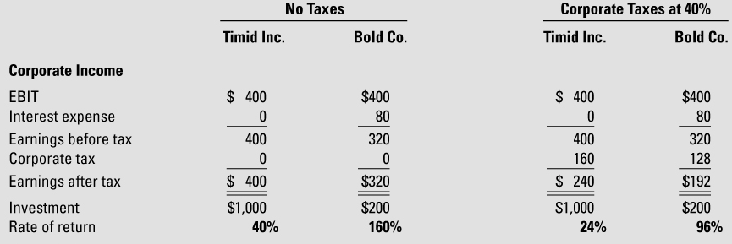
TABLE 6A.1 In the Absence of Taxes, Debt Financing Affects Neither Income nor Firm Value; In the Presence of Taxes, Prudent Debt Financing Increases Income and Firm Value

Slide 62
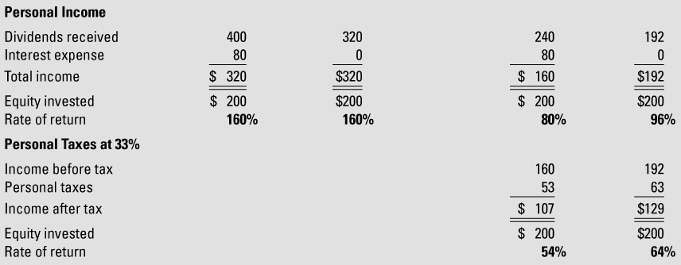
TABLE 6A.1 In the Absence of Taxes, Debt Financing Affects Neither Income nor Firm Value; In the Presence of Taxes, Prudent Debt Financing Increases Income and Firm Value (cont.)

