Slide 1
Discounted Cash Flow Techniques
Chapter Seven

Slide 2
Capital Budgeting
The future of a company lies in the investments it makes today.
Investment project proposals are the responsibility of all managers in the organization.
Capital budgeting is the financial evaluation of project proposals.
Weigh outlay today vs. expected future benefits

Slide 3
DCF
Discounted cash flow analysis is the backbone of modern academic finance.
DCF is used to evaluate cash flow streams whose costs and/or benefits extend beyond the current year.

Slide 4
Figures of Merit
Three-step procedure:
Estimate the relevant cash flows.
Calculate a figure of merit for the investment, summarizing the investment’s economic worth.
Compare the figure of merit to an acceptance criterion.

Slide 5
Estimating Cash Flows
The first step is challenging.
Doing it well requires a thorough understanding of the company’s markets, competitive position, and long-run intentions.
Potential estimation difficulties relate depreciation, financing costs, working capital investments, shared resources, excess capacity, and contingent opportunities.

Slide 6
TABLE 7.1 Cash Flows for Container-Loading Pier ($ millions)

Slide 7
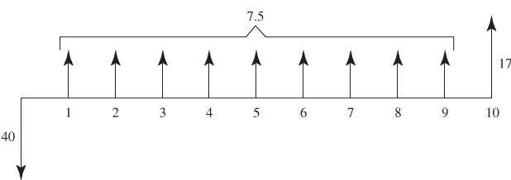
FIGURE 7.1 Cash Flow Diagram for Container-Loading Pier

Slide 8
Payback Period and Accounting Rate of Return
The payback period is the amount of time the company must wait before recouping its original investment.
The pier’s payback period: 40/7.5 = 5⅓
Accounting rate of return is the ratio of annual average cash flow to total cash outflow.
The pier’s accounting rate of return: [(7.5 × 9 + 17)/10]/40 = 21.1%

Slide 9
Problems with These Figures of Merit
The payback period ignores cash flows after payback, and also ignores the time value of money.
The payback period is sometimes useful as a rough guide to project risk.
The accounting rate of return ignores the timing of cash flows.

Slide 10
Time Value of Money
Reasons why a dollar today can be worth more than a dollar in the future:
Inflation
Uncertainty
Opportunity cost

Slide 11
Compounding and Discounting
Future value received in a year from $1 invested today at 10% is $1.10.
Present value of $1.10 to be paid in a year when the interest rate is 10% is $1.

Slide 12
Two Years
With compounding, future value received in 2 years from $1 invested today at 10% is
$1.21 = 1 × 1.1 × 1.1
In reverse, the present value of $1.21 to be paid in two years when the interest rate is 10% is obtained by
1.21/1.1² = 1

Slide 13
Interpretation of Discount Rate
If a company has cash on hand, the discount rate reflects the company’s opportunity cost of capital.
If a company raises the cash externally, the discount rate measures the investor’s opportunity cost of capital.

Slide 14
By Extension to t Years
By extension from 2 years to t years.
Divide by 1.1^{t} in the present value formula.
Multiply by 1.1^{t} in the future value formula.

Slide 15
You try it. Compounding and discounting cash flows.
Your employer promises you a bonus of $10,000 in 3 years. If your discount rate is 6%, what is the present value of this bonus?
You invest $5,000 in a savings account that pays 3% annually. How much will you have in the account in 10 years?
Notes:
10,000/1.06³ = $8,396.19
5,000 × 1.03¹⁰ = $6.719.58

Slide 16
Solving Present Value Problems with Calculators or Spreadsheets
PMT
FV
…
0
1
2
3
4 … n
PV

Slide 17
Using a calculator to find the future value of a $100 in 22 years, at an interest rate of 7%
Why is the answer negative?

Slide 18
Using a spreadsheet to find the future value of a $100 in 22 years, at an interest rate of 7%
Why are there brackets around these variables?

Slide 19
You try it. Find the present value of an annuity.
What is the present value of $1,000 to be received at the end of each the next 20 years if the discount rate is 12%?
Notes:
=PV(0.12,20,1000) = -7,469.44
N=20, I/YR=12, PMT=1,000, FV=0, answer is PV=-7,469.44

Slide 20
Equivalence and NPV
Two cash flow streams with the same present value can be transformed into each other.
Net present value is the present value of the future expected cash flows minus the initial investment.
NPV measures the amount of value creation.
Decline negative NPV projects, and accept non-negative NPV projects.

Slide 21
Example of Equivalence
A contract that pays $2 million per year for 4 years has a present value of $5.71 million at a 15% discount rate.
The chart below shows how $5.71 million can be transformed into the cash flows from the contract.

Slide 22

Benefit-Cost Ratio
$$BCR= \frac{PV of cash inflows}{PV of cash outflows}$$
The BCR is also known as the profitability index.

Slide 23
IRR
The internal rate of return (IRR) is “the” discount rate that makes the PV of a stream of cash flows equal to zero.
Loosely speaking, the IRR can be regarded as the rate of return associated with the cash flows.

Slide 24
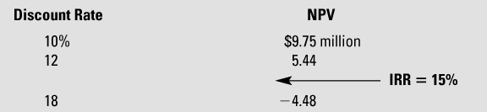
TABLE 7.2 NPV of Container Pier at Different Discount Rates

Slide 25
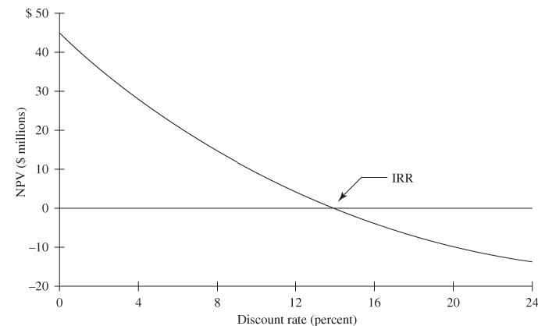
FIGURE 7.2 NPV of Container Pier at Different Discount Rates

Slide 26
Uneven Cash Flows
If the payment is not the same in every period, then we use different functions.
Instead of the spreadsheet functions PV or RATE, use NPV or IRR.
With a calculator, use the Cash Flow keys (e.g., CF_{j}) instead of the Annuity keys (N, I/YR, PMT, etc.)

Slide 27
Example of Uneven Cash Flows

Slide 28
TABLE 7.3 Finding the IRR and NPV with Uneven Cash Flows
Why is the first value B4 instead of B3?

Slide 29
You try it. Find the NPV and IRR of this project.
Notes:
=NPV(B4,C2:G2)+B2 = 599.37
=IRR(B2:G2) = 50.2%

Slide 30
Applications and Extensions: Bond Valuation
Par value of $1,000
Coupon rate of 8%
Maturity is 9 years
Required return is 7%
PV = $1,065.15
Why is the present value higher than the par value?

Slide 31
You try it. Bond valuation.
Wells Fargo has a $1,000 par value bond that matures in 9 years and carries a coupon rate of 4.95% (assume annual coupon payments). If the appropriate discount rate is 4.0%, what is the value of the Wells Fargo bond?
Notes:
=PV(0.04,9,49.5,1000) = -1,070.64

Slide 32
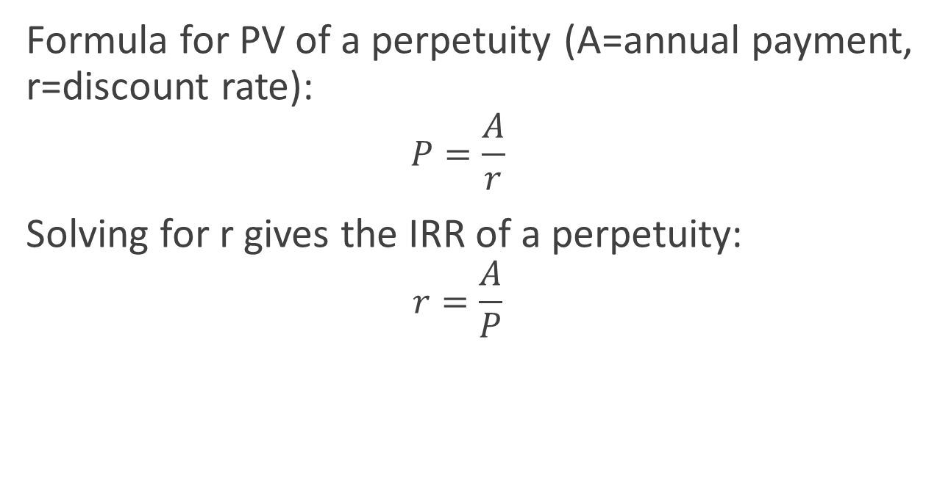
Applications and Extensions: IRR of a Perpetuity
Formula for PV of a perpetuity (A=annual payment, r=discount rate):
$$P=\frac{A}{r}$$
Solving for r gives the IRR of a perpetuity:
$$r=\frac{A}{P}$$

Slide 33
Applications and Extensions: Equivalent Annual Cost
The equivalent annual cost is an annuity payment that has the same present value as the actual cash flows on an investment.
Example: What annual lease payment would have to be charged to recover the cost of the $40 million container pier (assume a life of 12 years and a $4 million residual value at the end of 12 years).

Slide 34
Mutually Exclusive Alternatives and Capital Rationing
Situation → there is more than one way to accomplish an objective, and the investment problem is to select the best alternative.
When investments are independent, all three figures of merit – NPV, IRR, BCR – will generate the same investment decision.

Slide 35
Capital Rationing
Capital rationing exists when the decision maker has a fixed investment budget that is not to be exceeded.
Task is to rank the opportunities according to their investment merit.
Capital rationing can alter the ranking of alternative independent investments.

Slide 36
IRR in Perspective
IRR has more intuitive appeal than NPV and BCR.
IRR can sometimes allow the decision maker to sidestep the question of what is the right discount rate for the investment.
At the same time, there might be multiple values for IRR, or no IRR at all.
IRR might be invalid for analyzing mutually exclusive alternatives under capital rationing.

Slide 37
Determining the Relevant Cash Flows
Two principles:
Cash flow principle: time stamp cash flows, recording them when they actually occur.
With-without principle: record only cash flow differences that occur because an investment is made as opposed to not made.

Slide 38
Example
Consider Table 7.4, showing forecasted costs and benefits for a project introducing a new line of smartphones.
The Capital Expenditure Review Committee attacked the proposal from all sides.
Where are the problems?

Slide 39
Structure of Table 7.4
Top portion shows initial investment and anticipated salvage value.
Center portion shows forecasted income statement.
Bottom portion shows “Free Cash Flow.”
FCF = Earnings after tax + Noncash charges − Investment

Slide 40
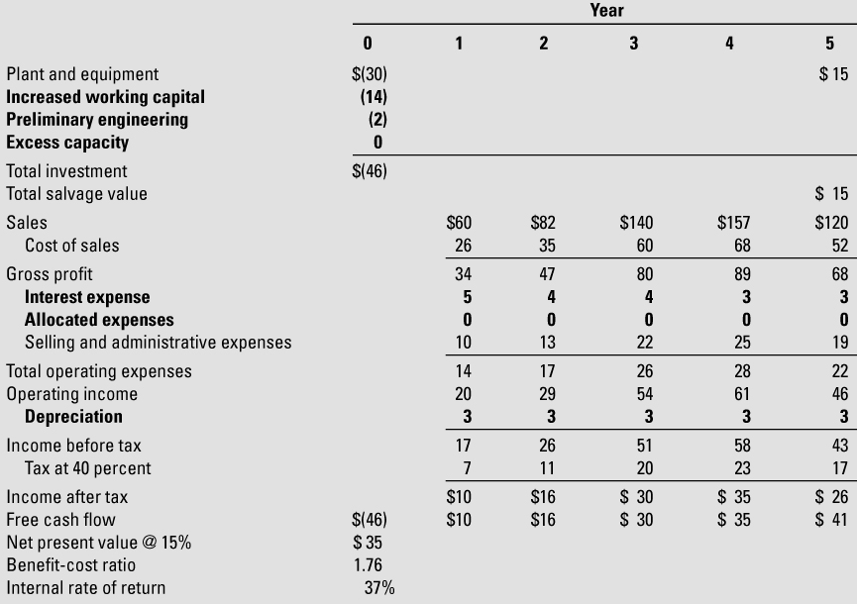
TABLE 7.4 Division Financial Analysis of New Line of Smartphones ($ millions)

Slide 41
Depreciation
Is it OK to subtract depreciation from gross profit to compute profit after tax?
Is physical depreciation captured by salvage value being less than the initial investment?
Does including both depreciation and salvage value amount to double counting?

Slide 42
Tax
Depreciation is relevant for computing tax.
After-tax cash flow = Operating income − Taxes
Deduct depreciation to compute tax and then add it back to find relevant cash flow ATCF (investment’s after-tax cash flow).
The next slide illustrates the concept.

Slide 43
The Two-Step Treatment of Depreciation when Calculating After-tax Cash Flow (ATCF)

Slide 44
Working Capital and Spontaneous Sources
The with-without principle indicates that changes in working capital that are the result of an investment decision are relevant to the decision.
Working capital needs typically fluctuate with sales.
Working capital investments typically have large salvage values, with associated inflows approximately as large as the outflows.

Slide 45
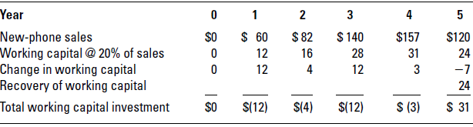
Calculating the Investment in Working Capital

Slide 46
Sunk Costs
The with-without principle implies that sunk costs are not part of project cash flows.
They might need to be recorded, but elsewhere.
Psychologically difficult to ignore sunk costs.
In some circumstances, it will have been unwise to adopt a project, but once undertaken, it is appropriate to continue the project.

Slide 47
Allocated Costs
Bearing the fair share of overhead?
With-without principles says to ignore allocated overhead because it’s fixed.
The problem is that, over time, overhead might not be fixed but may indeed vary with the size of the business.

Slide 48
Cannibalization
Should we account for the fact that sales of the new product will eat into sales of old products?

Slide 49
Excess Capacity
Is the use of excess capacity free?
If the excess capacity has no alternative use, then that is the case.
If using the excess capacity prevents the generation of cash flows from an alternative, then the with-without principle indicates that the foregone cash flows should be part of the analysis to reflect the opportunity cost.
Often important to link to future decisions.

Slide 50
Financing Costs
Financing costs refer to any dividend, interest, or principal payments associated with financing an investment.
The standard procedure is to reflect the cost of money in the discount rate and ignore financing costs in the cash flow projections.
This issue comes up again in the next chapter.

Slide 51
Table 7.5
The following table presents the revised figures for the project proposal.
The bold figures reflect changes stemming from the treatment of depreciation, working capital, sunk costs, interest expenses, allocated expenses, and excess capacity.

Slide 52
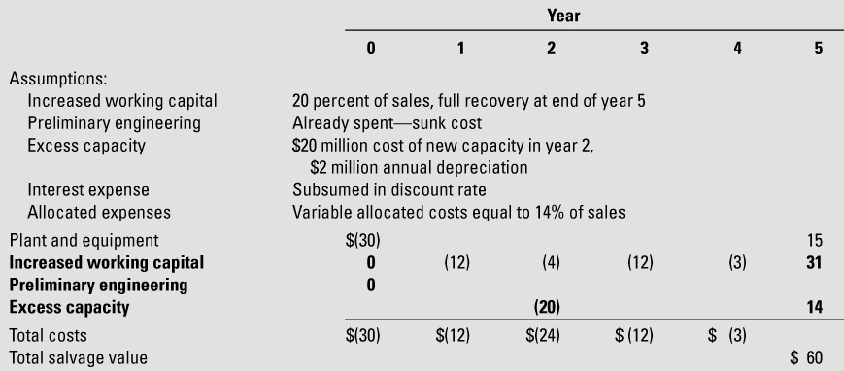
TABLE 7.5 Revised Financial Analysis of New Line of Smartphones ($ millions)

Slide 53
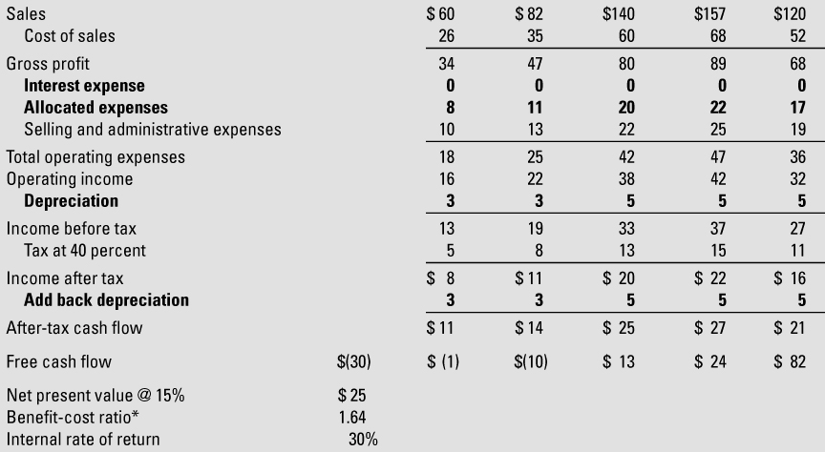
TABLE 7.5 Revised Financial Analysis of New Line of Smartphones ($ millions) (cont.)

Slide 54
You try it. Find the project NPV.
Anwar Corporation is considering a new project to manufacture solar calculators.
The project is expected to generate $2.5 million in incremental revenues and $0.6 million in incremental operating expenses each year for 5 years.
The project will require an initial expenditure of $5 million for new equipment. The machinery will be depreciated straight line to a salvage value of $0 over 5 years.
The project will require a one-time increase in working capital of $0.5 million in year 0.
The tax rate is 30%; the appropriate discount rate is 12%.
Notes:
This is a long problem, so the solution is on the next slide.

Slide 55
You try it. Solution

Slide 56
APPENDIX: Mutually Exclusive Alternatives and Capital Rationing
When investments are independent, the decision to accept or reject is the same regardless of which figure of merit is employed.
When investments are mutually exclusive, the decision task is not as simple.

Slide 57
Example
Figure 7A-1 illustrates two alternative projects, an inexpensive option and an expensive option.
At the bottom of the figure, the three figures of merit are displayed.

Slide 58
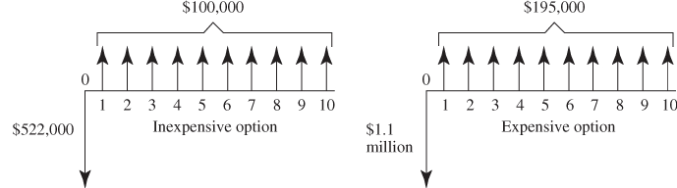
FIGURE/TABLE 7A.1 Alternative Service Station Designs
Since the projects are mutually exclusive, which should be chosen?

Slide 59
NPV
Although the inexpensive option has higher IRR and BCR, it is NPV that is the criterion that is relevant.
NPV measures total value creation, not value creation per dollar invested.
BCR and IRR are insensitive to the scale of the investment.

Slide 60
Unequal Lives
In the previous example, the two projects had the same lives.
What happens if they have different lives?
Suppose alternative #1 has a lower initial cost, higher maintenance costs, and a shorter life than alternative #2.
Straight NPV is not apples-to-apples comparison because the time frames are different, and some cash flows are implicitly neglected.

Slide 61
What to Do?
Restructure the problem with a common investment horizon to factor in omitted cash flows, such as replacement for alternative #1 at the end of its life.
Compute equivalent annual cost in an attempt to measure apples-to-apples.
Beware of hidden assumptions when doing either, such as inflation, changing prices, etc.

Slide 62
Capital Rationing
Table 7A.2 describes 4 investments that are mutually exclusive in a capital rationing decision environment.
The capital budget is capped at $200K.
One approach is to rank order alternative investments by BCR, and proceed down the list until the budget is exhausted or BCR falls below 1.

Slide 63
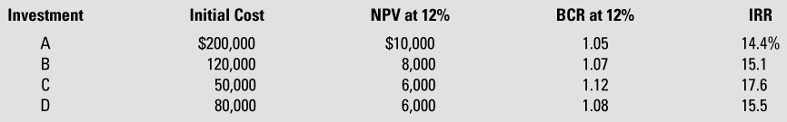
TABLE 7A.2 Four Independent Investment Opportunities under Capital Rationing
(Capital Budget = $200,000)

Slide 64
Fractional Investments
The “rank by BCR” rule will work if fractional investments are possible.
For example, choose C, D, and 7/12 of B.
Otherwise, it is typically necessary to look at every possible configuration of projects selected to choose the one that creates the most value.

Slide 65
Additional Issues
What’s wrong with just ranking by NPV?
In this setting, the goal is to maximize total NPV across project configurations, but because of the different investment amounts, doing so requires looking at NPV per dollar first.
This is what BCR does.
Be careful about IRR, because it does not always give the same answer as BCR.

Slide 66
Future Opportunities
Keep in mind that budgets apply over time periods, not just at points in time.
Therefore, focus on future opportunities as well as current opportunities, since undertaking an investment today can preclude undertaking a better investment in the future if they fall within the same budgeting period.

Slide 67
A Decision Tree
Figure 7A.2 provides a capsule summary of the key points involved in choosing an appropriate figure of merit.

Slide 68
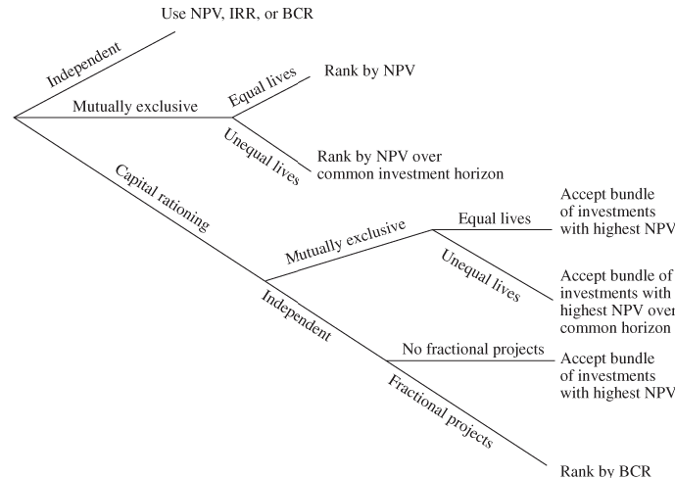
FIGURE 7A.2 Capital Budgeting Decision Tree

