Slide 1
Risk Analysis in Investment Decisions
Chapter Eight

Slide 2
DCF, Risk, and Return
Most people are averse to risk.
How should considerations of risk be incorporated into DCF?
In modern finance, the risk-return trade-off is linear and expressed by the market line.
The market line is an idealization.
See Figure 8.1.

Slide 3
FIGURE 8.1 The Risk-Return Trade-Off

Slide 4
Balance
Key question: is the expected return sufficient to justify the risk?
In Figure 8.1, B is superior to A, despite its lower expected return.
Why?
B can be levered up to outperform A.
Key innovation: incorporate risk into discount rate feature in DCF.

Slide 5
Risk Defined
There are two aspects to investment risk:
Dispersion
Correlation
Figure 8.2 illustrates dispersion.
Dispersion risk is often known as an investment’s total risk.

Slide 6
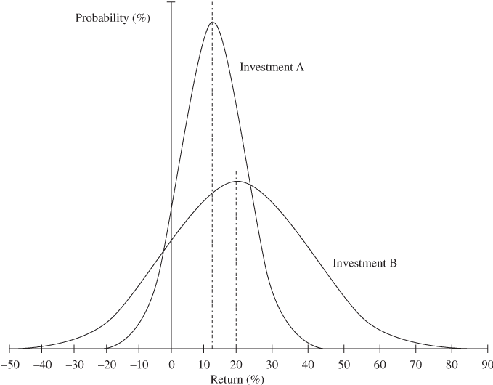
FIGURE 8.2 Illustration of Investment Risk: Investment A Has a Lower Expected Return and a Lower Risk than B

Slide 7
Risk and Diversification
Example: ice cream stand and umbrella shop are two possible investments
Correlated payoffs
The two investments are risky when viewed in isolation, but not when assembled into a portfolio.
Table 8.1 illustrates.

Slide 8
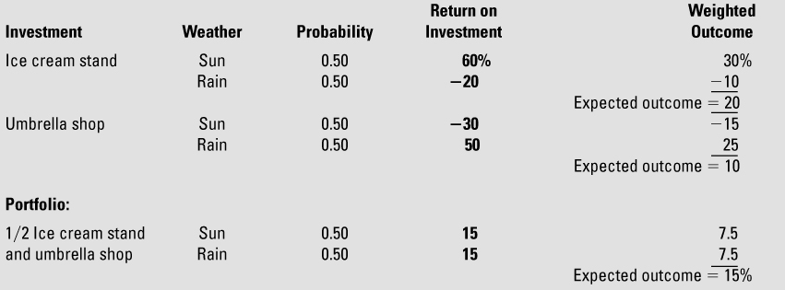
TABLE 8.1 Diversification Reduces Risk

Slide 9
Decomposing Total Risk
Total risk = Systematic risk + Unsystematic risk
Systematic risk reflects exposure to economy-wide events that cannot be eliminated through diversification.
In the preceding example, systematic risk = 0.

Slide 10
FIGURE 8.3 The Power of Diversification in Common Stock Portfolios
How many stocks does it take to make a diversified portfolio?

Slide 11
Estimating Investment Risk
Can estimate risk in a particular investment opportunity using:
Scientific or historical evidence (such as with oil and gas development)
Extrapolation based on past variability and performance (such as opening a new restaurant in a chain)
Subjective assessment based on knowledge of the industry

Slide 12
Three Techniques for Estimating Investment Risk
Sensitivity analysis (to changes in a single parameter)
Scenario analysis (optimistic, pessimistic, and most likely forecast)
Simulation (computer-generated multiple scenarios)
The chief value of these techniques is to help the analyst think systematically about the economic determinants.

Slide 13
Risk-Adjusted Discount Rates
How do you incorporate the degree of risk into the evaluation of an investment opportunity?
Use a risk-adjusted discount rate.
A higher discount rate reduces NPV.
The alternative is to compare IRR to a risk-adjusted benchmark, where the amount the benchmark is raised to reflect the degree of risk.

Slide 14
Example
Initial investment required = $10m
Future cash flows expected to be $2m for 10 yrs, but these are risky
Discount future cash flows at 7% more than risk-free rate of 5%
NPV = -10 + 11.3 = 1.3
Accept risk.
IRR = 15% > 12% (= 5% + 7%)

Slide 15
Ballparking
Most executives have a rough sense of how stocks have performed relative to bonds over time.
They know that stocks have outperformed government bonds by about 6.3 percentage points over time, which allows for a rough calculation of what discount rate to use for a project with average risk.

Slide 16
The Cost of Capital
How do you find the appropriate risk-adjusted discount rate for a specific investment?
Do you just add an estimate like 7% to the risk-free rate?
Use the cost of capital, which is the minimum rate of return the company must earn on its existing assets to meet the expectations of its capital providers.
The cost of capital can serve as the discount rate for a project of average risk.

Slide 17
The Cost of Capital Defined
The before-tax cost of capital is a weighted average of the return required by creditors and the return required by owners.
The weights are the relative liabilities of the two groups, the debt-to-capital and equity-to-capital ratios.

Slide 18
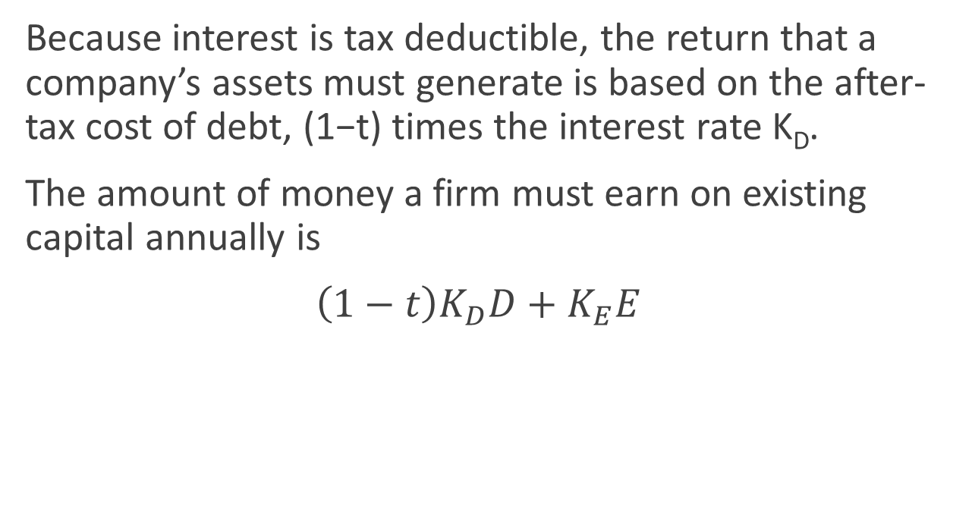
Tax
Because interest is tax deductible, the return that a company’s assets must generate is based on the after-tax cost of debt, (1−t) times the interest rate K_{D}.
The amount of money a firm must earn on existing capital annually is
$\left(1−t\right)K_{D}D+K_{E}E$

Slide 19
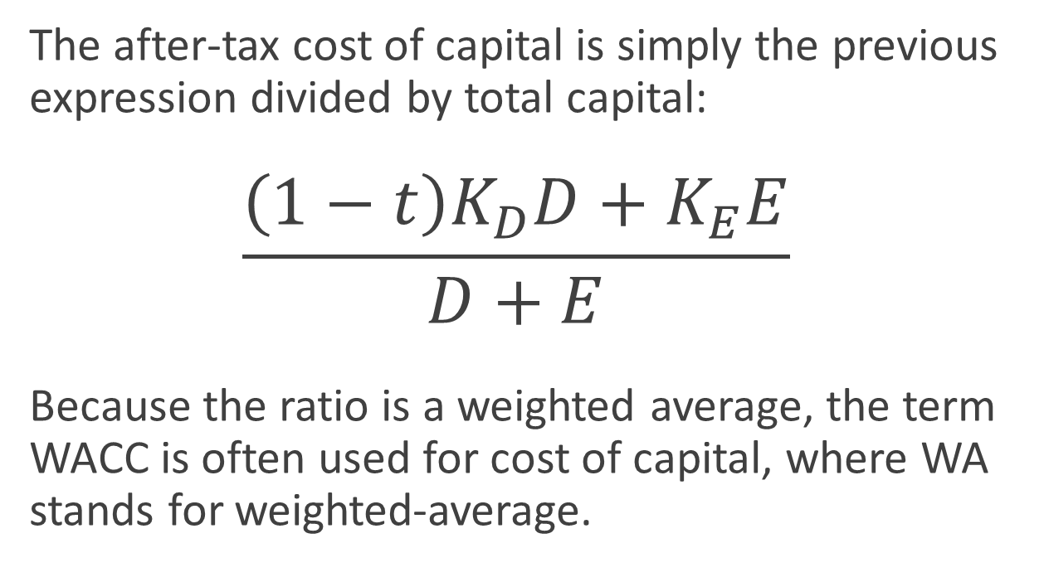
Formula for Cost of Capital
The after-tax cost of capital is simply the previous expression divided by total capital:
$$\frac{\left(1−t\right)K_{D}D+K_{E}E}{D+E}$$
Because the ratio is a weighted average, the term WACC is often used for cost of capital, where WA stands for weighted-average.

Slide 20
Cost of Capital and Stock Price
What happens when a firm earns more than its cost of capital?
Owners capture the entire excess.
If the situation persists, investors will bid up the price of the firm’s stock until the excess disappears.
A similar statement applies if the excess is negative.
The cost of capital is the return that “keeps the firm’s stock price constant.”

Slide 21
Example
What are the right weights to use when computing the WACC?
Weights based on book values or market values?
Table 8.2 on the next slide illustrates a case when the two sets of weights are quite different from each other.
Note that the table assumes that the market value of the debt is equal to the book value of the debt.

Slide 22

TABLE 8.2 Book and Market Values of Debt and Equity for Stryker Corporation (December 31, 2013)
Which is more appropriate for calculating the cost of capital?

Slide 23
Comments
In the last slide, market value of equity exceeds book value of equity.
Later in the chapter we will discuss what the market-to-book ratio measures for equity.
For now, keep in mind that a firm’s owners want a return on the current (market) value of their holdings, not on the historical (book) value of their investment.

Slide 24
The Cost of Debt
What return (K_{D}) are the company’s bonds yielding?
What is the marginal corporate tax rate t?
Multiply K_{D} by (1−t) to obtain the after-tax cost of debt.

Slide 25
The Cost of Equity
For preferred stock which pays a fixed dividend, and has a market price, use the same technique as with bonds, an IRR calculation.
For common stock, the issue is more difficult, because the company makes no promise about the future cash payouts to shareholders.

Slide 26
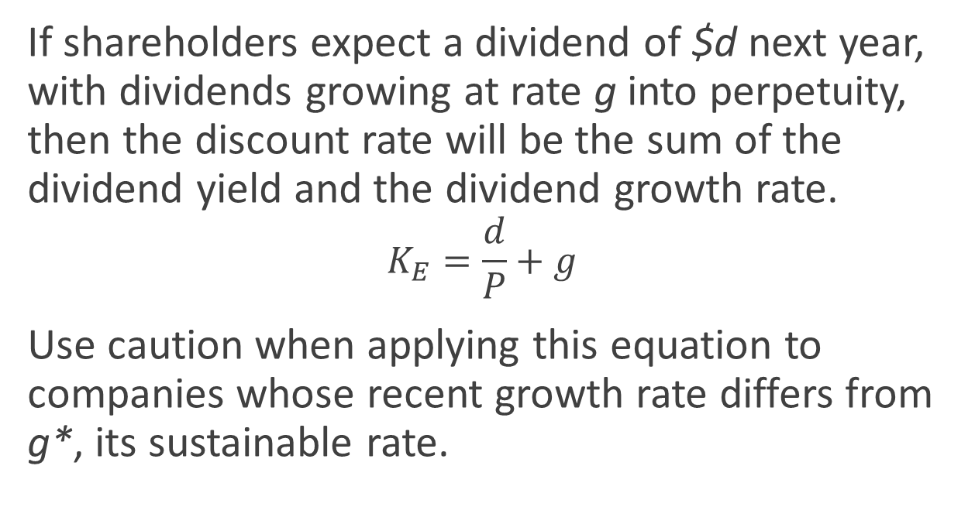
Perpetual Growth
If shareholders expect a dividend of $d next year, with dividends growing at rate g into perpetuity, then the discount rate will be the sum of the dividend yield and the dividend growth rate.
$$K_{E}=\frac{d}{P}+g$$
Use caution when applying this equation to companies whose recent growth rate differs from g*, its sustainable rate.

Slide 27
You try it. Calculate the cost of equity using the perpetual growth equation.
Waste Management’s annual dividend is $1.50 per share and its current stock price is $44.50. Assuming a 4% annual growth rate in dividends, what is Waste Management’s cost of equity?
Notes:
K_{E} = 1.5/44.50 + 0.04 = 7.4%

Slide 28
Let History Be Your Guide
The expected return on a risky asset is the sum of:
the risk-free rate
the inflation premium
the risk premium
The sum of the first two terms is the interest rate on a government bond.

Slide 29
Beta
Since 1928, the risk premium has been about 6.3%.
Some risky assets are riskier than others.
To customize expected return computation, use beta.
The risk premium is equal to the product of a beta and the historical excess return on common stocks.
For the average share, beta = 1.

Slide 30
How to Estimate Beta?
See Figure 8.4.
What are on the x-axis and y-axis?
What does a point on the graph mean?
What does the slope of the best-fit line measure?
What is the implication attached to a steeper line?
What is the meaning of points being off the line?

Slide 31
FIGURE 8.4 Stryker’s Beta is the Slope of the Best-Fit Line

Slide 32
Beta Table
Examine Table 8.3.
How variable are betas across companies?
Which companies and industries are low risk?
Which are high risk?

Slide 33
TABLE 8.3 Representative Company Betas

Slide 34
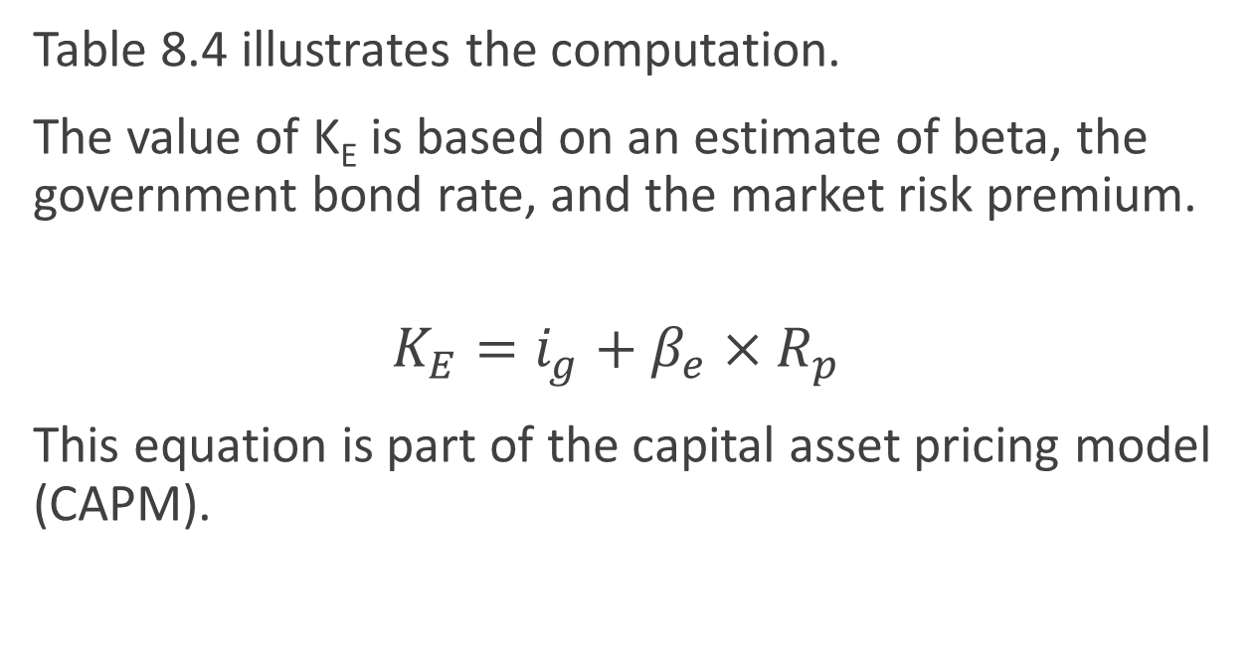
Computing the Cost of Equity
Table 8.4 illustrates the computation.
The value of K_{E} is based on an estimate of beta, the government bond rate, and the market risk premium.
$$K_{E}=i_{g}+β_{e}×R_{p}$$
This equation is part of the capital asset pricing model (CAPM).

Slide 35
You try it. Calculate the cost of equity using the CAPM.
The Coca-Cola Company’s beta is 0.73. The long-term government bond rate is 2.0%. Assuming 6.3% for the historical excess return on common stocks, what is Coca-Cola’s cost of equity capital?
Notes:
K_{E} = 2.0% + 0.73×6.3% = 6.6%

Slide 36
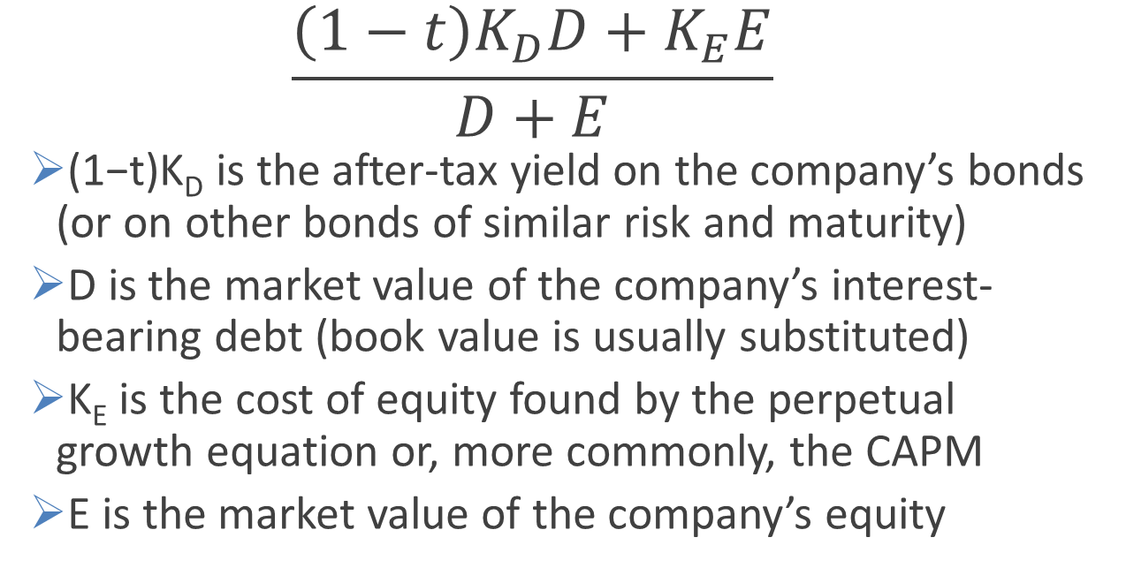
WACC: Putting it All Together
$$\frac{\left(1−t\right)K_{D}D+K_{E}E}{D+E}$$
(1−t)K_{D} is the after-tax yield on the company’s bonds (or on other bonds of similar risk and maturity)
D is the market value of the company’s interest-bearing debt (book value is usually substituted)
K_{E} is the cost of equity found by the perpetual growth equation or, more commonly, the CAPM
E is the market value of the company’s equity

Slide 37

TABLE 8.4 Calculation of Stryker’s Weighted-Average Cost of Capital

Slide 38
You try it. Calculate the weighted-average cost of capital
Information for Nike, Inc.:
Current stock price = $96.00
Beta = 0.50
Number of shares outstanding = 863 million
Book value of debt = $2.6 billion
Yield on bonds with risk similar to Nike = 2.8%
Tax rate = 25%
Market information:
Yield on long-term government bonds = 2%
Market risk premium = 6.3%
Notes:
K_{E} = 2.0% + 0.5×6.3% = 5.2%
E = 863M×96 = 82.8 B
K_{W} = [(1-0.25)2.8%(2.6) + 5.2%(82.8)]/(85.4) = 5.1%

Slide 39
The Cost of Capital in Investment Appraisal
The cost of capital is the return investors require that the company earn on its existing assets.
What about new investments?
Must they earn the cost of capital?
Only if the new investments feature the same risk as the risk associated with existing assets.

Slide 40
Varying Risk
If the risk associated with the new investments differs from the existing assets, additional considerations enter.
Consider the market line displayed in the next slide.
Higher risk implies a higher risk-adjusted discount rate.

Slide 41
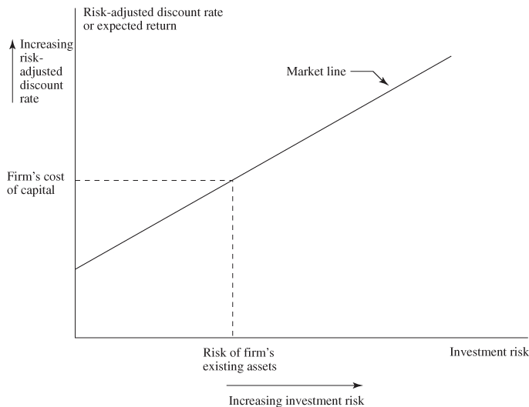
FIGURE 8.5 An Investment’s Risk-Adjusted Discount Rate Increases with Risk

Slide 42
Multiple Hurdle Rates
Three possible ways to adjust hurdle rates for differing investment risks (Be aware that multiple hurdle rate techniques involve arbitrary elements):
For large projects, identify an industry in which the contemplated investment is of average risk and estimate the WACC for this industry.
→Try to find “pure plays,” if possible.

Slide 43
Technique #2
In a multidivision company, calculate a separate cost of capital for each division.
Otherwise, the company runs the risk of accepting projects that are too risky and rejecting projects that are too safe.
Try to use primary division competitors, with pure plays, if possible.

Slide 44
Technique #3
Use risk buckets for different project types, and assign projects to buckets.
Examples of buckets, ranked from low risk to high risk, are:
replacement or repair
cost reduction
expansion
new product

Slide 45
Four Pitfalls
The general technique for doing investment appraisal is straightforward:
Estimate the cash flows.
Estimate the risk.
Identify the appropriate risk-adjusted discount rate.
Discount the cash flows at the appropriate risk-adjusted rate.
Be aware of the pitfalls described in the next few slides.

Slide 46
Pitfall #1: Enterprise Perspective vs. Equity Perspective
The enterprise perspective refers to the whole company.
The equity perspective refers to the owners (shareholders).
The next 2 slides contrast the two perspectives for a particular project, where the WACC is 14%, K_{D}(1−t) = 5%, K_{E} = 20%, and the company is 40% debt-financed.

Slide 47
Cash Flow Diagrams for ABC Industries’ Investment:
The enterprise perspective
$14 million per year
1 2 3 … …∞
$100 million
IRR = 14/100 = 14%

Slide 48
Cash Flow Diagrams for ABC Industries’ Investment:
The equity perspective
$12 million per year
1 2 3 … …∞
$60 million
IRR = 12/60 = 20%

Slide 49
The Pitfall
Don’t compare the 20% IRR in the equity perspective to the WACC.
Equity flows are riskier.
Which perspective is better?
The enterprise perspective is cleaner, as it makes the capital structure element more explicit.

Slide 50
Pitfall #2: Inflation
The pitfall is to omit inflation in the estimation of cash flows, but to include it in the discount rate.
This pitfall leads to an overly conservative investment policy.
Table 8.5 illustrates the point, where the error results from failing to build inflation into the price forecast.

Slide 51
TABLE 8.5 When Evaluating Investments under Inflation, Always Compare Nominal Cash Flows to a Nominal Discount Rate or Real Cash Flows to a Real Discount Rate ($ millions)

Slide 52
Pitfall #3: Real Options
The pitfall is failing to build future managerial decisions into a project.
Decisions stem from potential mid-course corrections.
Options to:
Abandon
Follow-on
Defer

Slide 53
Options
General Design’s Diamond Film project
Table 8.6a relates to a one-time decision.
Table 8.6b relates to a situation where the firm can abandon the project at the end of year 2 and dispose of the assets in year 3.

Slide 54
Example
Table 8.6a features 2 possible contingencies, success and failure.
Hurdle rate is 15%.
NPV@ 15% = −$18 million

Slide 55
TABLE 8.6a General Design’s Diamond Film Project ($ millions)

Slide 56
Example
Table 8.6b features 2 possible contingencies, success and failure, with option to abandon in year 2, and sell off assets for $50 million.
Hurdle rate is 15%.
NPV@ 15% = $7 million
Improved NPV comes from exercising option to abandon and selling assets for $50 million instead of continuing to lose stream of $10 million per year.

Slide 57
TABLE 8.6b General Design’s Diamond Film Project ($ millions)

Slide 58
Timing Option
Wind Resources, Inc. (WRI)
Develop and sell today
OR
Wait a year and sell at a higher or lower price, depending on prevailing natural gas
It might make sense to wait, unless the costs of waiting exceed the value of the option destroyed.

Slide 59
General Features
Timing option can only be exercised once.
Value of option rises with uncertainty.
Smart managers think about embedded options, qualitatively if not quantitatively.
Smart managers work to maintain and acquire embedded options, e.g. R&D.

Slide 60
Pitfall #4: Excessive Risk Adjustment
Applying a constant risk-adjusted discount rate to distant cash flows leads to a large penalty.
Table 8.7 illustrates the issue by contrasting a 1-year discount with a 10-year discount.

Slide 61
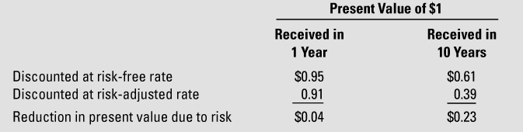
TABLE 8.7 Use of a Constant Risk-Adjusted Discount Rate Implies that Risk Increases with the Remoteness of a Cash Flow (Risk-Free Rate = 5%; Risk-Adjusted Rate = 10%)

Slide 62
Back to Real Options
The constant risk-adjusted discount rate assumption is special.
Think back to the options issue.
Most of the uncertainty might resolve itself after 2 years.
Given success in the first 2 years, the appropriate discount rate going forward, for 90% success, might be less than 15%.

Slide 63
Economic Value Added
Economic value added is the difference between after-tax EBIT and the required return on capital.
If economic value added is positive in a given year, the firm has earned more than the amount required to compensate debtholders and shareholders.
For an example, see Panel a of Table 8.8.

Slide 64
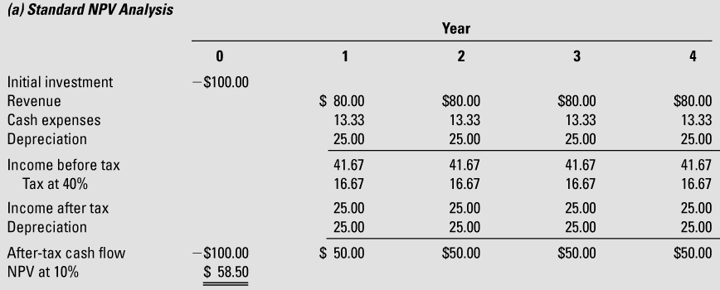
TABLE 8.8 Discounting an Investment’s Annual EVA Stream Is Equivalent to Calculating the Investment’s NPV

Slide 65
EVA and Investment Analysis
The present value of an investment’s EVA stream is equal to the NPV of the investment.
See Panel b of Table 8.8.

Slide 66
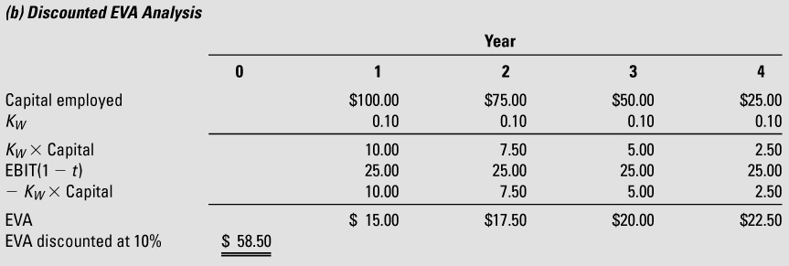
TABLE 8.8 Discounting an Investment’s Annual EVA Stream Is Equivalent to Calculating the Investment’s NPV (cont.)

Slide 67
EVA’s Appeal
There is no need to compute EVA in order to compute NPV.
Why compute EVA at all?
The answer is uniformity.
Capital budgeting, performance appraisal, and incentive compensation can all be based on EVA.
This is more streamlined than relying on a host of measures such as NPV, IRR, BCR, ROE, ROIC, EPS, etc.

Slide 68
APPENDIX: Asset Beta and Adjusted Present Value
Companies have two betas: an equity beta discussed in the chapter and an asset beta.
The asset beta measures the systematic risk of the company’s assets.
The asset beta corresponds to the equity beta when the firm is unlevered.

Slide 69
Beta and Financial Leverage
Shareholders face two distinct risks:
The basic business risks inherent in the markets in which the firm competes.
The added financial risk created by the use of debt financing.
Asset beta measures the business risk, while equity beta measures the combined effect of business and financial risks.

Slide 70
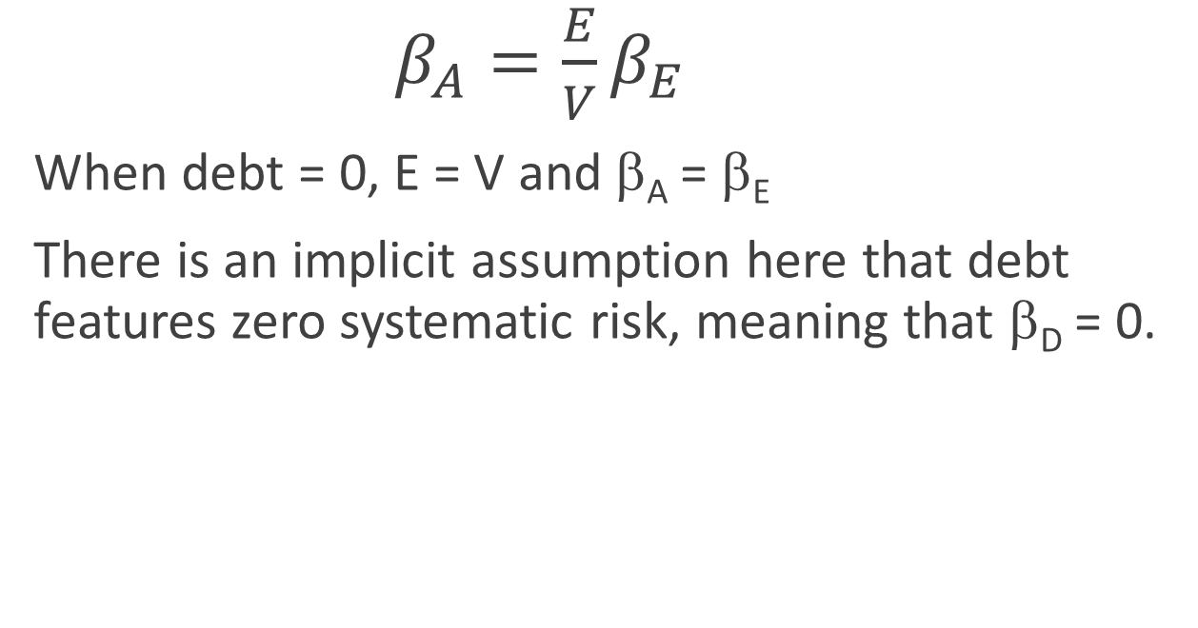
Formula for Asset Beta
$β_{A}=\frac{E}{V}β_{E}$
When debt = 0, E = V and β_{A} = β_{E}
There is an implicit assumption here that debt features zero systematic risk, meaning that β_{D} = 0.

Slide 71
Using Asset Beta to Estimate Equity Beta
Three steps to unlever and relever betas for a target company:
Identify industry competitors, calculate the asset beta of each by unlevering equity beta.
Compute an industry asset beta as the average of the competitor asset betas.
Relever the industry asset beta to the target company’s capital structure.

Slide 72
Similar Business Risks
The underlying idea is that firms in the same industry face the same business risk.
Averaging across competitors reduces unavoidable noise in the conventional single firm approach.

Slide 73
Asset Beta and APV
The after-tax WACC both reflects risk and captures the benefits of the tax shield.
When the firm’s capital structure changes over time, a better approach is to compute the value of the tax shields separately.
Interest tax shields are but one form of financing side effect.

Slide 74

TABLE 8A.1 Estimate of Industry Asset Beta for Stryker

Slide 75
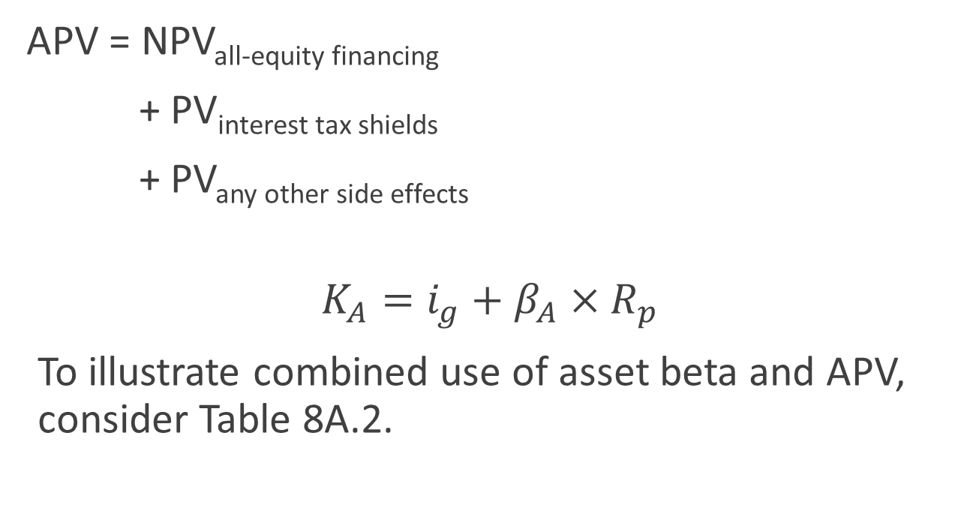
Adjusted Present Value
APV = NPV_{all-equity financing}
+ PV_{interest tax shields}
+ PV_{any other side effects}
$$K_{A}=i_{g}+β_{A}×R_{p}$$
To illustrate combined use of asset beta and APV, consider Table 8A.2.

Slide 76
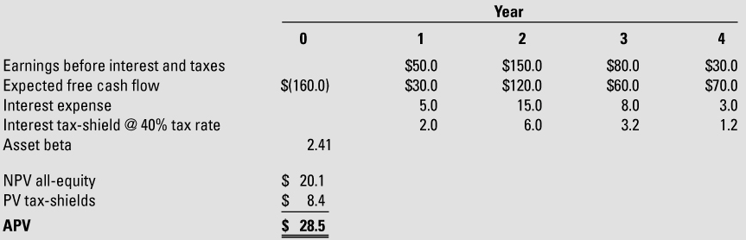
TABLE 8A.2 Adjusted Present Value Analysis of Automated Irrigation Controller ($ in millions)

Slide 77
Comments
Asset beta computed using technique described earlier.
Hurdle rate K_{A} computed to discount free cash flows.
Tax shield computed as t × interest payment.
Annual interest is 1/10 of EBIT, meaning target TIE = 10.
Discount rate used for tax shields should reflect riskiness of tax savings, so if interest is tied to EBIT, use K_{A}.

