Slide 1
The Highlights (Unit 1)
(As I See Them)

Slide 2
Longino (1990)
Why are we reading this?

Slide 3
Longino (1990)
Why are we reading this?
We want to develop a better understanding of how science operates.
The part where the decisions get made about method, and the part where the data get interpreted are frequently overlooked, but that is where the information really is.

Slide 4
Longino (1990)
Blow by blow:
Ch. 1:
Constitutive (rules for how science is done) vs. contextual (personal, social, and cultural) values.
Good science vs. bad science.
Contextual values = bad science.
Science is inherently driven by and inseparable from contextual values.
People who want it both ways (science is value laden and they want to say some particular belief is wrong).

Slide 5
Longino (1990)
Blow by blow:
Ch. 1:
Spoiler: Science is a social game, so it is vulnerable to social influences, but also protected from them by the social nature of science.
Ch. 2:
Paradox about learning facts through science: If we know something, we don’t need to do research to find it out, if we don’t know something, how do we know when we’ve found the answer?

Slide 6
Longino (1990)
Blow by blow:
Ch. 2:
Radical empiricism vs. wholism.
Goals of inquiry:
Construction of comprehensive accounts of the natural world.
Discovery of truth about the natural world.

Slide 7
Longino (1990)
Blow by blow:
Ch. 3:
How is something evidence for a hypothesis?
“states of affairs are taken as evidence in light of regularities discovered, believed, or assumed to hold. The evidential relations into which a given state of affairs can enter will thus be as varied as the beliefs about its relations with other states” (p. 41).
Red spots and measles.

Slide 8
Longino (1990)
Blow by blow:
Ch. 3:
“how one determines evidential relevance, why one takes some state of affairs as evidence for one hypothesis rather than for another, depends on one’s other beliefs, which we can call background beliefs or assumptions” (p.43).
Background assumptions not supposed to be part of science, but they are.
Alternations of day and night.

Slide 9
Snook, Cullen, Bennell, Taylor, & Gendreau (2008)
Why are we reading this?

Slide 10
Snook, Cullen, Bennell, Taylor, & Gendreau (2008)
Why are we reading this?
Some sense of how easily tricked we all are.
Some sense of how we evaluate claims.

Slide 11
Snook, Cullen, Bennell, Taylor, & Gendreau (2008)
Some sense of how easily tricked we all are.
The data support the claim that criminal profiling is used and believed in.
The authors present data to support their claim that what is being done has no empirical foundation.

Slide 12
Snook, Cullen, Bennell, Taylor, & Gendreau (2008)
The reasons starting on p. 1263 are especially important and apply to any critical thinking situation:
N=1 examples.
Repetition of the message.
How data are presented.
The expertise myth.

Slide 13
Snook, Cullen, Bennell, Taylor, & Gendreau (2008)
The reasons starting on p. 1263 are especially important and apply to any critical thinking situation:
Reasoning errors (p. 1267: self-serving bias, overconfidence, fundamental attribution error, hindsight bias, and illusory correlation, plus confirmation bias).
Finding meaning in ambiguous information.

Slide 14
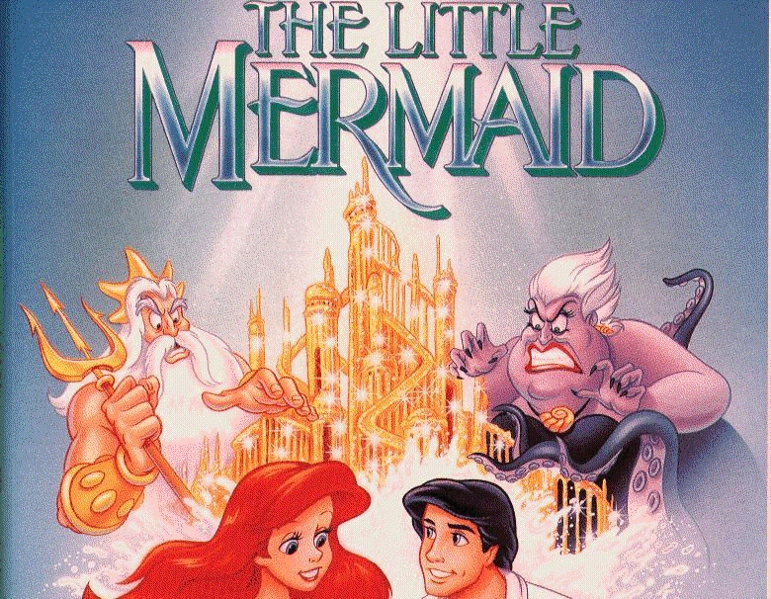
Snook, Cullen, Bennell, Taylor, & Gendreau (2008)

Slide 15
Snook, Cullen, Bennell, Taylor, & Gendreau (2008)
The reasons starting on p. 1263 are especially important and apply to any critical thinking situation:
Imitation and social contagion.
Mistaking fiction for fact.

Slide 16
Snook, Cullen, Bennell, Taylor, & Gendreau (2008)
Perhaps we could think about some instances in psychology to which these could be applied…

Slide 17
Snook, Cullen, Bennell, Taylor, & Gendreau (2008)
Some sense of how we evaluate claims.
So, we have an idea about how we can trick ourselves (emphasizing the point that there is nothing wrong or surprising in being tricked).
How should we evaluate claims? Let’s speculate on this particular example…

Slide 18
Snook, Cullen, Bennell, Taylor, & Gendreau (2008)
Tie to Longino (1990):
Obviously these authors are skeptics and profilers are believers. How could we collect data in such a way that those perspectives will not have an impact?

