Slide 1
Interesting Cognitive Stuff
Langston, PSY 4040
Cognitive Psychology
Notes 10

Slide 2
Where We Are
We’re moving into higher cognition. We’ve completed our tour of the cognitive architecture and now we’re going to look at how you use it. We’re going to hit five areas:
Categorization
Language—Structure
Language—Meaning
Reasoning/Decision making
Human factors

Slide 3
Where We Are
We have covered categorization, which can be incorporated into our discussion of semantic long-term memory.
We have some additional higher cognitive processes to consider, but I want to take a little detour to talk about some things that don’t fit, but have important implications.

Slide 4
Where We Are
We’ll look at three things:
Other aspects of memory that are derived from a real-world (as opposed to laboratory) context.
A longer-term view of memory, memory for the lifespan.

Slide 5
Counting-out Rhymes
Counting-out rhymes are used to determine who is “it.”
Complete the following:
Eenie, meenie…
One potato, two potato…

Slide 6
Counting-out Rhymes
I predict:
Eeenie, meenie, miney, mo | One potato, two potato
Catch a tiger by the toe | Three potato, four
If he hollers, let him go | Five potato, six potato
Eenie, meenie, miney, mo | Seven potato, more

Slide 7
Counting-out Rhymes
Why study these?
They’re designed to be memorized:
They serve a role in a ritualized activity.
Cheating in this activity has important consequences.
The people who use them are generally pre-literate, and can’t consult the books to use them; they have to be transmitted via oral tradition.
So: What can we learn about memory from material meant to work in the memory system?

Slide 8
Counting-out Rhymes
Why study these?
Almost everyone knows them (there is some variability, but that can be informative).
So: We have lots of potential data points.

Slide 9
Counting-out Rhymes
The first question: Is there a distinct genre? Or: Do these rhymes share properties in common that could teach us about memory?
The second question: What do they tell us about memory?

Slide 10
Counting-out Rhymes
Rubin (1995): Study the 24 most common rhymes in English and the 24 least common. Try to see if there are differences that might influence which ones are popular and which aren’t.

Slide 11
Counting-out Rhymes
A sample of the genre:
Property | Common | Rare
Lines per rhyme | 4.56 | 4.04
Words per rhyme | 21.42 | 16.96
Word repetition | .19 | .14
Rhyme | .24 | .21
Alliteration | .25 | .21
Assonance | .25 | .26
End rhyme | .79 | .63
Poetic words on beats | .90 | .79
Meaningful words | .79 | .77
Adapted from Rubin (1995, p. 231)

Slide 12
Counting-out Rhymes
What it means:
The rare and common are pretty similar, suggesting that there is a genre and the rules for making up rhymes are followed for all of them.
Properties:
Nonsense words (magic, ritual).
Lots of poetics.
Four-line rhymes with four beats per line (counting).
Poetic words on beats (especially for common).
Not much emphasis on meaning.

Slide 13
Counting-out Rhymes
What does this do?
Constraint satisfaction:
Write down a word that rhymes with most.
Write down a device for calculating numbers.
Write down a word that rhymes with shuttle.
Write down a spiritual figure.
Write down a word that rhymes with peanut.
Write down a spiritual figure that rhymes with most.
Combining constraints makes the choice easy because the burden has been moved from memory to the poetics.

Slide 14
Counting-out Rhymes
What does this do?
Constraint satisfaction:
Write down a word that rhymes with most.
Write down a spiritual figure.
Write down a spiritual figure that rhymes with most.
There are a lot of words in English that fit one constraint (host, toast, boast, coast…), but not many that fit both. If you’re telling a story and you know the properties of the word, you don’t have to remember it, it’s the one (or one of a few) that will work.

Slide 15
Counting-out Rhymes
Let’s look at the structure of one line:
Eenie, meenie, miney, mo:
Front to back progression (e, i, o).
Repetition of eenie in meenie.
Alliteration of meenie, miney, mo.
Rhyme eenie, meenie, miney.
Mo will rhyme with toe and go.
/n/ repeats in eenie, meenie, miney
The line repeats at the end.
Mo decides who is it and falls on a beat (won’t work if it’s monie).

Slide 16
Counting-out Rhymes
In other words, trying to change anything about the line would require a change to a lot of things. For example, the Scottish version is Eena, deena, dina, do.
The constraints make the rhyme carry most of the burden, not memory.

Slide 17
Counting-out Rhymes
Variability in people’s recall also tells us about memory and the genre. Most of the changes are to the meaning:
Change | Percent
Replace story line (if he hollers, make him pay…) | 28%
Change tiger (next slide) | 31%
Miscellaneous | 38%
Adapted from Rubin (1995, p. 240)

Slide 18
Counting-out Rhymes
What about the tiger? Originally, it was the n-word. When it had to go, what came in?
Rubin (1995): 73 tigers, 10 monkeys, 10 rabbits, 2 fellows, 2 piggies, and one bunny, blackbird, buyer, chicken, doggie, froggie, and wiffer waffer.

Slide 19
Counting-out Rhymes
The top 2:
Tiger alliterates with toe.
Monkey alliterates with meenie, miney, mo.
They had to be two-syllable (check the list).
In other words, when the rhyme changed, there was a period of instability and then the system settled on a substitution that improved the poetics.

Slide 20
Counting-out Rhymes
Tiger:
Year learned | N-word | Tiger
1953 | 40% | 56%
1965 | 6% | 70%
1976 | .5% | 84%
1978 | 0% | 100%
Adapted from Rubin (1995, p. 242)

Slide 21
Counting-out Rhymes
What about historical changes? Most popular until 1860:
Onery, twory, tickery, tevin
Alabone, crackabone, ten and eleven
Pin, pam, musky dam
Tweedleum, twaddleum, twenty-one
Where did this go and why?

Slide 22
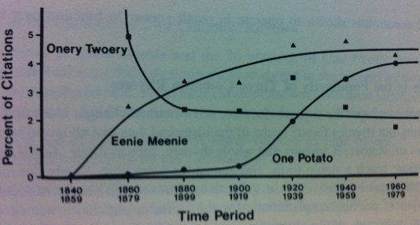
Counting-out Rhymes
Rubin (1995, p. 248)

Slide 23
Counting-out Rhymes
New favorites:
Tend to be more meaningful (dual sources of constraint).
Tend to be used by younger children.

Slide 24
Counting-out Rhymes
What did we learn about memory by looking at materials designed to be memorized?

Slide 25
Counting-out Rhymes
We can also test the existence of a genre by looking at rhymes from a different culture.
Rubin, Ciobanu, and Langston (1997). Collect counting-out rhymes from Romanian school children in Bucharest.

Slide 26
Counting-out Rhymes
Rhyme: | English translation: | Rhyme: | English translation:
Din oceanul Pacific | From the Pacific ocean | Pe o bara | On a bar
A iesit un peste mic | A little fish came out | Se caca o cioara | A crow was pooping
Si pe coada lui scria | And on his tail was written | Ga, ga, ga | Ga, ga, ga
Iesi afara dumneata | Out goes you | Drept in gura ta | Right in your mouth
Or:
Te iubesc, nu ma uita | I love you, don’t forget me

Slide 27
Counting-out Rhymes
What you find is:
The genre holds up (the importance of poetics as a source of constraint).
The variability reflects changes in meaning over changes in poetics.
This suggests that what we found out is actually a property of memory.

Slide 28
Memory Over the Lifespan
When you are older (>65), what will you remember about your life?
This is a good cognitive psychology question for a variety of reasons:
The method used to find out takes some creativity.
The results are interesting.

Slide 29
Memory Over the Lifespan
Method:
We can cue people with common words and ask them to write about the first memory that comes to mind (clear and distinct, and they participated in it). After they write about it, they date it (Robinson, 1976).
To validate the memory, we could ask about things that can be verified (e.g., news, music, sports).
If you plot the number of memories produced against age, you get a graph like this (Jansari & Parkin, 1996)…

Slide 30
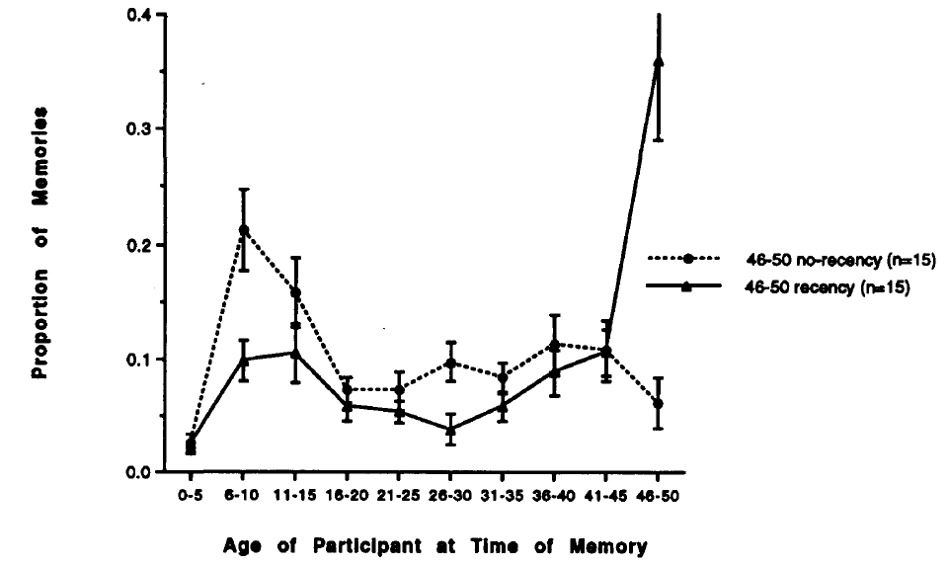
Memory Over the Lifespan
Jansari & Parkin (1996, p. 87)

Slide 31
Memory Over the Lifespan
The curve has three parts:
Recency: Rapid fall-off that is similar to laboratory studies.
Infantile amnesia: Not much before the age of 3 or so.
The reminiscence bump: More memories are in the 10-30 range than we would expect.

Slide 32
Memory Over the Lifespan
Bump properties:
Very robust across different kinds of memories and tasks.
Not so much for younger adults. Jansari and Parkin (1996) tested the hypothesis that this was because younger people are biased towards recency. The figure above is their data for 46-50 year-olds. Note that when they are told not to include recent memories, the bump grows.
Here are the data for 56-60…

Slide 33
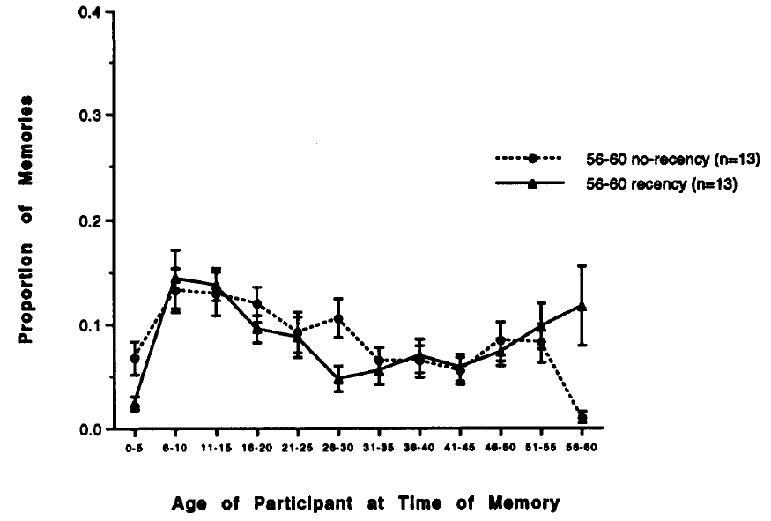
Memory Over the Lifespan
Jansari & Parkin (1996, p. 87)

Slide 34
Memory Over the Lifespan
Implication: Some aspect of your self will always be in the bump region (to the extent that your “you” is defined by memories). Make it count.

Slide 35
Memory Over the Lifespan
The interesting methodological part:
Why does this happen? Rubin and Schulkind (1997):
Demand characteristics.
People search here longer.
Bump more important.
Bump in central narrative of your life.
Bump novel and distinctive.
Bump vivid and emotional.
Bump encoded differently.

Slide 36
Memory Over the Lifespan
How do we tell?
Demand characteristics. People think those are the memories you want, so they give them to you.
Biasing instructions (telling them to be biased in various ways) don’t change the curves.
People search here longer. If it’s an old memory, I know it’s harder to retrieve so I work longer; if it’s recent and I don’t know it right away, I just quit.
No response time differences.

Slide 37
Memory Over the Lifespan
How do we tell?
Bump more important. These memories are the most important in your life narrative.
Not when people rate importance.
Bump in central narrative of your life. These memories are central to the narrative of your life (think of the kinds of things that happen here).
Bump memories not more significant.
Both of these assume nothing important happens later in life, and that’s wrong.

Slide 38
Memory Over the Lifespan
How do we tell?
Bump novel and distinctive. Things that are distinct are easier to retrieve, and more distinct things happen in this period.
Not rated that way.
Bump vivid and emotional. Vividness and emotionality affect memory.
Not rated that way.

Slide 39
Memory Over the Lifespan
How do we tell?
What’s left? Note that this is a kind of strong inference exercise where we rule out all of the competing hypotheses and have this one left over.
Bump encoded differently.
This appears to be the winning answer. Maybe there is something about brains and typical lifespans during evolution that make this period special…

Slide 40
Final Thoughts
Note how both of these topics take a different approach to memory. We’re not asking about how to study better for a test, we’re asking:
What do things look like when they’re designed to be remembered?
What will you remember about life?
This change in perspective to get outside of the paradigm could help us see things we wouldn’t otherwise see.

Slide 41
End of Interesting Cognitive Stuff Show

