Slide 1
Language--Structure
Langston, PSY 4040
Cognitive Psychology
Notes 11

Slide 2
Where We Are
We’re continuing with higher cognition. We still have:
  Language—Structure
  Language—Meaning
  Reasoning/Decision making
  Human factors

Slide 3
Plan of Attack
Syntax: How does word order information influence comprehension?
Semantics (meaning): How can we account for your understanding of the meaning of language?
As we go we will consider major influences on the comprehension process.

Slide 4
Foundation
We will have two themes:
Grammars can be developed at every level.
  A grammar has two parts:
    A set of elements.
    Rules for combining those elements.
  We will see how far we can get working out grammars for each step of the comprehension process.
Ambiguity is a common feature of language. We will need to come up with a way to deal with ambiguity. Two approaches:
  Brute force: Try all solutions.
  Heuristics: Make a guess and go with it.

Slide 5
Syntax
Syntax is what people typically think of when they hear the word grammar. What kind of system might account for your knowledge of word order rules? I will present three ideas:
  Finite state grammars.
  Phrase structure grammars.
  Transformational grammars.

Slide 6
Word Order
One way to model syntax would be to calculate the probabilities of various words occurring together.
For example, Miller and Selfridge (1950; doi 10.2307/1418920) created word lists that were various approximations to English.

Slide 7
Word Order
Miller and Selfridge (1950):
  For a second-order approximation, present a word to a person and have them use it in a sentence. See what word they give after the target word, give that to someone, see what word they use, etc. When you string these together, you have a sequence that is a second-order approximation.
  Scale up for 3-7.

Slide 8
Word Order
Miller and Selfridge (1950):
  First order:
  Third order:

Slide 9
Word Order
Miller and Selfridge (1950):
  Fifth order:
  Seventh order:

Slide 10
Word Order
Miller and Selfridge (1950):
  Look at recall of the lists.
  Does approximation to English affect recall?

Slide 11
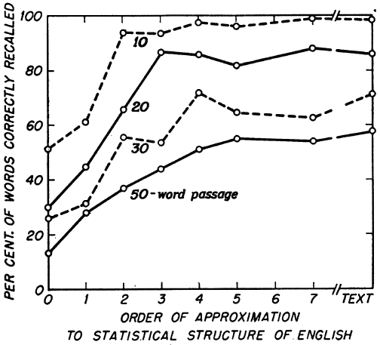
Word Order

Slide 12
Word Order
Miller and Selfridge (1950):
  Order of approximation does affect memory.
  Could something like this be scaled up to account for syntax?
  Or, does understanding syntax require something more?

Slide 13
Syntax
Finite state grammars: These grammars treat a sentence as a word chain. A sentence is a string of S-R pairs. Each word is a response to a stimulus (the word before it) and a stimulus (for the next word).
For example: Mary told Todd to shut up and eat the cheese.
  S: Mary, R: told
  S: told, R: Todd
  S: Todd, R: to…

Slide 14
Syntax
This idea can be tested with sentences of nonsense words (you can’t use real words because you need to see the associations develop, and real words are contaminated by a lifetime of associations).
For example: Vrom frug trag wolx pret.
Have people memorize these sentences and then test them with a free association-type task to uncover their representation of sentence structure.

Slide 15
Syntax
When you test, you get a pattern like this:
The data suggest that people do treat sentences as a string of words.
Stimulus: | Response:
Vrom | Frug
Frug | Trag
Trag | Wolx

Slide 16
Syntax
Problems for finite state grammars:
  People do things when producing sentences that require knowledge of more than the previous word. Long distance dependencies occur when the form of a later word (or the choice of which word to use) depends on something that happened earlier. For example, what should come later if you say:
    Either?
    Neither?
    If?

Slide 17
Syntax
Problems for finite state grammars:
  Long distance dependencies.
    Consider this sentence: The dogs walked in the park pee on trees.
    You can’t say pees because dogs is plural. You have to remember the form of a word five words back to choose the correct form of the word you want to say.
    This can be overcome if you allow your window to include more words. For example, base your choice of a word on the probabilities of various words following the previous four words. It’s better, but not perfect.

Slide 18
Syntax
Problems for finite state grammars:
  Sentences have a structure. When you use real sentences, you don’t get the pattern you get with nonsense words. Consider Pale children eat cold bread.
Stimulus: | Response:
Pale | Children
Children | Pale
Eat | Cold or bread
Cold | Bread
Bread | Cold

Slide 19
Syntax
Problems for finite state grammars:
  Sentences have a structure. Pale children is a noun phrase. The two words belong together as part of a structure. This structure combines with another structure (the verb phrase) to make a sentence.
  There are some other technical problems that we won’t get into here, but it turns out to be hard to use finite state grammars to account for language.

Slide 20
Syntax
Phrase structure grammars: Model a sentence as a set of phrases. Each word is grouped into successively larger units until you account for the sentence. The resulting structure is called a phrase marker.

Slide 21
Syntax
Phrase structure grammars solve the problems we identified for finite state grammars.
  Long distance dependencies: The structure can support distant relationships between words and you can have rules that tell you how the parts go together.
  Structure: Structure is inherent in the phrase marker.

Slide 22
Syntax
Consider: The television shows the boring program.
S
NP
VP
Det
N
V
NP
Det
Adj
N
The
television
shows
the
boring
program

Slide 23
Syntax
The grammar is a series of rewrite rules that tell you to take an element on the left side of a rule and rewrite it into the elements on the right side.
Here is a grammar for our “television” sentence:
  P1: S -> NP VP
  P2: VP -> V (NP)
  P3: NP -> Det (Adj) N
”Parsing” is using the rules to uncover the structure.

Slide 24
Syntax
The parts:
  P1: Phrase structure rules start with P.
  S: Sentence.
  NP: Noun phrase.
  VP: Verb phrase.
  V: Verb.
  Det: Determiner (a, an, the).
  Adj: Adjective.
  N: Noun.
  (): Element is optional.
  *: Element can repeat as many times as you’d like.
  {}: Choice of elements in these brackets.

Slide 25
Syntax
The lexicon can be included as lexical insertion rules (the elements in brackets can connect to one of the models of semantic memory to access the concepts the words stand for):
  L1: N -> {television, professor, program, lecture}
  L2: Det -> {a, an, the}
  L3: V -> {shows, delivers}
  L4: Adj -> {boring, exciting}

Slide 26
Syntax
Putting it all together:
  P1: S -> NP VP
  P2: VP -> V (NP)
  P3: NP -> Det (Adj) N
  L1: N -> {television, professor, program, lecture}
  L2: Det -> {a, an, the}
  L3: V -> {shows, delivers}
  L4: Adj -> {boring, exciting}
Parse: The professor delivers the exciting lecture.

Slide 27
Syntax
Consider: The professor delivers the exciting lecture.
S
NP
VP
Det
N
V
NP
Det
Adj
N
The
professor
delivers
the
exciting
lecture

Slide 28
Syntax
You can increase the complexity of these grammars by adding rules. For example, to handle The professor delivers the exciting lecture in the classroom we would need to add a prepositional phrase rule:
  P4: PP -> Prep NP
We would also need to add that rule to some other rules as an option.

Slide 29
Syntax
A revised grammar:
  P1: S -> NP VP
  P2: VP -> V (NP) (PP)
  P3: NP -> Det (Adj) N (PP)
  P4: PP -> Prep NP
  L1: N -> {television, professor, program, lecture}
  L2: Det -> {a, an, the}
  L3: V -> {shows, delivers}
  L4: Adj -> {boring, exciting}
  L5: Prep -> {of, on, for, …}
Parse: The exciting professor delivers the boring lecture on the television.

Slide 30
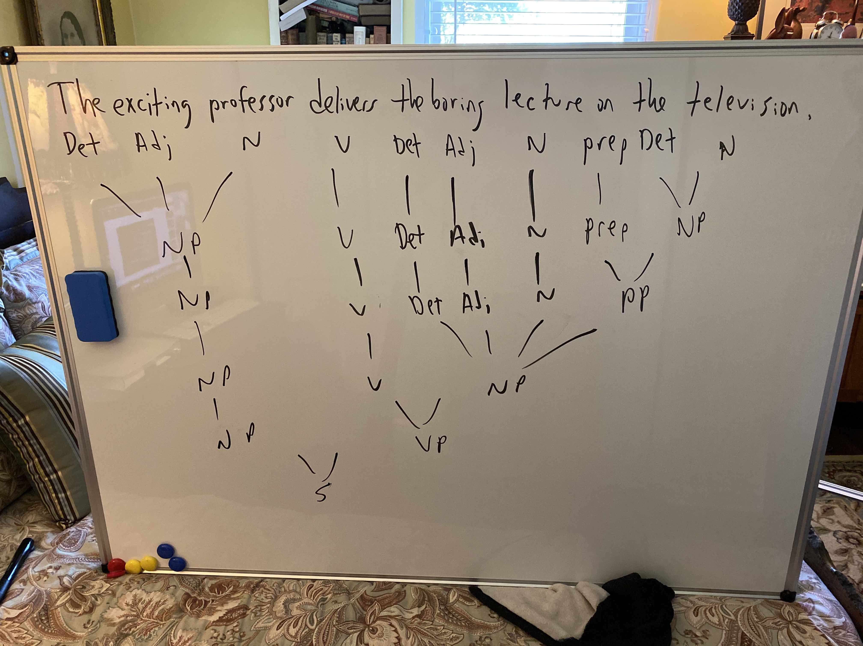
Syntax

Slide 31
Syntax
In my parse of this one:
  I started with the sentence and then put all of the parts of speech under the words.
  Then, I connected them up into phrases.
  You do have to do a little prep work (thinking) about how it will end up. For example, in the rightmost NP, I didn’t connect up the noun phrase until the PP was done so it could go in there.

Slide 32
Syntax
In my parse of this one:
  Note that I also like to keep the bottom of the tree even. I bring down the ones I haven’t used yet until it’s their turn to get connected up.

Slide 33
Syntax
Note that ambiguity has now shown up. The phrase on the television could be modifying delivers (as in the lecture is being delivered on TV), or it could modify lecture (Which lecture? The one on the television).
Which version goes with my parse?

Slide 34
Syntax
Note that ambiguity has now shown up. The phrase on the television could be modifying delivers (as in the lecture is being delivered on TV), or it could modify lecture (Which lecture? The one on the television).
Which version goes with my parse?
  In this case, it is in the NP, so it modifies the lecture.

Slide 35
Syntax
This is the kind of thing that gets better with practice, so try these:
  The dog eats the cheese.
  The cow with the spots spies the moon.
  The tall player dunks the ball through the hoop.
  (Note that I generalized the word lists, but nothing about the grammar changes.)

Slide 36
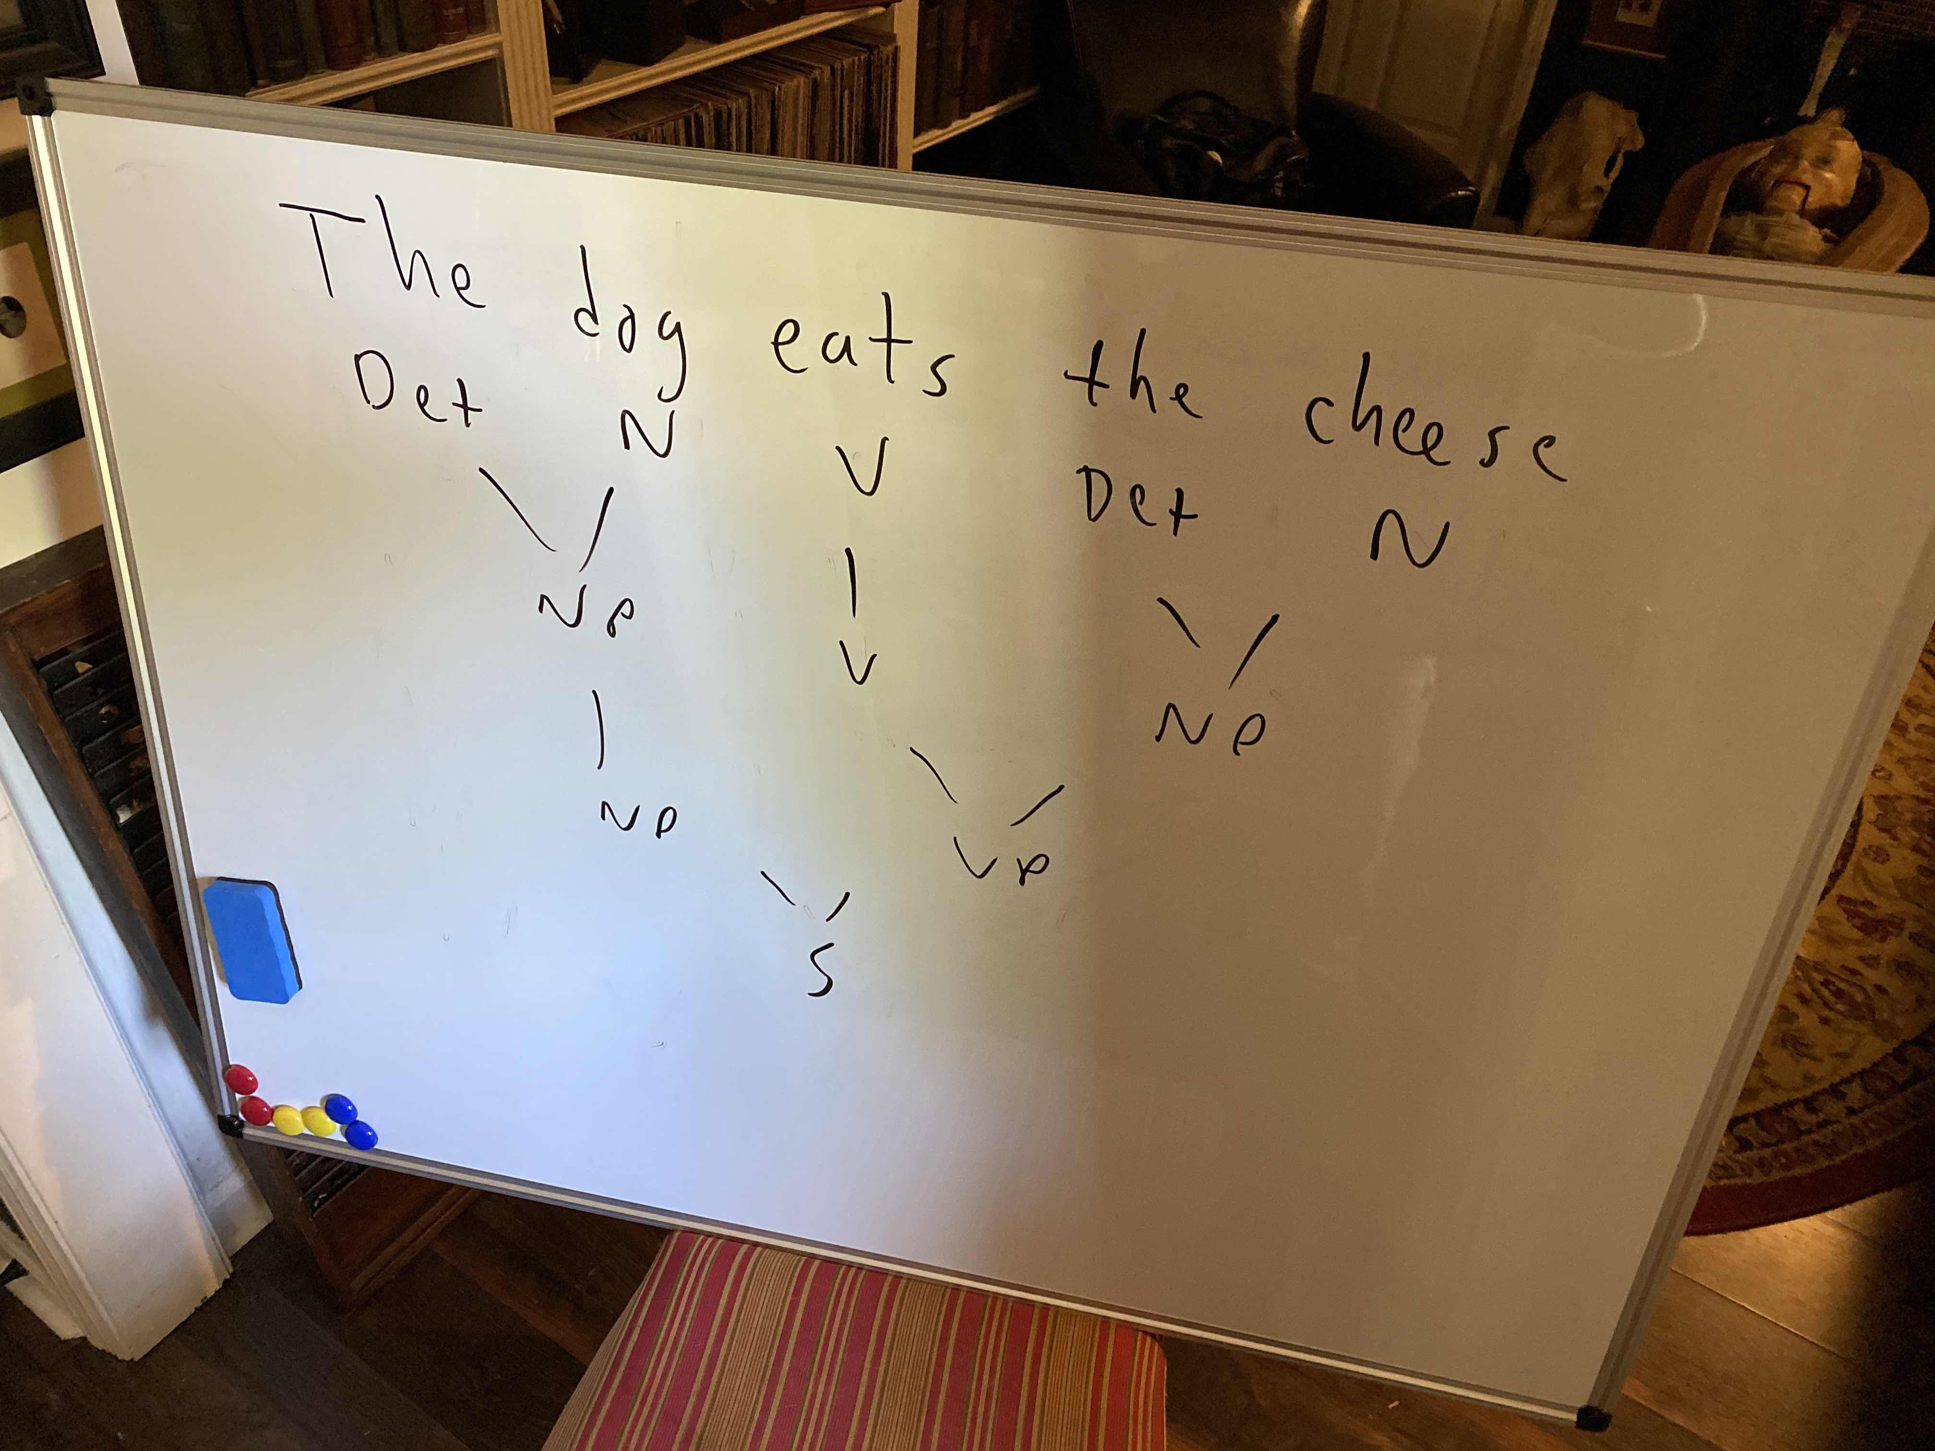
Syntax

Slide 37
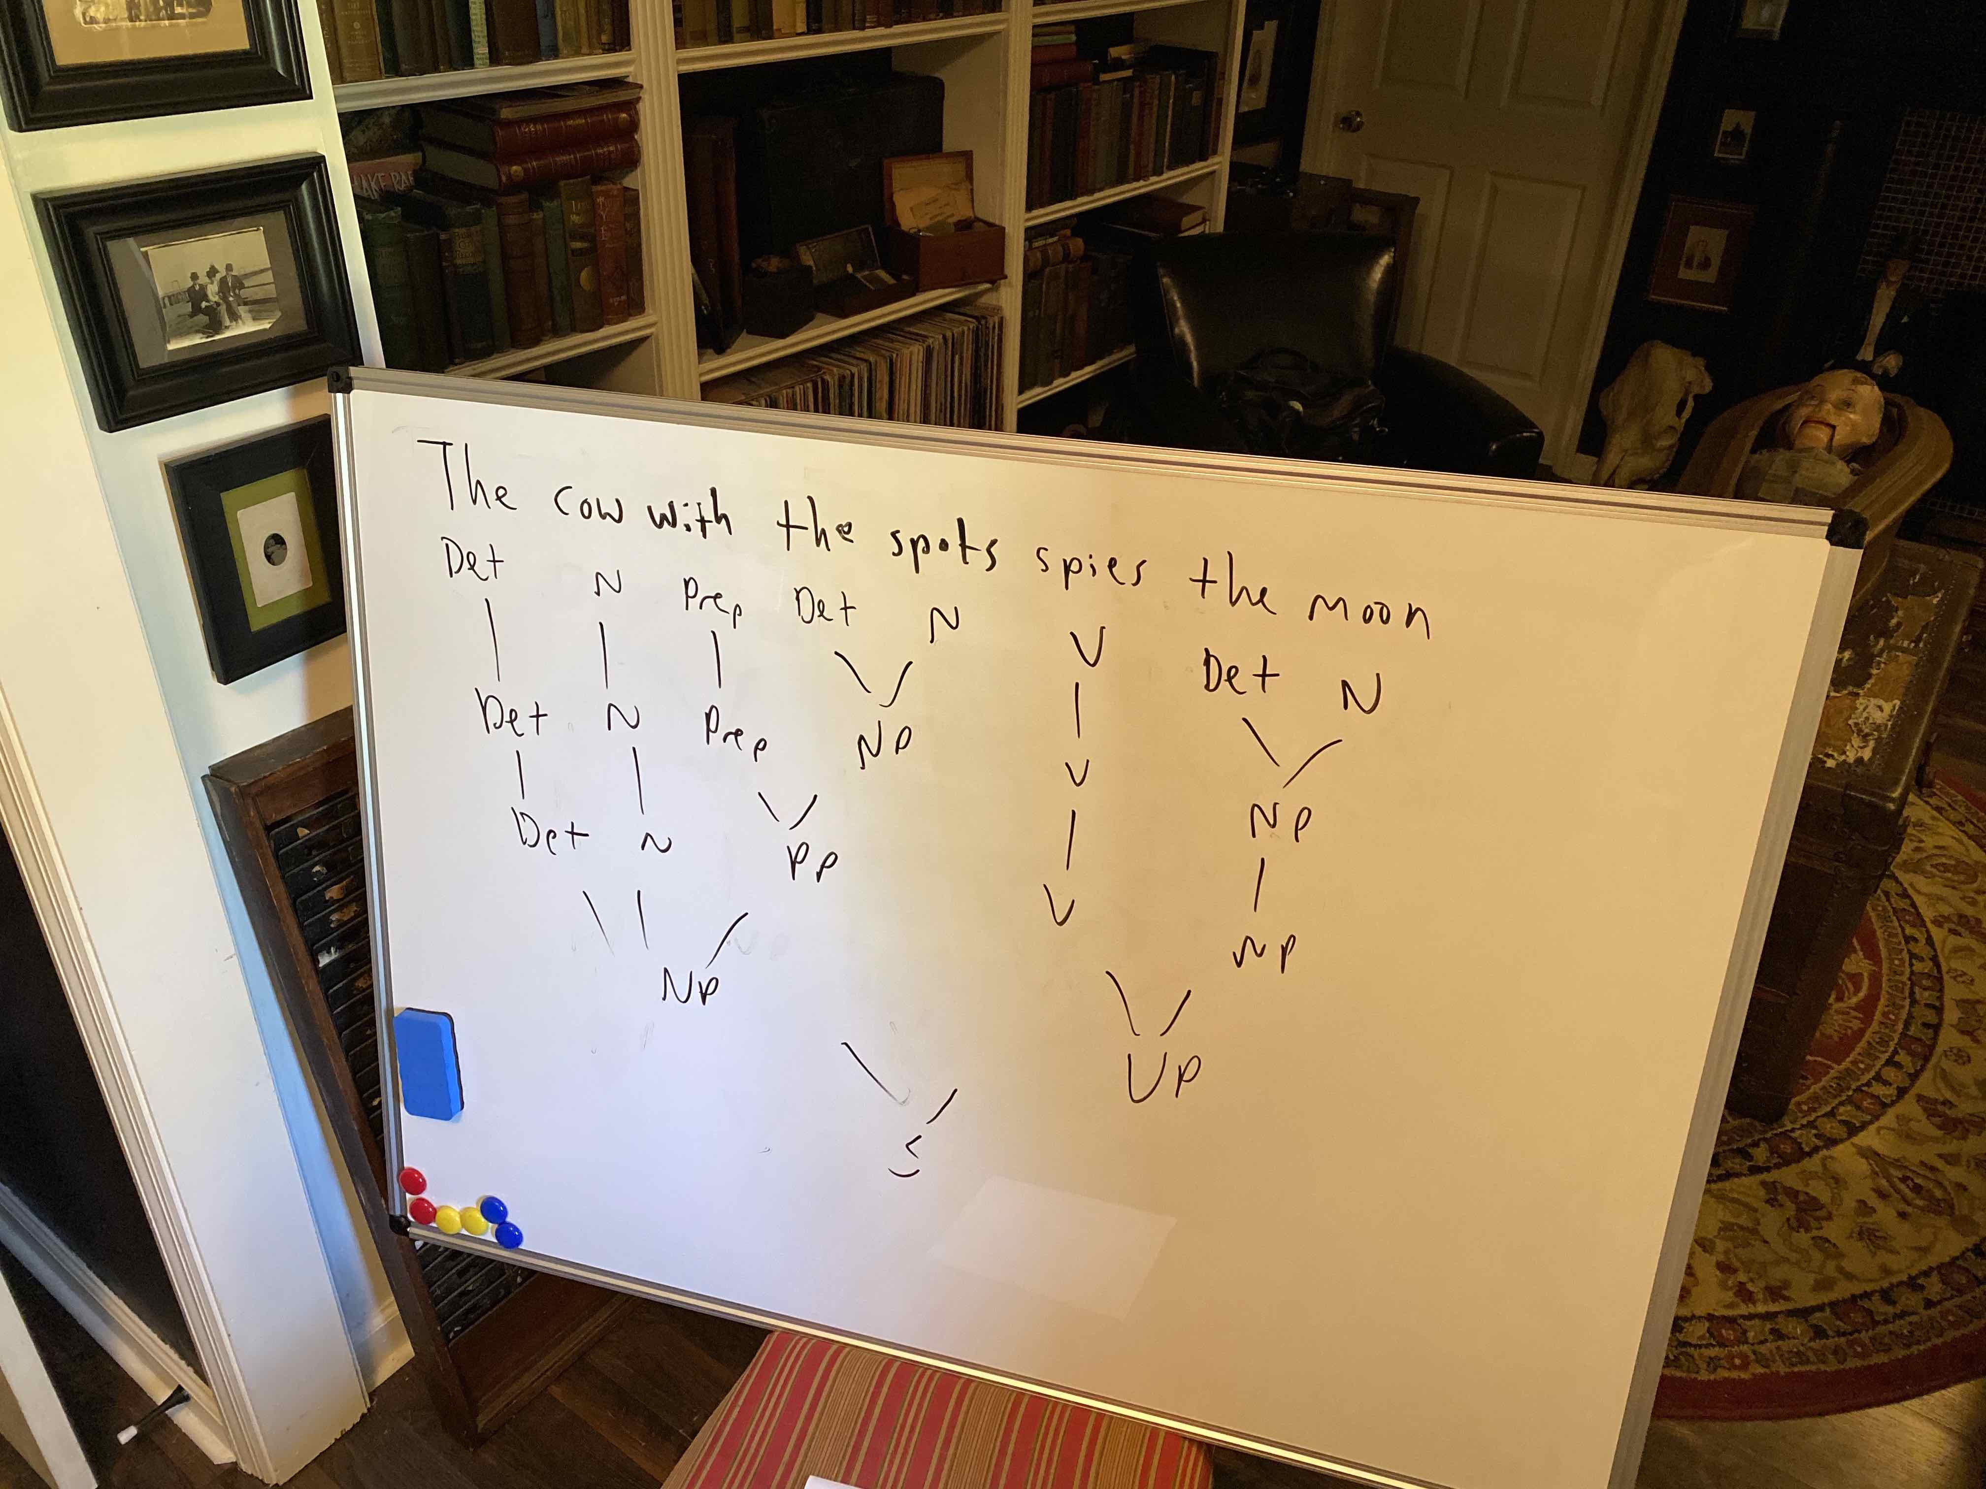
Syntax

Slide 38
Syntax
You can understand the position of the PP if you think of it as answering the question “which cow?” Having “with the spots” in the NP makes it the answer to that question.

Slide 39
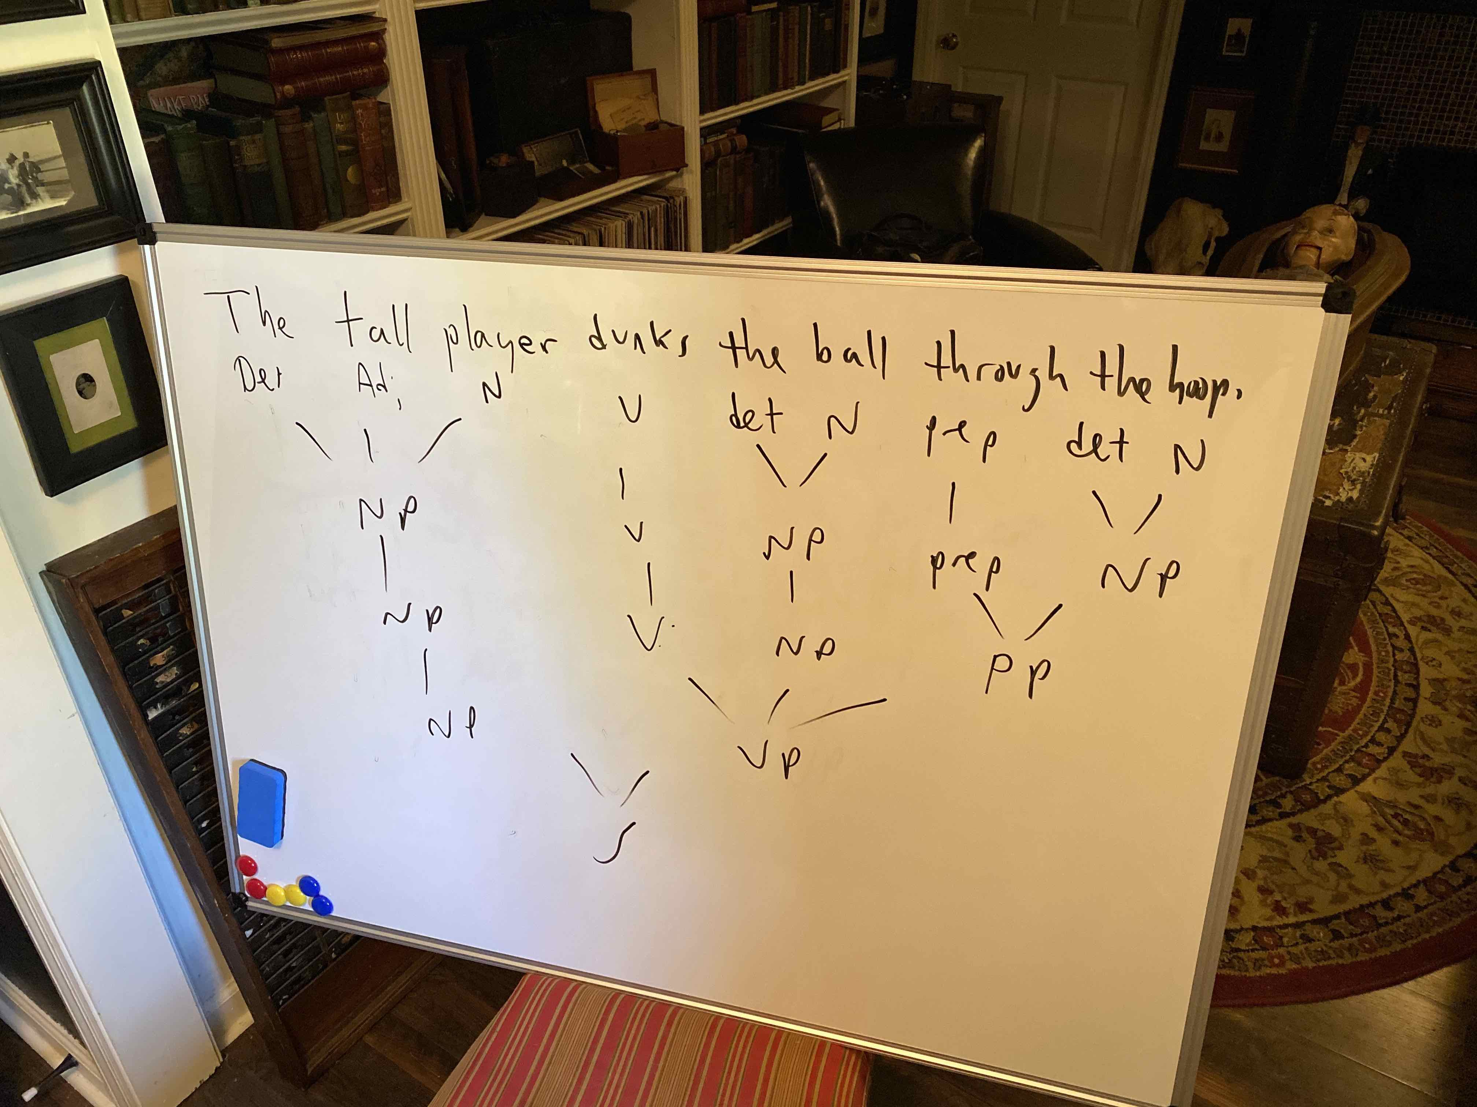
Syntax

Slide 40
Syntax
The trick on this one is where to put “through the hoop.” It’s not modifying the ball (“the ball through the hoop” is not a kind of ball). So, it is part of the VP to modify “dunks.”

Slide 41
Syntax
Problems for phrase structure grammars:
  Particle movement: Some verbs have a particle included with them (phone up, look up). This can be detached from the verb.
    John looked up the address.
    John looked the address up.
  Phrase structure grammars can’t handle this. How can part of the verb go in various places?

Slide 42
Syntax
Problems for phrase structure grammars:
  Some other things that language does that would be nice to capture in grammar:
    Two sentences with very different surface structures can have similar meanings.
      Arlene is playing the tuba.
      The tuba is being played by Arlene.
    One sentence is active, one is passive, but they mean the same thing. It would be nice if our grammar captured the fact that there is a relationship between these two sentences.

Slide 43
Syntax
Problems for phrase structure grammars:
  Some other things that language does that would be nice to capture in grammar:
    One sentence can have two very different meanings:
      Flying planes can be dangerous.
    It would be nice if our grammar could capture this phenomenon as well.

Slide 44
Syntax
Transformational grammars: Chomsky proposed transformational grammars to improve upon phrase structure grammars. He made three changes:
  Include a deep structure. Between the surface structure (what is actually produced) and the thoughts that you are trying to convey, there’s an intermediate step in the development of a sentence plan (the deep structure). This solves the problem of different sentences meaning the same thing (same deep structure) and one sentence meaning more than one thing (different deep structures).

Slide 45
Syntax
Changes to make transformational grammar:
  Introduce transformation rules (hence the name of the grammar). These rules allow you to take a phrase marker (the deep structure) and move the parts around to create a surface structure. Transformation rules control this process. This lets you deal with particle movement. The particle is attached in the deep structure, but a transformation rule lets you move it if you want to. (To make these work, we have to allow the left side of our rewrite rules to have more than one element.)

Slide 46
Syntax
The steps in transformational grammar:
(Construct trees)
Phrase structure rules
(Add words)
Lexical insertion rules
Deep structure
Transformation rules
(Pronounce)
Morpho-phonological rules
Surface structure

Slide 47
Syntax
Transformational grammar rules:
  P1: S -> NP VP
  P2: NP -> Det N
  P3: VP -> Aux V (NP)
  P4: Aux -> C (M) (have en) (be ing)
  L1: Det -> {a, an, the}
  L2: M -> {could, would, should, can, …}
  L3: C -> {ø (empty), -s (singular subject), -past (past tense), -ing (progressive), -en (past participle)}
  L4: N -> {cookie, boy}
  L5: V -> {steal}
This part is pretty similar to what we’ve seen.

Slide 48
Syntax
Transformational grammar rules:
  T1: C V -> V C (affix hopping rule; obligatory)
  T2: NP1 Aux V NP2 -> NP2 Aux be en V by NP1 (active to passive transformation; optional)
  These rules are the heart of the grammar. This is just a sample of possible rules.
Morpho-phonological rules: These rules tell you how to pronounce the final product.
  M1: steal -> /s/ /t/ /i/ /l/…

Slide 49
Syntax
Playing with transformational grammar. To get an idea of how powerful the rules are, and a sense of the complexity of syntax, let’s try a few sentences:
  The boy steals the cookie.
  The boy is stealing the cookie.
  The boy could have stolen the cookie.
  The boy stole the cookie.

Slide 50
Syntax
All grammars are bi-directional. You can parse with them (as we’ve been doing) to recover the structure of a sentence to begin to understand it.
You can also use them to produce sentences. We’ll take that approach to the transformational ones.

Slide 51
Syntax
All of these start the same:
  P1: S -> NP VP
  P2: NP -> Det N
  P3: VP -> Aux V (NP)
  P4: Aux -> C (M) (have en) (be ing)
Build the sentence from a NP and VP.
There’s only one type of NP, so build that.
The only option on VP is do you have an NP, Aux and V are required. We can build up to there and then look at the sentence to decide.
Here it is at the start:

Slide 52
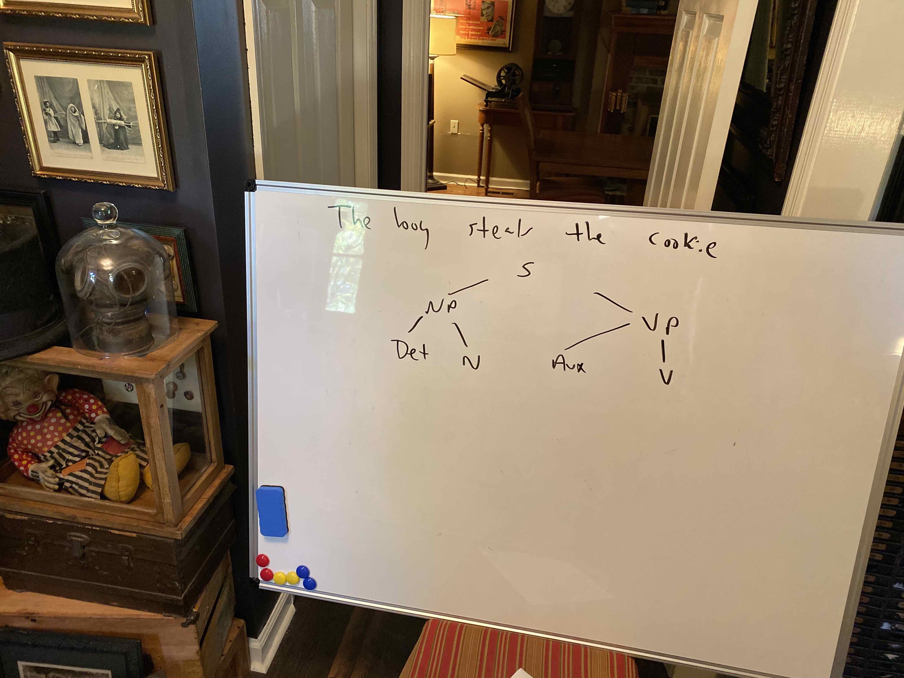
Syntax

Slide 53
Syntax
Now we can do our sentence the rest of the way.

Slide 54
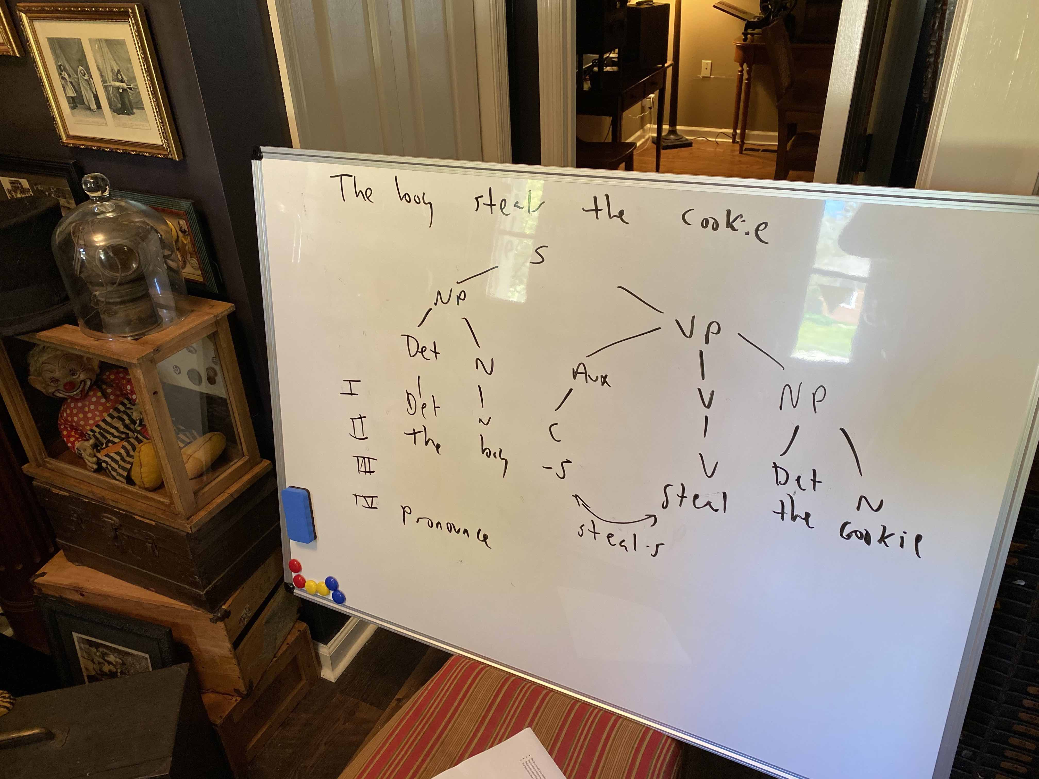
Syntax

Slide 55
Syntax
We had an NP in the VP, so I added it.
I added the rest of the structure. Aux has to have C, NP has to be Det N.
The row labeled “I.” has the result of the phrase structure grammar step. The rules are a little different (and we’re producing the sentence), but this is what we’ve been doing.

Slide 56
Syntax
The row labeled “II.” is lexical insertion. I added the words.
  The only wrinkle is “-s” for C.
  L3: C -> {ø (empty), -s (singular subject), -past (past tense), -ing (progressive), -en (past participle)} (copied from before)
  Because C is for the bits added to verbs, we have to choose the correct one for the sentence. It’s present tense for a singular subject, so “-s” is the ending on the verb.
  “But,” you say, “the –s is in front of the verb.” Yes, the affix hopping rule will get that in step III.

Slide 57
Syntax
Here are the transformation rules (just a taste):
  T1: C V -> V C (affix hopping rule; obligatory)
  T2: NP1 Aux V NP2 -> NP2 Aux be en V by NP1 (active to passive transformation; optional)
I’m not going to try any passive sentences here.
T1 says if you encounter anything in the bottom of the tree as you scan across that goes C V, flip it to V C.
I did that in step III on the picture with arrows indicating that they swap.
Step IV would just be to pronounce it, and then you’re done.

Slide 58
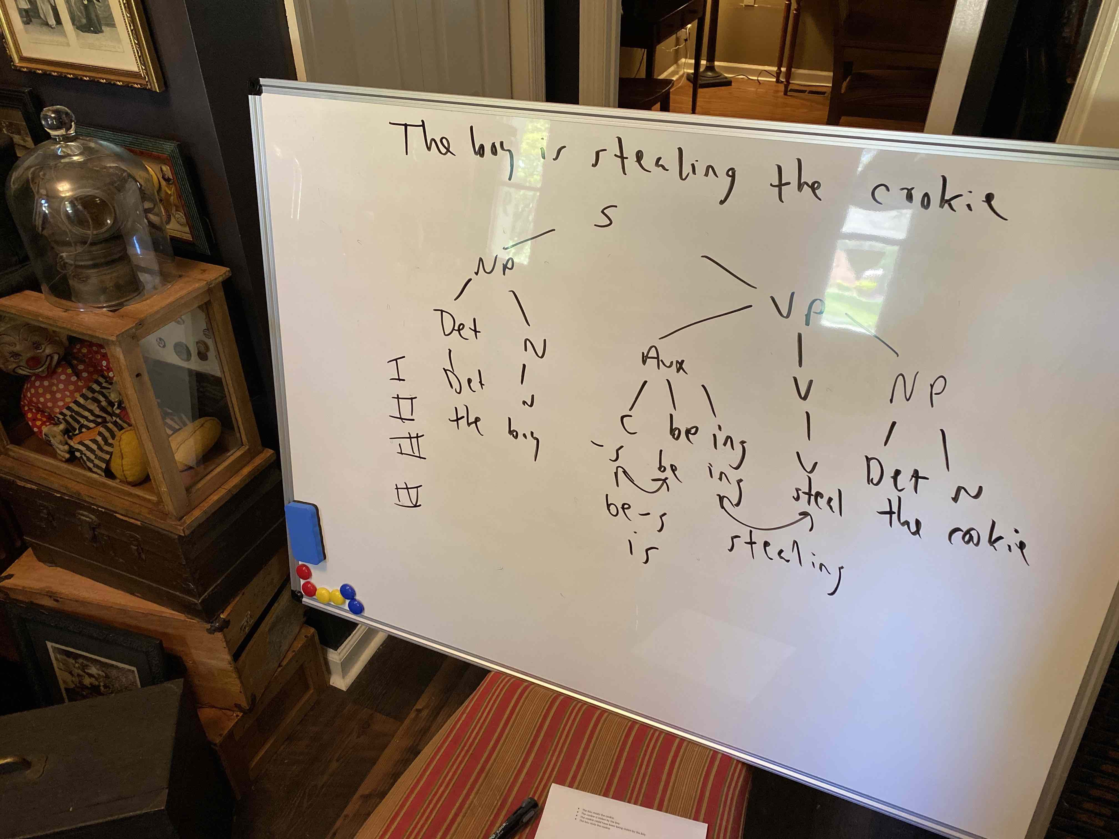
Syntax

Slide 59
Syntax
P4: Aux -> C (M) (have en) (be ing) (copied from before)
This one adds a be verb to the Aux. It says if you’re using a be, you have to also bring in an –ing (they’re in the parentheses together).
“Is” is also present tense, singular, so –s is C.
When we hop, you hop –s and be to “be-s” and ing and steal to ”steal-ing.”
You pronounce be-s as “is” in standard English vernacular.

Slide 60
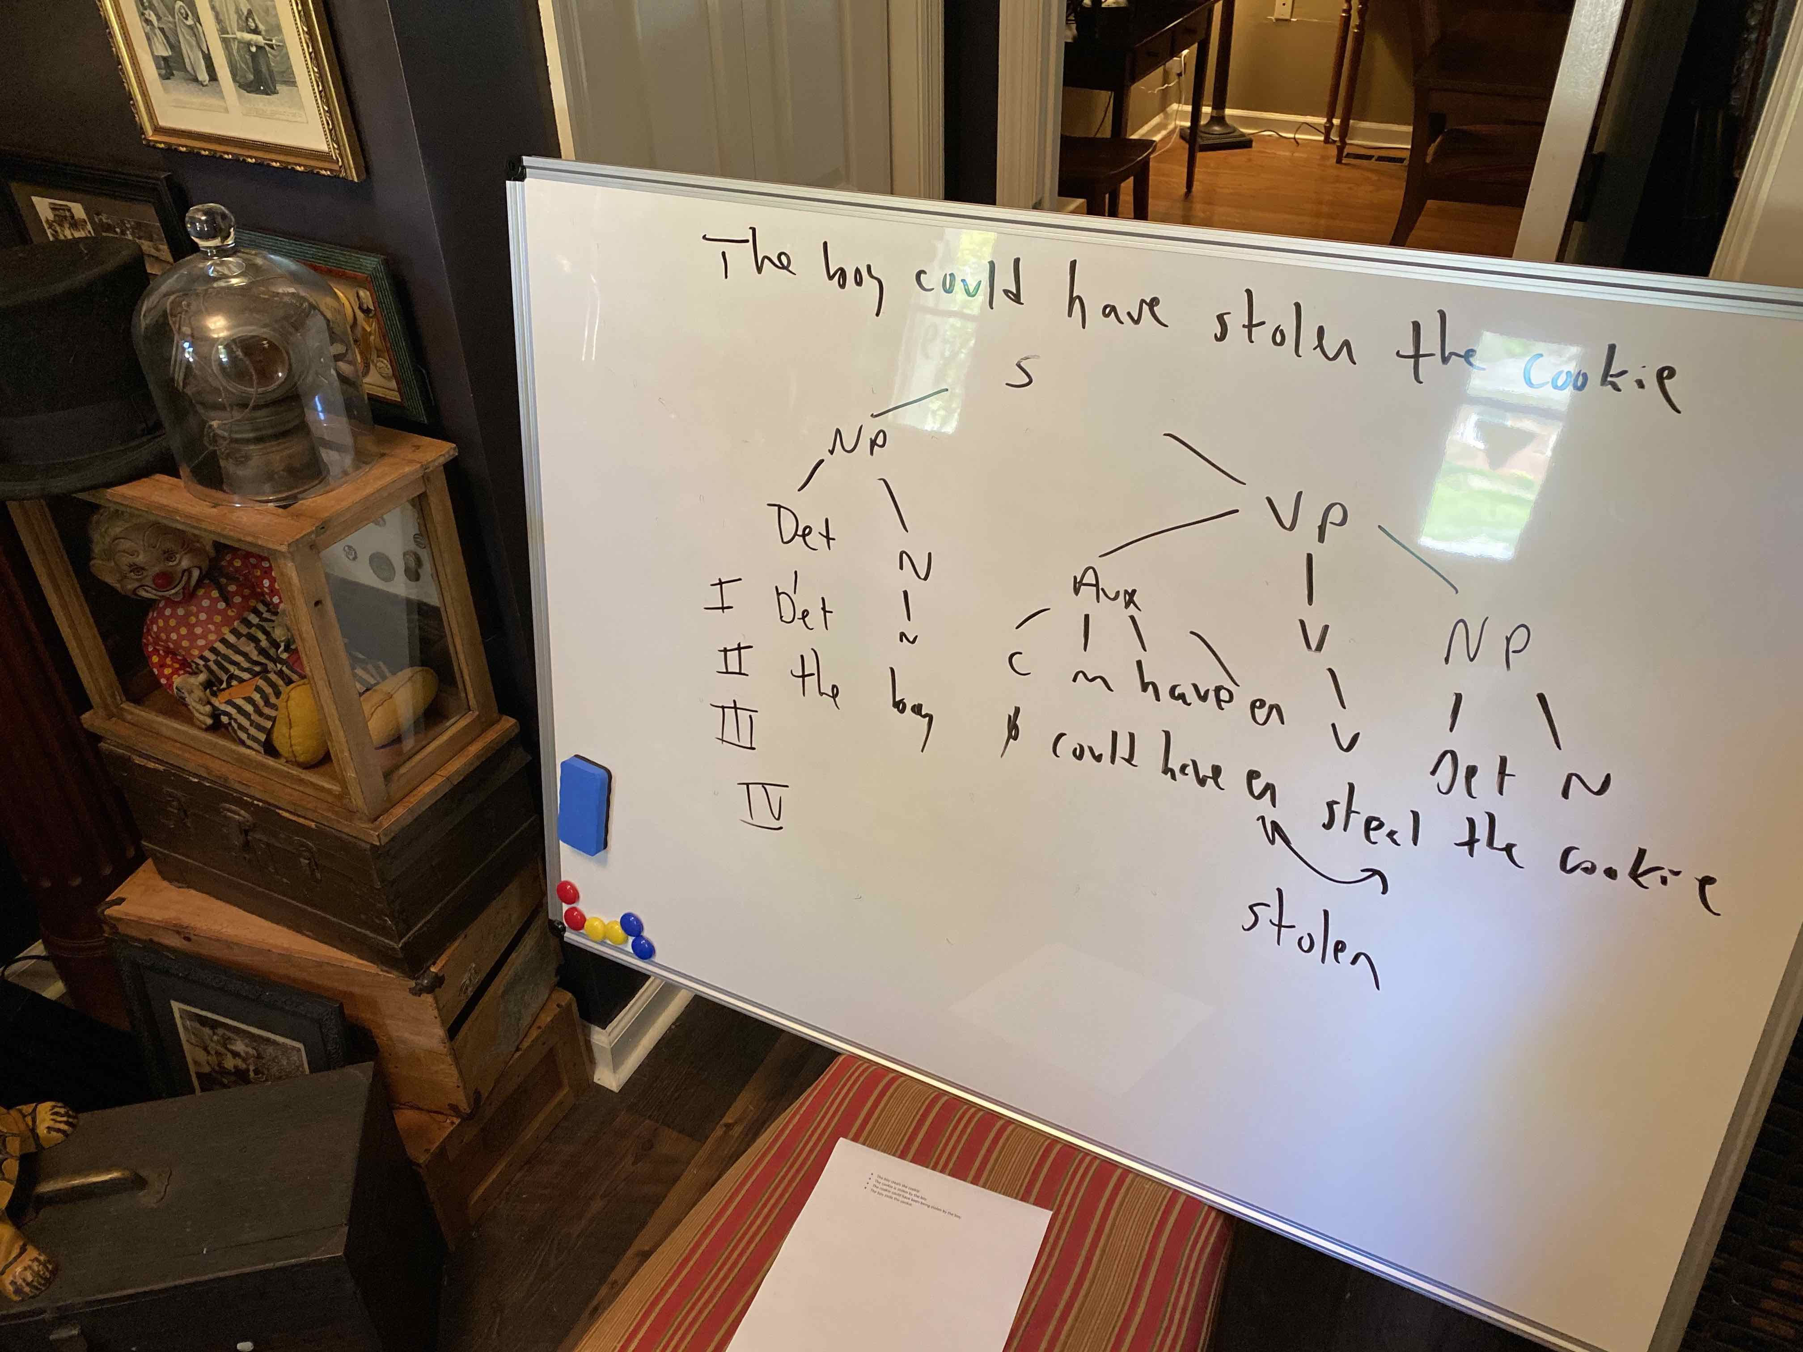
Syntax

Slide 61
Syntax
P4: Aux -> C (M) (have en) (be ing) (copied from before)
This one adds M to the Aux.
  L2: M -> {could, would, should, can, …} (copied from before)
M are the modal verbs and “could” is one of those.
If you have M, C will always be nought (we don’t modify words like “could” in English).
In this case I wanted a “have.” Have and –en have to come together because they’re in the parentheses together.
The rest should be getting familiar.
You try the last one for practice on your own.

Slide 62
Syntax
Evidence: The basic idea is to take a sentence and run a bunch of transformations on it, then measure how long it takes to understand it. For The man was enjoying the sunshine:
  The man was not enjoying the sunshine. (N)
  The sunshine was being enjoyed by the man. (P)
  Was the man enjoying the sunshine? (Q)
  The sunshine was not being enjoyed by the man. (NP)
  Was the man not enjoying the sunshine? (NQ)
  Was the sunshine being enjoyed by the man? (NP)
  Was the sunshine not being enjoyed by the man? (NPQ)
You should see slower comprehension for more transformations.

Slide 63
Syntax
We can wrap up syntax at this point. You have a great deal of complexity, English addresses it with word-order rules, we need some way to capture that.
Let’s turn to semantics (meaning).

Slide 64
Semantics
Pure syntax models have problems:
  They’re not very elegant, and the rules can become very complex.
  The transformations are overly powerful and kind of arbitrary. For example, we can go from The girl tied her shoe to The shoe was tied by the girl but not Shoe by tied is the girl. Why not?
  Syntax models ignore meaning. Chomsky notes that They are cooking apples is ambiguous. But, that’s only if you take it out of context. Putting meaning back in might solve some problems.

Slide 65
Semantics
Semantic grammar: Instead of ignoring meaning, base grammar on meaning. The goal of parsing is to figure out how all of the elements in the sentence relate to one another.
  Case: Things like time, location, instrument.
  Role: Actors in the sentence, agent, patient…

Slide 66
Semantics
Start with the verb, load in its set of obligatory cases and roles, plus any optional ones, and then fit that to the sentence. Fill in all of the parts of the verb frame with the parts of the sentence, and that is your parse.

Slide 67
Semantics
We can get some things that are hard for syntactic grammars. For example:
  John strikes me as pompous.
  I regard John as pompous.
Without a semantic grammar it’s hard to know that John is the experiencer of the action in both cases.

Slide 68
Semantics
Father carved the turkey at the Thanksgiving dinner table with his new carving knife.
location
table
agent
father
time
Carve
Thanksgiving
knife
turkey
instrument
patient

Slide 69
Influences
Attaching meaning to words:
  Word frequency. Faster with more frequent words.
  Morphology. Number of morphemes influences access.
  Syntactic category. Nouns are faster than verbs (semantic grammars).
  Priming. Material that is related to what you are currently thinking about will be accessed faster (semantic memory).
  Ambiguity. Syntactic (pardon is a noun and a verb) and semantic (bank). The more you have, the worse.

Slide 70
Influences
Lexical access, two possibilities:
  Search: Look through everything and find the word, activate all meanings. Then, pare down to the contextually appropriate meaning.
    The man dug with the spade. (shovel, ace)
  Direct access: Go directly to the word you’re looking for. Influenced by context.
    Neighborhood effects:
      Game: gave, gape, gate, came, fame, tame, name, same, lame, gale.
      Film: file, fill, firm.
    Neighborhood size affects access, suggesting that it is direct.

Slide 71
Influences
Sentence processing: Two big ones:
  Ambiguity: There is almost always the potential for the sentence to mean different things depending on how you connect the words.
    John bought the flower for Susan.
    The boy saw the statue in the park with the telescope.
  Due to the second big influence, you have to decide right away.

Slide 72
Influences
Sentence processing: Two big ones:
  Working memory: Capacity is very limited. For reading, you have to hold and process features, orthographic information, word meanings, sentence meanings, syntax, discourse goals, global meanings…
  If a sentence has three points where there could be two choices, there are 8 parses. The numbers grow from there. You can’t hold all of that, so you have to decide about ambiguous sentences right away.

Slide 73
Influences
How does working memory influence processing? Try:
  The plumber the doctor the nurse met called ate the cheese.

Slide 74
Influences
How does working memory influence processing? Try:
  The plumber the doctor the nurse met called ate the cheese.
  The plumber that the doctor that the nurse met called ate the cheese.

Slide 75
Influences
How does working memory influence processing? Try:
  The plumber the doctor the nurse met called ate the cheese.
  The plumber that the doctor that the nurse met called ate the cheese.
  The nurse met the doctor that called the plumber that ate the cheese.

Slide 76
Influences
Center embedding is possible:
  The plumber ate the cheese.
  The plumber the doctor called ate the cheese.
  The plumber the doctor the nurse met called ate the cheese.
However, you should find a point where it gets past working memory capacity.

Slide 77
Influences
Strategies to minimze working memory demands on parsing:
  Recovering clauses (NP, VP, etc.):
    Constituent. Function words start a new constituent.
    Det: NP
    Prep: PP
    Aux: VP

Slide 78
Influences
Recovering clauses (NP, VP, etc.):
  Content word. Once a constituent is going, look for content words to put in it.
  Det: Adj or N
  V: Det, Adj, Prep, N…

Slide 79
Influences
Recovering clauses (NP, VP, etc.):
  Noun-verb-noun. As an overall plan for the sentence, expect agent, action, patient. Apply this parse to every sentence as a first try.
  Evidence:
    The editor authors the newspaper hired liked laughed.
  Garden path sentences support parsing strategies: If people “boggle” where the theory predicts, that means they tried the parse that way.

Slide 80
Influences
Recovering clauses (NP, VP, etc.):
  Clausal. When you finish with a clause, put the product of the parse in LTM, and discard the clause from WM.
  Evidence:
    Now that artists are working in oil prints are rare. (863 ms)
    Now that artists are working longer hours oil prints are rare. (794 ms)
  When the word is in the final clause, response time is faster.

Slide 81
Influences
Connecting clauses:
  Late closure. Keep the current node open as long as possible.
  Minimizes working memory demands by letting you work where you are instead of retrieving more of the tree.
  Consider:
    Tom said Bill ate the cake yesterday.
  Evidence: Garden path sentences:
    Since J always jogs a mile seems like a very short distance to him.

Slide 82
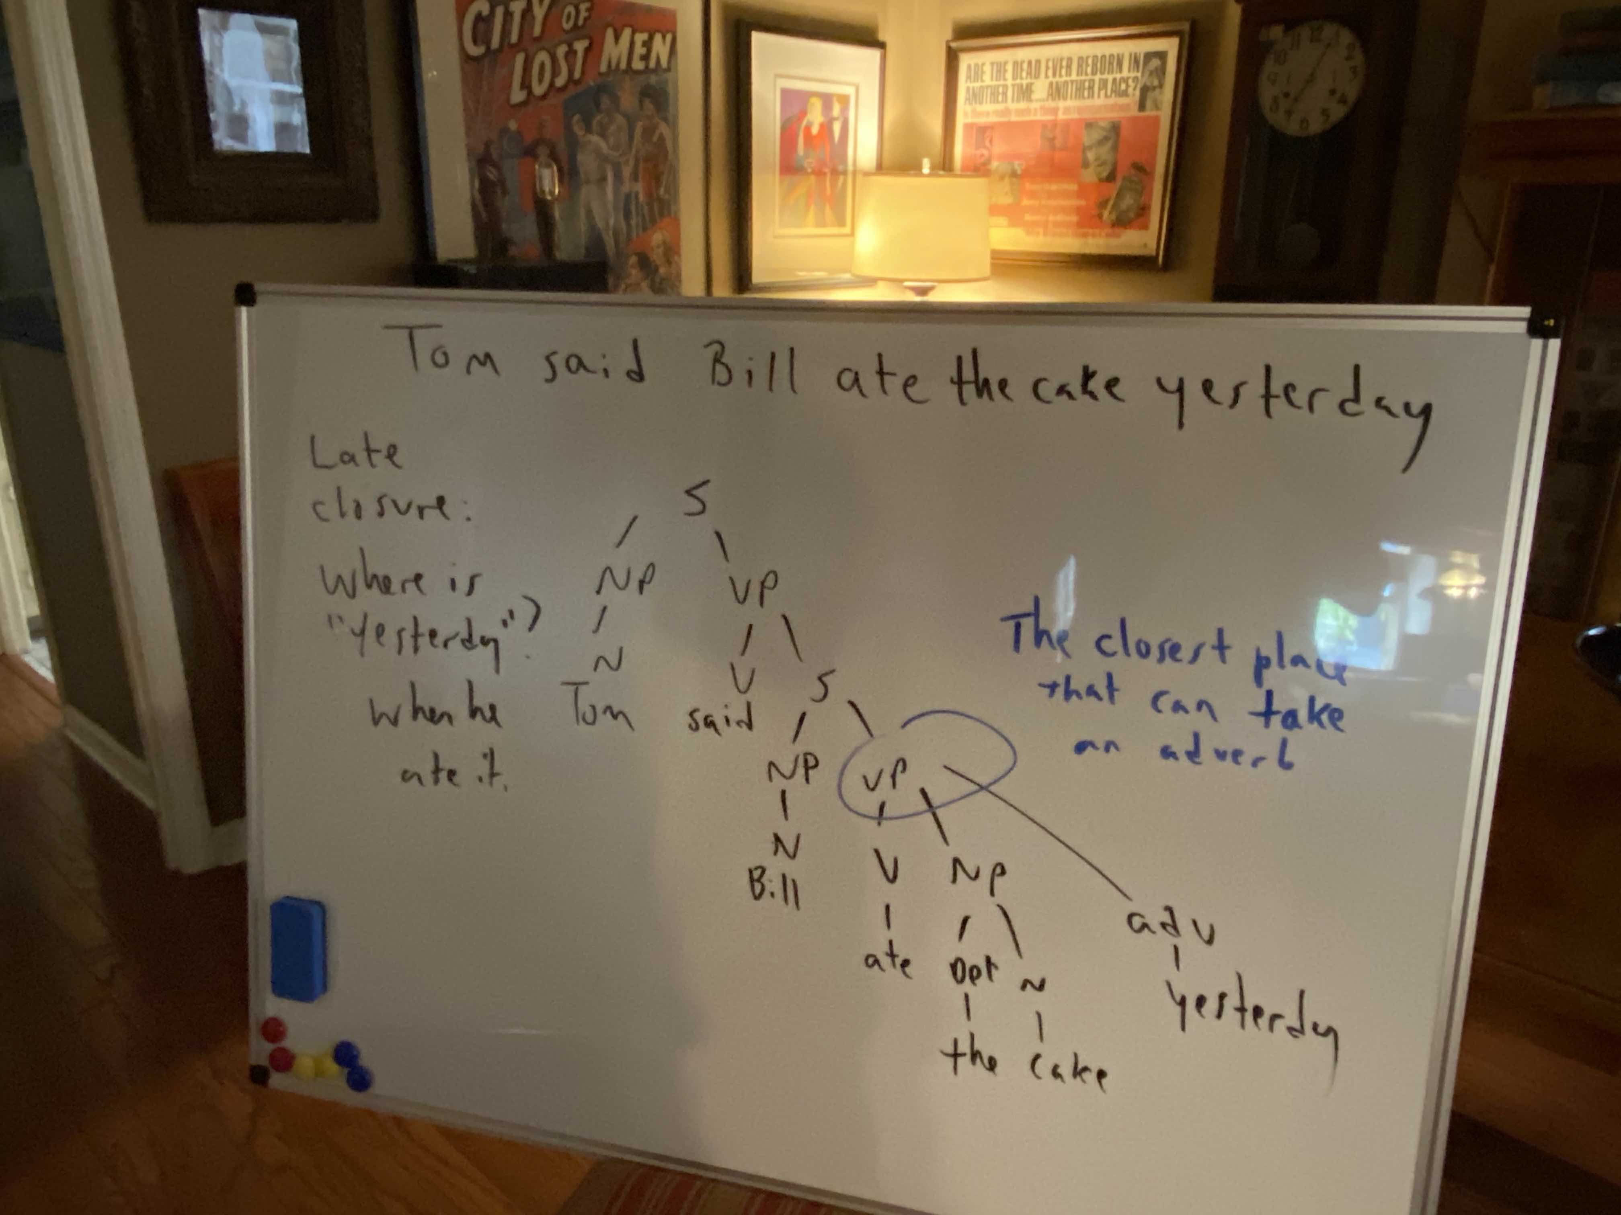
Influences

Slide 83
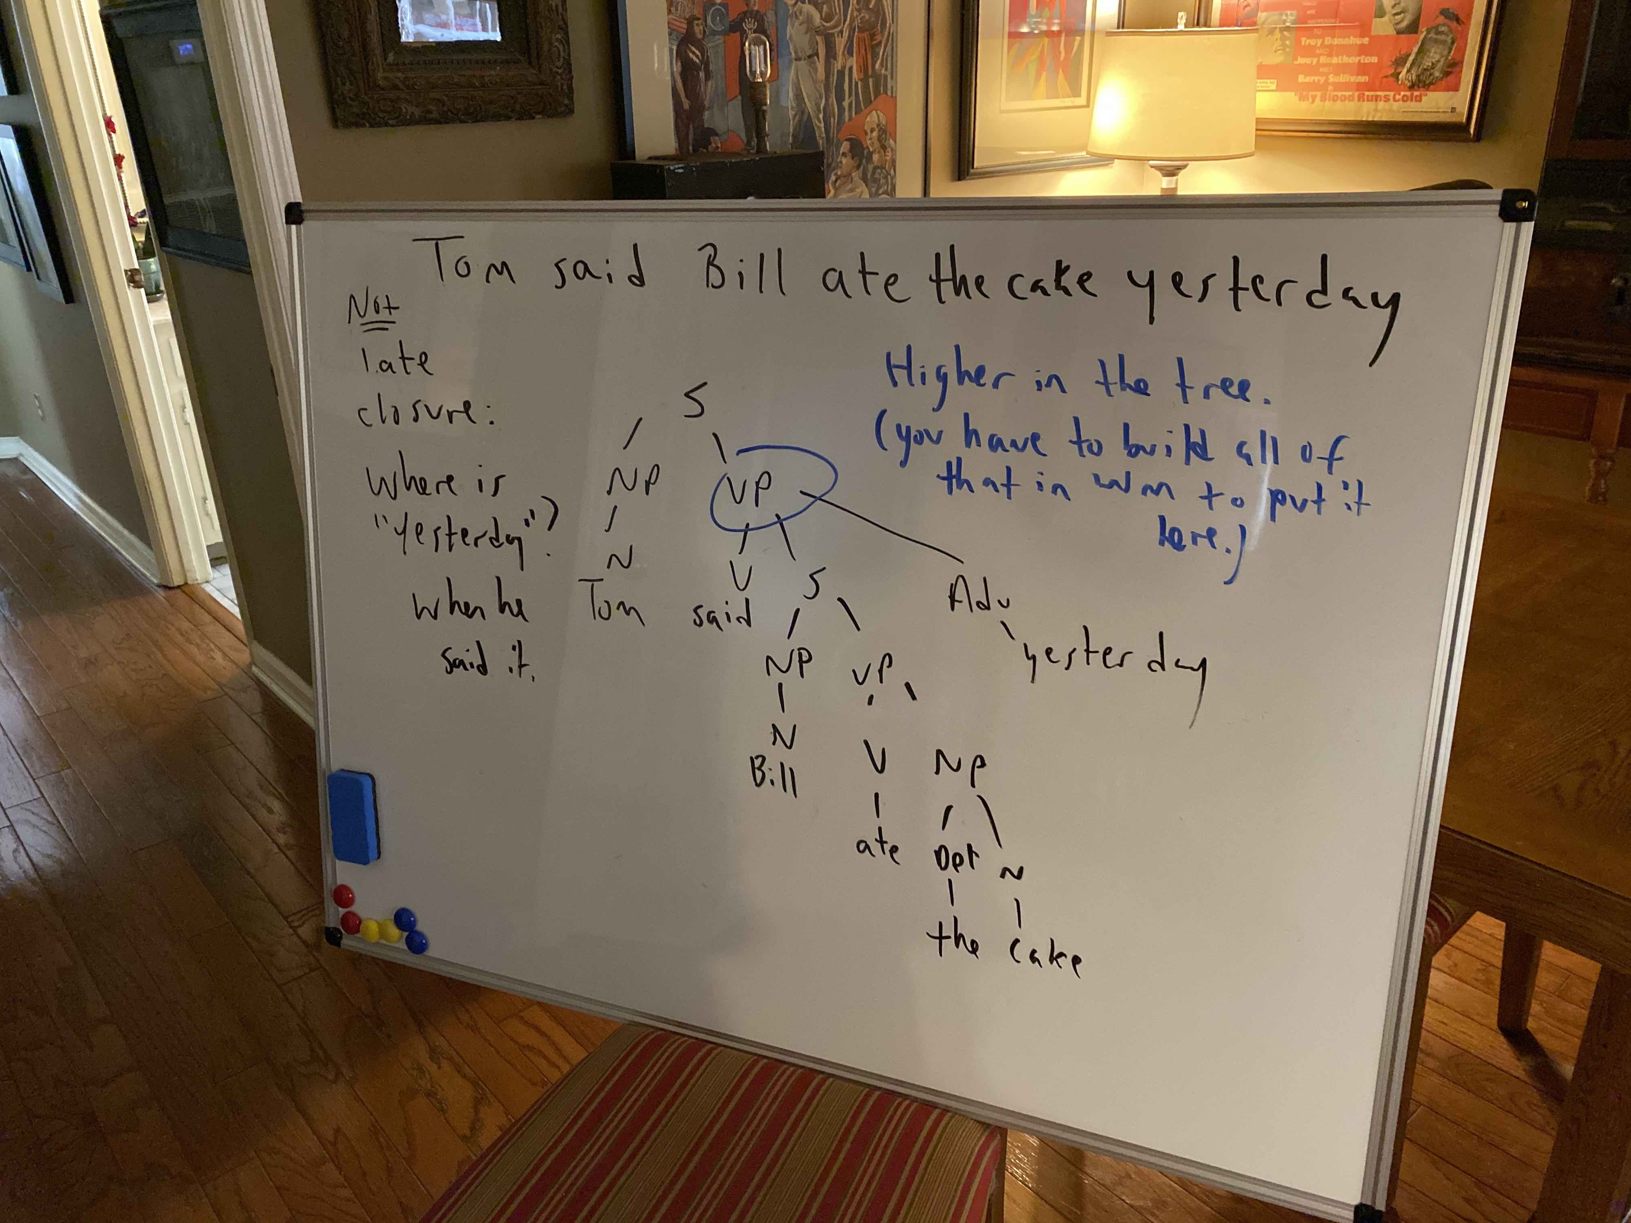
Influences

Slide 84
Influences
Connecting clauses:
  Minimal attachment. Make the smallest tree possible.
  Reduces WM demands.
  Consider:
    Ernie kissed Marcie and Joan…
  Evidence:
    The city council argued the mayor’s position forcefully.
    The city council argued the mayor’s position was incorrect.

Slide 85
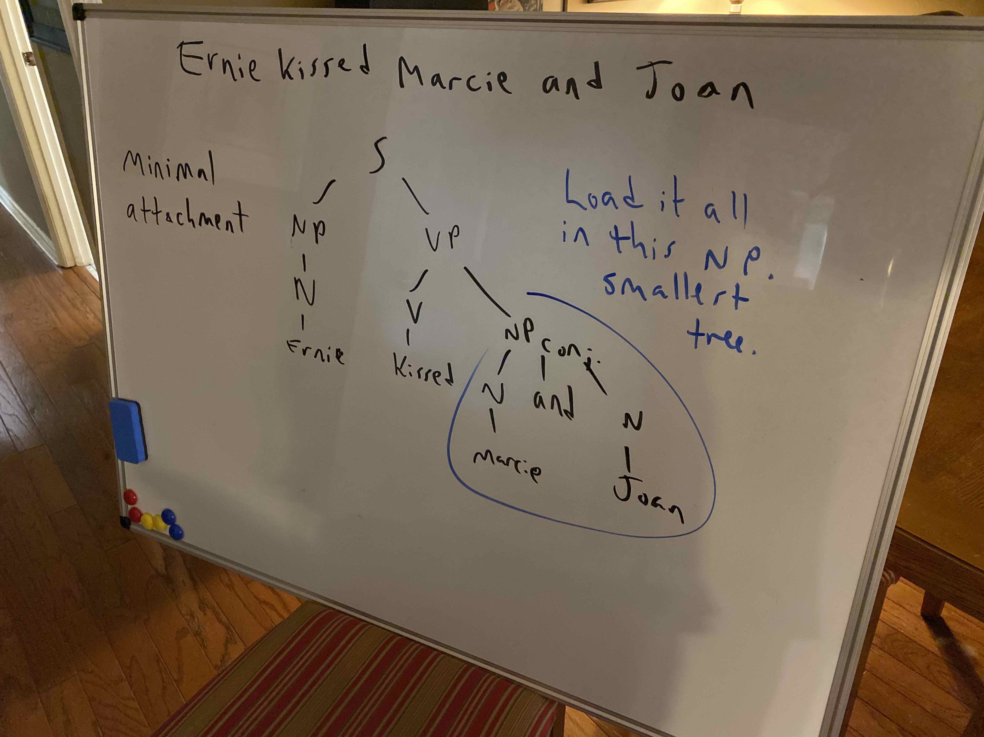

Slide 86
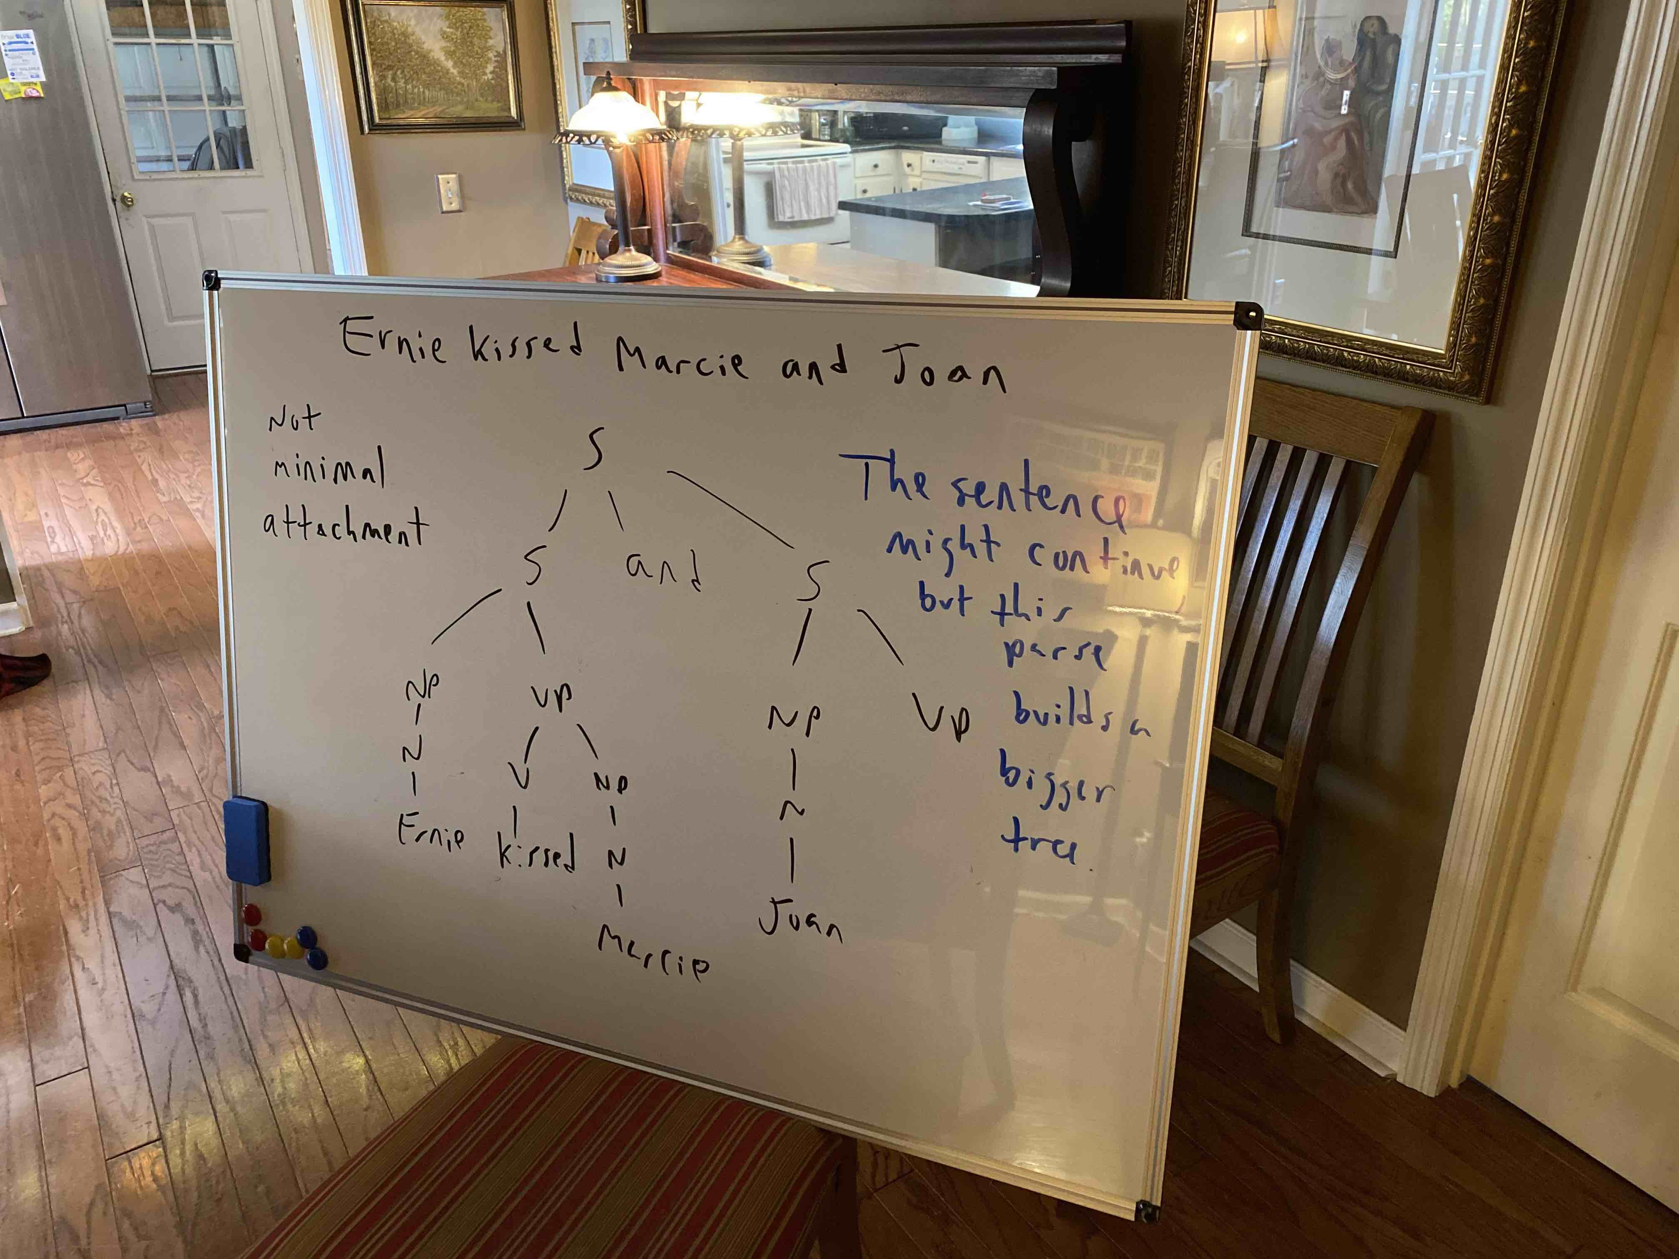

Slide 87
End of Language--structure Show

