Slide 1
Reasoning and Decision Making
Langston, PSY 4040
Cognitive Psychology
Notes 13

Slide 2
Where We Are
We’re continuing our tour of higher cognition. We’ve covered:
Categorization
Language—Structure
Language—Meaning
And we continue with:
Reasoning/Decision making
Human factors

Slide 3
Plan of Attack
We’ll look at three areas:
Logic. We’ve already seen that the rules of logic don’t account for performance on a variety of cognitive tasks. You will not be surprised to know that people’s reasoning about logic is also faulty.
Heuristics: What short-cuts do people take and how do those short-cuts affect decisions?
Probability: People are notoriously bad at understanding probability. We’ll look at that and try to understand why.

Slide 4
Logic
We’ll consider conditional reasoning here. You’re presented with a rule in the form of an if-then statement. You want to test this rule to see if it is supported by the situation.

Slide 5
Logic
People tend to be pretty bad at these problems. Try this one: If there’s an even number on one side, then there’s a vowel on the other. Which should you flip to check?
A
B
1
2

Slide 6
Logic
The correct answer is 2 and B. In a test of similar problems, people pick:
2: 33%
2 and A: 46%
2 and B: 4%
A
B
1
2

Slide 7
Logic
How do you know what the correct answer should be? Consider this problem:
If the red light appears, then the engine is overheating. Two valid tests:
Modus ponens:
The red light appeared.
Therefore the engine is overheating.
Modus tollens:
The engine is not overheating.
Therefore, the red light must not have appeared.

Slide 8
Logic
How do you know what the correct answer should be? Consider this problem:
If the red light appears, then the engine is overheating. Two invalid tests:
Denying the antecedent:
The red light did not appear.
Therefore, the engine is not overheating.
Affirming the consequent:
The engine is overheating.
Therefore, the red light appeared.

Slide 9
Logic
In general terms:
If p then q:
Modus ponens:
p.
Therefore q.
Modus tollens:
not q.
Therefore, not p.
Denying the antecedent:
not p.
Therefore, not q.
Affirming the consequent:
q.
Therefore, p.

Slide 10
Logic
If you look closely at the invalid ones, they assume a relationship that is not stated in the hypothesis.
Affirming the consequent: “If p then q. Present q, must be p.” That’s really saying “If p then q and if q then p.”
Denying the antecedent: “If p then q. Present not p, must not be q.” That’s really saying the only way to get q is p, and I didn’t claim that in the hypothesis. I never said “If not p then not q.”

Slide 11
Logic
The interesting cognitive question is: Why are people so bad at this?
Illicit conversion. People tend to reverse the order of the terms or make it into a biconditional problem. They read “if p then q” as “if p then q and if q then p.” However, the order matters. Except for writing things down and being careful, there’s not a tip to avoid this kind of confusion.

Slide 12
Logic
The interesting cognitive question is: Why are people so bad at this?
Illicit conversion. Consider this:
If you smoke, then you will get cancer.
Valid:
I smoke and didn’t get cancer, so it’s wrong.
Invalid:
I got cancer and I never smoked, so it’s wrong.
If you turned it around to: If cancer, then smoked, the invalid test becomes valid.

Slide 13
Logic
The interesting cognitive question is: Why are people so bad at this?
Illicit conversion. Tangent: This is related to one of the themes of the class. People make mistakes, and a lot of those mistakes are relatively easy to predict. For example, if you exceed the capacity of STM, you will not remember everything you are trying to remember. This is one of those cases. Use this class to gain insight into how things might go wrong, and then make them go right.

Slide 14
Logic
The interesting cognitive question is: Why are people so bad at this?
Confirmation bias. People have a tendency to confirm what they believe to be true rather than to try to disconfirm. Since q is in the hypothesis, when people see q, they think that’s the one to pick for the test. That’s part of what’s going on in the card sorting task.
Confirmation bias can also interact with other parts of people’s reasoning problems to reinforce stereotypes.

Slide 15
Logic
Another interesting cognitive question is: Why are people so good at some conditional reasoning problems? If you’re under 21 then you should not be drinking alcohol. You know either the age or the drink. Which two should you pick to test the rule?
18
coke
43
beer

Slide 16
Logic
Most people guess 18 and beer with no problem. Why? One hypothesis is contextual support. Another is that you have evolved an ability to detect cheaters and are good at permission situations.
18
coke
43
beer

Slide 17
Logic
The Wason selection CogLab examined this, let’s turn to that now…

Slide 18
Heuristics
There are two ways to solve problems.
Algorithmic: Go through each step in the process. Multiply 365 by 48. This is usually impractical, and people rarely do it.
Heuristics: Rough and ready rules that get the answer most of the time. We’ll look at heuristics in thinking.

Slide 19
Heuristics
Representativeness heuristic: Judge how likely something is based on how representative it is.
Which is a more likely outcome of flipping a fair coin six times in a row:
H H H T T T
H H T H T T
Most people pick the second because it looks more random. Of course, they’re equal.

Slide 20
Heuristics
Some implications of representativeness:
Lottery play. Does 1 2 3 4 5 6 seem like a good set of numbers to play? Most people think it’s a bad choice because it’s “so unlikely.” But, every set of numbers is equally likely.
If you’re thinking about playing, ask yourself if you would play 1 2 3 4 5 6. If the answer is no, you understand the odds and shouldn’t play.
But, 1 2 3 4 5 6 is actually very representative of numbers other people won’t play, which means a lot of people do play it, and that makes it a bad choice (you’ll split the pot with more people, decreasing the expected value of the lottery payoff). Numbers > 31 are also bad due to representativeness.

Slide 21
Heuristics
Some implications of representativeness:
Stereotypes. If something you see is representative of a stereotype you are more likely to notice it and add it as evidence (especially with confirmation bias).

Slide 22
Heuristics
Availability heuristic. When you decide how likely something is, think of an example, and base your estimate on how hard it is to do that.
Are there more words that begin with a k or have a k as the third letter?

Slide 23
Heuristics
Another example:
Pick a number from 1-9. Subtract 5, multiply by 3, and square it.
If more than one digit, add them together (e.g., 64 = 6 + 4 = 10 = 1 + 0 = 1)
If your number is less than 5, add 5. Otherwise, subtract 4.
Multiply by 2 and subtract 6.
Map the digit to the letter of the alphabet it goes with (1 = A, 2 = B…)
Pick a country that begins with that letter. Take the second letter of the country and pick an animal name that begins with that letter. What color is that animal?

Slide 24
Heuristics
There are no gray elephants in Denmark.
Availability: Denmark and elephant.
Representativeness: Gray.

Slide 25
Heuristics
Availability is influenced by a lot of factors that should be unsurprising to people finishing a cognitive class:
Frequency: More frequent = more available.
Familiarity: More familiar = more available.
Vividness: More vivid = more available.
Recency: More recent = more available.
How could these influence people’s thinking that driving is safer than flying?

Slide 26
Heuristics
Simulation heuristic. Ease of simulation influences people’s judgments.
Two men are on flights that leave at the same time and are riding in the same car. They arrive 1/2 hour late. Mr. Crane’s flight left on time, but Mr. Tee’s flight was delayed and only left five minutes ago. Who is more annoyed at missing their flight?

Slide 27
Heuristics
Influences on simulation:
Undoing. People usually file down unusual details to make the sequence of events more typical (downhill change) rather than add details (uphill change) when simulating events.
George decides to leave work early. When he gets to the parking lot he has a flat tire and stops to change it. Still in a good mood, he decides to take the scenic drive home even though that will take a little longer. He stops at the store on the way. As he is nearing his house, his car is hit by a drunk driver running a red light and he is killed. If only…

Slide 28
Heuristics
Influences on simulation:
Hindsight bias. Once you know the outcome, it’s easier to simulate how that outcome could have happened, and that makes the outcome seem more likely. It can also make you reinterpret how you felt about the probability of the outcome before it happened.
Rodgers stuck it to each of those 23 NFL teams that ignored him on the longest day of his life: April 23, 2005, when the Packers chose him with the 24th pick of the draft. He says it turned out to be the best day of his life, but sorry, here’s guessing Feb. 6, 2011 -- when Rodgers’ Packers beat the Pittsburgh Steelers -- just moved ahead. ESPN.com 2/7/11
In football, should a team go for it on fourth down?
In Deal or No Deal, should someone take the deal?

Slide 29
Heuristics
John S. is a supervisor in a local manufacturing firm. John is responsible for promoting the employees in his department. In the past he has been accused of being against equal rights and opportunities for women. There are 1 male and 9 females in his department who are potential candidates for promotion. John decides to give these employees a written examination to help with his decision. John grades these exams himself, and reports that the highest mark was obtained by a man, whom he promotes.
How suspicious are you that John’s grading of the exam was unfair? (Write 1-100, with 100 being very suspicious).

Slide 30
Heuristics
John S. is a supervisor in a local manufacturing firm. John is responsible for promoting the employees in his department. In the past he has been accused of being against equal rights and opportunities for women. There are 10 male and 90 females in his department who are potential candidates for promotion. John decides to give these employees a written examination to help with his decision. John grades these exams himself, and reports that the highest mark was obtained by a man, whom he promotes.
How suspicious are you that John’s grading of the exam was unfair? (Write 1-100, with 100 being very suspicious).

Slide 31
Heuristics
Ease of simulation makes the first one sound more suspicious.

Slide 32
Additional Influences
Anchoring and adjustment. People tend to start from the first part of the problem (the anchor) and then adjust from there. If you start with a high anchor people tend to go high and vice versa.

Slide 33
Additional Influences
Anchoring and adjustment examples:

Slide 34
Additional Influences
Anchoring and adjustment examples:
One half multiply 8 X 7 X 6 X 5 X 4 X 3 X 2 X 1

Slide 35
Additional Influences
Anchoring and adjustment examples:
One half multiply 1 X 2 X 3 X 4 X 5 X 6 X 7 X 8

Slide 36
Additional Influences
Anchoring and adjustment examples:
One half multiply 8 X 7 X 6 X 5 X 4 X 3 X 2 X 1
One half multiply 1 X 2 X 3 X 4 X 5 X 6 X 7 X 8
The median for the first problem was 2250, for the second it was 512 (Tversky & Kahneman, 1974). The answer is 40320.

Slide 37
Additional Influences
Anchoring and adjustment examples:
Two lotteries:
50% red marbles in a bag, 50% white. You try to draw a red marble.
90% red marbles, 10% white. You try to draw 7 red marbles in a row.
Which gives the best chance of winning?
They’re about equal. Why do people prefer one over the other?

Slide 38
Additional Influences
Set/Fixedness.
Mental set: A biased way of responding based on previous experience and an understanding of the task demands.
Fixedness: Getting stuck in a particular solution and not being able to get out of it.
Functional fixedness. Thinking of something’s typical use and not seeing how else it could apply.

Slide 39
Additional Influences
Set/Fixedness examples.
Set. Connect the nine dots below by drawing four straight lines (you can’t pick up your pen):

Slide 40
Additional Influences
Set/Fixedness examples.
Fixedness. Jug problems.
You can fill a jug all the way up and dump it all the way out or all the way into another jug. Solve these:
1: Fill B, pour it into A, pour it into C twice = 100 left
Problem: | Jug A: | Jug B: | Jug C: | Target:
1 | 21 | 127 | 3 | 100
2 | 14 | 46 | 5 | 22
3 | 18 | 43 | 10 | 5
4 | 15 | 39 | 3 | 18

Slide 41
Additional Influences
Set/Fixedness examples.
Functional fixedness. You’re in a plane crash in the desert. You have the following items: A parachute, a map, a compass, and a pocket mirror. What is your most valuable asset?

Slide 42
Additional Influences
Set/Fixedness examples.
Set. Connect the nine dots below by drawing four straight lines:
People don’t realize that the answer requires literally thinking outside the box.

Slide 43
Additional Influences
Set/Fixedness examples.
Fixedness. Solve these jug problems:
The trick is that you can do the last one in an easier way, but once you get in a groove you just keep going.
Problem: | Jug A: | Jug B: | Jug C: | Target:
1 | 21 | 127 | 3 | 100
2 | 14 | 46 | 5 | 22
3 | 18 | 43 | 10 | 5
4 | 15 | 39 | 3 | 18

Slide 44
Additional Influences
Set/Fixedness examples.
Functional fixedness. You’re in a plane crash in the desert. You have the following items: A parachute, a map, a compass, and a pocket mirror. What is your most valuable asset?
Your mirror is the most important to signal for help. You have to get past the usual use of a mirror to see its value.

Slide 45
Additional Influences
Confidence. Generally people are more confident in their answers to general knowledge questions than they are correct. The more confident, the more they are overestimating their ability.
Hirsute probably means either “really hairy” or “habitually late.” Pick one and rate your confidence.

Slide 46
Additional Influences
Belief. Once people state a belief it’s hard to get them to change their mind, even if you tell them that the facts upon which the belief was based are made up.
It’s better to be in the back of an airplane in a crash. Why?

Slide 47
Additional Influences
Belief. Once people state a belief it’s hard to get them to change their mind, even if you tell them that the facts upon which the belief was based are made up.
It’s better to be in the back of an airplane in a crash. Why?
It really doesn’t matter, but once you make up the reasons it can be hard to let it go.

Slide 48
Additional Influences
Framing. How you frame the question impacts how people reason about it. Framing as gains increases people’s choices of lotteries. On a scale of 1 - 7 (where one is not dangerous), rate how dangerous each is:
10% of the people who eat a new kind of sushi will die.
90% of the people who eat a new kind of sushi will live.

Slide 49
Additional Influences
Framing. How you frame the question impacts how people reason about it. Framing as gains increases people’s choices of lotteries. On a scale of 1 - 7 (where one is not dangerous), rate how dangerous each is:
10% of the people who eat a new kind of sushi will die.
90% of the people who eat a new kind of sushi will live.
People think the “live” one is safer, but they’re the same.

Slide 50
Additional Influences
Let’s look at the CogLab exercise on decision making…

Slide 51
Probability
People have pretty poor comprehension of probability, and rarely use it well in their day-to-day reasoning (e.g., Deal or No Deal).
It’s only sort of related, but let’s look at the Monty Hall problem CogLab.

Slide 52
Probability
Conjunction. How do people combine the probabilities of independent events?
Try the “causes of death” estimate…
Not being killed in a car accident may be 99% certain, not perishing in a household accident is 98% certain, not dying of lung disease is 95% certain, dementia 90%, cancer 80%, heart disease 75%. What is the chance of not dying from any of them?

Slide 53
Probability
Conjunction. How do people combine the probabilities of independent events?
Try the “causes of death” estimate…
Not being killed in a car accident may be 99% certain, not perishing in a household accident is 98% certain, not dying of lung disease is 95% certain, dementia 90%, cancer 80%, heart disease 75%. What is the chance of not dying from any of them?
Approximately 50% (.4977).

Slide 54
Probability
Conjunction fallacy.
Try the two conjunction exercises…
Health survey of a random sample of adults, including Mr. F. Which is more probable:
Mr. F has had one or more heart attacks.
Mr. F has had one or more heart attacks and is over 55.

Slide 55
Probability
Conjunction fallacy.
Try the two conjunction exercises…
Linda is 31 years old, single, outspoken, and very bright. She majored in philosophy. As a student, she was deeply concerned with discrimination and social justice, and participated in anti-nuclear demonstrations. Which is more likely:
Linda is a bank teller.
Linda is a bank teller and a feminist.

Slide 56
Probability
Conjunction fallacy.
Try the two conjunction exercises…
Health survey of a random sample of adults, including Mr. F. Which is more probable:
Mr. F has had one or more heart attacks.
Mr. F has had one or more heart attacks and is over 55.

Slide 57
Probability
Conjunction fallacy.
Try the two conjunction exercises…
Linda is 31 years old, single, outspoken, and very bright. She majored in philosophy. As a student, she was deeply concerned with discrimination and social justice, and participated in anti-nuclear demonstrations. Which is more likely:
Linda is a bank teller.
Linda is a bank teller and a feminist.

Slide 58
Probability
Conjunction fallacy.
Mr. F has had one or more heart attacks.
Mr. F has had one or more heart attacks and is over 55.
One or more heart attacks and over 55
One or more heart attacks
Over 55

Slide 59
Probability
Conjunction fallacy.
Linda is a bank teller.
Linda is a bank teller and a feminist.
Bank teller and feminist
Bank teller
Feminist

Slide 60
Probability
Conjunction fallacy.
The probability of the conjunction of two independent events has to be smaller than the probability of either one of them. People usually get that wrong, influenced by typicality.
We can look at our CogLab exercise for typical reasoning…

Slide 61
Probability
Perceptions of randomness.
“People think a sequence is more likely, and hence random, if there is some irregularity in order of appearance (e.g., HHTHTH vs. HTHTHT).
“People think a sequence is more likely, and hence random, if the equiprobable outcomes occur equally often.
“The outcome alternation rate (i.e., how often H switches to T and vice versa) that people consider to be random is higher than that associated with chance.” (Hahn & Warren, 2009, p. 454)

Slide 62
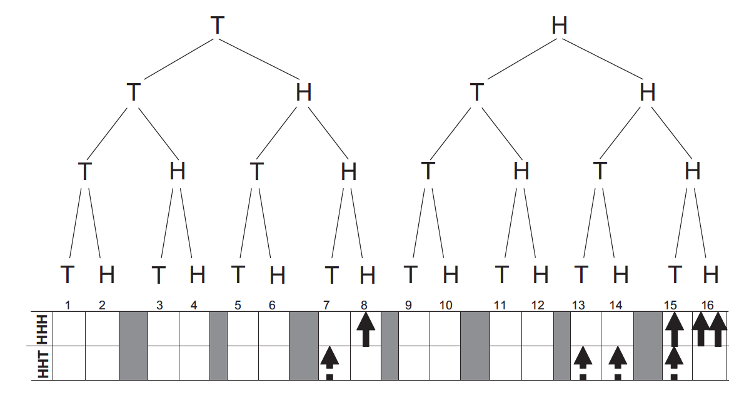
Probability
Hahn & Warren (2009, p. 455)

Slide 63
Probability
“Figure 1. A probability tree indicating the 16 possible outcomes of a sequence of four coin tosses. Also marked are the outcomes on which HHH (unbroken arrows) and HHT (broken arrows) occur. Note that although there are four occurrences of both HHH and HHT in the tree, in the case of HHT, these occur in four different independent outcomes (HHHT, THHT, HHTH, HHTT), whereas for HHH they occur in only three (HHHH, THHH, HHHT) because two occurrences are in the same outcome (HHHH).” (Hahn & Warren, 2009, p. 454)

Slide 64
Probability
Why is this important?
In local strings (real time), the wait time for HHH is 14 tosses, the wait time for HHT is 8 tosses. In other words, given the limited lifespan of people and limited working memory resources, people are correct to say that HHH is less likely than HHT.
It solves a problem: People are generally really good at being tuned to the environment, then they stink at this. It’s because the assumptions don’t match reality.

Slide 65
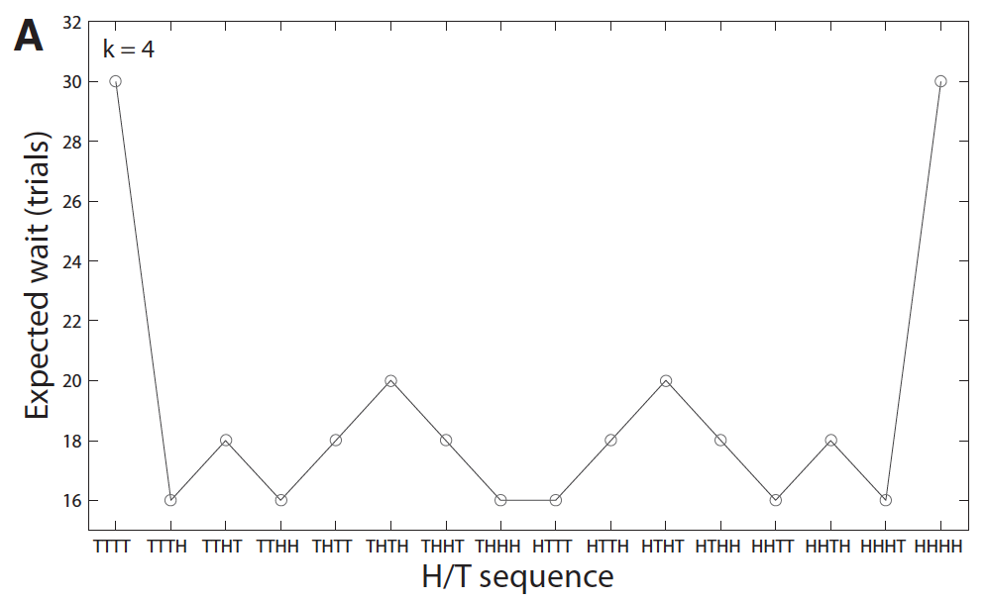
Probability
Hahn & Warren (2009, p. 456)

Slide 66
Probability
The power of chance. People often underestimate the power of chance.
Out of 1000 stock picking professionals, person A has picked correctly which direction the market would move 10 weeks in a row. Is that an impressive record?

Slide 67
Probability
Even if they’re only flipping a coin, we would expect by chance:
1000
500 (week one)
250
125
62
31
16
8
4
2
1 (week ten)

Slide 68
Probability
In other words, the odds that someone could do it were high. The same is true of the lottery. The odds that someone will win are pretty high. The odds that your ticket will win are not so great.

Slide 69
Probability
Implications of chance:
Amazing coincidences: I have a pair of women, both are Baptists, studying nursing, prefer vacations to historical places, like tennis and volleyball, and enjoyed english and math in school. These two women were twins reared apart. Amazing?

Slide 70
Probability
Implications of chance:
Amazing coincidences: Twins. Wyatt, Posey, Welker, and Seamonds (1984) studied pairs of random people. You get lots of pairs like these. For any one thing the odds of a match might be low, but with an unlimited number of variables to choose from, the odds of some overlap are quite high.

Slide 71
Probability
Implications of chance:
The power of prediction. With the biases we discussed above, it’s easy to interpret an outcome as a confirmation of a prediction. You must be careful of probability and coincidence. An example:
I predict two people in here have the same birthday. Let’s see.

Slide 72
Probability
Implications of chance:
The power of prediction. With the biases we discussed above, it’s easy to interpret an outcome as a confirmation of a prediction. You must be careful of probability and coincidence. An example:
I predict two people in here have the same birthday. Let’s see.

Slide 73
Probability
Implications of chance:
The power of prediction. Most people do the math wrong, and it seems amazing. In fact, with 23 people in the room the odds are 51% that two will share a birthday. In other words, I have an even chance of being right. In general, if I know more about probability than you do, I can come off as an amazing psychic.

Slide 74
Probability
Implications of chance:
Coincidence. Here’s an amazing fact: The odds of George Washington being born on February 22 and Queen Victoria being born on May 24 are 1 in 130,000. Are you blown away? Why not? Think of the Lincoln-Kennedy assassination coincidences.

Slide 75
Probability
Certainty. Related to people’s failure to understand probability is the problem of certainty. When something is guaranteed to happen, you shouldn’t be surprised by it, but people usually are.

Slide 76
Probability
Certainty. Add these up:
1000
40
1000
30
1000
20
1000
10

Slide 77
Probability
Certainty. You got 5000. The actual sum was 4100. Almost 100% of the population makes this mistake, it’s not exciting.

Slide 78
Probability
Certainty. I have some additional demonstrations if there’s time…

Slide 79
End of Reasoning and Decision Making Show

