Slide 1
Processing
Langston, PSY 4040
Cognitive Psychology
Notes 7

Slide 2
Questions
Why do you have such a hard time learning some things, even with studying?
How can you improve your studying to be more effective?

Slide 3
More Specific Themes
What is deeper processing? What does it do to memory?
Do we need separate long term and short term memories? Is there such a thing as memory?

Slide 4
Where We Are
We’re examining memory from a processing perspective to see what we get.
We’ll return to the box model next class, and then move on to higher cognition. Technically, we’re still in the episodic box right now.

Slide 5
Memory Codes
Deeper processing is partly different memory codes:
Counting e’s or deciding if “word” is “CVCC” is pretty shallow, and creates a code that is surface based.
Deciding if something is pleasant or a synonym is a meaning based code.

Slide 6
Memory Codes
Deeper processing:
It’s not going to be “deeper = more effort” because you can make a CCVCVVCVC task really hard and much more effortful than a categorization task and still get a huge depth of processing effect.
Deeper is also not more time. CVCC judgements can take a lot longer and yet not improve memory.

Slide 7
Memory Codes
Deeper processing:
Having completed our caveating, deeper processing usually is more effortful and usually does take longer. Why? Different codes take different amounts of effort.
What is it about the deeper codes that improves memory? It’s going to boil down to retrieval cues. I’m going to develop that answer.

Slide 8
Memory Codes
Deeper processing:
I have a demonstration of memory codes and memory for a list…

Slide 9
Memory Codes
Deeper processing:
This was based on Craik and Tulving (1975). Generally, you get more memory as you go from surface to rhyming to semantic.
I hoped to show that when you heard the word, rhyming changed places with the surface task. Trying to generate the sound from the visual word or the visual word from the sound should be more difficult and leave more traces of processing, improving recall.

Slide 10
Memory Codes
Deeper processing:
Here’s that sentence in a table:
Task: | Difficulty:
Sound from visual word (rhymes with eagle) | High
Sound from a spoken word | Low
Count e’s from a visual word | Low
Count e’s from a spoken word | High

Slide 11
Memory Codes
Deeper processing:
The difficulty increases the amount of “effort trace” that’s available to be accessed with a retrieval cue.

Slide 12
Memory Codes
To answer the second question, one suggestion is to improve memory by thinking about elaborative processing. Deeper processing generates more cues that can be used for retrieval later. Put forth the effort, increase your chance of getting it out.

Slide 13
Encoding Specificity
Now for wrinkles. The “deeper = better” story isn’t perfect. A big influence on how well you’ll retrieve something is what cues you created when you put it in.
Encoding specificity is this: What is stored determines what retrieval cues are effective in providing access to what is stored.

Slide 14
Encoding Specificity
In other words, the most effective retrieval cues will be the ones you used during the original learning.
For example, Thompson and Tulving (1970) had people learn lists of strong or weak associates. What do you think of when I say:
Hot?
Wind?

Slide 15
Encoding Specificity
Thompson and Tulving (1970):
In general terms, the best retrieval cue for a word like “cold” would be a strong associate like “hot.” “Wind” is weakly associated to “cold,” and would be unlikely to pull it out.
Thompson and Tulving showed that this can be reversed if you change the study context.

Slide 16
Encoding Specificity
Thomson and Tulving (1970):
Learning Context: | Retrieval context: | Performance:
Hot-cold | Hot | Good (20.2)
Wind-cold | Hot | Poor (13.9)
Hot-cold | Wind | Poor (9.2)
Wind-cold | Wind | Good (15.7)
(Thomson & Tulving (1970, p. 257)

Slide 17
Encoding Specificity
Thomson and Tulving (1970):
Learning Context: | Retrieval context: | Performance:
Hot-cold | Hot | Good (20.2)
Wind-cold | Hot | Poor (13.9)
Hot-cold | Wind | Poor (9.2)
Wind-cold | Wind | Good (15.7)
(Thomson & Tulving (1970, p. 257)

Slide 18
Encoding Specificity
Thomson and Tulving (1970):
Learning Context: | Retrieval context: | Performance:
Hot-cold | Hot | Good (20.2)
Wind-cold | Hot | Poor (13.9)
Hot-cold | Wind | Poor (9.2)
Wind-cold | Wind | Good (15.7)
(Thomson & Tulving (1970, p. 257)

Slide 19
Encoding Specificity
Thomson and Tulving (1970):
Learning Context: | Retrieval context: | Performance:
Hot-cold | Hot | Good (20.2)
Wind-cold | Hot | Poor (13.9)
Hot-cold | Wind | Poor (9.2)
Wind-cold | Wind | Good (15.7)
(Thomson & Tulving (1970, p. 257)

Slide 20
Encoding Specificity
Thomson and Tulving (1970):
Learning Context: | Retrieval context: | Performance:
Hot-cold | Hot | Good (20.2)
Wind-cold | Hot | Poor (13.9)
Hot-cold | Wind | Poor (9.2)
Wind-cold | Wind | Good (15.7)
(Thomson & Tulving (1970, p. 257)

Slide 21
Encoding Specificity
Thompson and Tulving (1970):
What we can conclude from this is that even if a cue is not “optimal,” if it’s the one you studied with, it’s the best one.
Make sure the encoding cues will be available at retrieval since they’ll be the most likely to get something out.
I should point out that within the “Wind-cold” comparison, “Wind-” was a better cue, but it didn’t reach the level of “Hot-” for “cold.” In other words, the matching cues are the best if that’s what you used, but the best cues are still better. Choose your cues wisely!

Slide 22
Encoding Specificity
Thomson and Tulving (1970):
Learning Context: | Retrieval context: | Performance:
Hot-cold | Hot | Good (20.2)
Wind-cold | Hot | Poor (13.9)
Hot-cold | Wind | Poor (9.2)
Wind-cold | Wind | Good (15.7)
(Thomson & Tulving (1970, p. 257)

Slide 23
Encoding Specificity
We can look at the results of our CogLab demonstration here.
 | Test Cue Weak | Test Cue Strong
Study Cue Weak
Study Cue Strong

Slide 24
Encoding Specificity
We can look at the results of our CogLab demonstration here:
N = 7 ?!? | Test Cue Weak | Test Cue Strong
Study Cue Weak | 70 | 60
Study Cue Strong | 73 | 70

Slide 25
Encoding Specificity
We can look at the results of our CogLab demonstration here. Matching encoding and retrieval context:
 | Test Cue Weak | Test Cue Strong
Study Cue Weak | 70 | 60
Study Cue Strong | 73 | 70

Slide 26
Encoding Specificity
We can look at the results of our CogLab demonstration here. Mismatching encoding and retrieval context:
 | Test Cue Weak | Test Cue Strong
Study Cue Weak | 70 | 60
Study Cue Strong | 73 | 70

Slide 27
Encoding Specificity
We could also use this to predict a context effect.
Godden and Baddeley (1975) had divers learn a list on land or under water. They showed that matching the retrieval context to the learning context improved recall.
Learn: | Recall: | Performance:
Land | Land | Good
Land | Water | Poor
Water | Land | Poor
Water | Water | Good

Slide 28
Encoding Specificity
This might lead you to wonder: Is it better to take the test in the same room as the class? Encoding specificity would suggest a “yes” since the cues at encoding would match. I’d suggest that if you’re learning cognitive psychology based on the bricks and the color of the paint, you’re doing it wrong.
Smith, Glenberg, and Bjork (1978) did show some evidence of a room based context effect in a carefully controlled study.
If you think of the other material studied at the same time as a context, that could make a more important contribution to your long term learning.

Slide 29
Encoding Specificity
We can also think about the meaning of forgetting at this point:
STM:
Interference
Maybe decay
Either way, gone is gone
LTM: Maybe there’s no such thing. Instead, it’s retrieval failure. The material is in there, but you can’t construct the right cue to get it out.
Library analogy…
I have a demonstration of this…
Implication for studying: Think about retrieval cues while you’re putting it in.

Slide 30
Transfer Appropriate Processing
Roediger (1990)
Blaxton (1989)
Meier & Graf (2000) with prospective memory
From McBride text review, Ch. 5

Slide 31
Transfer Appropriate Processing
Retrieval will be best if the processes you do at retrieval match the processes you did at encoding.
Morris, Bransford, and Franks (1977):
Encoding: | Recognition test:
Does ____ rhyme with legal? (eagle) | 63%
Does ____ have feathers? (eagle) | 84%

Slide 32
Transfer Appropriate Processing
Retrieval will be best if the processes you do at retrieval match the processes you did at encoding.
Morris, Bransford, and Franks (1977):
Encoding: |  | Rhyming test:
Does ____ rhyme with legal? (eagle) |  | 49%
Does ____ have feathers? (eagle) |  | 33%

Slide 33
Transfer Appropriate Processing
Retrieval will be best if the processes you do at retrieval match the processes you did at encoding.
Morris, Bransford, and Franks (1977):
Encoding: | Recognition test: | Rhyming test:
Does ____ rhyme with legal? (eagle) | 63% | 49%
Does ____ have feathers? (eagle) | 84% | 33%

Slide 34
Transfer Appropriate Processing
Retrieval will be best if the processes you do at retrieval match the processes you did at encoding.
Morris, Bransford, and Franks (1977):
Encoding: | Recognition test: | Rhyming test:
Does ____ rhyme with legal? (eagle) | 63% | 49%
Does ____ have feathers? (eagle) | 84% | 33%

Slide 35
Transfer Appropriate Processing
The take-home message is that when the processing at encoding matches the processing at retrieval, performance will be better.
This overwhelms a rule like “deeper processing is better.” “Does ___ have feathers?” is deeper (semantic) than “Does ____ rhyme with legal?” (see our earlier notes and demonstrations). However, that doesn’t lead to better performance on a rhyming test compared to a “shallow” rhyming encoding.

Slide 36
Transfer Appropriate Processing
Glenberg, Smith, and Green (1977): More maintenance rehearsal is no help with recall (see our previous demonstration).
But, rehearsal should increase familiarity, and that’s an important component of a recognition test. Will more maintenance rehearsal improve recognition? Their results are “yes” (but it didn’t improve recall).
The take-home message: Match the processes at study to the processes at retrieval to maximize performance.

Slide 37
Transfer Appropriate Processing
Another aspect of this has to do with your expectations for the kind of test you will see.
d’Ydewalle and Rosselle (1978) told people to expect either a multiple choice test or open questions. Half got what they expected, half got the other. Either way, getting what they expected led to better performance. In other words, people do seem to make transfer appropriate processing assumptions when planning their studying.

Slide 38
Putting It Together
Let’s revisit the advice I’ve been giving you about memory. Can we say things like (sort of lifted from CogLab):
Deeper processing is better?
Increasing maintenance rehearsal isn’t much use in improving memory?
Recognition is superior to recall?
Pictures are recalled better than words?
No. (Unless we discuss encoding and retrieval together.)

Slide 39
Putting It Together
Let’s look at these:
Deeper processing is better?
See the discussion of Morris, Bransford, and Franks (1977) above.
Increasing maintenance rehearsal isn’t much use in improving memory?
See the discussion of Glenberg, Smith, and Green (1977).
Recognition is superior to recall?
I’d expect to see this as a problem for you to work out on the exam.
Pictures are recalled better than words?
I’d expect to see this as a problem for you to work out on the exam.

Slide 40
Putting It Together
Again, we should incorporate some sense of your overall goals into this discussion.
What we’ve been talking about will maximize your chances of beating the test. That may not be your best approach.
As an example, looking at Glenberg, Smith, and Green (1977), increasing maintenance rehearsal helps on a recognition test, but why are you only doing maintenance rehearsal in the first place? What would happen to a recognition test if you did elaborate rehearsal? Is one of those better than the other when you compare them side-by-side?

Slide 41
Kind of Elaboration
Assuming you do elaborate the representation, what sorts of elaboration work best?
Precise elaborations that emphasize the relevant features.
For example: “The fat man read the sign about thin ice” will help you remember “fat” better than “the fat man read the sign that was about two feet tall.”
This might explain some of the differences between the different “deep” tasks.

Slide 42
Kind of Elaboration
Anderson and Ortony (1975) investigated this:
Read: | Cue: | Effectiveness:
Pianos can be pleasing to listen to. | Music | High
Pianos can be pleasing to listen to. | Heavy | Low
Pianos can be difficult to move. | Music | Low
Pianos can be difficult to move. | Heavy | High

Slide 43
Kind of Elaboration
Take-home message: The context at testing is going to provide cues that relate to some nuance of the information. If you encode the kinds of cues with the information that is likely to be triggered by the retrieval context, you will have a better chance of getting it back.

Slide 44
Sum Up Processing
Processing:
Can lead to different memory codes that can improve retrieval.
Remember encoding specificity.
Can influence the effectiveness of different types of retrieval processes.
Remember transfer appropriate processing.
Can influence how well the retrieval context will help to get the information out.
Remember kind of elaboration.

Slide 45
Distinctiveness
Processing can also influence distinctiveness. Schmidt (1991) laid out four kinds:
Primary: If an item on a list is different from other items on that list (e.g., a word in red ink on a list of words in black ink).
Secondary: If an item is different from other items in long term memory (e.g., words like “khaki” and “lymph” have an odd shape).

Slide 46
Distinctiveness
Four kinds of distinctiveness:
Emotional: Strong emotional context (e.g., 9/11).
Processing: If an item on a list receives a different kind of processing (e.g., only do a rhyming task on one word).

Slide 47
Distinctiveness
What does distinctiveness do? Retrieval cues are generally more effective if they activate fewer items in long term memory. Distinctiveness can help to make the relationships between cues and items unique.
Think how this might also account for some effects of deeper processing.

Slide 48
Retrieval and Memory
Karpicke & Roediger (2008)
“The standard assumption in nearly all research is that learning occurs while people study and encode material. Therefore, additional study should increase learning.” (p. 966)
“Retrieving information on a test, however, is sometimes considered a relatively neutral event that measures the learning that occurred during study but does not by itself produce learning.” (p. 966)

Slide 49
Retrieval and Memory
Karpicke & Roediger (2008)
What is the effect on long term memory of additional study trials once the information has been successfully retrieved?
What is the effect on long term memory of additional retrieval attempts once the information has been successfully retrieved?

Slide 50
Retrieval and Memory
“Standard” study conditions:
Standard method: Learn list, test, learn list, test… (ST)
Dropout approach: Learn list, test, drop items that were successfully recalled, learn list, test, drop, learn, test… (S_{N}T)
Assumption is that additional study of learned items takes away time from unlearned items.

Slide 51
Retrieval and Memory
To separate testing effects from study effects, two more conditions were added:
Drop items from testing after successful retrieval, keep studying them. (ST_{N})
Drop items from study and test after successful retrieval. (S_{N}T_{N})

Slide 52
Retrieval and Memory
Design:
 |  | Study after Successful Retrieval
 |  | Yes | No
Test after Successful Retrieval | Yes | ST | S_{N}T
 | No | ST_{N} | S_{N}T_{N}

Slide 53
Retrieval and Memory
Method:
Students learned 40 Swahili-English word pairs (e.g., mashua-boat).
First trial study all 40, test all 40.
After that, follow the dropout procedure for each list.
Four total study-test trials.

Slide 54
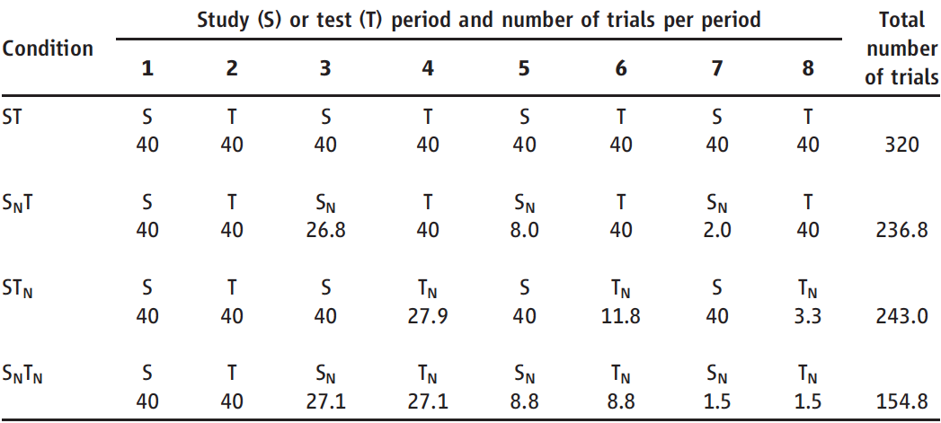
Retrieval and Memory
Karpicke & Roediger (2008, p. 966)

Slide 55
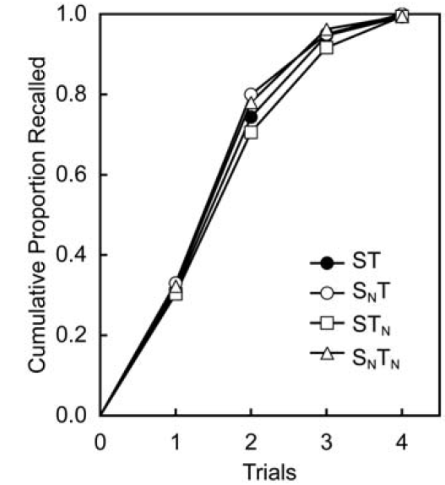
Retrieval and Memory
Learning phase results:
Karpicke & Roediger (2008, p. 967)

Slide 56
Retrieval and Memory
Learning phase:
All groups achieved nearly 100% performance during the learning phase.
No difference in the learning curves.
What happens one week later?

Slide 57
Retrieval and Memory
Predictions: Once an item has been correctly recalled once…
Study matters, retrieval does not:
(ST = ST_{N}) > (S_{N}T = S_{N}T_{N})
Retrieval matters, study does not:
(ST = S_{N}T) > (ST_{N} = S_{N}T_{N})
Retrieval and study both matter:
ST > S_{N}T ? ST_{N} > S_{N}T_{N}
Results…

Slide 58
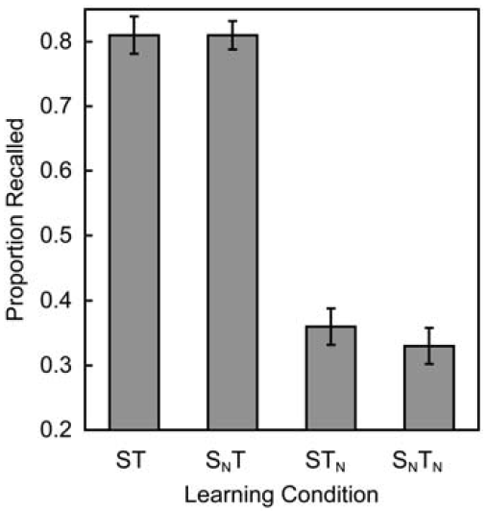
Retrieval and Memory
Karpicke & Roediger (2008, p. 967)

Slide 59
Retrieval and Memory
Additional notes:
ST_{N} had around 88 more trials than S_{N}T_{N}. No gain in retention.
ST about 83 more than S_{N}T. Likewise, no gain in retention.
ST had 77 more than ST_{N}, huge gain in retention.
S_{N}T had about 82 more than S_{N}T_{N}, likewise huge gain.
Where you put your 80 trials really matters.

Slide 60
Retrieval and Memory
Additional notes:
What about student perceptions?
Predict all will be about the same (50%).
Makes sense given learning data.
Obviously they are all wrong. But, it highlights how easily tricked we are.

Slide 61
Retrieval and Memory
Conclusions:
“…shows a striking absence of any benefit of repeated studying once an item could be recalled from memory.” (p. 968)
“The benefits of repetition for learning and long-term retention clearly depend on the processes learners engage in during repetition.” (p. 968)

Slide 62
Final Demonstrations
We’ve discussed a lot of influences on episodic long term memory. Let’s do one more demonstration to tie that all together…

Slide 63
Final Demonstrations
We can address the question of “How can my study be more effective” by looking at the LT&ITC Brownbag on the web page…

Slide 64
Final Demonstrations
We also asked the question: Is there even such a thing as memory? Let’s try a demonstration to address that question a bit…

Slide 65
End of Processing Show

