Slide 1
Semantic Long Term Memory
Langston, PSY 4040
Cognitive Psychology
Notes 8

Slide 2
Where We Are
We’re looking at long term memory. We started with episodic long term memory and processing.
For this unit, we’ll look at semantic long term memory.

Slide 3
Where We Are
Here are the boxes:
Working Memory (STM)
LTM
Sensory
Store
Executive
Episodic
AL
VSS
Semantic
Input
(Environment)
Response

Slide 4
Questions
What is the structure of the representation in semantic memory? We’ll look at two views:
Traditional models.
Neural networks.
What processes act on the representation?
Encoding: I’ll probably leave you less than satisfied on this one.
Retrieval: How do you get information out?

Slide 5
Models of Semantic Memory
Symbolic models:
A symbolic model uses symbols (something that stands for something else). For instance, the word “moon” is a symbol for the thing in the sky.
Symbols are discrete.
There is no inherent relationship between the symbol and the thing being represented (this is becoming a topic of discussion).
Cognition involves manipulating symbols.

Slide 6
Models of Semantic Memory
Symbolic models:
A symbolic model uses symbols:
The analogy is to language. You arrange language symbols to represent meaning (“The dog bit the man” is different from “The man bit the dog”). At the cognitive level, you arrange your symbols to produce meaning. Note that the symbols are not words or units we would think of as language.
Our first set of models will all be symbolic.

Slide 7
Models of Semantic Memory
Network models (Collins & Quillian, 1970):
Concepts are organized as a set of nodes and links between those nodes.
Nodes hold concepts. For example, you would have a node for RED, FIRE, FIRETRUCK, etc. Each concept you know would have a node.
Links connect the nodes and encode relationships between them. Two kinds:
Superset/subset: Essentially categorize. For example, ROBIN is a subset of BIRD.
Property: Labeled links that explain the relationship between various properties and nodes. For example, WINGS and BIRD would be connected with a “has” link.

Slide 8
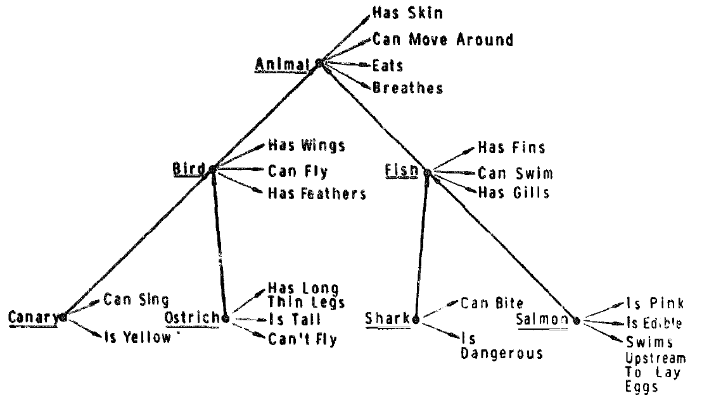
Models of Semantic Memory
Network models (Collins & Quillian, 1970):
Here’s a sample of a network:
Collins & Quillian (1970, p. 305)

Slide 9
Models of Semantic Memory
Network models (Collins & Quillian, 1970):
The nodes are arranged in a hierarchy and distance (number of links traveled) matters. The farther apart two things are, the less related they are. This is going to be important in predicting performance.
The model has a property called cognitive economy. Concepts are only stored once at the highest level to which they apply (e.g., BREATHES is stored at the ANIMAL node instead of with each individual animal). This was based on the model’s implementation on early computers and may not have a brain basis. Also, not necessarily crucial for the model.

Slide 10
Models of Semantic Memory
Network models (Collins & Quillian, 1970):
Evidence: When people do a semantic verification task, you see evidence of a hierarchy (response times are correlated with the number of links).
Superset (category): | Property: | Number of links:
A canary is a canary (S0) | A canary can sing (P0) | 0
A canary is a bird (S1) | A canary can fly (P1) | 1
A canary is an animal (S2) | A canary has skin (P2) | 2

Slide 11
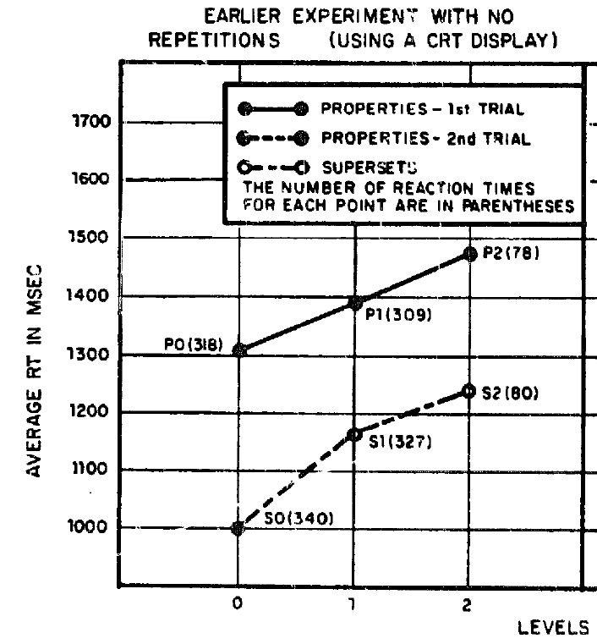
Models of Semantic Memory
Network models (Collins & Quillian, 1970):
Collins & Quillian (1970, p. 306; reporting data from Collins & Quillian, 1969)

Slide 12
Models of Semantic Memory
Network models (Collins & Quillian, 1970):
The CogLab exercise on lexical decision is relevant here, so we’ll look at the data…

Slide 13
Models of Semantic Memory
Network models:
Problems:
Typicality: Typicality seems to influence responses. Technically, “a robin is a bird” and “a chicken is a bird” are each one link. But, the robin is more typical. What is that in the network? Shows up in reaction times as well.

Slide 14
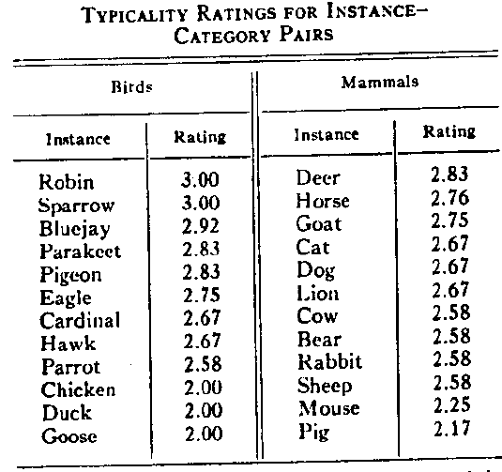
Models of Semantic Memory
Smith, Shoben, & Rips (1974, p. 218)

Slide 15
Models of Semantic Memory
Network models:
Problems:
With the hierarchy: “A horse is an animal” is faster than “A horse is a mammal” which violates the hierarchy.
A chicken is more typical of animal than a robin, a robin is more typical of bird than a chicken. How can a network account for this (Smith, Shoben, & Rips, 1974)?

Slide 16
Models of Semantic Memory
Network models:
Problems:
Answering “no”: You know the answer to a questions is “no” (e.g., “a bird has four legs”) because the concepts are far apart in the network. But, some “no” responses are really fast (e.g., “a bird is a fish”) and some are really slow (e.g., “a whale is a fish”). The reason for this isn’t obvious in the model.
“Loosely speaking, a bat is a bird” is true, but how does a network model do it (Smith, Shoben, & Rips, 1974)?

Slide 17
Models of Semantic Memory
Feature models (Smith, Shoben, & Rips, 1974):
Concepts are clusters of semantic features. There are two kinds:
Distinctive features: Core parts of the concept. They must be present to be a member of the concept, they’re the defining features. For example, WINGS for BIRD.
Characteristic features: Typically associated with the concept, but not necessary. For example, CAN FLY for BIRD.

Slide 18
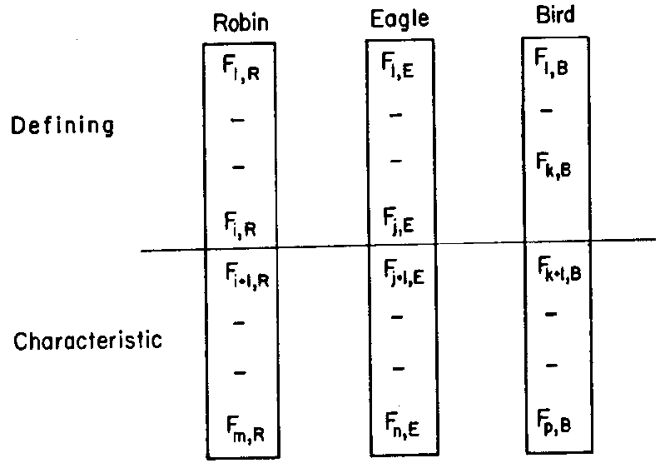
Models of Semantic Memory
Smith, Shoben, & Rips (1974, p. 216)

Slide 19
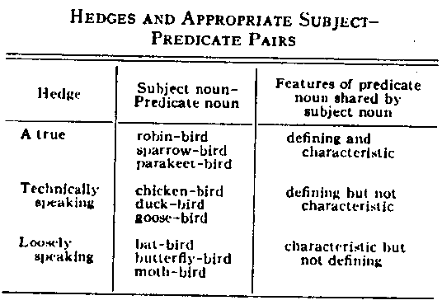
Models of Semantic Memory
Feature models (Smith, Shoben, & Rips, 1974):
Why have defining and characteristic features? Various evidence, such as hedges:
Smith, Shoben, & Rips (1974, p. 217)

Slide 20
Models of Semantic Memory
Feature models (Smith, Shoben, & Rips, 1974):
A linguistic hedge is a kind of categorization statement.
A robin is a true bird. “A true” is a hedge that puts robin strongly in the bird category.
Technically speaking, a whale is a mammal. “Technically speaking” acknowledges that whales aren’t ideal representations of the mammal category.
A hedge works as longs as it respects the types of features on the last slide.

Slide 21
Models of Semantic Memory
Feature models (Smith, Shoben, & Rips, 1974):
Why characteristic features? Various evidence, such as hedges:
OK:
A robin is a true bird. Has both defining and characteristic.
Technically speaking, a chicken is a bird. Has defining features of what a bird is, but not the characteristic features.

Slide 22
Models of Semantic Memory
Feature models (Smith, Shoben, & Rips, 1974):
Why characteristic features? Various evidence, such as hedges:
Feels wrong:
Technically speaking, a robin is a bird. It has both, so you’re using the wrong hedge.
A chicken is a true bird. It lacks characteristic, so you wouldn’t say it like this.

Slide 23
Models of Semantic Memory
Feature models (Smith, Shoben, & Rips, 1974):
Answering a semantic verification question is a two-step process.
Compare on all features. If there is a lot of overlap it’s an easy “yes.” If there is almost no overlap, it’s an easy “no.” In the middle, go to step two.
Compare distinctive features. This involves an extra stage and should take longer.

Slide 24
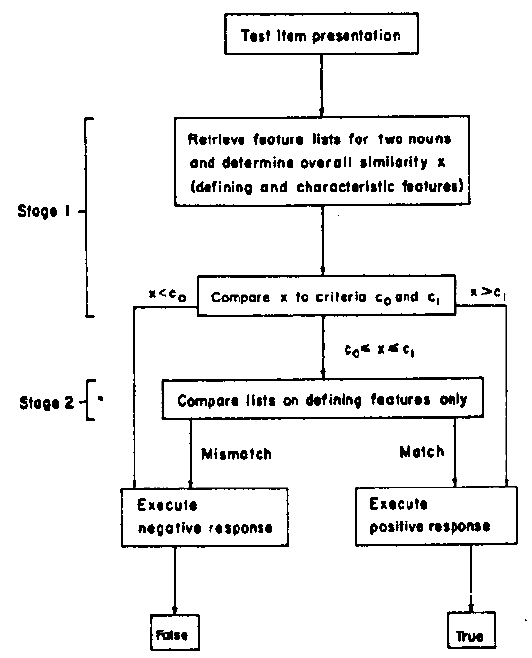
Smith, Shoben, & Rips (1974, p. 222)

Slide 25
Models of Semantic Memory
Feature models (Smith, Shoben, & Rips, 1974):
Some examples:
 | BIRD | MAMMAL
Distinctive | Wings Feathers… | Nurses-young Warm-blooded Live-birth…
Characteristic | Flies Small… | Four-legs…
 | ROBIN | WHALE
Distinctive | Wings Feathers… | Swims Live-birth Nurses-young…
Characteristic | Red-breast | Large

Slide 26
Models of Semantic Memory
Feature models (Smith, Shoben, & Rips, 1974):
Some questions:
Easy “yes” | Easy “no” | Hard “yes” | Hard “no”
A robin is a bird | A robin is a fish | A whale is a mammal | A whale is a fish

Slide 27
Models of Semantic Memory
Feature models (Smith, Shoben, & Rips, 1974):
Evidence: We can account for:
Typicality effects: One step for more typical members, two steps for less typical members, that explains the time difference.
Answering “no”: Why are “no” responses different? Depends on the number of steps (feature overlap).
Hierarchy: Since it isn’t a hierarchy but similarity, we can understand why different types of decisions take different amounts of time.

Slide 28
Models of Semantic Memory
Feature models (Smith, Shoben, & Rips, 1974):
Problem: How do we get the distinctive features?
What makes something a game? What makes someone a bachelor? How about cats?
How many of the features of a bird can you lose and still have a bird?
The distinction between defining and characteristic features addresses this somewhat, but it is still a problem in implementation.

Slide 29
Models of Semantic Memory
Spreading activation (Collins & Loftus, 1975):
Bring back the network model, but make some modifications:
The length of the link matters. The less related two concepts are, the longer the link. This gets typicality effects (put CHICKEN farther from BIRD than ROBIN).
Search is a process called spreading activation. Activate the two nodes involved in a question and spread that activation along links. The farther it goes, the weaker it gets. When you get an intersection between the two spreading activations, you can decide on the answer to the question.
This model gets around a lot of the problems with the earlier network model.

Slide 30
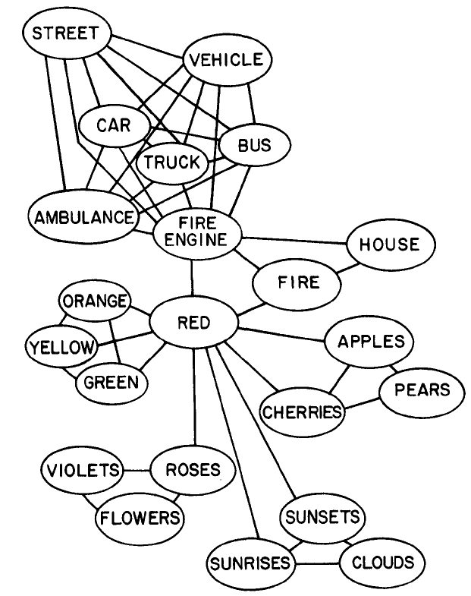
Models of Semantic Memory
Collins & Loftus (1975, p. 412)

Slide 31
Models of Semantic Memory
Spreading activation (Collins & Loftus, 1975):
This is probably the explanation for the false memory CogLab exercise, so we can look at the results here…

Slide 32
Models of Semantic Memory
Spreading activation (Collins & Loftus, 1975):
Problem: It’s kind of cheating to make your model overly powerful and build in all of the effects you’re trying to account for. Having said that, this model is still around.

Slide 33
Models of Semantic Memory
Propositional models:
The elements are idea units. Meaning is represented by these idea units, their relationships, and the operations you can perform on them.
For example, consider:
Pat practiced from noon until dusk.

Slide 34
Models of Semantic Memory
Propositional models:
The propositions would be:
(EXIST, PAT)
(PRACTICE, A:PAT, S:NOON, G:DUSK)
(We have this thing “Pat.” Pat is the agent of the verb “to practice,” the source of the practice is noon and the goal is dusk.)
The elements of the proposition are in all caps to emphasize that they are arbitrary symbols and not words.

Slide 35
Models of Semantic Memory
Propositional models:
Propositional models can solve some problems that other models would have a hard time with. For example: “Bilk is not available in all areas” could mean:
There is no area in which Bilk is available.
Bilk is available in some areas, but not all.
The ambiguity comes from the scope of the “not.” How much of the sentence is covered by it? A propositional model can handle this reasonably well (next slide).

Slide 36
Models of Semantic Memory
Propositional models:
There is no area in which Bilk is available.
For all x, not (Bilk is available in x)
Bilk is available in some areas, but not all.
Not, for all x (Bilk is available in x)
Where you put the ”not” determines the interpretation.

Slide 37
Models of Semantic Memory
Scripts and schemas (Bartlett, Schank):
Knowledge is packaged in integrated conceptual structures.
Scripts: Typical action sequences (e.g., going to the restaurant, going to the doctor…)
Schemas: Organized knowledge structures (e.g., your knowledge of cognitive psychology).
It would be possible to describe these with nodes and links, but that would mask their “specialness.” For example, a schema could be a sub-network related to a particular area.

Slide 38
Models of Semantic Memory
Scripts and schemas (Bartlett, Schank):
Evidence: When people see stories like this:
Chief Resident Jones adjusted his face mask while anxiously surveying a pale figure secured to the long gleaming table before him. One swift stroke of his small, sharp instrument and a thin red line appeared. Then an eager young assistant carefully extended the opening as another aide pushed aside glistening surface fat so that vital parts were laid bare. Everyone present stared in horror at the ugly growth too large for removal. He now knew it was pointless to continue.

Slide 39
Models of Semantic Memory
Scripts and schemas (Bartlett, Schank):
And you ask them to recognize words that might have been part of the story, they tend to recognize material that is script or schema typical even if it wasn’t presented. Let’s try:
Scalpel?
Assistant?
Nurse?
Doctor?
Operation?
Hospital?

Slide 40
Models of Semantic Memory
Scripts and schemas (Bartlett, Schank):
And you ask them to recognize words that might have been part of the story, they tend to recognize material that is script or schema typical even if it wasn’t presented. Let’s try:
Scalpel? No
Assistant? Yes
Nurse? No
Doctor? No
Operation? No
Hospital? No
I had to re-read it a surprising number of times to be sure of these answers.

Slide 41
Models of Semantic Memory
Scripts and schemas (Bartlett, Schank):
People also tend to fill in missing details from scripts and schemas if they are not provided (as long as those parts are typical).
When people are told the script or schema that is appropriate before hearing some material they tend to understand it better than if they are not told it at all or are told it after the material.
We’ll see a lot more evidence in the language units.

Slide 42
Models of Semantic Memory
Scripts and schemas (Bartlett, Schank):
Divide into group 1 and group 2…

Slide 43
Models of Semantic Memory
Scripts and schemas (Bartlett, Schank):
How are scripts organized? Let’s see:
Group 1: Write down everything you can think of about going to the doctor from the most central to least central action.

Slide 44
Models of Semantic Memory
Scripts and schemas (Bartlett, Schank):
How are scripts organized? Let’s see:
Group 2: Write down everything you can think of about going to the doctor from the first to the last action.

Slide 45
Models of Semantic Memory
Scripts and schemas (Bartlett, Schank):
How are scripts organized? We should find (as in Barsalou & Sewell, 1985) that people organize by performance and not centrality.

Slide 46
Models of Semantic Memory
A final thought on these models: We’ve considered representation and process, but we’ve really left out a significant part of process. How did this information get into this format in semantic memory? Except for noting it, we will not be addressing it at this time.

Slide 47
Non-symbolic Models
An alternative approach is to get rid of discrete nodes (in which each node holds a concept), and rearrange how we think about knowledge representation.
The goal is to develop a model that is more like the way brains work.
In neural network models, we still have nodes and links, but the knowledge is contained in the weights on the links and not in the nodes.

Slide 48
Non-symbolic Models
We’re going to start with the simplest neural network model, the perceptron. A perceptron is a lot like a single neuron. It can be used to:
Answer questions about semantic knowledge (e.g., superset/subset relations).
Learn new semantic knowledge by figuring out which features are relevant to solving a problem and how to use those features.

Slide 49
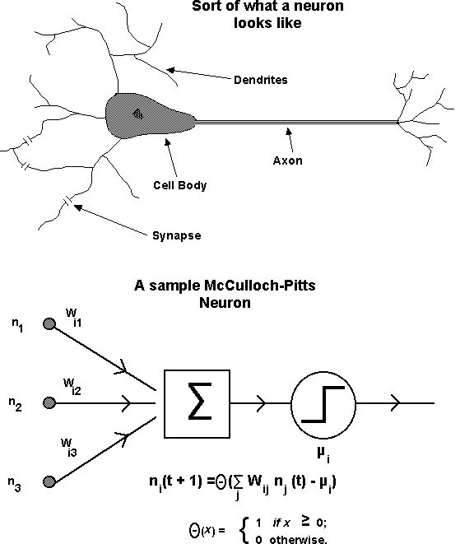
Non-symbolic Models

Slide 50
Non-symbolic Models
Neurons:
Have inputs from various sources.
Weight those inputs (some excite, some inhibit).
Sum the inputs multiplied by the weights.
Decide based on that if they will fire.
Perceptrons (artificial neurons):
Have inputs from various sources.
Weight those inputs and multiply.
Sum and decide.

Slide 51
Non-symbolic Models
Nobody is going to argue that what we talk about with perceptrons = brain operations. We’re just trying a different approach to organizing knowledge.

Slide 52
Non-symbolic Models
Let’s consider each of the two tasks in turn. For the symbolic models we looked at:
Representation and process in accessing the information in semantic memory.
How that information came to be organized in that way (we didn’t actually look at this).
Now we’ll do it for non-symbolic models.

Slide 53
Non-symbolic Models
Accessing semantic knowledge:
We need a knowledge domain to work with. I am going to work with categorizing fruits. This is pretty arbitrary, and is only to illustrate the model, it’s not intended to be comprehensive.
We’re going to have it decide whether a particular fruit is a good fruit or a not good fruit. As we work, we can define how fruits get assigned to these categories in different ways.

Slide 54
Non-symbolic Models
Accessing semantic knowledge:
The features:
Taste | Sweet = 1, Not_Sweet = 0
Seeds | Edible = 1, Not_Edible = 0
Skin | Edible = 1, Not_Edible = 0

Slide 55
Non-symbolic Models
Accessing semantic knowledge:
Taking a variety of fruits and defining them by using the features we get:
 | Banana | Pear | Lemon | Strawberry | Green apple
Taste
Seeds
Skin

Slide 56
Non-symbolic Models
Accessing semantic knowledge:
Taking a variety of fruits and defining them by using the features we get:
 | Banana | Pear | Lemon | Strawberry | Green apple
Taste | 1
Seeds | 1
Skin | 0

Slide 57
Non-symbolic Models
Accessing semantic knowledge:
Taking a variety of fruits and defining them by using the features we get:
 | Banana | Pear | Lemon | Strawberry | Green apple
Taste |  | 1
Seeds |  | 0
Skin |  | 1

Slide 58
Non-symbolic Models
Accessing semantic knowledge:
Taking a variety of fruits and defining them by using the features we get:
 | Banana | Pear | Lemon | Strawberry | Green apple
Taste |  |  | 0
Seeds |  |  | 0
Skin |  |  | 0

Slide 59
Non-symbolic Models
Accessing semantic knowledge:
Taking a variety of fruits and defining them by using the features we get:
 | Banana | Pear | Lemon | Strawberry | Green apple
Taste |  |  |  | 1
Seeds |  |  |  | 1
Skin |  |  |  | 1

Slide 60
Non-symbolic Models
Accessing semantic knowledge:
Taking a variety of fruits and defining them by using the features we get:
 | Banana | Pear | Lemon | Strawberry | Green apple
Taste |  |  |  |  | 0
Seeds |  |  |  |  | 0
Skin |  |  |  |  | 1

Slide 61
Non-symbolic Models
Accessing semantic knowledge:
Taking a variety of fruits and defining them by using the features we get:
 | Banana | Pear | Lemon | Strawberry | Green apple
Taste | 1 | 1 | 0 | 1 | 0
Seeds | 1 | 0 | 0 | 1 | 0
Skin | 0 | 1 | 0 | 1 | 1

Slide 62
Non-symbolic Models
Accessing semantic knowledge:
So far, we’re just looking at knowledge that exists in the world, we haven’t gotten to the model part yet.
How would this knowledge be represented in a perceptron and how would it be accessed? Let’s turn to the trained perceptron module to find out…
(Run the trained perceptron powerpoint.)

Slide 63
Non-symbolic Models
Learning semantic knowledge:
Now, where did that knowledge come from? Turn to the percetron learning module to find out…
(Run the perceptron learning powerpoint.)

Slide 64
Non-symbolic Models
Issues:
We’re doing a lot of work to prepare the concept (identifying features, classifying all of the examples, and so forth). However, if we thought of that step as a low-level analysis that is wired into the system, that might not be a bad thing.
We didn’t have to figure anything out about the concept for the network to learn it. We also don’t have to understand what it did. If a pattern exists in the data, the network will find that pattern. It’s like magic.

Slide 65
Non-symbolic Models
Issues:
We have a teacher (which might seem a little arbitrary), but the environment can serve in that role. For example, if you touch the stove, the stove will reply “hot” and you will adjust your weights to make you less likely to touch the stove in the future.

Slide 66
Non-symbolic Models
Generalizing beyond perceptrons:
Perceptrons have a very basic problem: There are a lot of concepts that they cannot learn. Perceptrons can only solve problems that have a property called linear separability (if you chart the features in space you can draw a line through that space such that all of the positive examples are on one side of the line and all of the negative examples are on the other side of the line).

Slide 67
Non-symbolic Models
Generalizing beyond perceptrons:
Consider the truth table for “AND” (a problem we can solve):
Input 1: | Input 2: | Output:
1 | 1 | 1
1 | 0 | 0
0 | 1 | 0
0 | 0 | 0

Slide 68
Non-symbolic Models
Generalizing beyond perceptrons:
“AND”
(0,1)
(1,1)
1
(0,0)
(1,0)
0
0
1

Slide 69
Non-symbolic Models
Generalizing beyond perceptrons:
“AND”
(0,1)
(1,1)
1
(0,0)
(1,0)
0
0
1

Slide 70
Non-symbolic Models
Generalizing beyond perceptrons:
Now, consider the truth table for “XOR” (a problem we cannot solve):
Input 1: | Input 2: | Output:
1 | 1 | 0
1 | 0 | 1
0 | 1 | 1
0 | 0 | 0

Slide 71
Non-symbolic Models
Generalizing beyond perceptrons:
“XOR”
(0,1)
(1,1)
1
(0,0)
(1,0)
0
0
1

Slide 72
Non-symbolic Models
Generalizing beyond perceptrons:
“XOR”
(0,1)
(1,1)
1
(0,0)
(1,0)
0
0
1

Slide 73
Non-symbolic Models
Generalizing beyond perceptrons:
“XOR”
(0,1)
(1,1)
1
(0,0)
(1,0)
0
0
1

Slide 74
Non-symbolic Models
Generalizing beyond perceptrons:
“XOR”
(0,1)
(1,1)
1
(0,0)
(1,0)
0
0
1

Slide 75
Non-symbolic Models
Generalizing beyond perceptrons:
Our first problem (edible seeds and skin = good fruit) turns out not to be linearly separable. I made it work because I figured out what weights to use. The perceptron couldn’t have learned it on its own. It would be a useful exercise to try to learn those weights and see what happens…

Slide 76
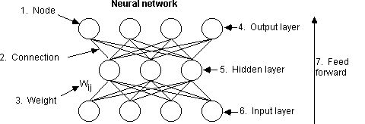
Non-symbolic Models
Generalizing beyond perceptrons:
To solve this problem, we need an internal representation:

Slide 77
Non-symbolic Models
Generalizing beyond perceptrons:
We’re going to stop here without going into all of the technical issues. The take-home message is that some categorization problems can be learned using these types of models, and these models can be very powerful. What makes them attractive is that they incorporate both access to semantic knowledge and how semantic knowledge is acquired.
Accessing knowledge in these models also changes it, simulating some of the false memory data we’ve considered.

Slide 78
End of Semantic Long Term Memory Show

