Slide 1
Categorization
Langston, PSY 4040
Cognitive Psychology
Notes 9

Slide 2
Where We Are
We’re moving into higher cognition. We’ve completed our tour of the cognitive architecture and now we’re going to look at how you use it. We’re going to hit five areas:
Categorization
Language—Structure
Language—Meaning
Reasoning/Decision making
Human factors

Slide 3
Categorization
What does categorization do for you?
Reduces complexity: You don’t have to treat every experience as a unique event. For example, if you get bitten by a bee, you can learn to avoid bees in general instead of having to learn bee by bee.
Allows identification: A lot of identification comes from figuring out how to categorize something.

Slide 4
Categorization
What does categorization do for you?
Reduces the need for constant learning: If you can learn about classes from examples, you can save a lot of work.
Allows for action: If something is in the category of things that are likely to eat me I know to run from it.

Slide 5
Describing the Problem
On the slides that follow I have clipped in some examples from a creativity task called the unusual uses task.
People answer a question about all of the uses they can think of for a common object.

Slide 6
Describing the Problem
To score this task, a group of raters assign them to categories. The more categories people use, the more creative (a whole bunch of the same thing is less creative than a lot of different things).
To see how difficult categorization can be, develop the list of categories for the uses of a brick on the next slides…

Slide 7
Describing the Problem

Slide 8
Describing the Problem

Slide 9
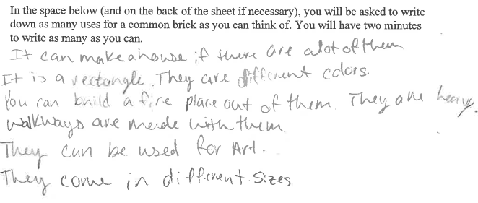
Describing the Problem

Slide 10
Describing the Problem

Slide 11
Kinds of Categorization
Logical categories:
Defined according to a rule. For example, you can categorize on the basis of the conjunction of two features (has-four-legs and barks = dog). Anything that satisfies the rule for the category goes into that category.

Slide 12
Kinds of Categorization
Logical categories:
Conjunction: Combine two features with “and.” To be a member of the category, both features must be present.
Mammal = warm-blooded and live-birth.
Disjunction: Combine two features with “or.” Either must be present to be a member of the category.
Mammal = warm-blooded or live-birth (lets in platypuses).

Slide 13
Kinds of Categorization
Logical categories:
Conditional: If…then… Everything without the first feature is in the category. Anything with the first feature also has to have the second feature.
Mammal = if lays-eggs then warm-blooded (anything that doesn’t lay eggs plus things that do lay eggs that are also warm blooded).

Slide 14
Kinds of Categorization
Logical categories:
Biconditional: If and only if…then… Everything without the first or second feature is in the category. Anything with the first feature also has to have the second feature and anything with the second feature has to have the first feature.
Mammal = if and only if lays-eggs then warm-blooded (anything that doesn’t lay eggs or isn’t warm blooded plus things that do lay eggs that are also warm blooded and things that are warm blooded that also lay eggs). This example is no good, try to do better.

Slide 15
Kinds of Categorization
Logical categories:
Let’s try some with the examples in the notes:
Conjunction: Large and red.

Slide 16
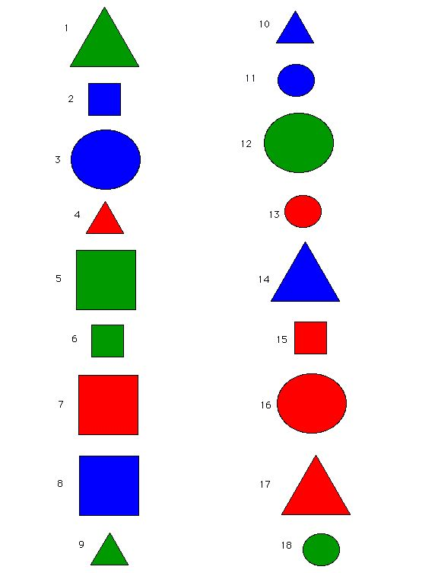

Slide 17
Kinds of Categorization
Logical categories:
Let’s try some with the examples in the notes:
Disjunction: Square or green.

Slide 19
Kinds of Categorization
Logical categories:
Let’s try some with the examples in the notes:
Conditional: If blue then circle.

Slide 21
Kinds of Categorization
Logical categories:
Let’s try some with the examples in the notes:
Biconditional: If and only if triangle then blue.

Slide 23
Kinds of Categorization
Logical categories:
Let’s try some with the examples in the notes:
Conjunction: Large and red.
(7, 16, 17)
Disjunction: Square or green.
(1, 2, 5, 6, 7, 8, 9, 12, 15, 18)
Conditional: If blue then circle.
(1, 3, 4, 5, 6, 7, 9, 11, 12, 13, 15, 16, 17, 18)
Biconditional: If and only if triangle then blue.
(5, 6, 7, 10, 12, 13, 14, 15, 16, 18)

Slide 24
Kinds of Categorization
Logical categories:
The rules vary in complexity. People’s use of the rules reflects this (more complex rules are harder to use).
Problem: Real categories don’t work like this. They have continuous and probabilistic features and can’t be made to fit this model.

Slide 25
Kinds of Categorization
Natural categories:
Base our model on a survey of the properties of real categories:
Continuous variables: A variety of colors get grouped together in the category “yellow.” There aren’t discrete features that separate colors from one another.
Graded membership: Some category members are “better” (which is a better mammal, a whale or a bear? which is a better even number, 4 or 106?).

Slide 26
Kinds of Categorization
Natural categories:
Base our model on a survey of the properties of real categories:
Hierarchical organization:
Superordinate: A broad level. General classes of things. Members at this level will be relatively dissimilar. (What makes dressers and beds similar besides being furniture?)
Basic: The “just right” level. A lot of feature overlap here.
Subordinate: A more specific level. Things in this level overlap a great deal. Telling things apart at the subordinate level takes expertise (one kind of tree from another).

Slide 27
Kinds of Categorization
Natural categories:
Why should we believe in the importance of basic level categories? Three sorts of evidence:
Listing features: When you ask people to list as many features as they can for various categories, you see that the action is at the basic level.

Slide 28
Kinds of Categorization
Natural categories:
Evidence:
Listing features: List as many features as you can for:
Clothing.
Pants.
Levis.

Slide 29
Kinds of Categorization
Natural categories:
Evidence:
Listing features: List as many features as you can for:
Clothing. (2)
Pants. (6)
Levis. (1)

Slide 30
Kinds of Categorization
Natural categories:
Evidence:
Identifying category members: There are differences in the time it takes to make category decisions based on the level.

Slide 31
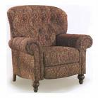
Kinds of Categorization
Natural categories:
Evidence:
Identifying category members:
Present the picture.
Is it:
Furniture?
A chair?
A living room chair?

Slide 32
Kinds of Categorization
Natural categories:
Evidence:
Typicality: Some members are better examples of the category than others. People are reasonably consistent in rating typicality (Rosch and Mervis, 1975).

Slide 33
Kinds of Categorization
Natural categories:
Evidence:
Typicality: Rate these from 1 (most typical) to 5 (least typical):
Vehicles: | Clothes:
_____ Car | _____ Jacket
_____ Elevator | _____ Mittens
_____ Sled | _____ Necklace
_____ Tractor | _____ Pajamas
_____ Train | _____ Pants

Slide 34
Kinds of Categorization
Natural categories:
Evidence:
Typicality: These were 1, 4, 10, 15, and 20 on the original list. Can you match them?
Vehicles: | Clothes:
_____ Car | _____ Jacket
_____ Elevator | _____ Mittens
_____ Sled | _____ Necklace
_____ Tractor | _____ Pajamas
_____ Train | _____ Pants

Slide 35
Kinds of Categorization
Natural categories:
Evidence:
Typicality: What makes things seem typical is how much feature overlap they have at the basic level.
Compute family resemblance: For each feature, count how many other members of the category share it. Add up the total number of shared features.
This score correlates highly with typicality (rs between .84 and .94).

Slide 36
Kinds of Categorization
Goal directed categories:
Some categories determine membership based on some goal. Membership in categories varies depending on the goal.
For example, “things to rescue from a burning house,” “things to pack for a vacation.”

Slide 37
Kinds of Categorization
Goal directed categories:
These categories seem to be organized around ideals. For example, if your ideal vacation is a cruise, then membership in the category “things to pack for vacation” would look really different from someone whose ideal was a trip to New York.

Slide 38
Theories of Categorization
Exemplar: Classify by comparing to specific examples.
Compare to everything in memory. Categorize based on whatever thing is the closest match. This model makes some predictions about the kinds of mistakes we would expect (e.g., a whale is a fish).
Average distance:
Compare to everything in memory, compute the distance in feature space from each thing, average the distances for each category, go with the category that has the lowest average distance.

Slide 39
Theories of Categorization
Feature counting:
Compare to everything in memory, count the number of features in common, categorize based on the item with the most feature matches.

Slide 40
Theories of Categorization
Prototypes:
Extract a prototype for each category. It’s kind of like an average of all of the members (an ideal member). For example, when I ask you to think of a cat, your generic cat image is probably not some particular cat but rather the average of cats you have seen.

Slide 41
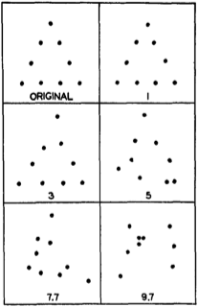
Theories of Categorization
Prototypes:
Evidence (Posner & Keele, 1968).
Make shapes out of dots. Create category members by moving each dot in a random direction. Move dots a little, medium, or a lot.
Posner, Goldsmith, & Welton (1967, p. 30)

Slide 42
Theories of Categorization
Prototypes:
Evidence (Posner & Keele, 1968).
Show people the category members. Have them categorize them. At first, they make a lot of mistakes, but they gradually learn.

Slide 43
Theories of Categorization
Prototypes:
Evidence (Posner & Keele, 1968).
Find:
Prototype recognized best of all even though it was never seen.
The amount of variability matters. The more variable the training, the better people were at categorizing new examples. People trained with low variability were bad if there was a lot of variability in the new examples.
It looks like categorization involves extracting the prototype and some estimate of the variability around it.

Slide 44
Theories of Categorization
Prototypes:
Evidence (Posner & Keele, 1968).
Our CogLab exercise was based on this study. Let’s check our results…

Slide 45
Theories of Categorization
Prototypes:
Additional information (taken from Hintzman, 1986):
Prototype classification is more stable over time than classification of the exemplars, suggesting that that is what is stored in LTM.
Old exemplars are classified better than new ones.
Classification of new examples is best for prototypes followed by low-level distortions, followed by high-level distortions.
Transfer is better if there are more examples or if there is more variability.

Slide 46
Theories of Categorization
Prototypes:
Note that you can get a lot of these effects without needing prototypes. If you arrange memory the right way, these effects just emerge (Hintzman, 1986).

Slide 47
Theories of Categorization
Fuzzy-set theory (Zadeh):
Classical logic is overly restrictive. Only having two truth values (true or false) is OK for decisions like “A robin is a fish” or “A robin is a bird.” But, a lot of categorization won’t fit into this model.
E.g., linguistic hedges: Appear to put things into categories by degree rather than all or none (“loosely speaking, a whale is a fish,” “technically speaking, a whale is a mammal,” “Ethel Merman is a regular fish”). (What follows is a joke about confusing Ethel Merman and Esther Williams, but why not listen to Ethel Merman’s fabulously terrible disco album?)

Slide 48
Ethel Merman: http://www.youtube.com/watch?v=1Q7uWXhZPQE
Esther Williams: http://3.bp.blogspot.com/-ABNYRCmcAMQ/TZ8a_LGkjwI/AAAAAAAAKTA/nL551Vc3hL8/s1600/PFAAF00Z.jpg

Slide 49
Theories of Categorization
Fuzzy-set theory:
Instead, allow for graded truth values (between 0.0 and 1.0).
A whale is a fish to degree 0.3.
A whale is a mammal to degree 0.7.
Ethel Merman is a fish to degree 0.2…

Slide 50
Theories of Categorization
Fuzzy-set theory:
What does this buy us?
A way to handle “hard” categories like “tall.” The boundary between tall and short is fuzzy. If we allow degrees, we can move from 0.0 (not at all tall; 4’) to 0.5 (sort of tall; 6’2”) to 1.0 (absolutely tall; 8’).
A solution to paradoxes like “If you take a man with a full head of hair and pluck one, is he bald? Keep repeating. When does he become bald?” If you have graded membership, he can be bald to various degrees.

Slide 51
Theories of Categorization
Fuzzy-set theory:
Some work: We need to work out truth tables if we get rid of the traditional logic. AND:
A: | B: | A AND B:
T | T | T
T | F | F
F | T | F
F | F | F

Slide 52
Theories of Categorization
Fuzzy-set theory:
Some work: We need to work out truth tables if we get rid of the traditional logic. OR:
A: | B: | A OR B:
T | T | T
T | F | T
F | T | T
F | F | F

Slide 53
Theories of Categorization
Fuzzy-set theory:
Some work: What do we do with fuzzy categories?
AND: Minimum rule. Figure out degree of membership in each category and take the minimum to compute AND.
OR: Maximum rule. Figure out degree of membership in each category and take the maximum to compute OR.

Slide 54
Theories of Categorization
Fuzzy-set theory:
Test: Storms, De Boek, Van Mechelen, and Ruts (1998) had people rate membership in various categories and then combined those with AND and rated them again. For example, rate AIDS as:
A disease.
A cause of death.
A disease and a cause of death.
The minimum rule would predict that the combination would be the lower of the other two. Instead, it was the highest.

Slide 55
Theories of Categorization
Fuzzy-set theory:
Storms, et al. (1998) found a lot of categories that violated the minimum rule:
Item: | Category A: | Category B: | AND:
Panties | Underwear | Pants | Underwear and pants
Noriega | Military man | Political leader | Military man and political leader
Car crash | Murdering method | Suicide method | Murdering method and suicide method

Slide 56
Theories of Categorization
Fuzzy-set theory:
This shows that there are problems with the minimum rule, but there are other ways to do conjunction that might work.

Slide 57
End of Categorization Show

