Slide 1
Trained Perceptron Demonstration
Langston,
Cognitive Psychology

Slide 2
Trained Perceptron
I trained the following perceptron on the category “good fruit” defined as anything with edible skin and seeds. We’ll show it various fruits and have it categorize them as good or bad fruits to see how it performs.

Slide 3
Trained Perceptron
Remember our features:
For output:
Good_Fruit = 1
Not_Good_Fruit = 0
Taste | Sweet = 1, Not_Sweet = 0
Seeds | Edible = 1, Not_Edible = 0
Skin | Edible = 1, Not_Edible = 0

Slide 4
Trained Perceptron
Problem space:
 | Banana | Pear | Lemon | Strawberry | Green apple
Taste | 1 | 1 | 0 | 1 | 0
Seeds | 1 | 0 | 0 | 1 | 0
Skin | 0 | 1 | 0 | 1 | 1
Good fruit? | 0 | 0 | 0 | 1 | 0

Slide 5
Trained Perceptron
Problem space: Note that the category (whether or not it’s a good fruit) is now in the table…
 | Banana | Pear | Lemon | Strawberry | Green apple
Taste | 1 | 1 | 0 | 1 | 0
Seeds | 1 | 0 | 0 | 1 | 0
Skin | 0 | 1 | 0 | 1 | 1
Good fruit? | 0 | 0 | 0 | 1 | 0

Slide 6
Trained Perceptron
Here is the trained perceptron:
Input
Taste
0.0
Output
0.25
Seeds
0.25
If ∑ > 0.4
then fire
Skin

Slide 7
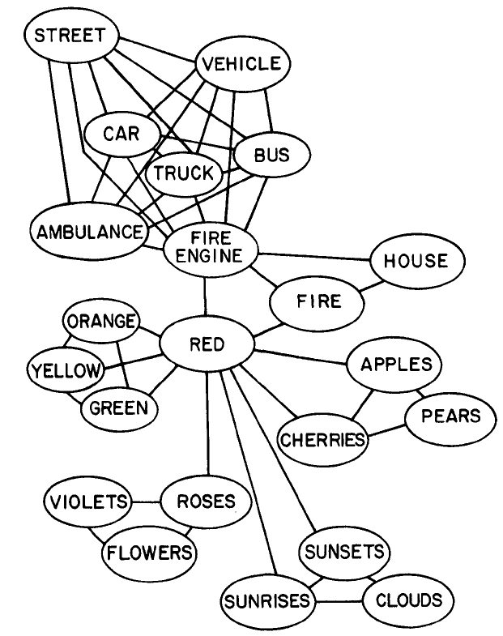
Models of Semantic Memory
Contrast it to the leading symbolic model.
Collins & Loftus (1975, p. 412)

Slide 8
Trained Perceptron
The knowledge is in the weights on the links (rather than in the nodes):
Input
Taste
0.0
Output
0.25
Seeds
0.25
If ∑ > 0.4
then fire
Skin

Slide 9
Trained Perceptron
The way it works is:
You show it an example.
If the feature has a value of 1, that is multiplied by the weight and put in the sum. If the value is zero, it won’t add to the sum because
0 times anything = 0.
Add up all of the products of multiplying features times weights.

Slide 10
Trained Perceptron
The way it works is:
Once you have a sum, you compare that to some threshold for responding.
If the sum is larger than the threshold, respond “yes.”
If the sum is smaller than the threshold, respond “no.”
Let’s look at the perceptron and classify our fruits.

Slide 11
Trained Perceptron
Show it a banana:
Input
1
1
Taste
0.0
Output
1
0.25
.00
Seeds
1
0.25
If ∑ > 0.4
then fire
0
0
Skin

Slide 12
Trained Perceptron
Show it a banana:
Input
1
1
Taste
0.0
Output
1
0.25
.25
Seeds
1
0.25
If ∑ > 0.4
then fire
0
0
Skin

Slide 13
Trained Perceptron
Show it a banana:
Input
1
1
Taste
0.0
Output
1
0.25
.25
Seeds
1
0.25
If ∑ > 0.4
then fire
0
0
Skin

Slide 14
Trained Perceptron
Show it a banana:
Input
1
1
Taste
0.0
Output
1
0.25
.25
Seeds
1
0
0.25
If ∑ > 0.4
then fire
0
0
Skin

Slide 15
Trained Perceptron
In this case we have:
(1 X 0) = 0
+ (1 X 0.25) = 0.25
+ (0 X 0.25) = 0
It adds up to 0.25.
Since that is less than the threshold (0.40), we responded “no.”
Is that correct (banana is not a good fruit)? (Yes, it’s correct.)

Slide 16
Trained Perceptron
Show it a pear:
Input
1
1
Taste
0.0
Output
0
0.25
.00
Seeds
0
0.25
If ∑ > 0.4
then fire
1
1
Skin

Slide 17
Trained Perceptron
Show it a pear:
Input
1
1
Taste
0.0
Output
0
0.25
.00
Seeds
0
0.25
If ∑ > 0.4
then fire
1
1
Skin

Slide 18
Trained Perceptron
Show it a pear:
Input
1
1
Taste
0.0
Output
0
0.25
.25
Seeds
0
0.25
If ∑ > 0.4
then fire
1
1
Skin

Slide 19
Trained Perceptron
Show it a pear:
Input
1
1
Taste
0.0
Output
0
0.25
.25
Seeds
0
0
0.25
If ∑ > 0.4
then fire
1
1
Skin

Slide 20
Trained Perceptron
In this case we have:
(1 X 0) = 0
+ (0 X 0.25) = 0
+ (1 X 0.25) = 0.25
It adds up to 0.25.
Since that is less than the threshold (0.40), we responded “no.”
Is that correct (pear is not a good fruit)? (Yes, it’s correct.)

Slide 21
Trained Perceptron
Show it a lemon:
Input
0
0
Taste
0.0
Output
0
0.25
.00
Seeds
0
0.25
If ∑ > 0.4
then fire
0
0
Skin

Slide 22
Trained Perceptron
Show it a lemon:
Input
0
0
Taste
0.0
Output
0
0.25
.00
Seeds
0
0.25
If ∑ > 0.4
then fire
0
0
Skin

Slide 23
Trained Perceptron
Show it a lemon:
Input
0
0
Taste
0.0
Output
0
0.25
.00
Seeds
0
0.25
If ∑ > 0.4
then fire
0
0
Skin

Slide 24
Trained Perceptron
Show it a lemon:
Input
0
0
Taste
0.0
Output
0
0.25
.00
Seeds
0
0
0.25
If ∑ > 0.4
then fire
0
0
Skin

Slide 25
Trained Perceptron
In this case we have:
(0 X 0) = 0
+ (0 X 0.25) = 0
+ (0 X 0.25) = 0
It adds up to 0.00.
Since that is less than the threshold (0.40), we responded “no.”
Is that correct (lemon is not a good fruit)? (Yes, it’s correct.)

Slide 26
Trained Perceptron
Show it a strawberry:
Input
1
1
Taste
0.0
Output
1
0.25
.00
Seeds
1
0.25
If ∑ > 0.4
then fire
1
1
Skin

Slide 27
Trained Perceptron
Show it a strawberry:
Input
1
1
Taste
0.0
Output
1
0.25
.25
Seeds
1
0.25
If ∑ > 0.4
then fire
1
1
Skin

Slide 28
Trained Perceptron
Show it a strawberry:
Input
1
1
Taste
0.0
Output
1
0.25
.50
Seeds
1
0.25
If ∑ > 0.4
then fire
1
1
Skin

Slide 29
Trained Perceptron
Show it a strawberry:
Input
1
1
Taste
0.0
Output
1
0.25
.50
Seeds
1
1
0.25
If ∑ > 0.4
then fire
1
1
Skin

Slide 30
Trained Perceptron
In this case we have:
(1 X 0) = 0
+ (1 X 0.25) = 0.25
+ (1 X 0.25) = 0.25
It adds up to 0.50.
Since that is greater than the threshold (0.40), we responded “yes.”
Is that correct (strawberry is a good fruit)? (Yes, it’s correct.)

Slide 31
Trained Perceptron
Show it a green apple:
Input
0
0
Taste
0.0
Output
0
0.25
.00
Seeds
0
0.25
If ∑ > 0.4
then fire
1
1
Skin

Slide 32
Trained Perceptron
Show it a green apple:
Input
0
0
Taste
0.0
Output
0
0.25
.00
Seeds
0
0.25
If ∑ > 0.4
then fire
1
1
Skin

Slide 33
Trained Perceptron
Show it a green apple:
Input
0
0
Taste
0.0
Output
0
0.25
.25
Seeds
0
0.25
If ∑ > 0.4
then fire
1
1
Skin

Slide 34
Trained Perceptron
Show it a green apple:
Input
0
0
Taste
0.0
Output
0
0.25
.25
Seeds
0
0
0.25
If ∑ > 0.4
then fire
1
1
Skin

Slide 35
Trained Perceptron
In this case we have:
(0 X 0) = 0
+ (0 X 0.25) = 0
+ (1 X 0.25) = 0.25
It adds up to 0.25.
Since that is less than the threshold (0.40), we responded “no.”
Is that correct (green apple is not a good fruit)? (Yes, it’s correct.)

Slide 36
Trained Perceptron
Using the perceptron we can correctly categorize each of the fruit examples we looked at.
The next question is “How did we get the weights that represent its knowledge of the category?” Look at the perceptron learning demonstration for that…

Slide 37
End Trained Perceptron Demonstration

